Slide 1


Rocket Science for Trading
John Ehlers
MESA Software
ehlers@mesasoftware.com
www.mesasoftware.com
www.mesa-systems.com

Slide 2
RISK STATEMENT
There is no guarantee that technical analysis will result in profits or that it will not result in losses. Past performance is not a guarantee of future results. All investments and trades carry risk and all trading decisions of an individual remain the responsibility of that individual. The use of any concepts presented does not constitute trading advice in any way.

Slide 3
AGENDA
The character of Momentum Functions
The character of Moving Averages
Hilbert Transforms
Measuring Cycle Periods
Signal to Noise Indicator
Signal Phase
Sinewave Indicator
Instantaneous Trendline
The Awesome Oscillator
Market Mode Detector

Slide 4
Momentum Functions
T = 0
RAMP
FUNCTION
1st derivative
(Momentum)
STEP
IMPULSE
2nd derivative
(Acceleration)
JERK
3rd derivative
CONCLUSIONS:
1. Momentum can NEVER lead the function
2. Momentum is always more disjoint (noisy)

Slide 5
Moving Averages
c.g.
Window
Moving Average
Lag
CONCLUSIONS:
1. Moving Averages smooth the function
2. Moving Averages Lag by the center of gravity of the observation window
3. Using Moving Averages is always a tradeoff between smoothing and lag

Slide 6
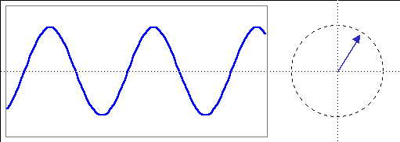
A Phasor Describes a Cycle
Cycle
Phasor
Phase Angle
Quadrature
θ
InPhase
Cycle Amplitude (Pythagorean Theorem)
Amplitude² = (InPhase)² + (Quadrature)²
Phase Angle = ArcTan(Quadrature / InPhase)
Cycle Period when Σ Phase Angles = 360⁰
So, the trick is to find the InPhase and Quadrature Components

Slide 7
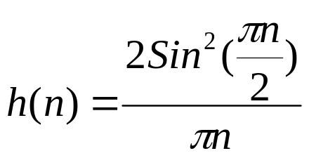
Hilbert TransformsYield I & Q
Frequency response is exactly zero in the lower half of the unit circle
Implemented as a folded FIR Filter
  Few terms are used to minimize lag
X(n)
Z⁻¹
Z⁻²
I(n)
Z⁻²
Z⁻¹
+
-
+
-
.75
+
.25
Q(N)
+

Slide 8
Hilbert Transforms (cont)
InPhase Component must have zero at zero frequency
  Detrend Inphase component over the filter length
Hilbert Transform advances phase by 90 degrees
EasyLanguage Code is:
{Smooth with less than one bar lag}
Smoother = (4*Price + 3*Price[1] + 2*Price[2] + Price[3]) / 10;
{Detrend with linear phase}
Detrender = .25*Smoother + .75*Smoother[2] - .75*Smoother[4] - .25*Smoother[6];
{Compute InPhase and Quadrature components}
Q1 = .25*Detrender + .75*Detrender[2] - .75*Detrender[4] - .25*Detrender[6];
I1 = Detrender[3];

Slide 9
Compensating Hilbert Transforms
Differencing (momentum) is analogous to a calculus derivative
  d(sin(ωt))/dt = ω∗Cos(ωt)
Think about it
  1 bar delta of a 2 bar cycle is 2 (between +1 and -1)
  maximum 1 bar delta of a 50 bar cycle is about 2/25 = .08
Hilbert Detrender and Quadrature must be amplitude compensated
  Use the period of the last bar since period changes slowly
Smoother = (4*Price + 3*Price[1] + 2*Price[2] + Price[3]) / 10;
Detrender = (.25*Smoother + .75*Smoother[2] - .75*Smoother[4] - .25*Smoother[6])*(.046*Period [1] + .332);
{Compute InPhase and Quadrature components}
Q1 = (.25*Detrender + .75*Detrender[2] - .75*Detrender[4] - .25*Detrender[6])*(.046*Period[1] + .332);
I1 = Detrender[3];

Slide 10
Measuring Cycle Period
Use delay line discriminator for best performance in low signal to noise conditions
  Z(n) = X + jY = ρe^{j(nt + ϕ)}
  Z(n)*Z*(n-1) = ρe^{j(ωn+ ϕ)} ρe^{-j(ω(n-1) + ϕ)} = ρ²e^{jω}
Frequency is obtained by taking the arctangent of the argument of the data multiplied by the complex conjugate of the data delayed by one bar
It is assumed there is only one dominant cycle present at a time

Slide 11
Cycle Period Code
CORE CODE
Inputs: Price((H+L)/2);
Vars: Smoother(0), Detrender(0),
I1(0), Q1(0), jI(0), jQ(0), I2(0), Q2(0), X1(0), X2(0), Y1(0), Y2(0), Re(0), Im(0), Period(0);
If CurrentBar > 5 then begin
Smoother = (4*Price + 3*Price[1] + 2*Price[2] + Price[3]) / 10;
Detrender = (.25*Smoother + .75*Smoother[2] - .75*Smoother[4] - .25*Smoother[6])*(.046*Period [1] + .332);
{Compute InPhase and Quadrature components}
Q1 = (.25*Detrender + .75*Detrender[2] - .75*Detrender[4] - .25*Detrender[6])*(.046*Period[1] + .332);
I1 = Detrender[3];
{advance the phase of I1 and Q1 by 90 degrees}
jI = .25*I1 + .75*I1[2] - .75*I1[4] - .25*I1[6];
jQ = .25*Q1 + .75*Q1[2] - .75*Q1[4] - .25*Q1[6];
{Phasor addition to equalize amplitude due to quadrature calculations (and 3 bar averaging)}
I2 = I1 - jQ;
Q2 = Q1 + jI;
{Smooth the I and Q components before applying the discriminator}
I2 = .15*I2 + .85*I2[1];
Q2 = .15*Q2 + .85*Q2[1];

Slide 12
Cycle Period Code (cont)
{Homodyne Discriminator}
{Complex Conjugate Multiply}
X1 = I2*I2[1];
X2 = I2*Q2[1];
Y1 = Q2*Q2[1];
Y2 = Q2*I2[1];
Re = X1 + Y1;
Im = X2 - Y2;
{Smooth to remove undesired cross products}
Re = .2*Re + .8*Re[1];
Im = .2*Im + .8*Im[1];
{Compute cycle period}
If Im <> 0 and Re <> 0 then Period = 360/ArcTangent(Im/Re);
If Period > 1.5*Period[1] then Period = 1.5*Period[1];
If Period < .67*Period[1] then Period = .67*Period[1];
If Period < 6 then Period = 6;
If Period > 50 then Period = 50;
Period = .2*Period + .8*Period[1];
end;
TO CORE CODE ADD:
Plot1(Period, “Period”);

Slide 13
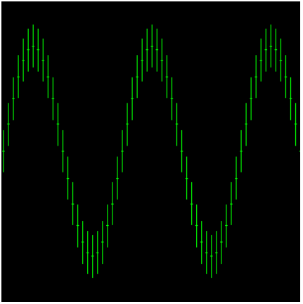
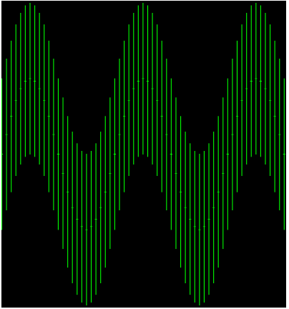
Signal-to-Noise Indicator
Noise is the uncertainty of a price sample
  Can be pictured as the daily range on a chart
Trading should only be done when signal is large relative to the noise
0 dB S/N occurs when the lowest low of a high signal point is equal to the highest high of a low signal point
High S/N
0 dB S/N

Slide 14
Signal-to-Noise Indicator Code
To CORE CODE ADD:
vars: Signal(0), Noise(0),SNR(0);
{Signal Amplitude Squared comes directly from the discriminator}
Signal = SquareRoot(I1*I1 + Q1*Q1);
{Noise is a 20 bar EMA of ranges squared}
Noise = .1*(H - L)*(H - L) + .9*Noise[1];
{Convert to dB and smooth with EMA}
If (Noise <> 0 and Signal <> 0) then SNR = .33*(10*Log(Signal/Noise)/Log(10)) + .67*SNR[1];
Plot1(SNR, "SNR");
Plot2(6, "Ref");

Slide 15
Measuring Phase
Phase is measured at the period of the dominant cycle
TO CORE CODE ADD
vars: count(0), RealPart(0), ImagPart(0), DCPhase(0);
Value5 = IntPortion(Period);
RealPart = 0;
ImagPart = 0;
If Value5 > 6 then begin
For count = 0 To Value5 - 1 begin
RealPart = RealPart + Sine(360 * count / Value5) * (Price[count]);
ImagPart = ImagPart + Cosine(360 * count / Value5) * (Price[count]);
end;
end;
RealPart = .33*RealPart + .67*RealPart[1];
ImagPart = .33*ImagPart + .67*ImagPart[1];
If AbsValue(ImagPart) > 0.001 then DCPhase = Arctangent(RealPart / ImagPart);
If AbsValue(ImagPart) <= 0.001 then DCPhase = 90 * Sign(RealPart);
{Compensate phase for smoothing lag prior to taking the arctangent}
DCPhase = DCPhase + 720 / Period;
DCPhase = DCPhase + 90;
If ImagPart < 0 then DCPhase = DCPhase + 180;
If DCPhase > 270 then DCPhase = DCPhase - 360;
Plot1(DCPhase, "Phase");

Slide 16
Using Phase - The Sinewave Indicator
Code is exactly the same as the Phase Measurement except the Sine of the Phase Angle is Plotted
Sine of Phase Angle plus 45 degrees is also plotted
Plot1(Sine(DCPhase), "Sine");
Plot2(Sine(DCPhase + 45), "LeadSine");

Slide 17
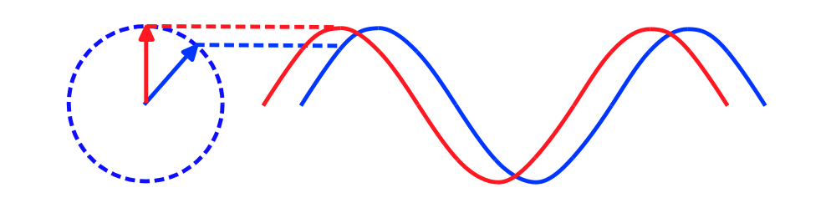
Sinewave Indicator Advantages
Line crossings give advance warning of cyclic turning points
Advancing phase does not increase noise
Indicator can be “tweaked” using theoretical waveforms
No false whipsaws when the market is in a trend mode

Slide 18
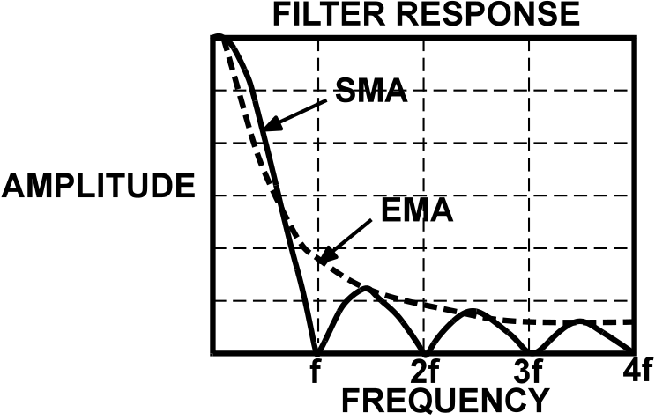
Instantaneous Trendline
Trend Mode exists when the phasor ceases to rotate - no rate change of phase
Objective is to remove any dominant cycle component
  Use a Simple Moving Average over the Dominant Cycle Period

Slide 19
Instantaneous Trendline Code
Trendline Lags Price by half the Dominant Cycle
Trend is in force if Smooth fails to cross the Instantaneous Trendline within a half cycle period
ADD TO CORE CODE
vars: count(0), Trend(0), Smooth(0);
{Insert this line immediately after the variable declarations}
If CurrentBar = 5 then Trend = Close;
Value5 = IntPortion(Period);
Trend = 0;
for count = 0 to Value5 - 1 begin
Trend = Trend + Price[count];
end;
If Value5 <> 0 then Trend = Trend/Value5;
Trend = .25*Trend + .75*Trend[1];
Smooth = (7*Price + 6*Price[1] + 5*Price[2] + 4*Price[3] + 3*Price[4] + 2*Price[5] + Price[6])/28;
Plot1(Trend, "ITrend");
Plot2(Smooth, "Smooth");

Slide 20
The Awesome Oscillator
Derived from RADAR Moving Target Indicator (MTI) circuits
Handy to correlate with Sinewave Indicator
Reference July 2000 Stocks & Commodities
Inputs: Price((H+L)/2);
Vars: Detrend(0),
Smooth(0);
Value1 = (4*Price + 3*Price[1] + 2*Price[3] + Price[4])/10;
Value2 = Value1 + .088*Value2[6];
Value3 = Value2 - Value2[6] + 1.2*Value3[6] - .7*Value3[12];
Detrend = Value3[12] - 2*Value3[6] + Value3;
Smooth = .13785*(2*Detrend - Detrend[1]) +.0007*(2*Detrend[1] - Detrend[2])
+ .13785*(2*Detrend[2] - Detrend[3]) + 1.2103*Smooth[1] - .4687*Smooth[2];
Plot1(Detrend,"Detrend");
Plot2(Smooth,"Smooth");

Slide 21
Market Mode Detector
Compile as a Paintbar
TO CODE FOR PHASE ADD
vars: trend(0), DaysInTrend(0);
{Rule 1: Sinewave Indicator Crossing initializes half cycle crossing timing}
If Sine(DCPhase) Crosses Over Sine(DCPhase + 45) or
Sine(DCPhase) Crosses Under Sine(DCPhase + 45) Then begin
DaysInTrend = 0;
trend = 0;
end;
DaysInTrend = DaysInTrend + 1;
{Rule2: Phase rate of change must be within 50% of dominant cycle phase rate of change}
If Value5 <> 0 and (DCPhase - DCPhase[1] > .67*360/Value5
and DCPhase - DCPhase[1] < 1.5*360/Value5) then trend = 0;
If DaysInTrend > .5*Period then trend = 1;
If trend = 0 then begin
Plot1(high, "high");
Plot2(low, "low");
end;

Slide 22
And In Conclusion . . .
I know you believe you understood
what you think I said,
but I am not sure you realize
that what you heard is not what I meant

