Slide 1

www.swamicharts.com
Not Rocket Science – An Intuitive New Display
John Ehlers

Slide 2
SwamiCharts Overview
www.swamicharts.com
Welles Wilder published the RSI in 1978 using a 14 period lookback period
I started on a decades-long research to find the correct lookback period for indicators
  MESA measures the dominant cycle
I have now discovered a new display technique that where you to see the results of all lookback periods at a glance
  Enables easy cross-indicator correlation (price / volume)
This new display has also spawned new indicators
  Relative Performance. Useful for sector rotation
  Convolution. Conclusively isolates turning points
  Market Mode. Identifies Trends and Swing conditions
  Swing Wave. View the complex price wave structure

Slide 3
SwamiCharts Structure
www.swamicharts.com
SwamiCharts are placed in subgraphs below the price chart
  The indicators are in time sync with prices
SwamiChart vertical scales are the lookback periods of the indicators
Colors represent indicator values over the range of time and lookback periods. Generally:
  Green represents increasing values
  Red represents decreasing values
  Yellow represents intermediate values
Some SwamiChart indicators have contrasting hues to maximize interpretation

Slide 4
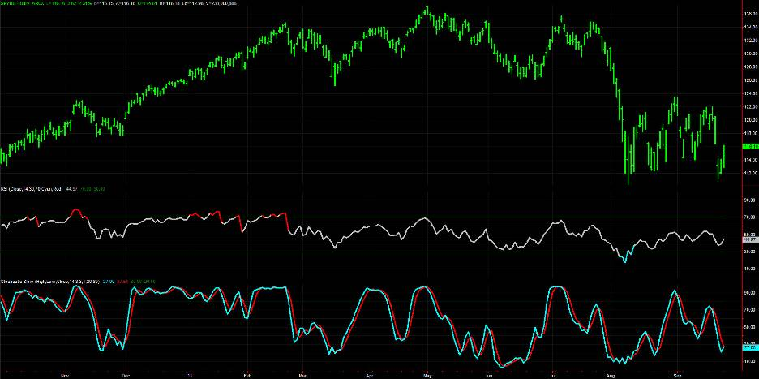
Standard Indicators are Confusing
www.swamicharts.com

Slide 5
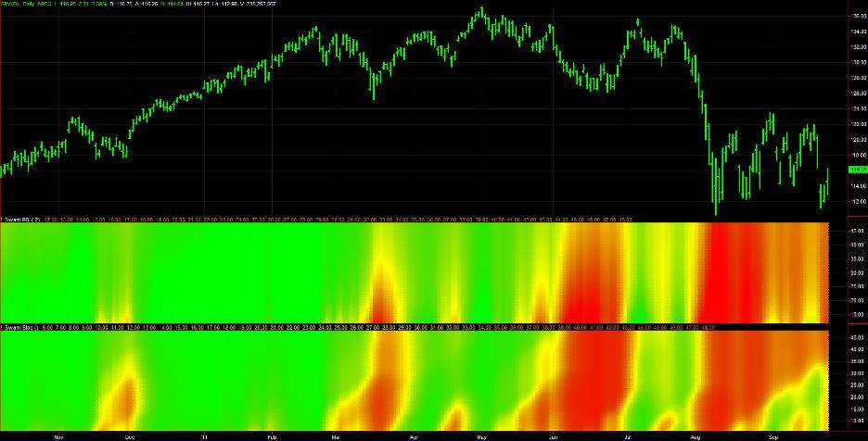
SwamiChart Indicators
Give a Clear Interpretation
www.swamicharts.com

Slide 6
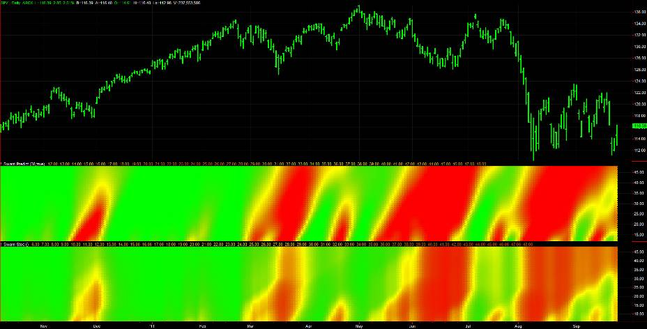
SwamiCharts Predict is Superior
to the Classic Stochastic
www.swamicharts.com

Slide 7
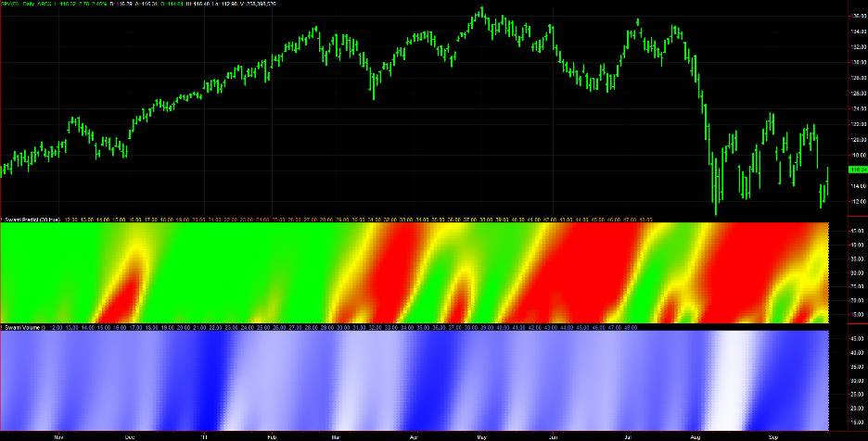
SwamiCharts Predict & Volume
Enable Easy Indicator Correlation
www.swamicharts.com

Slide 8
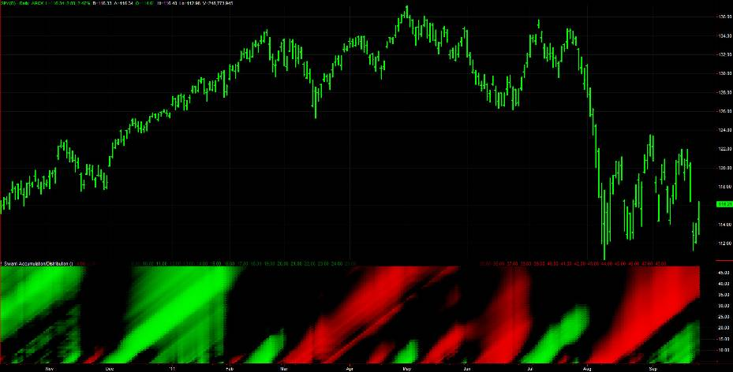
SwamiCharts Accumulation/Distribution
Combines Price and Volume Movements
www.swamicharts.com

Slide 9
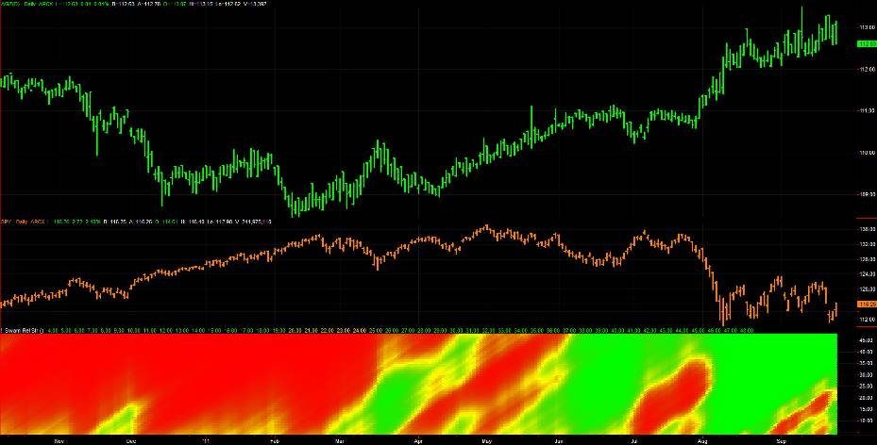
SwamiCharts Relative Performance
Is Useful for Sector Rotation
www.swamicharts.com

Slide 10
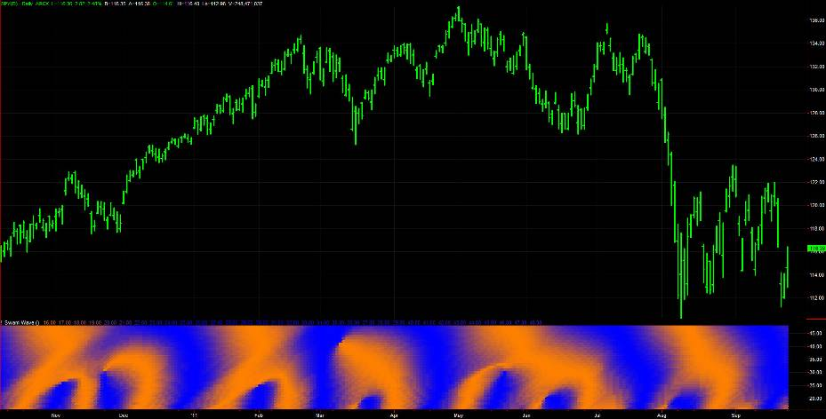
SwamiCharts Swing Wave
Clarifies Complex Market Waves
www.swamicharts.com

Slide 11
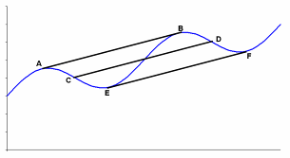
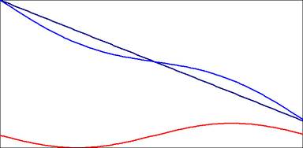
Wave Motion Does Not Consider Trends
Trend Slopes Can Swamp Swings
www.swamicharts.com
Slope is accurately computed over one cycle period
TREND
WAVE
A large slope trumps the cycle amplitude
CYCLE
Conclusion – Don’t swing trade if the trend slope exceeds the peak-to-peak swing over the cycle period

Slide 12
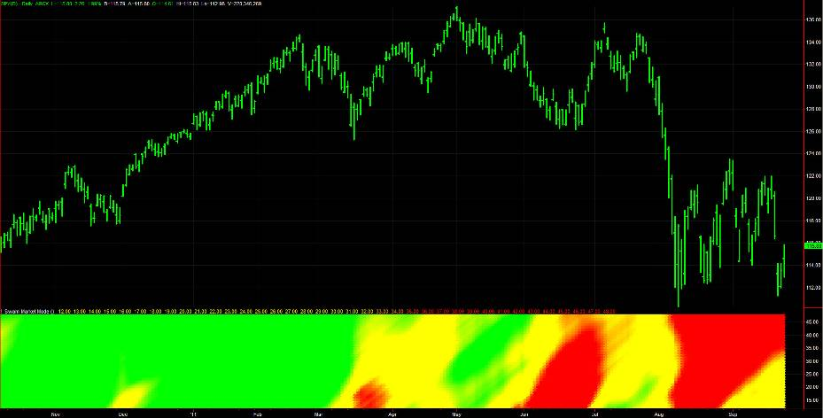
SwamiCharts Market Mode
Identifies Trends Up/Down & Cycle Modes
www.swamicharts.com

Slide 13
Convolution Means “Folding”
www.swamicharts.com
Trend
Turning Point
Convolution
Convolution
No Correlation
Correlation

Slide 14
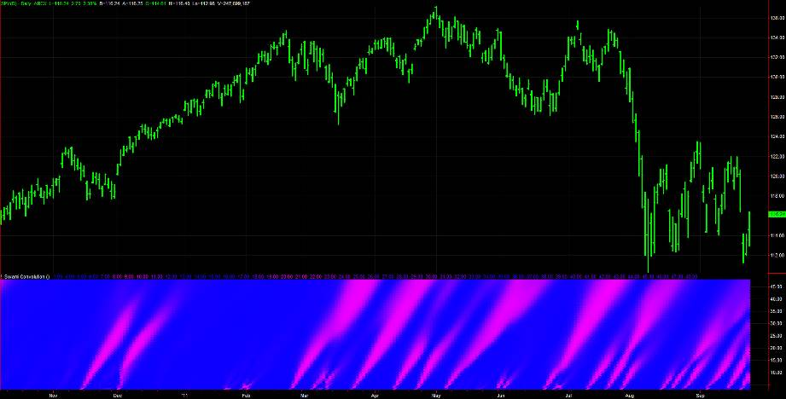
SwamiCharts Convolution
Pinpoints Major Turning Points
www.swamicharts.com

Slide 15
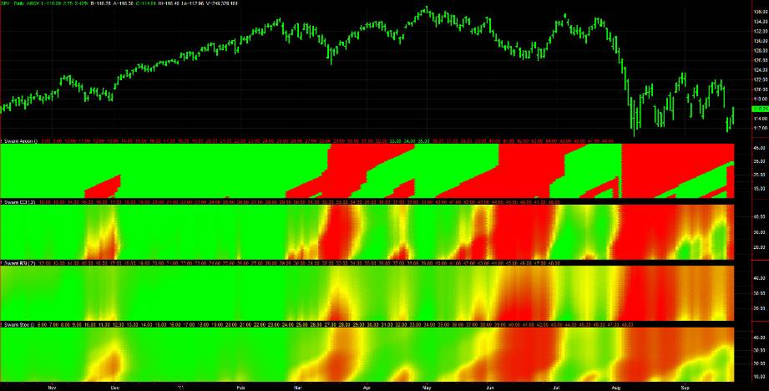
SwamiCharts Classic Package
(FREE)
www.swamicharts.com
Available on TradeStation Network – Search “SwamiCharts” or “John Ehlers”

Slide 16
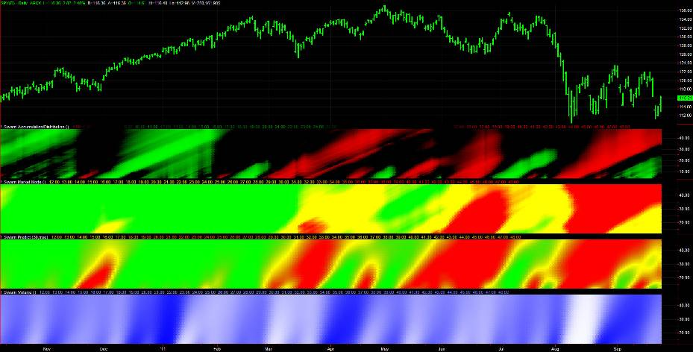
SwamiCharts Essentials Package
$35 / Month
www.swamicharts.com
Available on TradeStation Network – Search “SwamiCharts” or “John Ehlers”

Slide 17
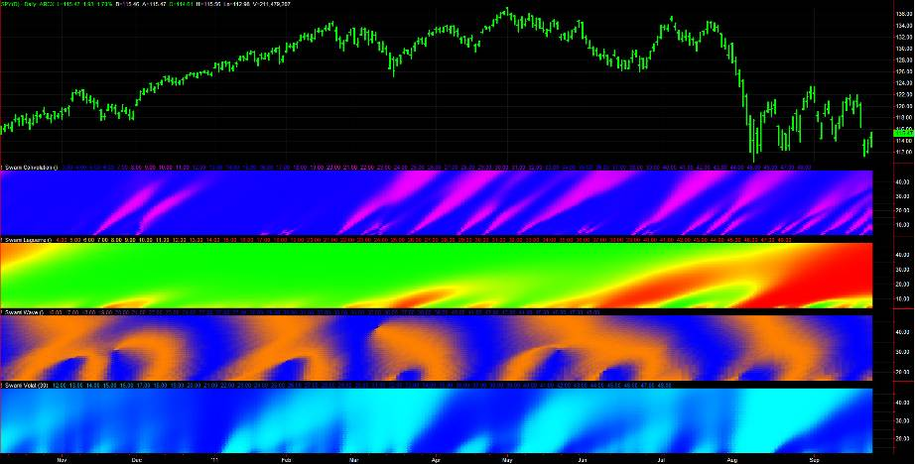
SwamiCharts Advanced Package
$50 / Month
www.swamicharts.com
Available on TradeStation Network – Search “SwamiCharts” or “John Ehlers”

Slide 18
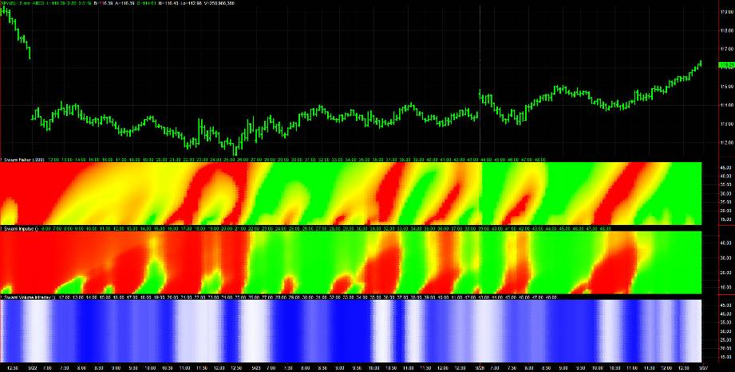
SwamiCharts Intraday Package
$75 / Month
www.swamicharts.com
Available on TradeStation Network – Search “SwamiCharts” or “John Ehlers”

Slide 19
www.swamicharts.com
Your Portal to a New Trading Dimension

Slide 20
www.swamicharts.com

Slide 21
www.swamicharts.com

