Slide 1
Bluestock MF Capstone - Starter Presentation
Auto-generated

Slide 2
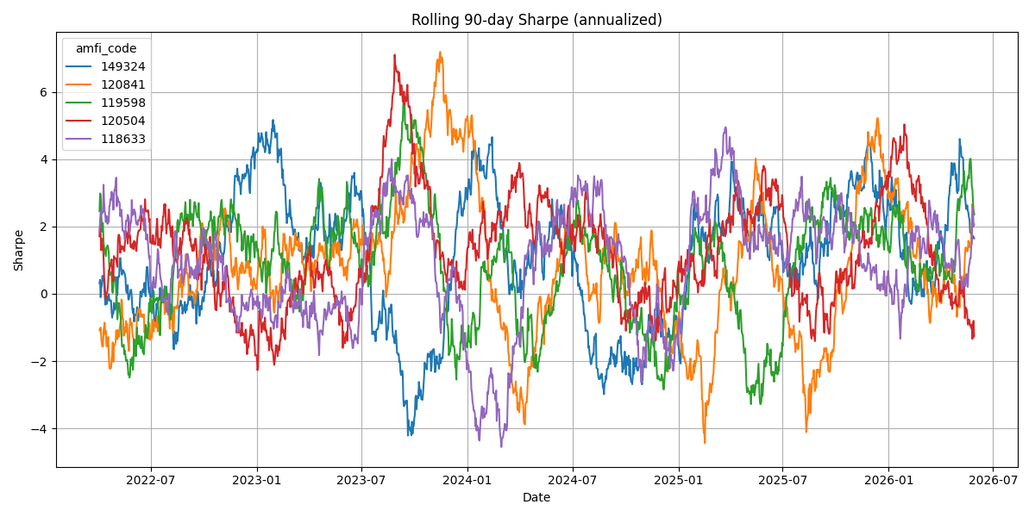
Rolling Sharpe Chart

Slide 3
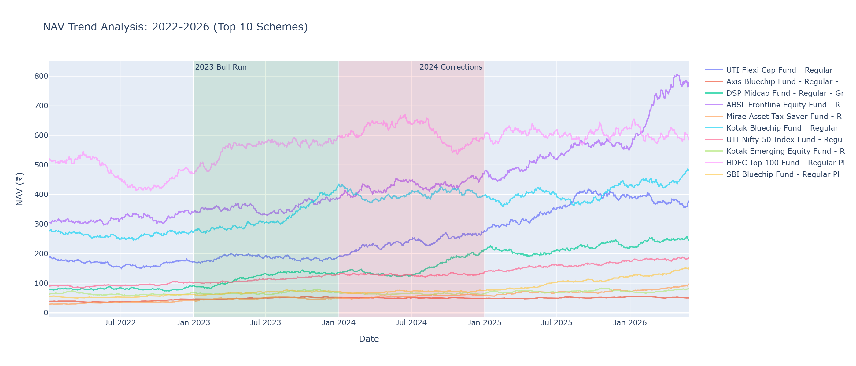
01 Nav Trend Analysis

Slide 4
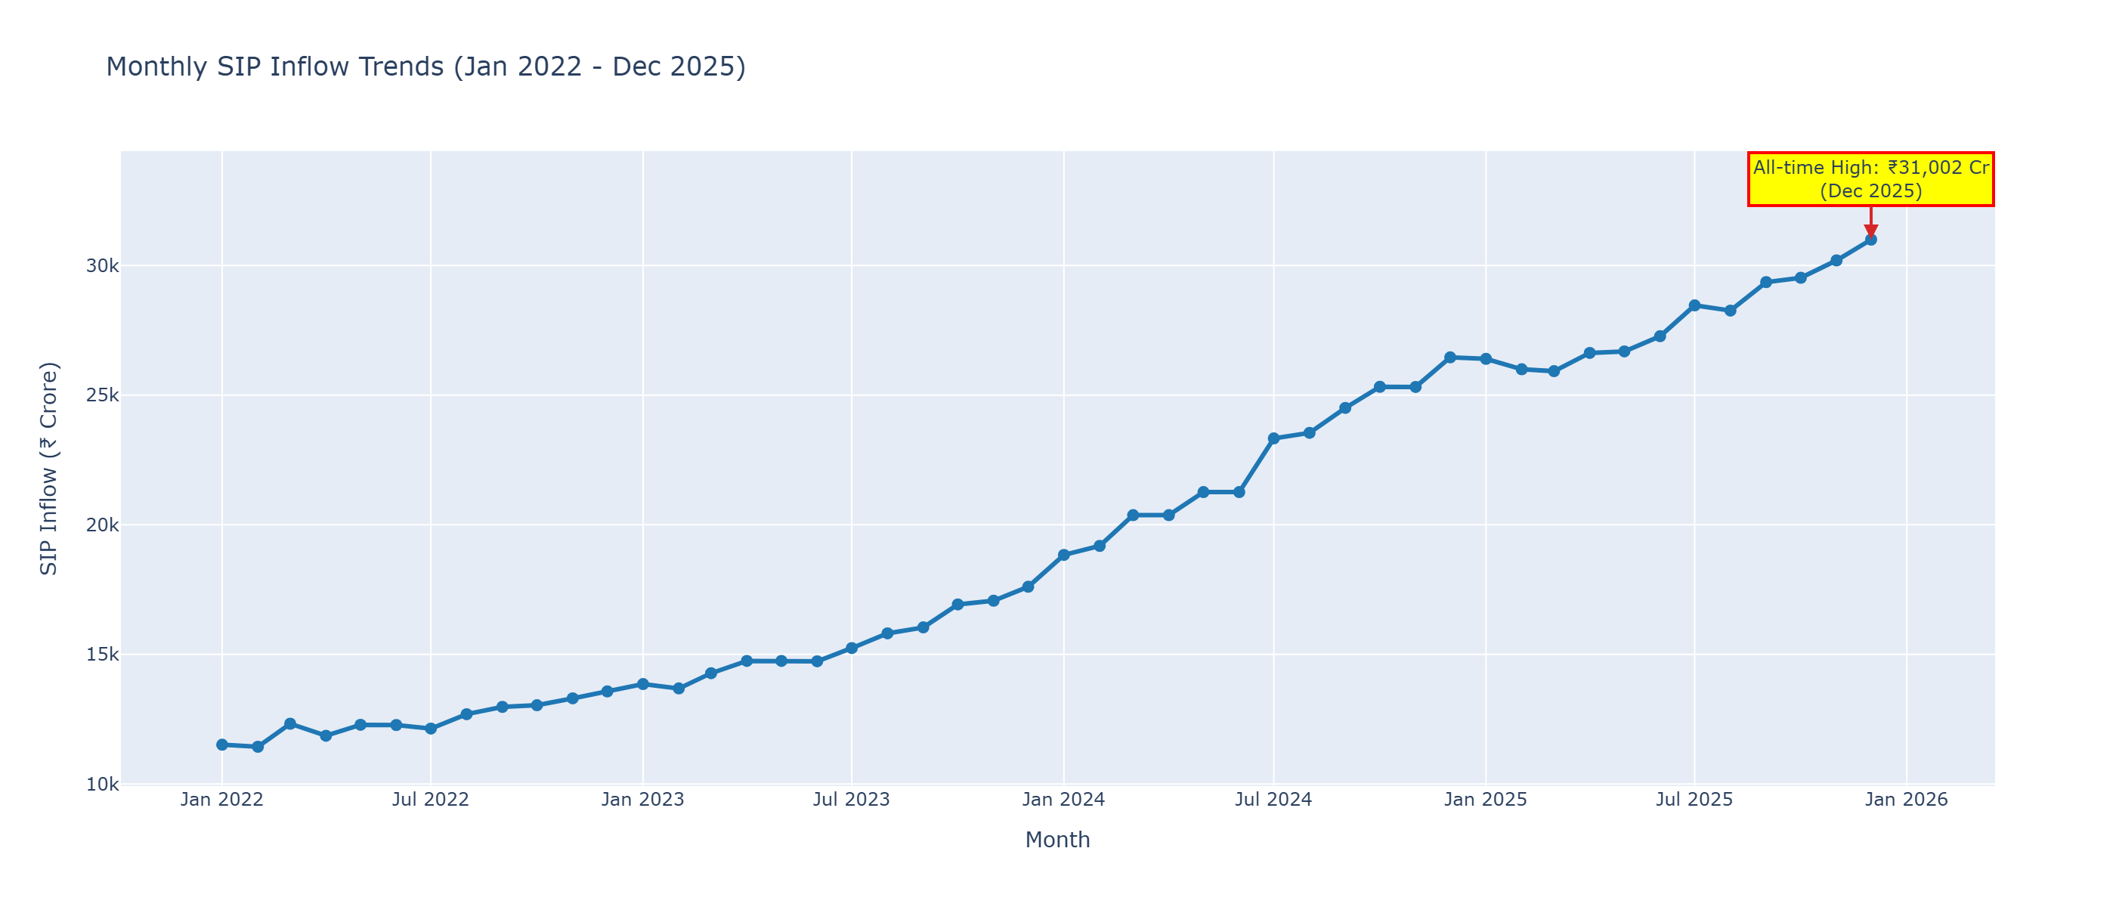
03 Sip Inflow Timeseries

