Slide 1
Course Project:
Web Document Classifier
By: Ishmeet Singh, Isha Raulji, Sambhav Jain, Umar Peera

Slide 2
Project Overview and Objective
The CP468 course project was intended to explore the process of search engines and web crawling. We dig a little deeper with datasets of web documents and use feature extractions approaches and machine learning algorithms to understand our data and use it for newer data.

Slide 3
Theory & Definitions:
Web Crawler: A program that searches the World Wide Web to collect data from pages and can be analysed. In our case: Google.
Data Sets: A collection of data that can hold information needed by programs and applications like ours.
Feature Extraction: Method that will select keywords from text and create features to effectively represent data
Feature Vectors: Vectors that contain multiple elements of an object that represent the object
Boolean attributes: [5]Returns either a 0 or 1 for the elements to be stored in the vectors

Slide 4
Theory & Definitions:
TF-IDF: “Term Frequency - Inverse Data Frequency”. TF gives us the term frequency in a given document in the dataset, each document has its own TF. IDF gives us a weight of rare words across all documents in the dataset. Combining the two we get an TF-IDF score that will be used in Phase 3 to assess data.
Supervised Learning Algorithm: [3] Machine learning algorithms that will analyze the training data and produce a model based on predictions from the training data.
Random Forest Classifier: A specific supervised learning algorithm that builds a “forest’ of decision trees from randomly selected vectors and will operate on a final test data from the “forest”

Slide 5
Understanding the Phases
This project was split into 3 phase:
Creating a Web Crawler and Exporting Datasets
Extracting Features and Creating Vectors of Datasets
Using Machine Learning and Creating Accuracy Models of Data
For these phases, we gathered some research to understand the project a bit better

Slide 6
Phase 1:
In this phase, we created a program that will ask for user input on different topics to crawl
The program will then create a dataset folder that contains topic folders with the list of textfiles
Phase 1 is complete when the dataset contains topic folder files ready for Phase 2

Slide 7
Phase 2:
We are now focused on taking the document textfiles and finding keywords to create feature vectors
We used two approaches:[5] Boolean attributes and [4]TD-IDF approach to compute a score for each feature found in the document
When we run the program, we get a new dataset with the vectors under the same name as the text file for better access

Slide 8
Phase 3:
Phase 3 was a big learning curve with regards to how a program can given data and how it will process it.
This phase was focused on Machine Learning and how our program was able to create models from the training data we had given from Phase 1 and 2
We used the [2]Random Forest classification algorithm as our supervised learning approach to output a confusion matrix, [7]classification report and an accuracy score of the data that we feed into the program.

Slide 9
HOW TO RUN GUIDE
After downloading the Project onto your Desktop. Run the following command on Terminal or Command Prompt:
$ cd Desktop
$ python3 <filename.py>
Phase 1: Enter topics of your choice and wait for the list of documents to be added to a dataset folder on your desktop.
Phase 2: The program will need no input and will export a dataset-vector folder onto your desktop
Phase 3: The program will automatically read the dataset-vector folder from desktop and output a model onto the Terminal or Command Prompt screen

Slide 10
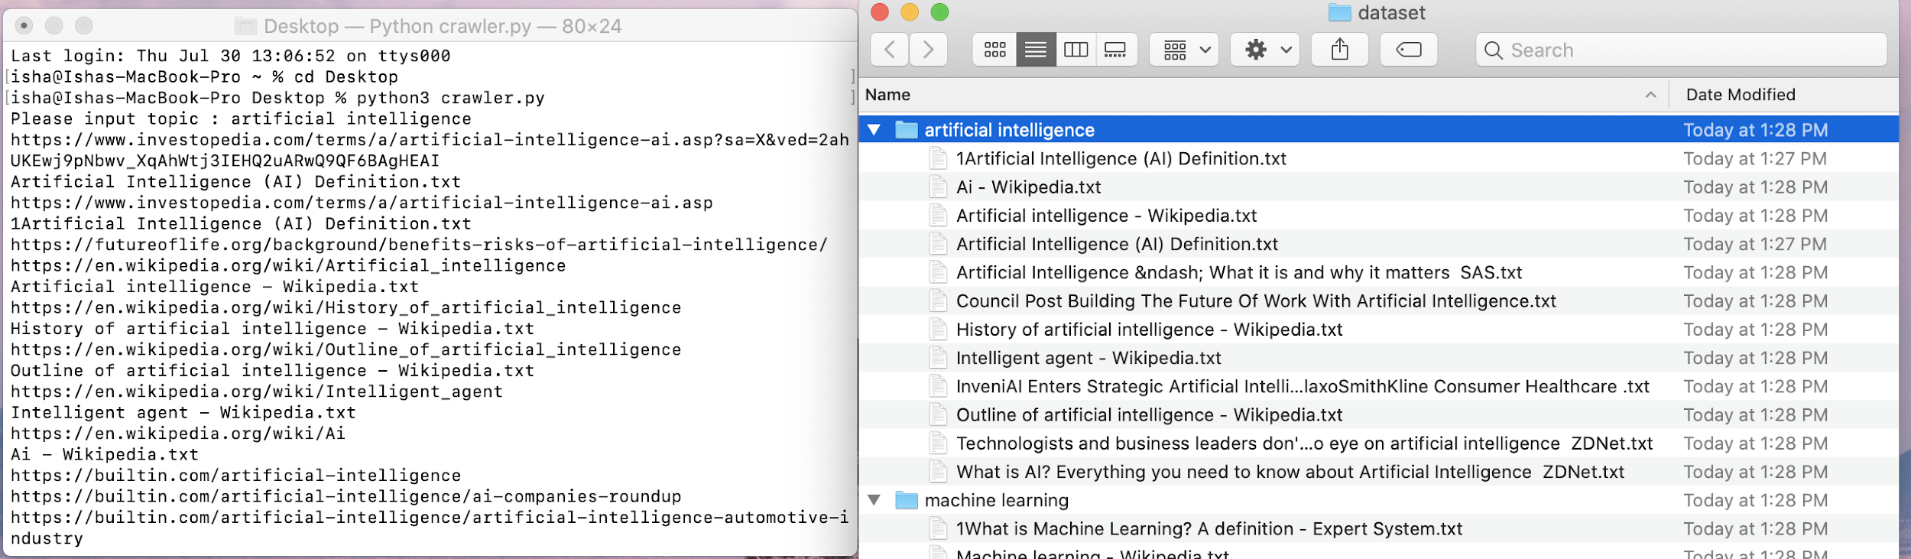
OUTPUT: Phase 1

Slide 11
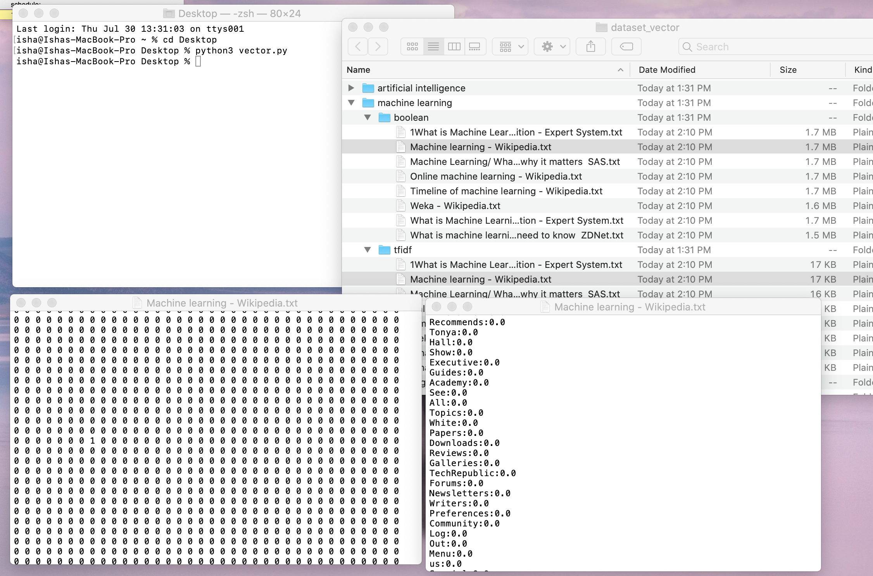
OUTPUT: Phase 2

Slide 12
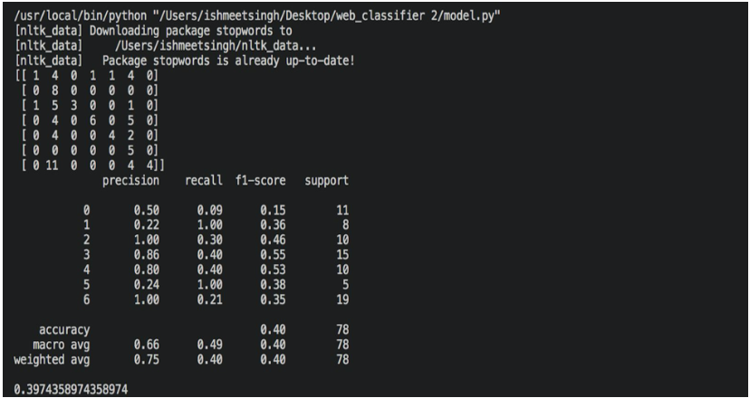
OUTPUT: Phase 3

Slide 13
CONCLUSION
There were a lot of new ideas and concept that we were exposed to and it helped deepen our understanding of data classification and web crawling
We reflected on how our web crawler can traverse through the Web and find documents that match our user input
We experimented with feature vector and how data can be assessed using different approaches
We also learned a lot about data classification algorithms; how they are used in the real world and how we can implement them into our program

Slide 14
Work DONE | Names
Progress Report | Ishmeet Singh
Phase 1 | Ishmeet Singh
Phase 2 | Isha Raulji
Phase 3 | ISHMEET SINGH
Powerpoint Slides | Isha Raulji
Video Presentation | Isha Raulji
Final Report | ISHMEET SINGH

Slide 15
Thank you!
References:
1] https://link.springer.com/referenceworkentry/10.1007%2F978-0-387-39940-9_457
[2] https://medium.com/@williamkoehrsen/random-forest-simple-explanation-377895a60d2d
[3]https://en.wikipedia.org/wiki/Supervised_learning#:~:text=Supervised%20learning%20is%20the%20machine,on%20example%20input%2Doutput%20pairs.&text=A%20supervised%20learning%20algorithm%20analyzes,used%20for%20mapping%20new%20examples.
[4]https://www.freecodecamp.org/news/how-to-process-textual-data-using-tf-idf-in-python-cd2bbc0a94a3/#:~:text=TF%2DIDF%20stands%20for%20%E2%80%9CTerm,each%20document%20in%20the%20corpus.
[5]https://knowledge.autodesk.com/support/maya/learn-explore/caas/CloudHelp/cloudhelp/2015/ENU/Maya/files/Attributes-Data-types-of-attributes-htm.html
[6]https://realpython.com/pandas-read-write-files/#understanding-the-pandas-io-api
[7]https://www.tutorialspoint.com/machine_learning_with_python/machine_learning_with_python_classification_algorithms_random_forest.htm

