Slide 1
SMS 9876501234
9:02 PM
प्रिय ग्राहक, आपके SBI खाते का KYC खत्म हो गया है। तुरंत अपडेट करें, नहीं तो आज रात खाता बंद हो जाएगा।
लिंक: http://sbi-kyc-update.xyz
“Your SBI KYC has expired. Update now, or your account will be closed tonight.”
A demo message, written by the team in the style of real KYC scams
Notes:
SHOW: The scam SMS, large, as a phone shows it: Hindi, with the English below.
DO: Before you walk on: the deck is on slide 1. Nothing in your hands but the clicker.
DO: Walk to the centre and stop. Look at the jury. Say nothing until the room is quiet. (about 2 s)
ISHMIIT: It’s nine at night, and a phone buzzes. You can read it for yourself. Her account closes tonight, unless she updates her KYC. And there’s a link.

Slide 2
WHO READS IT
74.
9 PM.
Bank closed.
Alone.
A demo persona, not a real person
Notes:
SHOW: Four words, one per line: 74. 9 PM. Bank closed. Alone.
DO: Click.
ISHMIIT: Now picture who’s holding that phone. She’s seventy-four. Her bank shut hours ago. Her son is in another city. Whatever she does next, she decides alone.

Slide 3
₹4 lakh
lost to cyber fraud in India, every minute, on average.
₹22,495 crore
₹4,005 crore
lost in 2025, across 24 lakh complaints
of it, from senior citizens
MHA / I4C, Rajya Sabha, Feb 2026; seniors: MHA, Rajya Sabha, 5 Aug 2026. Spread evenly over the year, ₹22,495 crore is about ₹7,133 a second.
Notes:
SHOW: “₹4 lakh”, lost to cyber fraud every minute, on average. Below: ₹22,495 crore in 2025, and ₹4,005 crore of it from senior citizens.
DO: Click. Say nothing for two seconds. Let the number sit. (about 2 s)
ISHMIIT: She isn’t one story. She’s millions. Last year, Indians reported losing over twenty-two thousand crore rupees to cyber fraud. That’s about four lakh rupees every minute, on average.

Slide 4
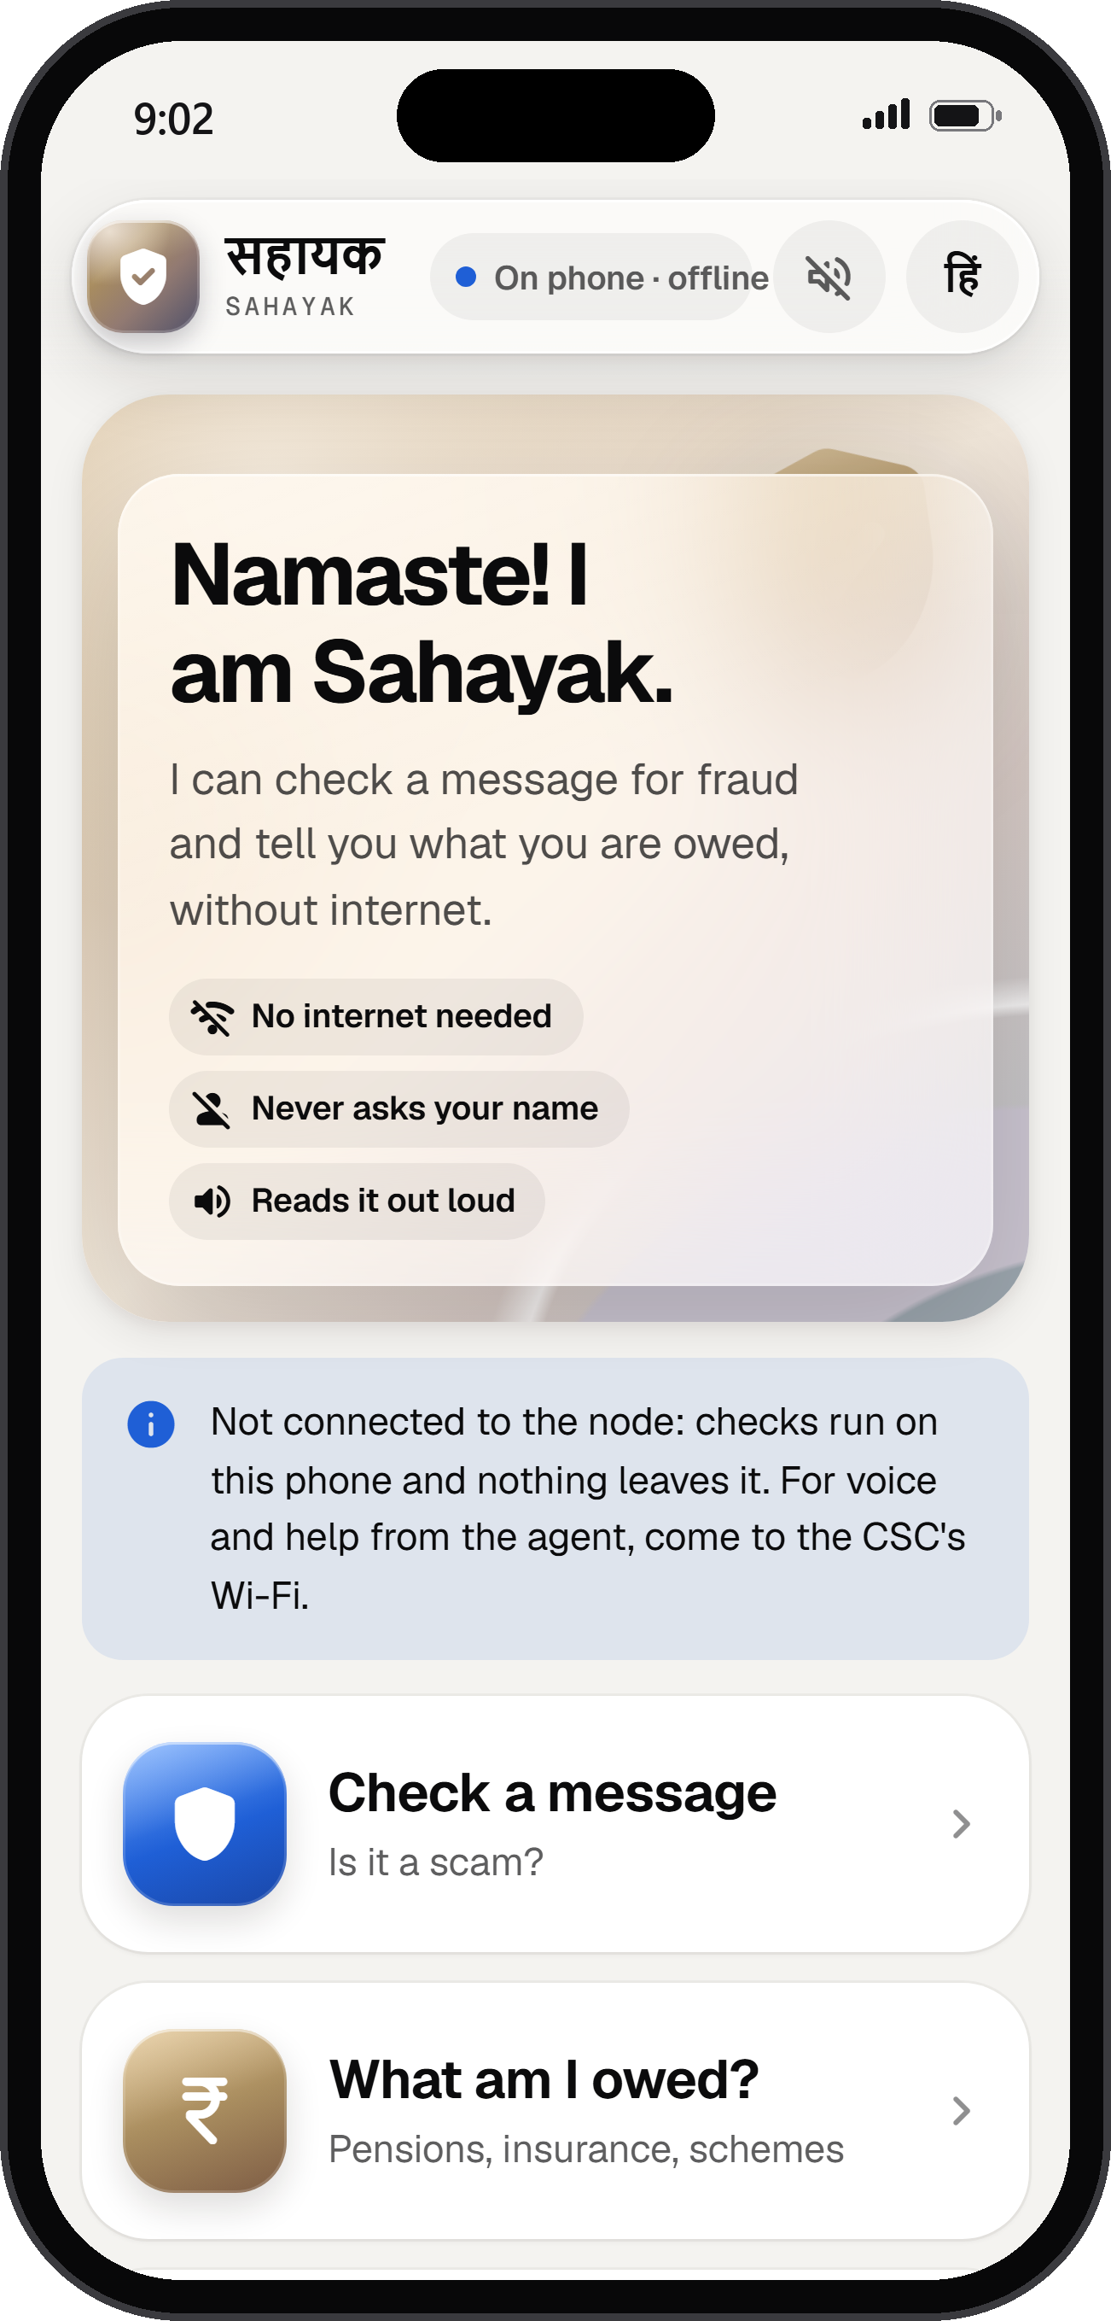
INTRODUCING
Sahayak सहायक
Someone to ask, before you tap.
Spot a scam before the money moves.
Claim what you’re owed.
CSC counter + your phone
Works offline
English · Hindi · regional next
Ishmiit Singh · Roshan Raj
Notes:
SHOW: Sahayak, its two promises, three short pills, and the app’s home screen on a phone.
DO: Click. Take one step toward the jury.
ISHMIIT: So we built her a helper. It’s called Sahayak, and it does two things. It catches the scam before the money moves. And it finds what she’s owed.
ISHMIIT: At the Common Services Centre in her village, or on her own phone, even offline. English and Hindi today, with regional languages on the way.
ISHMIIT: Good morning. I’m Ishmiit Singh, and this is Roshan Raj.
DO: On Roshan’s name, open a hand toward Roshan. Roshan nods.

Slide 5
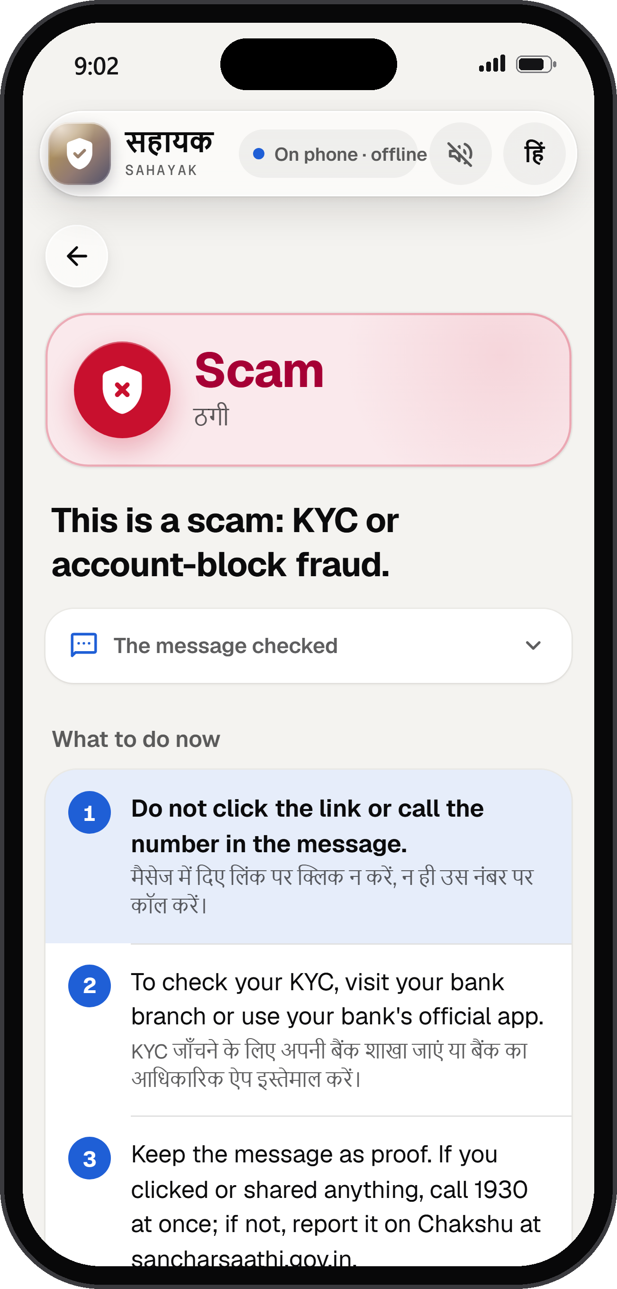
BACK TO HER MESSAGE
Scam.
WHY
Personal number
Fake SBI link
KYC never by link
WHAT TO DO
Don’t tap · keep the proof
Money gone? 1930
Warn the family
Demo persona and SMS written by the team · the app’s answer, on a phone, 14 Oct 2026
Notes:
SHOW: Sahayak’s answer to that SMS on a phone, “Scam.”, and six short cues: three reasons, three things to do.
DO: Click.
ISHMIIT: Back to her message. She pastes it in, and in under a second: Scam.
ISHMIIT: But a warning people don’t understand gets ignored. So Sahayak gives its reasons, in plain words. A bank won’t text from a personal number. That link only looks like SBI’s. And no bank updates KYC through a link.
ISHMIIT: Then, what to do. Don’t tap. Keep the message as proof. If money’s gone, call 1930. And one more tap warns her family.

Slide 6
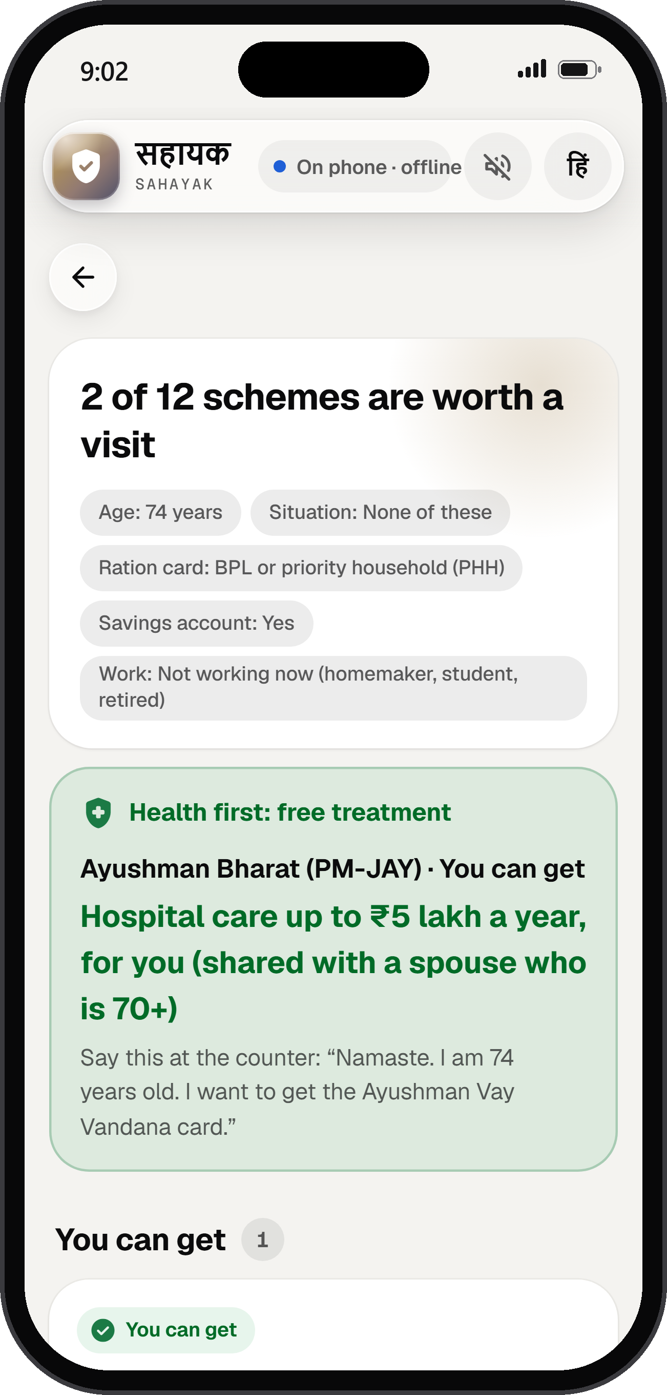
WHAT SHE’S OWED
₹5 lakh
of free hospital care, every year.
Vay Vandana card · every Indian 70+
Fewer than 1 in 5 · had it by Feb 2026
5 questions · the words to say
Stop the scam. Claim what you’re owed.
1.1 of ~6 crore aged 70+ had the card (MoHFW, Feb 2026) · shared with a spouse also 70+; hospital care only · screenshot: result for a 74-year-old
Notes:
SHOW: “₹5 lakh” of free hospital care a year, three short cues, and Sahayak’s benefits result for a 74-year-old.
DO: Click.
ISHMIIT: And building this, something surprised us. The people scammers chase are often missing out on what’s already theirs.
ISHMIIT: At seventy-four, she’s entitled to free hospital care, up to five lakh rupees a year, whatever her income. Yet by February, fewer than one in five people over seventy had the card.
ISHMIIT: So Sahayak asks five simple questions, puts that card first, and gives her the exact sentence to say at the counter.

Slide 7
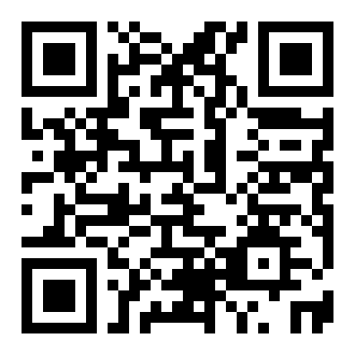
Try it.
Right now, on your phone.
1
Scan the code.
Nothing to install. No account.
2
Tap “Check a message”
then “Pay ₹500 for your Ayushman card”.
3
Turn on airplane mode.
Try another. It still works.
ishmiit.github.io/Sahayak
Opens in English. Tap हिं for Hindi.
Notes:
SHOW: The only QR code in the deck, and three things to try.
DO: Click.
ISHMIIT: Don’t take my word for it. Take out your phones, and scan this code. Nothing to install. No account.
DO: Wait until you see phones come up. (about 3 s)
ISHMIIT: Tap ‘Check a message’, and try the one asking five hundred rupees for an Ayushman card.
DO: Wait for the first faces to react. (about 2 s)
ISHMIIT: Scam. That card is free.
ISHMIIT: Now, my favourite part. Turn on airplane mode, and try another. It still works.
DO: Roshan holds up the demo phone.
ROSHAN: If it doesn’t open, just raise your hand. I’ll bring you this one.
DO: Stop talking and let them try it. Watch the jury, not the screen. Roshan walks the demo phone to anyone who raises a hand. (about 10 s)
ISHMIIT: The phone Roshan is holding has been in airplane mode since we walked into this room.

Slide 8
How it works
1
2
3
You ask.
Rules decide.
A clear answer.
Type · Speak
A call · A UPI QR
64 signals
On the device
4 answers
Never “safe”.
Phone = counter: 1,841 of 1,841 checks.
Notes:
SHOW: Three cards with a few words each: You ask. Rules decide. A clear answer. Below: phone and counter agree, 1,841 of 1,841.
DO: Click.
ISHMIIT: Under the hood, it’s deliberately simple. She can type, speak, describe a call, or photograph a UPI QR code.
ISHMIIT: Sixty-four scam signals run right on the device, so nothing she types leaves her phone.
ISHMIIT: She gets one of four answers, and ‘safe’ isn’t one of them. No one can promise that.
ISHMIIT: And her phone answers exactly like the counter. We checked, eighteen hundred and forty-one times.

Slide 9
ROUND ONE: A LARGE AI MODEL WOULD DECIDE
So we tested one.
A 3B language model
Sahayak
SCAMS CAUGHT
SCAMS CAUGHT
99 of 103
67 of 103
GENUINE MESSAGES FLAGGED
GENUINE MESSAGES FLAGGED
21 of 34
11 of 34
A warning that cries wolf gets ignored.
So rules decide, and every answer says why.
qwen2.5:3b, zero-shot, on the same 137 real published messages, first runs, 7 Oct 2026. In languages Sahayak can’t read yet, the model caught 14 of 15 scams.
Notes:
SHOW: A 3B language model against Sahayak on the same 137 real messages. Roshan speaks.
DO: Click.
ISHMIIT: In round one, we said a large AI model would make these decisions. So we tested one. Roshan.
DO: Turn to Roshan and step back. Roshan steps forward.
ROSHAN: On the same hundred and thirty-seven real messages, it caught more scams than we did.
ROSHAN: But it called twenty-one of thirty-four genuine messages a scam. We did that eleven times. A warning that cries wolf gets ignored. So rules decide.
ROSHAN: The model will help where it’s strongest: the new languages, as a second opinion that can only raise a warning.
ISHMIIT: Thank you, Roshan.

Slide 10
WE COULD HAVE SHOWN YOU
THE HONEST NUMBER
7 in 10
34 of 37
on messages we wrote
92 of 103
scams caught on 137 real messages people in India received.
on a blind red team, written by an AI that never saw our code
Scored once.
Not yet: real users, and messages from people’s own phones. That’s next.
In Hindi, English and Hinglish: 67 of 97 scams caught, 11 of 34 genuine flagged; published by the Income Tax portal, PIB Fact Check and fact-checkers · first runs, bench/results
Notes:
SHOW: “7 in 10” on 137 real messages, scored once, with the two bigger numbers greyed out on the left.
DO: Click.
ISHMIIT: We could have opened with a bigger number. Thirty-four of thirty-seven, on messages we wrote. Ninety-two of a hundred and three, against a blind red team.
ISHMIIT: But real messages are harder. On a hundred and thirty-seven that people in India actually received, scored once, it caught seven in ten.
ISHMIIT: That’s our number, because it’s the honest one. What it needs now is real users, with messages from their own phones.

Slide 11
THE PILOT
One district.
20
50
6
₹39 lakh
villages
counters
months
estimated
THE NEXT 30 DAYS
1
A field morning at a CSC
2
Real messages from people’s own phones
3
A district partner
Estimates, not quotes: the team’s line-item budget, 7 Oct 2026 (₹39.2 lakh). At 500 counters, about ₹24,000 a counter a year; the operator’s ₹9,600 is the biggest part.
Notes:
SHOW: One district: 20 villages, 50 counters, six months, about ₹39 lakh. The next 30 days.
DO: Click.
ISHMIIT: So, the pilot. One district. Twenty villages. Fifty counters. Six months. About thirty-nine lakh rupees, costed line by line.
ISHMIIT: And the biggest share goes to the local operator who runs each counter.
ISHMIIT: And in the next thirty days: a field morning at a CSC, real messages from real phones, and a district partner.

Slide 12
India has 6 lakh CSCs. We’re asking for 50 counters.
OUR ASK
Introduce us to one district.
One morning.
Six months.
Real numbers.
6 lakh functional CSCs, 4.7 lakh at gram-panchayat level (MeitY, Mar 2025) · the pilot’s 50 counters: nodes at 20 CSCs, the phone app at 30 bank-agent points
Notes:
SHOW: “Introduce us to one district.” Above it: 6 lakh CSCs, and the 50 counters we need.
DO: Click. Stop moving. Look at the head juror.
ISHMIIT: And that’s where you come in. India has six lakh Common Services Centres. We need fifty counters.
ISHMIIT: Introduce us to one district. One morning to start, then six months. And we’ll come back with real numbers, from real people.

Slide 13
ONE MORE THING
github.com/ishmiit/Sahayak
Everything you saw today
public_v0.json
7 in 10
is public.
redteam_v1_blind.json
92 of 103
scambench_v0_test.json
34 of 37
The code. The tests.
llm_baseline.json
21 vs 11
phone_parity.json
1,841 of 1,841
The file behind every number.
facts_v3.json
₹4 lakh a minute
github.com/ishmiit/Sahayak · results in bench/results, outside numbers in docs/deck/facts_v3.json, each with its source · MIT licence
Notes:
SHOW: Everything you saw today is public. A card lists the result file behind each number.
DO: Click. Pause. Take one step toward the jury. (about 2 s)
ISHMIIT: And, one more thing. Everything you’ve seen today is public. The code, the tests, and the file behind every number on these slides. Anyone can check our work. We’d like you to.

Slide 14
Nine at night. The bank is closed.
Now she has someone to ask.
Sahayak सहायक
Spot the scam before the money moves. Claim what you’re owed.
Ishmiit Singh · Roshan Raj
Notes:
SHOW: Nine at night. Now she has someone to ask. Sahayak, its two promises, and both your names.
DO: Click.
ISHMIIT: So, back to her, one last time. Nine at night. The bank is closed. The link is right there. But now, before she taps, she has someone to ask.
ISHMIIT: Sahayak. Spot the scam before the money moves. Claim what you’re owed. Thank you.
DO: Stand still. Let them applaud. (about 2 s)
ISHMIIT: Roshan and I would love to take your questions.
DO: Roshan steps to the centre for the questions. Ishmiit stays on stage, half a step back.

