Slide 1
SAHAYAK
Offline. Vernacular. On your side.
A scam shield and benefits guide that runs on one node at a CSC counter, with no internet, in Hindi and English, by voice or touch. Built and measured.
Ideas for India 2026 · Inclusive Innovation for Bharat
Roshan Raj · Ishmiit Singh
Notes:
India banked half a billion people, then left them to be robbed. Sahayak protects them where they are: offline, in their language, privately.

Slide 2
THE PROBLEM
Banked, then left to be robbed
Hundreds of millions of first-time account holders now receive OTPs, UPI requests and scheme messages they were never taught to read.
Fraud preys on the new
Benefits go unclaimed
Tools assume the connected
Fake KYC SMS, "scan to receive" QR codes, digital-arrest calls, fake scheme apps: built to fool people who cannot yet tell a real bank message from a trap.
Pensions, insurance and income support are lost to paperwork and to not knowing they exist, or which office to ask.
Every safety tool assumes internet, a smartphone, English and the cloud: the four things the excluded lack.
Notes:
The people most exposed to fraud and most in need of guidance are the ones digital services reach last.

Slide 3
THE SOLUTION
One offline node. Two questions answered.
Phones join the node's Wi-Fi, which has no internet, and ask in Hindi or English, by voice or touch.
"Is this a scam?"
"What am I owed?"
A counter, not an app
Paste, speak, photograph or describe a message, a call or a UPI QR. Verdict in milliseconds, the three reasons, what to do, and a ready 1930 complaint.
A spoken interview (median 5 questions) across 12 central schemes: what you can get, the papers to carry, where to go, what to say, and a printed slip.
The CSC or bank agent sees "Ask the agent" requests, prints 58 mm slips and reads monthly impact counters that hold no personal data.
Notes:
Design principle is subtraction: no internet, no English-only, no cloud, no expensive phone.

Slide 4
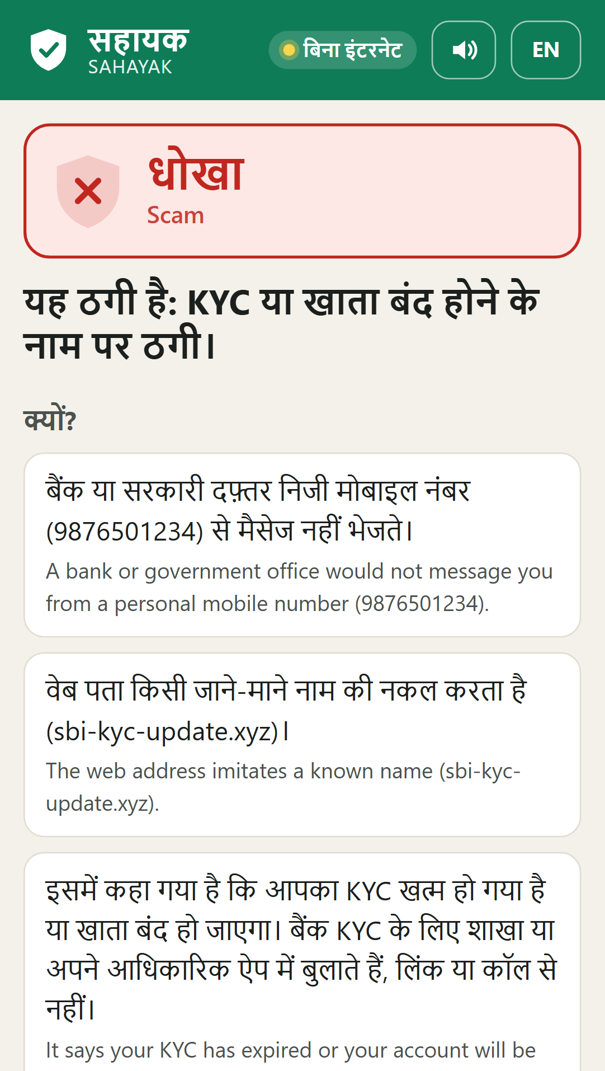
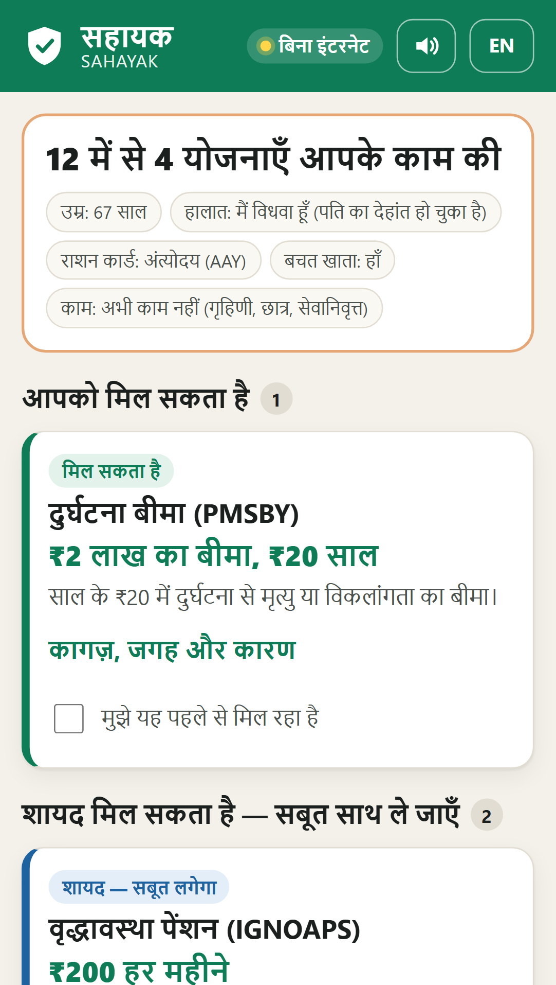
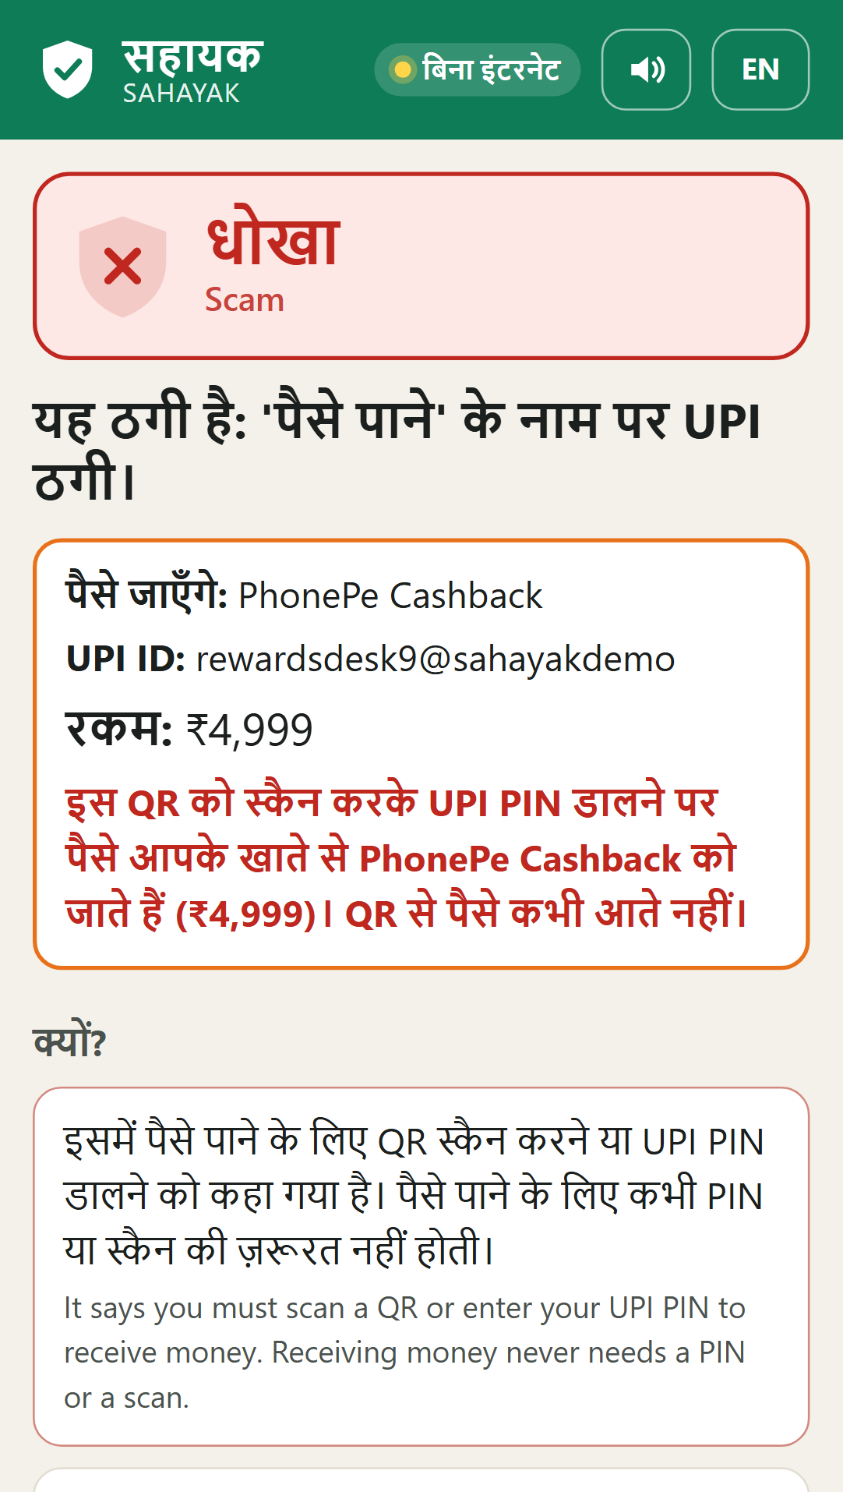
SEE IT WORKING
Built, and on a phone today
A fake KYC SMS
Widow, 67: what she can claim
"Scan to get cashback" QR
Notes:
Real screenshots from the running prototype: a scam verdict with reasons and 1930, a benefits result, and a UPI QR check.

Slide 5
HOW IT WORKS
Technology and implementation
01
Phone app
A cached web app (no install), Hindi and English, every screen read aloud; works on a basic Android phone.
02
Fraud-Shield
51 named signals in a signed content pack, a pattern matcher and a small classifier decide. Vetted templates explain; an optional local LLM may add a line, only through a safety gate.
03
Benefits Navigator
Scheme rules as data, each traced to its official page and date; yes / likely / unknown / no logic; asks only what can change the answer.
04
Offline voice
Speech in and out on the node (Vosk, Piper); amounts spoken as words; "I heard …, is that right?" before any answer is used.
05
The node
One laptop or mini-PC at a CSC. Zero-egress monitor, Ed25519-signed packs updated by USB, operator console, captive portal.
Notes:
The verdict never depends on the model alone; with the model switched off, everything still works.

Slide 6
INNOVATION AND UNIQUENESS
What no one else ships together
Offline, and it proves it
Explains, not a blocklist
Rules, not guesses
The node counts every outbound connection its own process makes, live on screen, next to the firewall's state. The judge's phone shows "no internet".
Named signals a judge can check. On ScamBench, 91.9% of scams caught against 51.4% for a keyword blocklist, with 8.7% false alarms against 43.5%.
Scheme answers computed from official rules: 2,400 of 2,400 decisions match an independent re-derivation; every rupee amount traces to a signed pack.
Notes:
Turns the usual trade-off, advanced AI or reaching the unconnected, into advanced AI because it reaches the unconnected.

Slide 7
FEASIBILITY: MEASURED, NOT CLAIMED
It already works, and we measured it
91.9%
2 ms
15.4%
0.65 s
5
scams caught (blocklist: 51.4%)
per verdict on a laptop CPU
Hindi word error, real speakers
from mic release to spoken reply
questions to find a person's schemes
How we know, and what it does not show
ScamBench v0 frozen test split (60 messages, 95% CI 82.1%–100.0%); SchemeBench (200 personas, exhaustive interview check); Google FLEURS Hindi (418 recordings). v0 messages were written by our team, so those numbers are optimistic; v1 adds real messages collected with consent. Red team: 46 of 52 scams disguised to slip past it caught on the first run (blocklist 33). All in the testing report.
Notes:
Every number here comes from a script in bench/ and the testing report; the caveats are on the slide.

Slide 8
SOCIAL AND ECONOMIC IMPACT
From "account opened" to "citizen safe"
Rupees at risk
Schemes found
Nothing leaves
The node adds up the money asked for in messages it flags, every month: never called "saved", always shown to the district without personal data.
People found eligible, by scheme, with the papers and the office; each printed slip lets the CSC operator finish the form at the counter.
Messages, voices and answers stay in the node's memory; the case log needs consent, holds no names and deletes itself after 30 days.
Pilot target, not a result: one node per CSC in a 20-village district, with an operator and real users. The counters are how the district will know.
Notes:
Impact is economic (rupees at risk, entitlements claimed) and social (safety, dignity, trust).

Slide 9
SCALABILITY AND SUSTAINABILITY
Grow by replication, not reinvention
Replicable node
Rides existing rails
Sustainable by design
A deployment is a node image plus signed content packs plus a one-page operator guide. A new scam pattern or scheme is a pack update by USB, not a code change.
Delivered through CSCs, bank business correspondents and ASHA workers: networks people already trust, with an operator at the counter.
No cloud or per-query cost; open, testable rules; counters give the district a monthly number to fund against.
Notes:
Every scheme the Navigator surfaces is a service the operator can complete at the counter, which keeps the node running.

Slide 10
ALIGNMENT WITH NATIONAL PRIORITIES
Built on India's own rails
Digital India, last mile
Jan Dhan · DBT · UPI
1930 and cybercrime.gov.in
Extends digital public services to the citizens they reach last.
Protects the financial-inclusion base the nation has already built.
Every scam verdict ends in the national helpline and a ready complaint.
Indian languages
DPDP Act
CSC · BC · ASHA
Hindi and English by voice today; the language data is a pack, so more languages follow.
Data stays on the node: consent first, nothing named, deleted by default.
Delivered through the public networks already trusted on the ground.
Notes:
Maps Sahayak onto the rubric's national-priorities line.

Slide 11
TEAM AND THE ASK
Builders who ship, seeking last-mile partners
Roshan Raj
The ask
Systems and AI-infrastructure engineer · Manipal Institute of Technology · 7 patents pending
A single-district pilot with the natural last-mile partners:
CSC e-Governance / State IT: village access points
A bank BC network / SLBC: reach and real messages for ScamBench v1
A reviewer for scheme rules and money answers
A rural NGO: field testing and Hindi review
Ishmiit Singh
Co-builder: product, content and evidence
Together: the node, the scam shield, the scheme navigator, offline voice, the operator console and the benchmarks behind every number in this deck.
Notes:
Honest: the technology is built; partnerships are what this challenge begins.

Slide 12
India banked half a billion people.
Sahayak helps keep them safe.
Offline · vernacular · privacy-first · built and measured. The connectivity divide, turned into a bridge.
Roshan Raj · Ishmiit Singh
Notes:
Close on the line: banked half a billion, and Sahayak helps keep them safe.

