Slide 1
SAHAYAK
Offline. Vernacular. On your side.
A scam shield and benefits guide for people new to digital money: at the CSC counter and on their own phone, with no internet, in Hindi and English, by voice or touch. Built and measured.
Ideas for India 2026 · Inclusive Innovation for Bharat · Financial Inclusion
Roshan Raj · Ishmiit Singh
Notes:
India banked half a billion people, then left them to be robbed. Sahayak protects them where they are: at the counter and at home, offline, in their language, privately.

Slide 2
PROBLEM STATEMENT
Banked, then left to be robbed
Hundreds of millions of first-time account holders now get OTPs, UPI requests and scheme messages they were never taught to read, and miss benefits they are owed.
₹22,495 crore
₹4,005 crore
1 in 5
55%
lost to financial cyber fraud in 2025, across 24 lakh complaints
lost by senior citizens in 2025 (1,03,488 complaints)
families with a UPI user hit by UPI fraud in the last 3 years; 51% never reported it
of people aged 60+ know the old-age pension exists; 29% of poor elders receive it
And most safety tools assume the internet, English, an app account and the cloud, and a person who already knows what a scam looks like: what the people most at risk are least likely to have, or trust.
Sources: MHA / I4C, Rajya Sabha, Feb 2026; MHA, Rajya Sabha, 5 Aug 2026; LocalCircles survey, 2025; LASI Wave 1, 2017–18 (IIPS)
Notes:
Losses were flat from 2024 to 2025 while complaints rose: the fraud is moving to the people least able to spot it. The pension figure is from LASI 2017–18, say so if asked.

Slide 3
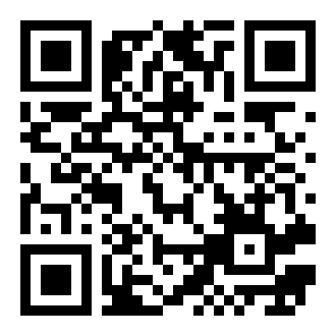
THE SOLUTION
At the counter, and on the phone at home
One small computer at a CSC or bank-agent counter; phones join its Wi-Fi, which has no internet. A phone that has opened Sahayak's secure web address once (the public site today; the node's own after a one-time HTTPS setup) runs the same checks with no node at all.
"Is this a scam?"
"What am I owed?"
Then, on their own phone
Paste, speak, photograph or describe a message, a call or a UPI QR. A verdict in milliseconds, the three reasons, what to do now, and a ready 1930 complaint.
A spoken interview (median 5 questions) across 12 central schemes, health first: what you can get, the papers, where to go, what to say, and a printed slip.
At home, when the call actually comes: the same scam check and benefits interview, on the phone, with no node and no internet. Nothing leaves the phone.
Try it now, on your own phone: roshworldwide.github.io/optum-v2
Check a message, switch on airplane mode, check another: it still works, and gives the node's exact answer.
Notes:
The counter is where people meet Sahayak and claim benefits; the phone is where it protects them. Invite the judges to scan the code now.

Slide 4
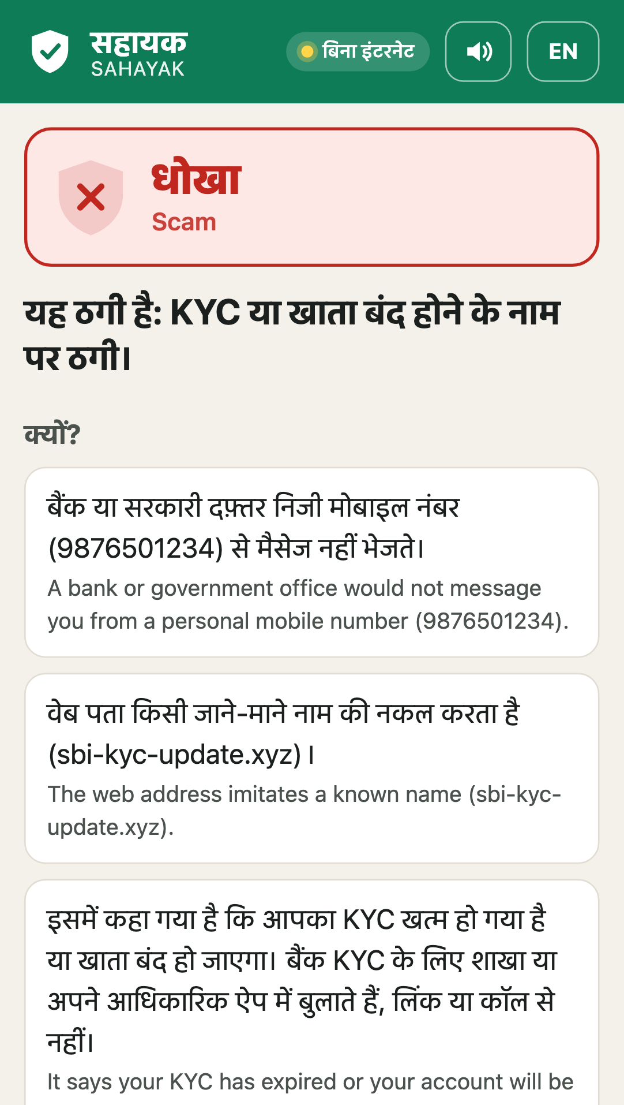
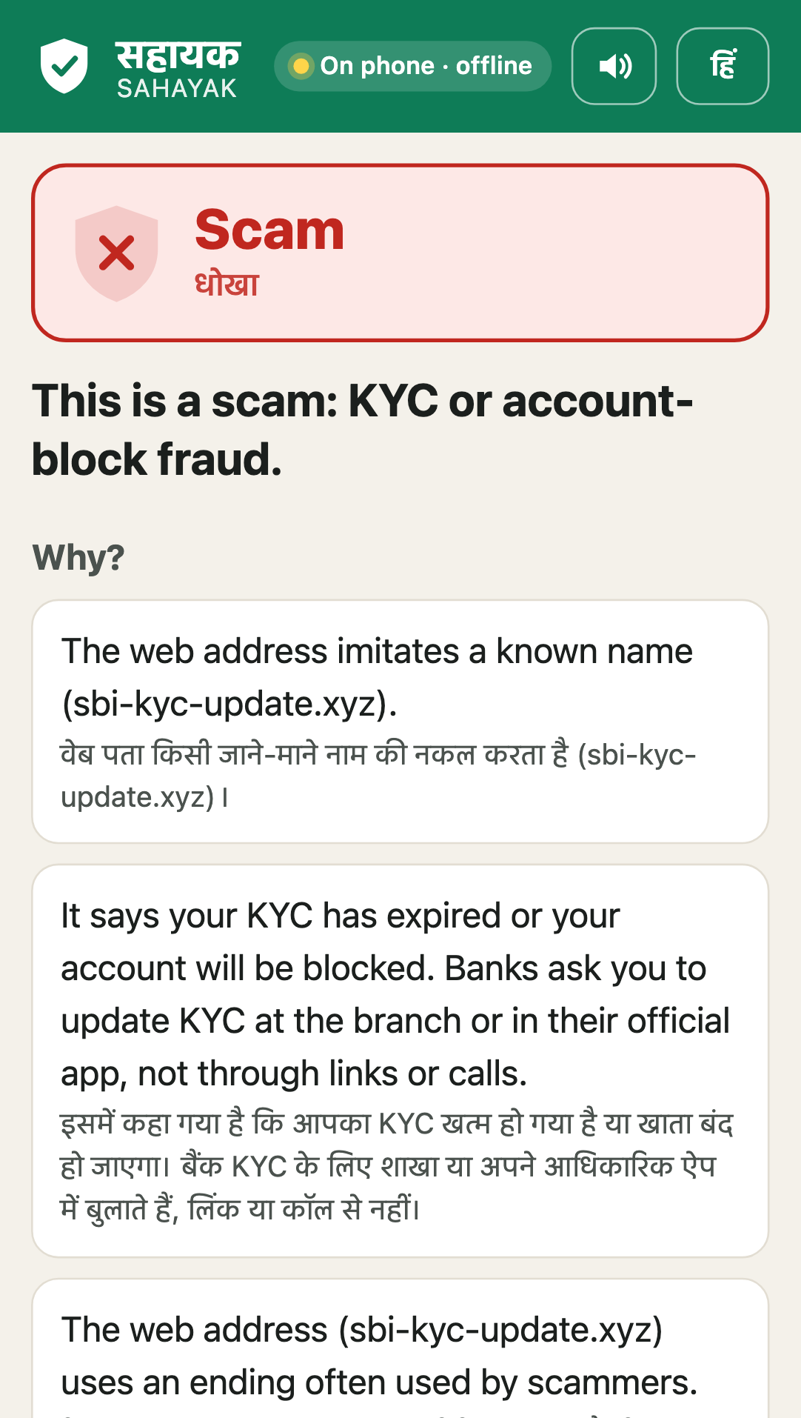
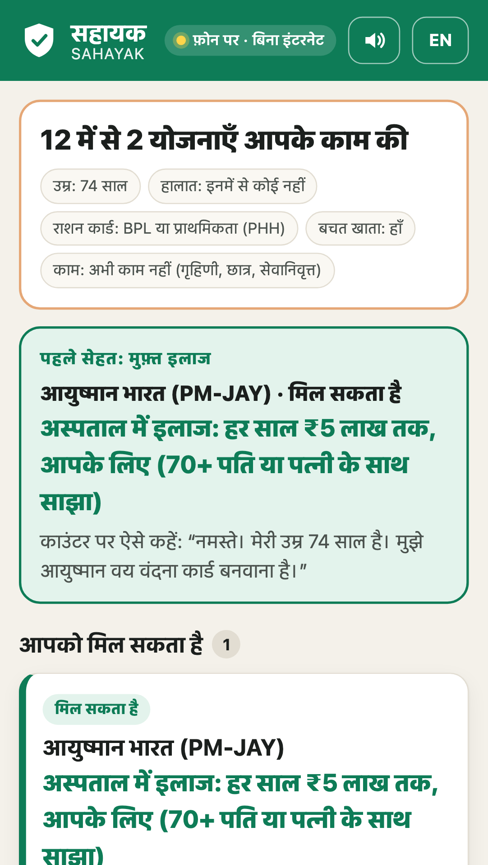
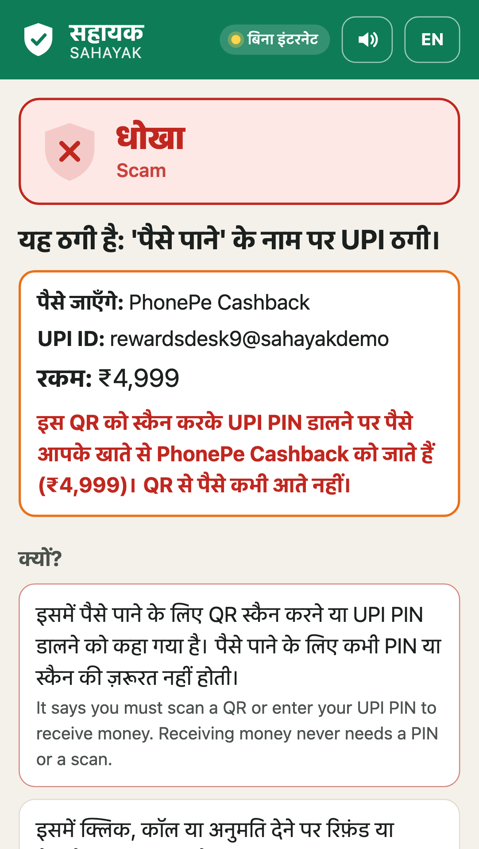
SEE IT WORKING
Built, and on a phone today
A fake KYC SMS, on the node
Airplane mode: checked on the phone
Age 74: health cover first
"Scan to get cashback" QR
Notes:
Real screenshots from the running prototype. The second one was taken with the network switched off: the pill says 'On this phone · offline'.

Slide 5
HOW IT WORKS
Technology and implementation
01
Phone app
A web app, no install, Hindi and English, every screen read aloud. After one visit it works offline on the phone.
02
Fraud-Shield
59 named signals in a signed content pack, a pattern matcher and a small classifier decide. Vetted templates explain; an optional local model may add a line, only through a safety gate.
03
Benefits Navigator
Scheme rules as data, each traced to its official page and date; yes / likely / unknown / no logic; asks only what can change the answer.
04
Offline voice
Speech in and out on the node (Vosk, Piper); amounts spoken as words; "I heard …, is that right?" before any answer is used.
05
The node
One mini-PC or laptop at a CSC. Zero-egress monitor, Ed25519-signed packs updated by USB, operator console, captive portal.
06
Same answer everywhere
The phone runs the same rules from the same signed packs: identical results to the node on 1,490 messages and 7,983 interviews.
Notes:
The verdict never depends on a model alone; with the model off, everything still works, on the node and on the phone.

Slide 6
WHAT CHANGED SINCE ROUND 1, AND WHY
We tested the big-model idea, and chose rules
Round 1 proposed
We built
Because we measured
A 14-billion-parameter language model, offline on a GPU server, deciding whether a message is a scam, with a fine-tuned finance model behind it.
59 named signals, a pattern matcher and a small classifier decide, in about 2 ms on a laptop CPU, and name their reasons. A language model is optional: it may reword the explanation, through a safety gate, and never decides.
A qwen2.5 3b model, asked zero-shot on 137 real published messages, caught 99 of 103 scams (Sahayak 67) but flagged 21 of 34 genuine ones (Sahayak 11), at 2.13 s a message on a GPU. Blind set: 24 of 64 genuine flagged (Sahayak 15).
A warning that fires on 6 in 10 real genuine messages teaches people to ignore warnings, and the model cannot say what made it decide. Where a model earns its place: it caught 14 of 15 blind-test scams in languages Sahayak cannot read yet, so next it becomes a raise-only second opinion there.
Sources: bench/results/llm_baseline.md, redteam_v1_blind.md (first runs, 7 Oct 2026); docs/APPLICATION_TO_PROTOTYPE.md
Notes:
Say it before they ask: we promised a big model, we measured one, and we chose rules for the verdict because it was right more often on genuine messages, 1,000 times faster, and every verdict explains itself. The Crucible server was never connected to Sahayak; the change note says so.

Slide 7
TECHNOLOGY DIFFERENTIATION
What already exists, and what Sahayak adds
Already out there | What it does well | What Sahayak adds
Airtel and Jio network filters | Block spam calls and links at network scale; Airtel reports 68.7% lower fraud losses | Checks the message, QR code or call story in front of the person and says why, in Hindi, offline
Truecaller | Caller ID and spam lists for 339 million users | No account and no upload: nothing leaves the phone; covers UPI QR codes and screenshots
Google on-device scam alerts | On-device call analysis | Runs in any phone's browser; Google's works on Pixel 9+ only (under 1% of phones)
1930, cybercrime.gov.in, Sanchar Saathi | Reporting and blocking after the fraud | Catches it before the payment, and ends every scam verdict in a ready 1930 complaint
myScheme | 4,700+ schemes in 15 languages, online, self-serve | Offline, spoken interview with a slip for the CSC; every rule and amount proven against official pages
Haqdarshak | ₹19,233 crore in benefits through trained agents | The offline front door and the scam shield; a content partner, not a rival
Sources: Airtel, citing I4C data, Sep 2025; Truecaller, Q2 2026; TechCrunch, Nov 2025; myScheme.gov.in, Oct 2026; Haqdarshak impact analysis, 2025
Notes:
We complement the network filters and the helplines; no one else checks the thing in front of the person, offline, and explains it.

Slide 8
TESTING AND VALIDATION
Measured on real messages, not just our own
69%
89%
92%
2 ms
15.4%
of 97 real published scams caught, first run (keyword blocklist 64%)
of scams caught in a blind test written by a separate AI model (blocklist 50%)
of our own test scams caught (blocklist 51%)
per verdict on a laptop CPU
Hindi word error, adults reading aloud
How we know, and what it does not show
Real messages: 137 that people received, published by the Income Tax portal, PIB Fact Check, courts and fact-checkers, scored once: 67 of 97 scams caught, 11 of 34 genuine flagged (blocklist 17). Fixes then learned from half of them; on the other half, never read, scams caught went from 28 to 30 of 44 and genuine flagged from 6 to 6 of 20. Blind red team, 182 messages: 92 of 103 caught, 14 of 59 hard genuine flagged; other languages get "could not check", never a false green. Our own test split: 34 of 37 (95% Wilson CI 79%–97%). Not yet: messages from people's own phones, and real users.
Notes:
Every number comes from a script in bench/ and the testing report; the caveats are on the slide.

Slide 9
HEALTH FIRST
₹5 lakh of health cover most seniors have not claimed
1.1 crore of ~6 crore
seniors aged 70+ had their Ayushman Vay Vandana card by Feb 2026
Every benefits result leads with Ayushman Bharat; for anyone 70 or older it is the Vay Vandana card: up to ₹5 lakh a year of hospital care whatever their income (shared with a spouse who is also 70 or more; not for outpatient visits).
One question, their age, finds them; the slip tells the operator what to make.
The CSC makes the card at the counter, and is paid ₹20 per first-time card; the citizen pays nothing.
The scam check flags "pay to get your Ayushman card" messages; the node counts seniors found, every month, with no personal data.
Sources: MoHFW, Feb 2026; Cabinet, Sep 2024; NHA–CSC MoU, 2021; Ministry of Labour
Notes:
Optum's mission is healthier lives: this is the shortest path from Sahayak to a hospital bill that never has to be paid.

Slide 10
IMPACT METRICS
From "account opened" to "citizen safe"
Rupees at risk
People found, health first
Reported in time
The node adds up the money asked for in messages it flags, every month: never called "saved", always shown to the district without personal data.
People found eligible, by scheme, with seniors found for Ayushman Vay Vandana counted on their own; each slip lets the operator finish the form.
From 1 Jan 2027, RBI compensates small losses from stolen OTPs and PINs if reported within 5 days; Sahayak drafts the complaint on the spot. Money sent willingly is not compensated: there, stopping the payment is the only protection.
Pilot target, not a result
One district: about 20 villages and 50 counters (nodes at 20 CSCs, the phone app at 30 bank-agent points), six months, ₹39.2 lakh line by line. Scams flagged, people found eligible and cards made (the operator ticks each), all from the node's counters. A one-morning field test at a CSC (protocol and consent ready) comes first.
Sources: RBI (Commercial Banks – Responsible Business Conduct) Third Amendment Directions, 2026, paras 4(15A) and 76T; press release 2026-2027/533, 24 Jun 2026
Notes:
Impact is economic (rupees at risk, entitlements claimed, cards made) and social (safety, dignity, trust).

Slide 11
SCALABILITY AND SUSTAINABILITY
Grow by replication; paid for by those who gain
Replication, not reinvention
Who pays
6 lakh functional CSCs, 4.7 lakh of them at gram-panchayat level: the counters already exist.
A deployment is a node image, signed packs and a one-page operator guide; a new scam or scheme is a pack update by USB.
Every phone that visits can keep its own copy, so protection spreads beyond the counter at no extra cost.
No cloud and no per-query fee; open, tested rules any state can audit.
₹25,000–35,000
once per node (an N150 mini-PC (8–16 GB) or a refurbished i5 laptop); each check costs nothing.
Banks: financial-inclusion or CSR budgets for their agent points, as customer education; fewer small-fraud payouts (shared with RBI from 1 Jan 2027) are a bonus, not the case.
The CSC network: paid about ₹20 per first-time Ayushman card or e-Shram registration Sahayak sends to the counter (how much reaches the operator varies); 86% of rural operators earn under ₹500 a month.
The State Health Agency and the district: Vay Vandana card drives at the CSCs, funded against a signed monthly count of cards made.
Sources: MeitY, Rajya Sabha, Mar 2025; Amazon.in listings, 6 Oct 2026; RBI (Commercial Banks – Responsible Business Conduct) Third Amendment Directions, 2026, paras 4(15A) and 76T; press release 2026-2027/533, 24 Jun 2026; NHA–CSC MoU, 2021; Ministry of Labour; CAG audit, reported Apr 2026
Notes:
The operator's incentive matters: most rural operators earn very little, and every slip is a paid service at the counter.

Slide 12
THEME ALIGNMENT
Inclusive innovation on India's own rails
Financial inclusion, made safe
1930 and RBI's 2027 rules
Ayushman Bharat
Protects the 59 crore Jan Dhan accounts and the UPI base the nation built, for the people who opened them last.
Every scam verdict ends in the national helpline; fast reporting is what RBI's compensation now requires.
Finds seniors for the Vay Vandana card and sends them to the counter that makes it.
Digital India, last mile
DPDP Act
CSC · BC · ASHA
Hindi and English by voice today, offline; the language data is a pack, so more languages follow.
Privacy by design: consent first, nothing named, nothing written to disk, deleted by default.
Delivered through the public networks people already trust, with an operator at the counter.
Notes:
Maps Sahayak onto the track: financial inclusion first, with public service delivery and health on the same counter.

Slide 13
COLLABORATIONS
Built in the open; seeking last-mile partners
CSC village-level entrepreneur or bank business correspondent
hosts the node and the field morning
seeking
A rural NGO or SHG federation
invites participants, checks the Hindi and the consent
seeking
A bank branch, regional office or SLBC
BC points for the pilot, real messages for ScamBench v1
seeking
Haqdarshak or myScheme
scheme content beyond 12 central schemes; Sahayak is the offline front door
seeking
Ready for each partner: a one-morning field protocol with consent in Hindi and English, a scoring script, and letters of intent. The code is MIT-licensed and open.
Notes:
Honest: the technology is built; the partnerships are what this challenge begins. Update the status pills in docs/deck/facts_v3.json as letters come in.

Slide 14
TEAM AND THE ASK
Builders who ship, asking for one district
Roshan Raj
The ask
Systems and AI-infrastructure engineer · Manipal Institute of Technology
A six-month, single-district pilot (about 20 villages, 50 counters, roughly ₹35–40 lakh) with:
Ishmiit Singh
CSC e-Governance or the State IT department: the counters
A bank BC network or SLBC: reach, and real messages for ScamBench v1
NHA or the state health agency: Vay Vandana cards made at the counter
A rural NGO: field testing and Hindi review
Co-builder: product, content and evidence
Together: the node, the scam shield, the scheme navigator, offline voice, the phone engine, the operator console and the benchmarks behind every number in this deck.
Notes:
The technology is built and measured; the pilot is integration and field validation, not new research.

Slide 15
ELEVATOR PITCH
India banked half a billion people.
Sahayak helps keep them safe, and claim what they are owed.
At the counter and on their own phone · offline · in their language · nothing leaves the device · built and measured. Starting with ₹5 lakh of health cover for every senior who does not yet have the card.
Roshan Raj · Ishmiit Singh
roshworldwide.github.io/optum-v2
Notes:
Close on the line: banked half a billion; Sahayak helps keep them safe and claim what they are owed.

