Slide 1
SAHAYAK सहायक
Offline. Vernacular. On your side.
India opened 59 crore Jan Dhan accounts.
Sahayak helps those account holders spot a scam before the money moves, and claim what they are owed.
At the CSC counter and on their own phone · no internet · Hindi and English, by voice or touch · built and measured
Ideas for India 2026 · Inclusive Innovation for Bharat · Financial Inclusion · Grand Jury Round, Delhi, 14 October 2026
Roshan Raj · Ishmiit Singh
Notes:
Say the opening line word for word, then go straight to slide 2. If the slot is 90 seconds: slides 1, 2, 5 and 7 (the QR code is on 3 and 7). In 4 minutes: all seven, with the judges trying it on slide 3. In 7 minutes: add a live check on the demo phone at slide 3 and take the round-1 story on slide 4 slowly. The 59 crore counts accounts, not people (PIB, Aug 2026; Finance Ministry RTI, Sep 2026).

Slide 2
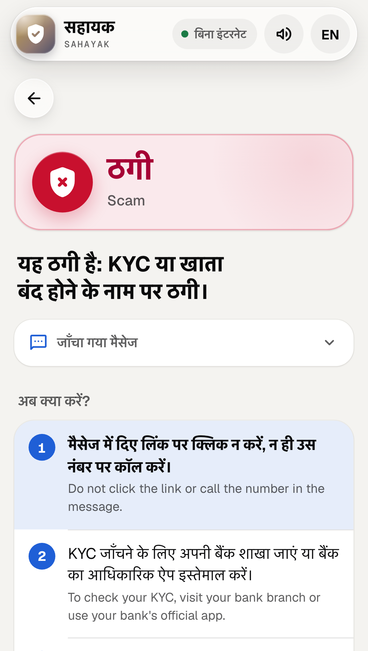
THE PROBLEM
Lost to fraud, and missing what they are owed
₹22,495
DEMO PERSONA · NOT A REAL PERSON
Aged 74, with a BPL ration card and a bank account
crore
An SMS arrives from 9876501234:
प्रिय ग्राहक, आपके SBI खाते का KYC खत्म हो गया है। तुरंत अपडेट करें, नहीं तो आज रात खाता बंद हो जाएगा। लिंक: http://sbi-kyc-update.xyz
lost to financial cyber fraud in 2025, across 24 lakh complaints
And is likely owed:
The Ayushman Vay Vandana card: hospital care up to ₹5 lakh a year, for you (shared with a spouse who is 70+).
Sahayak's answer to that SMS
Sources: MHA / I4C, Rajya Sabha, Feb 2026. Persona and SMS: jury kit cards P4 and M1, written by the team (not real messages); screenshot of the running app.
Notes:
One number: ₹22,495 crore lost to financial cyber fraud in 2025, across 24 lakh complaints. Then the demo persona, and say it is a demo persona: aged 74, a BPL card, a bank account. The SMS is a fake KYC message; Sahayak says Scam and names three reasons (a personal number, a lookalike link, the KYC threat). The same person is likely owed the Vay Vandana card: hospital care only, not OPD, shared with a spouse who is also 70+.

Slide 3
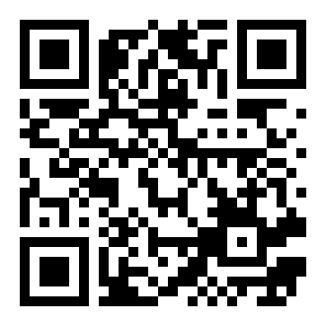
TRY IT NOW
Try it on your own phone, right now
Three things to try
Tap “Pay ₹500 for your Ayushman card”
1
Sahayak says Scam, and why: the card is free at the CSC.
Turn on airplane mode
2
Check another message: it still answers, on the phone itself.
Tap “What am I owed?”
3
Answer as someone aged 74: health cover comes first.
roshworldwide.github.io/optum-v2
No install, no account. Tap EN for English, or “Paste and check” a copied message.
Notes:
Stop talking and let them try; walk round with the demo phone for anyone whose phone will not load it, and never debug a judge's phone. The public site was rebuilt on 8 Oct with the node's packs and the redesigned app (fraud 1.7.0), "Could not check" included; before Delhi, open phone-packs/fraud.json on the site and check it matches the node page.

Slide 4
HOW IT WORKS, AND WHAT CHANGED SINCE ROUND 1
How it works, and why rules decide
Ask, at the counter or on the phone
ROUND 1 SAID
1
Paste, speak, photograph, describe a call, or scan a UPI QR. Nothing leaves the device.
A 14B language model, offline on the Crucible runtime, would decide, with a fine-tuned finance model.
Rules decide, offline
WE MEASURED A MODEL: QWEN2.5 3B, ZERO-SHOT
2
 | Scams caught | Genuine flagged | Per message
3B model | 99 of 103 | 21 of 34 | 2.13 s, GPU
Sahayak | 67 of 103 | 11 of 34 | 1.7 ms, CPU
Named signals, a pattern matcher and a small classifier, from signed packs: about 2 ms a check.
A clear answer, with reasons
The same 137 real published messages · first runs, 7 Oct
3
Scam, Suspicious, No scam signs (never “safe”) or Could not check; what to do; a complaint draft.
SO
Rules decide every verdict. A model may only reword the explanation, through a safety gate, and is off by default. Next, a second opinion that can only raise a warning, in languages Sahayak cannot read yet: there the model caught 14 of 15 scams.
The same answer on the phone
4
After one visit the phone runs the same engines offline: the node's exact answer on 1,841 of 1,841 test checks.
Sources: bench/results/llm_baseline.md (qwen2.5:3b zero-shot, dev Mac's Apple M3 GPU; Sahayak on its CPU), phone_parity.md; docs/APPLICATION_TO_PROTOTYPE.md
Notes:
Say it before they ask. Round 1 promised a 14B model on the Crucible runtime and a fine-tuned finance model; neither is in Sahayak, and Crucible has not been run with Sahayak. We measured a qwen2.5 3b model zero-shot on the same 137 real published messages: it caught more scams (99 of 103 against 67) but flagged 21 of 34 genuine messages (Sahayak 11), at 2.13 s a message on a GPU; a CSC laptop's CPU is slower. A warning that fires on that many genuine messages teaches people to ignore warnings. So rules decide, and every verdict names its reasons.

Slide 5
EVIDENCE: FIRST RUNS
Real messages are harder: it caught 7 in 10
REAL MESSAGES PEOPLE RECEIVED, AS PUBLISHED · FIRST RUN, 7 OCT
67 of 97
11 of 34
137 messages published by the Income Tax portal, PIB Fact Check, courts and fact-checkers; gathered by an AI agent that never saw the code.
Keyword blocklist: 62 of 97 caught, 17 of 34 flagged. Other languages: 6 of 6 scams “Could not check”, 0 green.
Fixes learned from one half only. The unread half: 31 of 44 caught (was 28), 6 of 20 flagged (was 6).
scams caught (69%)
genuine flagged (32%)
BLIND RED TEAM (7 OCT)
OUR OWN SET, FROZEN (2 OCT)
STRESS TEST RE-RUN (7 OCT)
92 of 103
34 of 37
0 errors
scams caught
scams caught · 95% CI 79–97%
30 phones, 300 checks at once
182 by an AI model that never saw the code; 14 of 59 genuine flagged.
Genuine flagged: 2 of 23. A 3B model: 36 of 37 caught, 7 of 23 flagged.
A 5,000-check soak. Hostile input: 360 cases, 0 unexpected.
Not yet: real users, and messages from people's own phones. Next: a field morning at a CSC.
Sources: bench/results/public_v0.md, redteam_v1_blind.md, scambench_v0_test.md, llm_baseline.md, stress_v0.md. First runs; later fixes are logged, not counted here.
Notes:
Lead with the real messages and say it plainly: on 137 messages people actually received, published by the Income Tax portal, PIB Fact Check, courts, banks and fact-checkers and scored once, Sahayak caught 67 of 97 scams and flagged 11 of 34 genuine messages. That is lower than on messages written for the test (92 of 103 blind, 34 of 37 on our own), and it is the honest number. Never quote 92% without saying it was on our own messages. What it missed on the real set: calls with no link or number yet (a "press zero" traffic-police call, a fake officer asking for money), stock-tip groups, long official-looking letters; false alarms: a bank maintenance notice, an ITR e-verify reminder, a prepaid-power bill. Blind set: the keyword blocklist caught 51; other languages got "Could not check", never a false green. Stress test: the first run found a speech queue, an empty-photo crash, an image bomb and unlimited uploads, all fixed before this run; on a slow phone (CPU 6x slower) the first visit took 6.4 s and a later offline check 0.88 s. Say the last line out loud.

Slide 6
HEALTH FIRST · IMPACT · WHO PAYS
Health first, counted every month, and who pays
Health first
Counted every month
Who pays
1.1 crore
of ~6 crore
Counts only: never names, numbers or messages.
₹39.23 lakh
Checks, and each verdict
Rupees at risk: the money a scam asks for, never called “saved”
People found eligible, by scheme
Cards made at the counter: the operator ticks each one
A signed monthly export for the district; counts under 5 hidden
One district, 20 villages, 50 counters, 6 months. Estimates, not quotes (round 1 said ₹35–40 lakh). Line items in the appendix.
seniors aged 70+ had their Ayushman Vay Vandana card by Feb 2026
For anyone 70+, results lead with it: hospital care up to ₹5 lakh a year, shared with a 70+ spouse; not OPD.
The CSC makes the card, free. The scam check flags “pay ₹500 for your card”.
At 500 counters: about ₹24,000 a counter a year. The operator's ₹9,600 is the biggest part.
After month six: bank, health agency, literacy-centre NGOs, card fees. Hypotheses, not commitments.
Pilot measures, not results yet.
Sources: MoHFW, Feb 2026; Cabinet, Sep 2024; NHA–CSC MoU, 2021; Ministry of Labour; budget: the team's line-item estimate, 7 Oct 2026 (appendix).
Notes:
Health first is in the product, not only on this slide: every benefits result for someone 70+ leads with the Vay Vandana card, hospital care only, not OPD. The CSC network is paid ₹20 per first-time card; the citizen pays nothing. The counts are what a pilot would report; none are results yet. Who pays in month seven: give the 30-second answer in the budget appendix (section 2). Nobody has agreed to pay; the payers are hypotheses to test; the coordinator and content upkeep have no payer yet. Say that before a judge finds it. RBI's compensation from 1 Jan 2027 covers credentials taken from the customer or payments under coercion, reported within 5 days; money a person sends willingly is not covered, so do not pitch fraud-loss savings to banks.

Slide 7
THE ASK, AND THE NEXT 30 DAYS
Our ask, and what we do next
Next 30 days
THE ASK
Introduce us to one district: a CSC or bank-agent network, or a district office, to host the field morning and then a 6-month pilot.
1
A field morning at a CSC
One morning, with consent: message cards before and after, the benefits interview, the operator's timing. Protocol, consent forms and scoring are ready.
2
Messages from people's own phones
Real scam and genuine messages, collected with consent, scored once on a frozen pack, every miss shown.
Roshan Raj
Manipal Institute of Technology · pitches
Ishmiit Singh
Co-builder of the prototype
[Who built what: team to fill in before 14 Oct]
3
A district partner
One district, with a CSC or bank-agent network and an NGO, for a 6-month pilot. Letter-of-intent templates are ready.
Try it
Sources: docs/field/ (field protocol, consent in Hindi and English, kit, scoring script, letter-of-intent templates).
Notes:
Close on the ask, then the opening line again: India opened 59 crore Jan Dhan accounts; Sahayak helps those account holders spot a scam before the money moves, and claim what they are owed. Before Delhi, replace the bracketed "who built what" line with what each of you built, and be ready for "Ishmiit, what did you build?".

