Slide 1
Latent Semantic Indexing
Adapted from Lectures by
Prabhaker Raghavan, Christopher Manning and Thomas Hoffmann
Prasad
L18LSI
Notes:
http://en.wikipedia.org/wiki/Singular_value_decomposition
http://www.uwlax.edu/faculty/will/svd/
http://irthoughts.wordpress.com/2007/05/01/irwatch-may-issue-demystifying-lsi/
http://www.miislita.com/information-retrieval-tutorial/svd-lsi-tutorial-1-understanding.html
http://www.miislita.com/information-retrieval-tutorial/svd-lsi-tutorial-2-computing-singular-values.html
http://www.miislita.com/information-retrieval-tutorial/svd-lsi-tutorial-3-full-svd.html
With examples:
www.cs.nmsu.edu/~mmartin/LSA_Intro_AI_Seminar.ppt

Slide 2
Today’s topic
Latent Semantic Indexing
  Term-document matrices are very large
  But the number of topics that people talk about is small (in some sense)
    Clothes, movies, politics, …
  Can we represent the term-document space by a lower dimensional latent space?
Prasad
L18LSI

Slide 3
Linear Algebra Background
Prasad
L18LSI

Slide 4

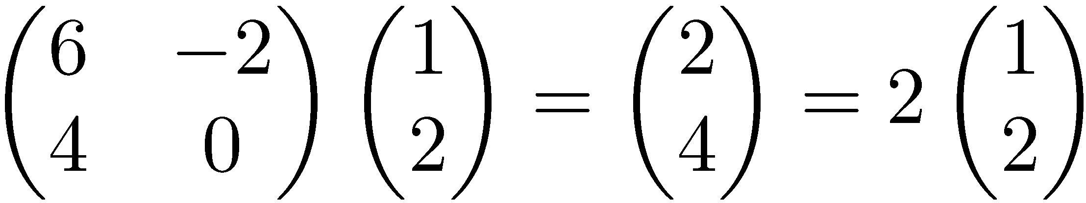
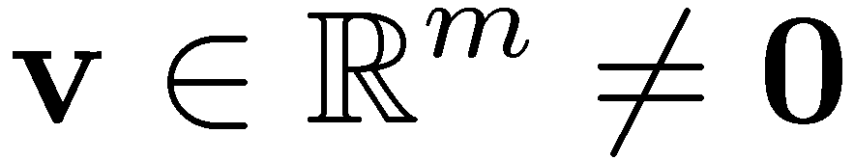

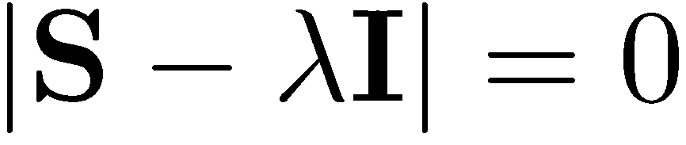
Eigenvalues & Eigenvectors
Eigenvectors (for a square m×m matrix S)
How many eigenvalues are there at most?
Example
(right) eigenvector
eigenvalue
only has a non-zero solution if
this is a m-th order equation in λ which can have at most m distinct solutions (roots of the characteristic polynomial) – can be complex even though S is real.
Notes:
|…| = determinant (Translation is also a linear transformation.)
A multiplication of a 2D vector with a 2x2 square matrix can be thought of
as a linear transformation of 2D coordinate points involving scaling and rotation.
Under 2D matrix multiplication, eigenvectors are “special” directions that are mapped
parallel to the original directions (that is, they do not suffer rotation). Instead they can
either get magnified or contracted (with eigenvalues serving as the scaling factor).

Slide 5
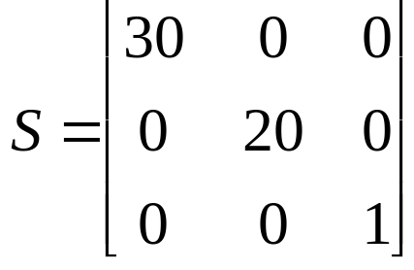
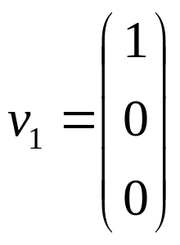
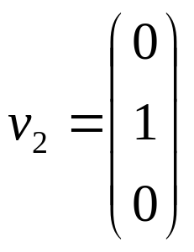
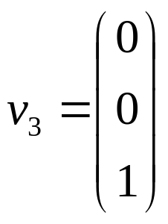

Matrix-vector multiplication
has eigenvalues 30, 20, 1 with
corresponding eigenvectors
On each eigenvector, S acts as a multiple of the identity
matrix: but as a different multiple on each.
Any vector (say x= ) can be viewed as a combination of
the eigenvectors: x = 2v₁ + 4v₂ + 6v₃

Slide 6
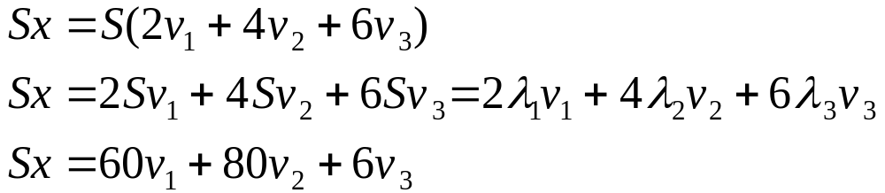
Matrix vector multiplication
Thus a matrix-vector multiplication such as Sx (S, x as in the previous slide) can be rewritten in terms of the eigenvalues/vectors:
Even though x is an arbitrary vector, the action of S on x is determined by the eigenvalues/vectors.
Prasad
L18LSI
Notes:
If x is described in a coordinate system involving the eigenvectors, the application of S is very straightforward to describe.
It just scales each coordinate using the eigenvalue.

Slide 7
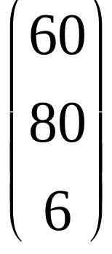
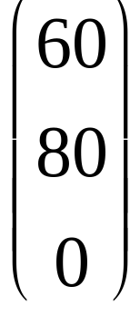
Matrix vector multiplication
Observation: the effect of “small” eigenvalues is small. If we ignored the smallest eigenvalue (1), then instead of
we would get
These vectors are similar (in terms of cosine similarity), or close (in terms of Euclidean distance).
Prasad
L18LSI

Slide 8
Eigenvalues & Eigenvectors
For symmetric matrices, eigenvectors for distinct
eigenvalues are orthogonal
  All eigenvalues of a real symmetric matrix are real.
All eigenvalues of a positive semi-definite matrix
are non-negative
Prasad
L18LSI
Notes:
Take a Linear Algebra course for concrete proofs!
Orthogonal = Perpendicular = Dot product 0

Slide 9
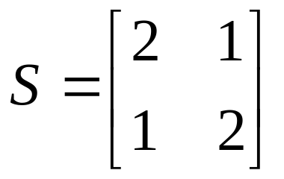
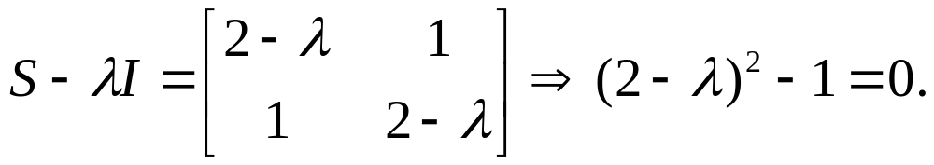
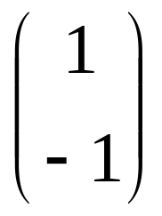
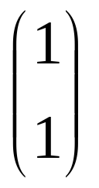
Example
Let
Then
The eigenvalues are 1 and 3 (nonnegative, real).
The eigenvectors are orthogonal (and real):
Real, symmetric.
Plug in these values and solve for eigenvectors.
Prasad
Notes:
2 – L= +- 1
[2 1] [x] = [Lx]
[1 2] [y] [Ly]
L = 3 => 2x + y = 3 x x + 2y = 3 y => x = y
Any vector in the direction of eigenvector will work!
L = 1 => 2x + y = x x + 2y = y => x = - y

Slide 10
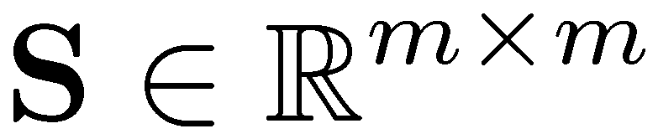
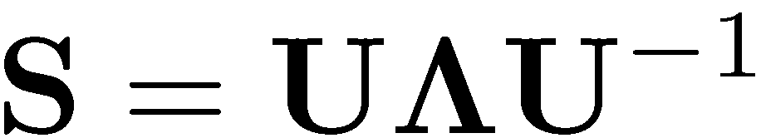


Eigen/diagonal Decomposition
Let be a square matrix with m linearly independent eigenvectors (a “non-defective” matrix)
Theorem: Exists an eigen decomposition
  (cf. matrix diagonalization theorem)
Columns of U are eigenvectors of S
Diagonal elements of are eigenvalues of
Unique for distinct eigen-values
diagonal
Prasad
L18LSI
Notes:
Linear transformation S can be expressed as a diagonal matrix when the points
are represented in the coordinate system of eigenvectors.
U^-1 maps a point from original coordinate system into the canonical coordinate system.
/\ applies the linear transformation via scalar multiplication.
U maps a point back from canonical coordinate system to the original coordinate system.
---------------------------------------------------------------------------------------------------------------
For identifying conic sections (ellipse, parabola, hyperbola, etc) or their 3D counterparts,
one can use the new coordinate system to obtain their tell-tale canonical representations
(lacking cross terms involving xy).
E.g., the canonical equation describing an ellipse is when the coordinate system is aligned
with the major and minor axis (and contains information about their lengths).
x^2 / a^2 + y^2/b^2 = 1

Slide 11
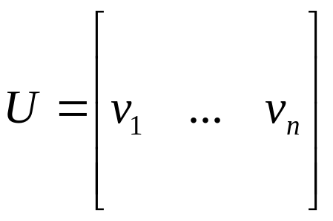
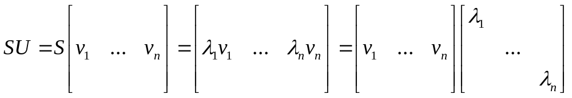
Diagonal decomposition: why/how
Let U have the eigenvectors as columns:
Then, SU can be written
Thus SU=UΛ, or U^{–1}SU=Λ
And S=UΛU^{–1}.
Prasad
Notes:
Recall:
U^-1 maps a point from original coordinate system into the canonical coordinate system.
/\ applies the linear transformation.
U maps a point back from canonical coordinate system to the original coordinate system.

Slide 12
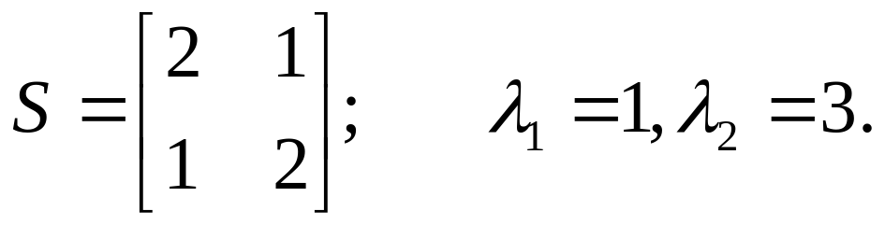
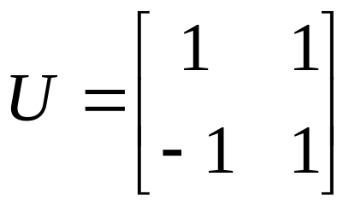
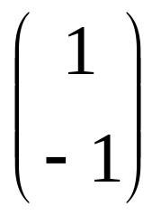
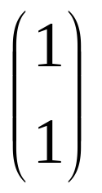
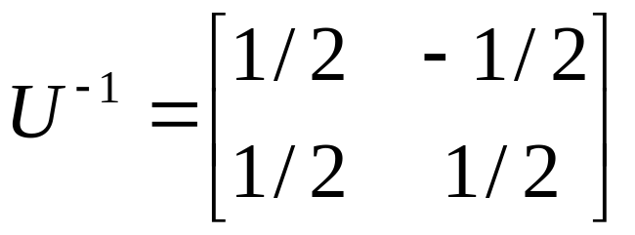
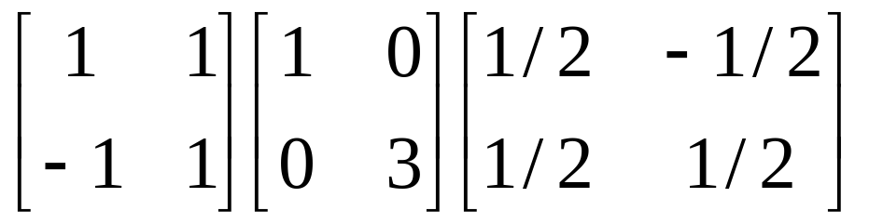
Diagonal decomposition - example
Recall
The eigenvectors and form
Recall
UU^{–1} =1.
Inverting, we have
Then, S=UΛU^{–1} =

Slide 13

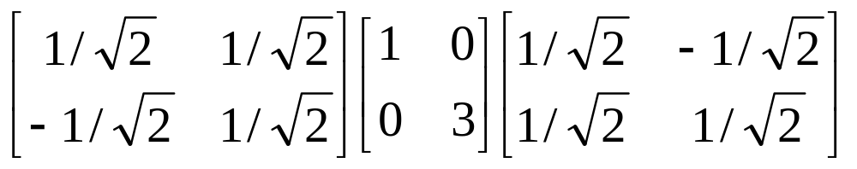
Example continued
Let’s divide U (and multiply U^{–1}) by
Then, S=
Q
Λ
(Q⁻¹= Q^{T} )
Why? Stay tuned …
Prasad
L18LSI

Slide 14
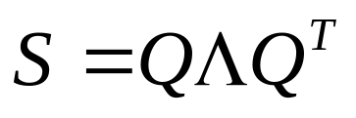
Symmetric Eigen Decomposition
If is a symmetric matrix:
Theorem: There exists a (unique) eigen decomposition
where Q is orthogonal:
  Q⁻¹= Q^{T}
  Columns of Q are normalized eigenvectors
  Columns are orthogonal.
  (everything is real)
Prasad
L18LSI
Notes:
Keep geometric interpretation in mind for visualization.
If U contains unit vectors, it is called an orthogonal matrix characterized by U^T = U^-1
S has a simplified representation in the coordinate system spanned by eigenvectors.
Application of S in ordinary coordinate system can be equivalently described
as mapping the points into coordinate system of eigenvectors by Q^T, scaling the point,
and mapping the points back via Q.

Slide 15
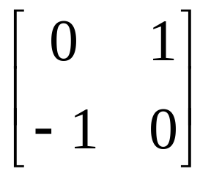
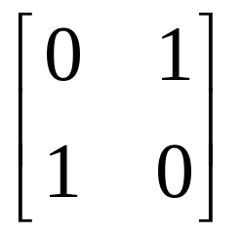
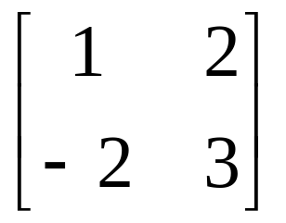
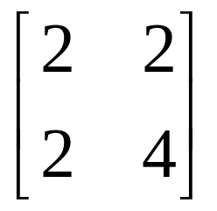
Exercise
Examine the symmetric eigen decomposition, if any, for each of the following matrices:
Prasad
L18LSI

Slide 16
Time out!
I came to this class to learn about text retrieval and mining, not have my linear algebra past dredged up again …
  But if you want to dredge, Strang’s Applied Mathematics is a good place to start.
What do these matrices have to do with text?
Recall M × N term-document matrices …
But everything so far needs square matrices – so …
Prasad
L18LSI

Slide 17
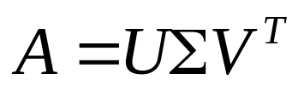
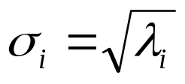
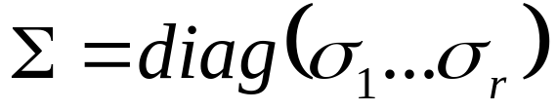
Singular Value Decomposition
For an M × N matrix A of rank r there exists a factorization
(Singular Value Decomposition = SVD) as follows:
M×M
M×N
V is N×N
The columns of U are orthogonal eigenvectors of AA^{T}.
The columns of V are orthogonal eigenvectors of A^{T}A.
Eigenvalues λ₁ … λ_{r} of AA^{T} are the eigenvalues of A^{T}A.
Prasad
Singular values.
Notes:
rank = number of linearly independent rows or columns A = term document matrix
A^T A = doc-doc correlation (aij proportional to how correlated doc i is to docj)
A A^T = term-term correlation (aij proportional to how correlated term i is to term j)

Slide 18
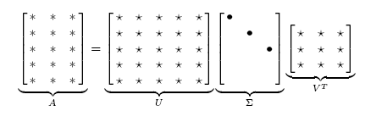
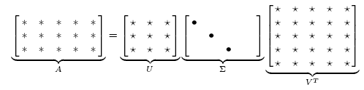
Singular Value Decomposition
Illustration of SVD dimensions and sparseness
Prasad
L18LSI

Slide 19
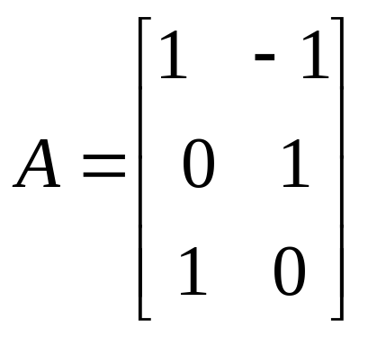
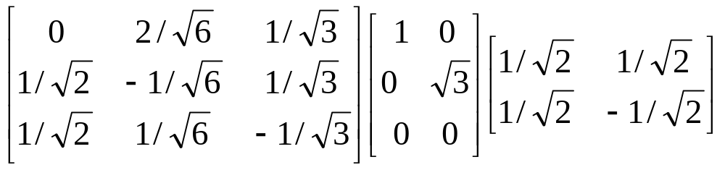
SVD example
Let
Thus M=3, N=2. Its SVD is
Typically, the singular values arranged in decreasing order.

Slide 20
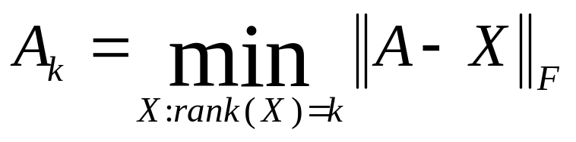

Low-rank Approximation
SVD can be used to compute optimal low-rank approximations.
Approximation problem: Find A_{k} of rank k such that
A_{k} and X are both m×n matrices.
Typically, want k << r.
Frobenius norm
Prasad
L18LSI
Notes:
Find closest (according to L2 norm) X of rank k approximating A of rank r.

Slide 21
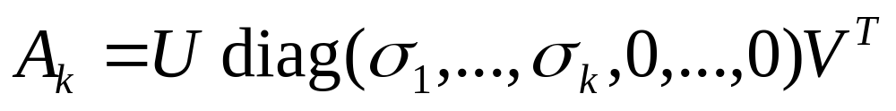
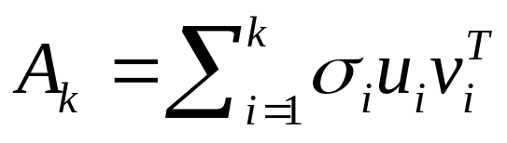
Low-rank Approximation
Solution via SVD
set smallest r-k
singular values to zero
k
column notation: sum
of rank 1 matrices
Notes:
In text retrieval application, lower rank approximation maps 10,000 term-space into 200-dimensional space.
Instead of transmitting 10K x 1M doc/bit matrix, we can obtain 10K x 200 + 200 + 200 x 1M data compression,
or abstraction to better reflect concepts. Terms, documents and queries mapped into 200-dim space and
distance/similarity compared/ranked gives better results.

Slide 22
Reduced SVD
If we retain only k singular values, and set the rest to 0, then we don’t need the matrix parts in red
Then Σ is k×k, U is M×k, V^{T} is k×N, and A_{k} is M×N
This is referred to as the reduced SVD
  It is the convenient (space-saving) and usual form for computational applications
k
Notes:
In text retrieval application, lower rank approximation maps 10,000 term-space into 200-dimensional space.
Instead of transmitting 10K x 1M doc/bit matrix, we can obtain 10K x 200 + 200 + 200 x 1M data compression,
or abstraction to better reflect concepts. Terms, documents and queries mapped into 200-dim space and
distance/similarity compared/ranked gives better results.

Slide 23
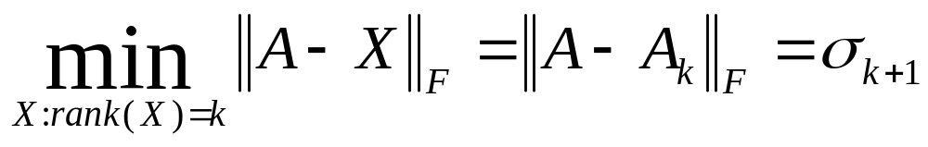
Approximation error
How good (bad) is this approximation?
It’s the best possible, measured by the Frobenius norm of the error:
where the σ_{i} are ordered such that σ_{i} ≥ σ_{i+1}.
  Suggests why Frobenius error drops as k increases.
Prasad
L18LSI

Slide 24
SVD Low-rank approximation
Whereas the term-doc matrix A may have M=50000, N=10 million (and rank close to 50000)
We can construct an approximation A₁₀₀ with rank 100.
  Of all rank 100 matrices, it would have the lowest Frobenius error.
Great … but why would we??
Answer: Latent Semantic Indexing
C. Eckart, G. Young, The approximation of a matrix by another of lower rank. Psychometrika, 1, 211-218, 1936.

Slide 25
Latent Semantic Indexing via the SVD
Prasad
L18LSI
Notes:
Scott C. Deerwester, Susan T. Dumais, Thomas K. Landauer, George W. Furnas, Richard A. Harshman: Indexing by Latent Semantic Analysis. JASIS 41(6): 391-407 (1990)
http://www.miislita.com/information-retrieval-tutorial/svd-lsi-tutorial-1-understanding.html

Slide 26
What it is
From term-doc matrix A, we compute the approximation A_{k.}
There is a row for each term and a column for each doc in A_{k}
Thus docs live in a space of k<<r dimensions
  These dimensions are not the original axes
But why?
Prasad
L18LSI
Notes:
Ak is an M x N matrix but of rank k (while A is an M x N matrix with rank r)

Slide 27
Vector Space Model: Pros
Automatic selection of index terms
Partial matching of queries and documents (dealing with the case where no document contains all search terms)
Ranking according to similarity score (dealing with large result sets)
Term weighting schemes (improves retrieval performance)
Various extensions
  Document clustering
  Relevance feedback (modifying query vector)
Geometric foundation
Prasad
L18LSI

Slide 28
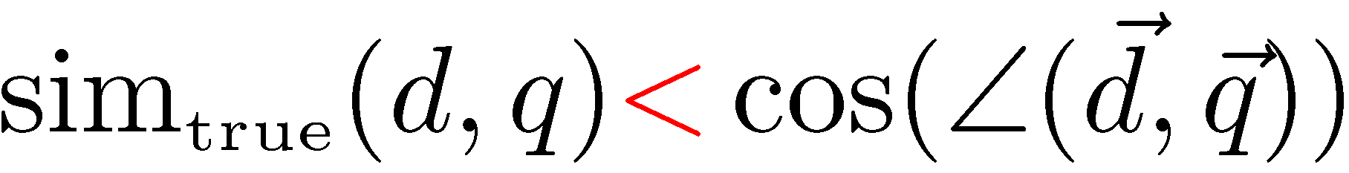
Problems with Lexical Semantics
Ambiguity and association in natural language
  Polysemy: Words often have a multitude of meanings and different types of usage (more severe in very heterogeneous collections).
  The vector space model is unable to discriminate between different meanings of the same word.
Prasad

Slide 29
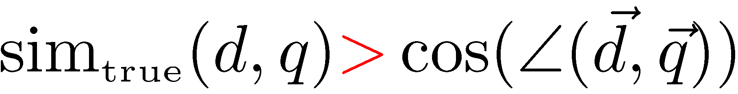
Problems with Lexical Semantics
  Synonymy: Different terms may have identical or similar meanings (weaker: words indicating the same topic).
  No associations between words are made in the vector space representation.
Prasad
L18LSI

Slide 30
Polysemy and Context
Document similarity on single word level: polysemy and context
ring
jupiter
•••
space
voyager
meaning 1
…
planet
...
…
saturn
...
meaning 2
car
company
•••
dodge
ford
contribution to similarity, if used in 1st meaning, but not if in 2nd
Prasad
L18LSI

Slide 31
Latent Semantic Indexing (LSI)
Perform a low-rank approximation of document-term matrix (typical rank 100-300)
General idea
  Map documents (and terms) to a low-dimensional representation.
  Design a mapping such that the low-dimensional space reflects semantic associations (latent semantic space).
  Compute document similarity based on the inner product in this latent semantic space
Prasad
L18LSI

Slide 32
Goals of LSI
Similar terms map to similar location in low dimensional space
Noise reduction by dimension reduction
Prasad
L18LSI
Notes:
Distance reduction among similar terms in the new space!
In text retrieval application, representing terms, documents and queries on reduced dimensional space
brings “semantically” related entities closer driven by other CORRELATED terms.
It is ROBUST wrt synonyms because they may appear in similar context, and
wrt polysymy because it picks up documents with the same context.

Slide 33
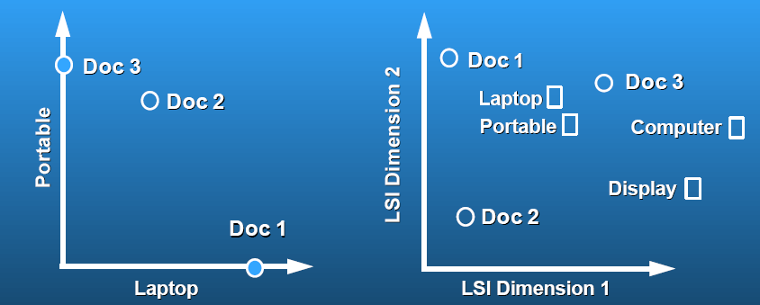
Latent Semantic Analysis
Latent semantic space: illustrating example
courtesy of Susan Dumais
Prasad
L18LSI
Notes:
Both terms and documents are represented as vectors in the latent semantic space

Slide 34
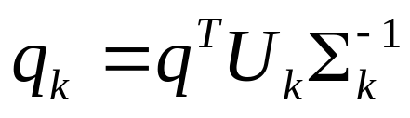
Performing the maps
Each row and column of A gets mapped into the k-dimensional LSI space, by the SVD.
Claim – this is not only the mapping with the best (Frobenius error) approximation to A, but in fact improves retrieval.
A query q is also mapped into this space, by
  Query NOT a sparse vector.
Prasad
L18LSI
Notes:
Measure distance of query vector to all the documents in LSS to rank them.

Slide 35
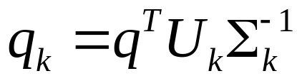
Performing the maps
Sec. 18.4
A^{T}A is the dot product of pairs of documents
A^{T}A ≈ A_{k}^{T}A_{k} = (U_{k}Σ_{k}V_{k}^{T})^{T} (U_{k}Σ_{k}V_{k}^{T})
= V_{k}Σ_{k}U_{k}^{T} U_{k}Σ_{k}V_{k}^{T}
= (V_{k}Σ_{k}) (V_{k}Σ_{k}) ^{T}
Since V_{k} = A_{k}^{T}U_{k}Σ_{k}⁻¹
we should transform query q to q_{k} as follows

Slide 36
Empirical evidence
Experiments on TREC 1/2/3 – Dumais
Lanczos SVD code (available on netlib) due to Berry used in these expts
  Running times of ~ one day on tens of thousands of docs [still an obstacle to use]
Dimensions – various values 250-350 reported. Reducing k improves recall.
  (Under 200 reported unsatisfactory)
Generally expect recall to improve – what about precision?
L18LSI

Slide 37
Empirical evidence
Precision at or above median TREC precision
  Top scorer on almost 20% of TREC topics
Slightly better on average than straight vector spaces
Effect of dimensionality:
Dimensions | Precision
250 | 0.367
300 | 0.371
346 | 0.374
Prasad
L18LSI

Slide 38
Failure modes
Negated phrases
  TREC topics sometimes negate certain query/terms phrases – automatic conversion of topics to
Boolean queries
  As usual, freetext/vector space syntax of LSI queries precludes (say) “Find any doc having to do with the following 5 companies”
See Dumais for more.

Slide 39
But why is this clustering?
We’ve talked about docs, queries, retrieval and precision here.
What does this have to do with clustering?
Intuition: Dimension reduction through LSI brings together “related” axes in the vector space.
Prasad
L18LSI

Slide 40
Intuition from block matrices
N documents
Block 1
What’s the rank of this matrix?
Block 2
0’s
M
terms
…
0’s
Block k
Prasad
= Homogeneous non-zero blocks.

Slide 41
Intuition from block matrices
N documents
Block 1
Block 2
0’s
M
terms
…
0’s
Block k
Vocabulary partitioned into k topics (clusters); each doc discusses only one topic.

Slide 42
Intuition from block matrices
Likely there’s a good rank-k
approximation to this matrix.
wiper
Block 1
tire
V6
Block 2
Few nonzero entries
…
Few nonzero entries
Block k
car
1
0
automobile
0
1
Notes:
What’s the best rank-k approximation to this matrix?

Slide 43
Simplistic picture
Topic 1
Topic 2
Prasad
Topic 3

Slide 44
Some wild extrapolation
The “dimensionality” of a corpus is the number of distinct topics represented in it.
More mathematical wild extrapolation:
  if A has a rank k approximation of low Frobenius error, then there are no more than k distinct topics in the corpus.
Prasad
L18LSI

Slide 45
LSI has many other applications
In many settings in pattern recognition and retrieval, we have a feature-object matrix.
  For text, the terms are features and the docs are objects.
  Could be opinions and users …
  This matrix may be redundant in dimensionality.
  Can work with low-rank approximation.
  If entries are missing (e.g., users’ opinions), can recover if dimensionality is low.
Powerful general analytical technique
  Close, principled analog to clustering methods.
Prasad

Slide 46
Hinrich Schütze and Christina Lioma
Latent Semantic Indexing

Slide 47
Overview
Latent semantic indexing
Dimensionality reduction
LSI in information retrieval

Slide 48
Outline
Latent semantic indexing
Dimensionality reduction
LSI in information retrieval

Slide 49
Recall: Term-document matrix
 | Anthony and Cleopatra | Julius Caesar | The Tempest | Hamlet | Othello | Macbeth
anthony | 5.25 | 3.18 | 0.0 | 0.0 | 0.0 | 0.35
brutus | 1.21 | 6.10 | 0.0 | 1.0 | 0.0 | 0.0
caesar | 8.59 | 2.54 | 0.0 | 1.51 | 0.25 | 0.0
calpurnia | 0.0 | 1.54 | 0.0 | 0.0 | 0.0 | 0.0
cleopatra | 2.85 | 0.0 | 0.0 | 0.0 | 0.0 | 0.0
mercy | 1.51 | 0.0 | 1.90 | 0.12 | 5.25 | 0.88
worser | 1.37 | 0.0 | 0.11 | 4.15 | 0.25 | 1.95
This matrix is the basis for computing the similarity between documents and queries. Today: Can we transform this matrix, so that we get a better measure of similarity between documents and queries? . . .

Slide 50
Latent semantic indexing: Overview
  We decompose the term-document matrix into a product of matrices.
  The particular decomposition we’ll use is: singular value decomposition (SVD).
  SVD: C = UΣV ^{T} (where C = term-document matrix)
  We will then use the SVD to compute a new, improved term-document matrix C′.
  We’ll get better similarity values out of C′ (compared to C).
  Using SVD for this purpose is called latent semantic indexing or LSI.

Slide 51
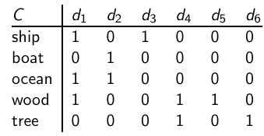
  Example of C = UΣV^{T} : The matrix C
This is a standard term-document matrix. Actually, we use a non-weighted matrix here to simplify the example.

Slide 52
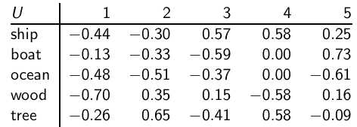
  Example of C = UΣV^{T} : The matrix U
One row per term, one column per min(M,N) where M is the number of terms and N is the number of documents. This is an orthonormal matrix:
(i) Row vectors have unit length. (ii) Any two distinct row vectors
are orthogonal to each other. Think of the dimensions (columns) as “semantic” dimensions that capture distinct topics like politics, sports, economics. Each number u_{ij} in the matrix indicates how strongly related term i is to the topic represented by semantic dimension j .

Slide 53
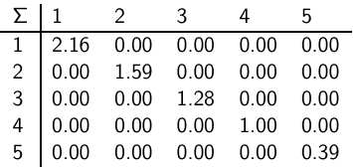
  Example of C = UΣV^{T} : The matrix Σ
This is a square, diagonal matrix of dimensionality min(M,N) × min(M,N). The diagonal consists of the singular values of C. The magnitude of the singular value measures the importance of the corresponding semantic dimension. We’ll make use of this by omitting unimportant dimensions.

Slide 54
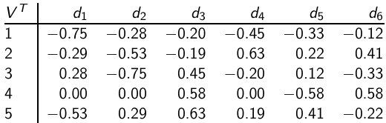
  Example of C = UΣV^{T} : The matrix V^{T}
One column per document, one row per min(M,N) where M is the number of terms and N is the number of documents. Again: This is an orthonormal matrix: (i) Column vectors have unit length. (ii) Any two distinct column vectors are orthogonal to each other. These are again the semantic dimensions from the term matrix U that capture distinct topics like politics, sports, economics. Each number v_{ij} in the matrix indicates how strongly related document i is to the topic represented by semantic dimension j .

Slide 55

  Example of C = UΣV^{T} : All four matrices

Slide 56
LSI: Summary
  We’ve decomposed the term-document matrix C into a product of three matrices.
  The term matrix U – consists of one (row) vector for each term
  The document matrix V^{T} – consists of one (column) vector for each document
  The singular value matrix Σ – diagonal matrix with singular values, reflecting importance of each dimension
  Next: Why are we doing this?

Slide 57
Outline
Latent semantic indexing
Dimensionality reduction
LSI in information retrieval

Slide 58
How we use the SVD in LSI
  Key property: Each singular value tells us how important its dimension is.
  By setting less important dimensions to zero, we keep the important information, but get rid of the “details”.
  These details may
    be noise – in that case, reduced LSI is a better representation because it is less noisy.
    make things dissimilar that should be similar – again reduced LSI is a better representation because it represents similarity better.

Slide 59
How we use the SVD in LSI
  Analogy for “fewer details is better”
    Image of a bright red flower
    Image of a black and white flower
    Omitting color makes is easier to see similarity

Slide 60

Recall unreduced decomposition C=UΣV^{T}

Slide 61

Reducing the dimensionality to 2

Slide 62

Reducing the dimensionality to 2
  Actually, we
  only zero out
  singular values
  in Σ. This has
  the effect of
  setting the
  corresponding
  dimensions in
  U and V ^{T} to
  zero when
  computing the
  product
  C = UΣV ^{T} .

Slide 63

Original matrix C vs. reduced C₂ = UΣ₂V^{T}
We can view
C₂ as a two-dimensional
representation
of the matrix.
We have
performed a
dimensionality
reduction to
two dimensions.

Slide 64
Why is the reduced matrix “better”
Similarity of d2 and d3 in the original space: 0.
Similarity of d2 und d3 in the reduced space:
0.52 * 0.28 + 0.36 * 0.16 + 0.72 * 0.36 + 0.12 * 0.20 + - 0.39 * - 0.08 ≈ 0.52
Notes:
Does similarity computation require sqrt(Sigma) (scaling by eigenvalues) correction?

Slide 65
Why the reduced matrix is “better”
“boat” and “ship” are semantically similar.
The “reduced” similarity measure reflects this.
What property of the SVD reduction is responsible for improved similarity?
Notes:
Existence of the connector “ocean‘‘

Slide 66
Outline
Latent semantic indexing
Dimensionality reduction
LSI in information retrieval

Slide 67
Why we use LSI in information retrieval
  LSI takes documents that are semantically similar (= talk about the same topics), . . .
  . . . but are not similar in the vector space (because they use different words) . . .
  . . . and re-represent them in a reduced vector space . .
  . . . in which they have higher similarity.
  Thus, LSI addresses the problems of synonymy and semantic relatedness.
  Standard vector space: Synonyms contribute nothing to document similarity.
  Desired effect of LSI: Synonyms contribute strongly to document similarity.
Notes:
My intuitive take: If we consider the geometric meaning of principal eigenvalue,
it tries to determine the resultant of the various columns (rows?) and picks the
direction that is strongest. Multiple related columns (rows?) will influence it more.
http://www.mathworks.com/help/techdoc/ref/eig.html
Compute eigenvalues and eigenvectors of a matrix whose rows are identical
e.g., ((1,2,3), (1,2,3),(1,2,2))
=================================================
>> B=[1 2 3
1 2 3
1 2 3]
B =
1 2 3
1 2 3
1 2 3
>> d = eig(B)
d =
6.0000
-0.0000
-0.0000
>> [V,D] = eig(B)
V =
0.5774 -0.2724 0.9003
0.5774 -0.7562 -0.4351
0.5774 0.5949 -0.0101
D =
6.0000 0 0
0 -0.0000 0
0 0 -0.0000
[V,D] = eig(A) produces matrices of eigenvalues (D) and eigenvectors (V) of matrix A, so that A*V = V*D. Matrix D is the canonical form of A — a diagonal matrix with A's eigenvalues on the main diagonal. Matrix V is the modal matrix — its columns are the eigenvectors of A.
[s 2*s 3*s] v = d v where s = [1 1 1]^T d principal eigenvalue and v is the principal eigenvector
s*v1 + 2*s*v2 + 3*s*v3 = d [v1 v2 v3]^T
6 * (0.577) * [1 1 1]^T = 6 * [0.577 0.577 0.577]^T

Slide 68
How LSI addresses synonymy and semantic relatedness
  The dimensionality reduction forces us to omit “details”.
  We have to map different words (= different dimensions of the full space) to the same dimension in the reduced space.
  The “cost” of mapping synonyms to the same dimension is much less than the cost of collapsing unrelated words.
  SVD selects the “least costly” mapping (see below).
  Thus, it will map synonyms to the same dimension.
  But, it will avoid doing that for unrelated words.

Slide 69
LSI: Comparison to other approaches
  Recap: Relevance feedback and query expansion are used to increase recall in IR – if query and documents have (in the extreme case) no terms in common.
  LSI increases recall and can hurt precision.
  Thus, it addresses the same problems as (pseudo) relevance feedback and query expansion . . .
  . . . and it has the same problems.

Slide 70


Implementation
  Compute SVD of term-document matrix
  Reduce the space and compute reduced document representations
  Map the query into the reduced space
  This follows from:
  Compute similarity of q₂ with all reduced documents in V₂.
  Output ranked list of documents as usual
  Exercise: What is the fundamental problem with this approach?

Slide 71

Optimality
  SVD is optimal in the following sense.
  Keeping the k largest singular values and setting all others to zero gives you the optimal approximation of the original matrix C. Eckart-Young theorem
  Optimal: no other matrix of the same rank (= with the same underlying dimensionality) approximates C better.
  Measure of approximation is Frobenius norm:
  So LSI uses the “best possible” matrix.
  Caveat: There is only a tenuous relationship between the Frobenius norm and cosine similarity between documents.

Slide 72
Example from Dumais et al
Prasad
L18LSI

Slide 73

Latent Semantic Indexing (LSI)

Slide 74

Prasad
L18LSI

Slide 75

Prasad
L18LSI

Slide 76

Reduced Model (K = 2)
Prasad
L18LSI

Slide 77


Prasad
L18LSI
Notes:
Terms => filled circles : Documents => open squares
q: Query: “human computer interaction”
Component terms that constitute a document are shown parenthetically.
The coordinates of the terms and documents are from the last slide.
SCALING QUESTION: Are the scaling for query matching vs doc-doc or term-term
similarity consistent?

Slide 78
LSI, SVD, & Eigenvectors
SVD decomposes:
  Term x Document matrix X as
    X=UΣV^{T}
      Where U,V left and right singular vector matrices, and
      Σ is a diagonal matrix of singular values
    Corresponds to eigenvector-eigenvalue decompostion: Y=VLV^{T}
      Where V is orthonormal and L is diagonal
    U: matrix of eigenvectors of Y=XX^{T}
    V: matrix of eigenvectors of Y=X^{T}X
    Σ : diagonal matrix L of eigenvalues

Slide 79

Computing Similarity in LSI

