Slide 1
DS202: Algorithmic Foundations of Big Data Biology
NEURAL DISTANCE EMBEDDINGS FOR BIOLOGICAL SEQUENCES
Manya Ganapathy
Shobhnik Kriplani
S.R. No. 23849
S.R. No. 23697

Slide 2
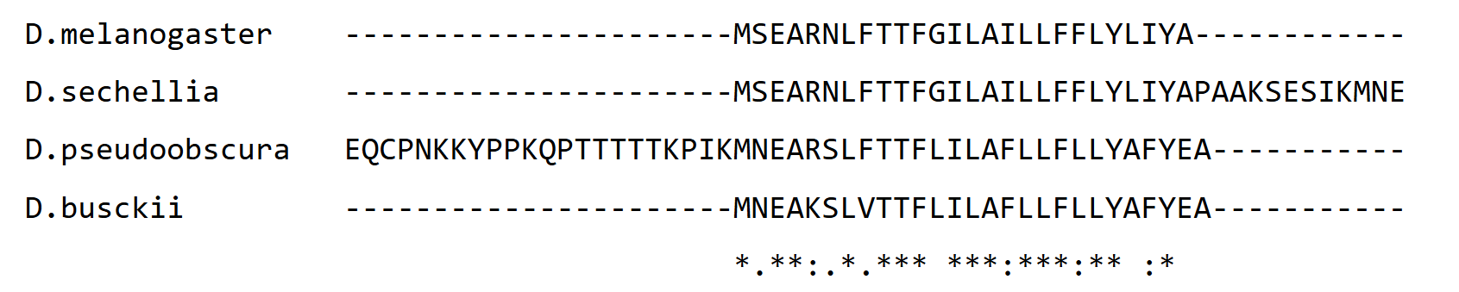
MOTIVATION
Biological significance of multiple sequence comparison
Deduction of evolutionary relationships
Identification of conserved motifs in DNA or protein sequences
Hierarchical Clustering
Multiple Sequence Alignment
Common structure
Common biological function
Sequences of a fragment of the protein Sarcolamban in different species of Drosophila
Chapter 14, Gusfield
Chapter 4, Applied Bioinformatics, Oregon State University
Notes:
Comparing multiple sequences of proteins or DNA allows for us to achieve two goals

Slide 3
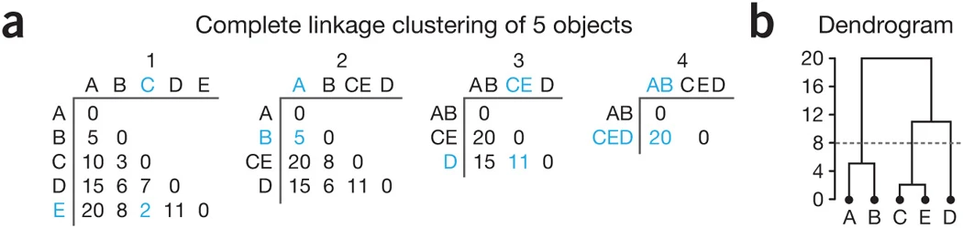
MOTIVATION
Hierarchical clustering (HC)
Agglomerative Algorithms
Identifies groups in a dataset by recursively clustering two items at a time
Its result can be visualised as a dendrogram
Partitioning Algorithms
Construct a distance matrix for all pairs of sequences
At each iteration
Join objects (sequences or clusters) having minimum distance between them
Update the distance matrix to include distances of all objects from the newly formed cluster
Dependence on distance between pairs of sequences
Lesson 5, Statistical Analysis of Genomic Data, Eberly College of Science
Altman, N., Krzywinski, M. Clustering. Nat Methods 14, 545–546 (2017)

Slide 4
MOTIVATION
Multiple Sequence Alignment (MSA)
Can be achieved by extending the dynamic programming algorithms for alignment of a pair of sequences to higher dimensions
Time complexity ⟶ O( L^{N} ) for N sequences of length L each
Certain commonly used heuristic progressive alignment methods (eg: ClustalW) achieve MSA by using a guide tree
Dependence on distance between pairs of sequences
Construct a distance matrix and a guide tree
Align nearest sequences
Align the next nearest sequence to the existing alignment
Chapter 6, An Introduction to Bioinformatics Algorithms, www.bioalgorithms.info
Chapter 4, Applied Bioinformatics, Oregon State University

Slide 5
MOTIVATION
Must be lower bound by the time complexity for computation of all pairwise distances, i.e. the distance matrix
Time Complexity of HC AND MSA
A Measure of Distance between Two Strings : Edit (Levenshtein) Distance
Definition: The edit distance between two strings is defined as the minimum number of edit operations - insertions, deletions, and substitutions - needed to transform the first string into the second
Alignment Based Methods
Alignment Free Methods
Eg: Needleman-Wunsch algorithm
Eg: k-mer
Chapter 11, Gusfield
Notes:
There are several ways to formalise distance, one simple way being that of edit distances

Slide 6
MOTIVATION
Alignment Based Methods : Dynamic Programming
For two strings S₁ and S₂ of lengths m and n respectively, D(i, j) is defined to be the edit distance of S₁ [ 1....i ] and S₂ [ 1....j ]
Base Conditions:
D(i,0) = i
D(0,j) = j
Recurrence Relation:
D(i, j) = min [D(i - 1, j) + 1, D(i, j - 1) + 1, D(i - 1, j - 1) + t(i, j)]
where,
t(i,j) = 0, if S₁ ( i ) = S₂ ( j )
t(i,j) = 1, if S₁ ( i ) ≠ S₂ ( j )
Bottom up computation of D(m,n) using a dynamic programming table
Time complexity ⟶ O(mn)
Chapter 11, Gusfield

Slide 7
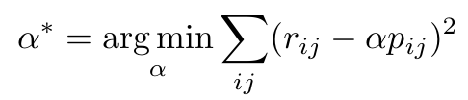


MOTIVATION
Alignment Free Methods : k-mer Method
For two strings S₁ and S₂ of length n
Consider all possible sequences of a fixed length k
4^{k} k-mers
For each sequence, construct a vector k-mer(S_{i}) with components corresponding to the number of occurences of each k-mer in the sequence
ED(S₁,S₂) ≈ nα d(k-mer(S₁),k-mer(S₂))
α learnable parameter with optimal value at α*
d(k-mer(S₁),k-mer(S₂)) is the distance between the k-mer vector representations of S₁ and S₂
The distance between the sequences is then approximated by some type of distance between the vectors
Time complexity ⟶ O(4^{k} . n)
Corso, G. Neural Distance Embeddings for Biological Sequences (2021)

Slide 8
MOTIVATION
Computing a Distance Matrix
For N strings of length M each
Total number of pairs = O(N²)
Computationally intractable for a large number of sequences
Time complexity for computing distance matrix:
Alignment based method ⟶ O(N² . M²)
Alignment free method ⟶ O(N² . 4^{K} . M)
Two major problems:
Alignment based method ⟶ computing exact edit distance is expensive
Alignment free method ⟶ accounts for the entire sequence space of high dimension

Slide 9
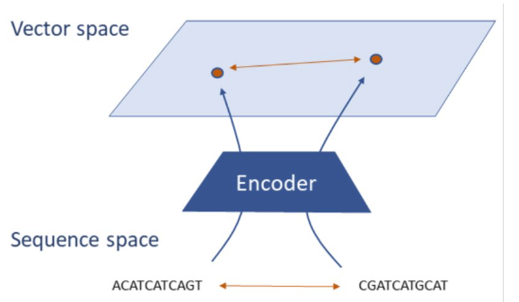
NeuroSEED​
Neural Distance Embeddings for Biological Sequences
NeuroSEED learns low-dimensional geometric embeddings of biological sequences so that distances in the embedding space directly approximate true evolutionary/phylogenetic distances.
INPUT
raw biological sequences (DNA/RNA/Protein)
OUTPUT
points in a geometric space
TRAINING
end-to-end with a distance-preserving loss​
Once trained, any new sequence can be embedded in milliseconds​
Corso, G. Neural Distance Embeddings for Biological Sequences (2021)

Slide 10
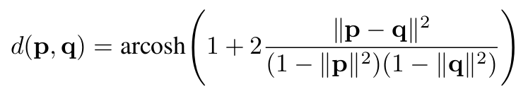
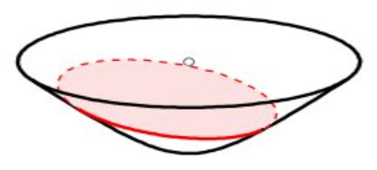
NeuroSEED​
Embedding Geometry: Where Do We Place the Sequences?​
The distance function d between the embedded points defines the geometry of the embedding space
The choice of geometry really affects how well distances between sequences are preserved
Euclidean​
Hyperbolic
Standard distance: ‖u − v‖₂ ​
Simple and widely used baseline ​
Works well for flat, uniform data ​
Struggles to represent hierarchical relationships
Distance grows rapidly near boundary
Naturally models exponential expansion ​
Captures hierarchical / tree-like relationships ​
Best fit for biological evolution and sequence data
Cosine ​
Formula: 1 − cos(θ) ​
Compares direction, not magnitude ​
Useful when embeddings are normalized ​
Ignores hierarchical depth differences ​
Hyperbolic space works best for biology’s tree-like evolution
Corso, G. Neural Distance Embeddings for Biological Sequences (2021)

Slide 11
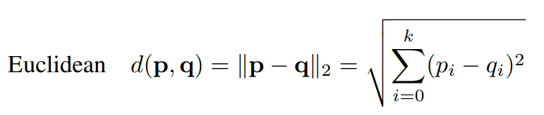
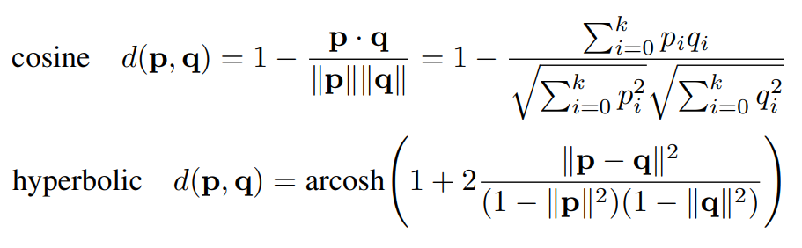
NeuroSEED​
Embedding Geometry: Where Do We Place the Sequences?​
The distance function d between the embedded points defines the geometry of the embedding space
The choice of geometry really affects how well distances between sequences are preserved
Euclidean​
Hyperbolic
Simple and widely used baseline ​
Works well for flat, uniform data ​
Struggles to represent hierarchical relationships
Distance grows rapidly near boundary
Naturally models exponential expansion ​
Captures hierarchical / tree-like relationships ​
Cosine ​
Compares direction, not magnitude ​
Useful when embeddings are normalized ​
Ignores hierarchical depth differences ​
Hyperbolic space works best for biology’s tree-like evolution
Corso, G. Neural Distance Embeddings for Biological Sequences (2021)

Slide 12
NeuroSEED​
Dataset Structure & Synthetic Data Generation
The significance of exploiting the low dimensional manifold that characterises real world biological data was demonstrated by training the model on two types of datasets
Real Biological Data ( 16SrRNA)​
Synthetic Data Generation
Load raw FASTA file of 16S rRNA sequences​
Clean & filter:​
Remove duplicates​
Remove sequences with length < 1200 bp​
Truncate / pad to fixed length 1500 bp​
Encode nucleotides (A/C/G/T/N → integers)​
Compute full pairwise Levenshtein distance matrix​
Split into train / validation / test sets​
Start with random independent base sequences​
Iteratively generate new sequences in each batch:​
Pick a random “parent” sequence​
Apply k random mutations (insert/delete/substitute)​
k sampled from 1 + Geometric distribution​
Compute full pairwise edit distance matrix per batch​
Generate thousands of independent batches.
Corso, G. Neural Distance Embeddings for Biological Sequences (2021)

Slide 13
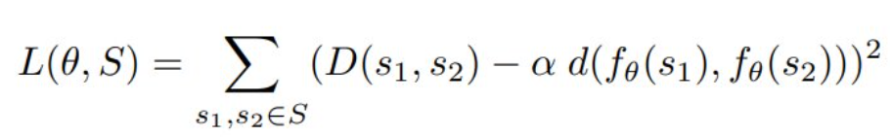
NeuroSEED​
Neural Encoders & Training Objective
Encoder model:
The encoder model f maps sequences to points in the embedding space. A variety of models were tested as encoder functions.​
θ
Linear​
Convolutional Neural Network ​
Transformer (Self-Attention)
Simplest baseline encoder ​
Direct mapping from sequence features ​
Fast and lightweight
Uses 1D convolutions along the sequence ​
Captures local patterns and motifs
Based on attention mechanisms ​
Models long-range dependencies across the entire sequence
All three encoders output a fixed-size vector that is then projected onto the chosen geometric space (Euclidean / Cosine / Hyperbolic).
Loss function:
The simplest way to train a NeuroSEED encoder is to directly minimise the mean square error (MSE) between the sequences’ ground truth distance and its approximation as the distance between the embeddings:​
Corso, G. Neural Distance Embeddings for Biological Sequences (2021)

Slide 14
NeuroSEED​
Training & Evaluation Pipeline
Once the encoder and geometry are chosen, NeuroSEED follows a simple end-to-end pipeline for training and fast inference.
Training Pipeline
Load Data:
Encoder:
Geometry Projection:
Real or synthetic sequences​
Maps each sequence to fixed-size vector (embedding)
Projects embeddings into chosen space​
Pairwise Geometric Distance:
Loss Computation:
Optimization:
Compute distances between all pairs in embedding space
MSE between true normalized edit distances and geometric distances
Backprop + Adam optimizer. Update encoder weights (Early stopping on validation loss)​
Corso, G. Neural Distance Embeddings for Biological Sequences (2021)

Slide 15
NeuroSEED​
Training & Evaluation Pipeline
Evaluation / Inference Pipeline
Embed New Sequences ​
Fast Approximate Distances
Pass any sequence through the trained encoder + geometry projection (milliseconds)​
Compute pairwise distances directly in embedding space (no alignments!)
Downstream Tasks
Steiner String Approximation
Closest-string retrieval
Hierarchical clustering / MSA guide-tree
Corso, G. Neural Distance Embeddings for Biological Sequences (2021)

Slide 16
NeuroSEED​
Run-Time Analysis
For N sequences of length M each
Classical Alignment based Algorithms: O(N².M²)
Fastest algorithm for computing distance matrix: O((N² . M²)/logM)
NeuroSEED Heuristics
Assuming constant embedding size and a model linear with respect to the sequence length
Time taken to embed a sequence in geometric space ⟶ O(M)
Time taken to embed N sequence in geometric space ⟶ O(NM)
Time taken to compute distances between two embeddings in geometric space ⟶ O(1)
Time taken to compute pairwise distances between all embeddings in geometric space ⟶ O(N²)
Total computational complexity ⟶ 0(NM+N²) = O(N(M+N))

Slide 17
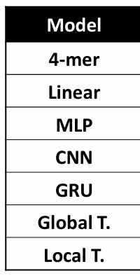
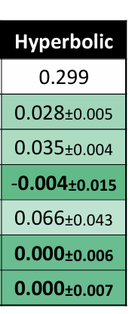
APPLICATIONS IN BIOINFORMATICS
Hierarchical Clustering
Agglomerative clustering can be run on approximate distance matrix constructed from NeuroSEED embeddings
Advantages
Time complexity to generate the pairwise distance matrix reduces from O((N²M²)/log M) to O(N(M +N))
Clustering itself may be accelerated by geometric optimisations such as locality sensitive hashing
Observations
On a set of 10K unseen sequences from the Qiita dataset, time taken to construct the tree is reduced from more than 30 minutes to less than one
% increase in Dasgupta’s cost compared to clustering on ground truth distance
Corso, G. Neural Distance Embeddings for Biological Sequences (2021)

Slide 18
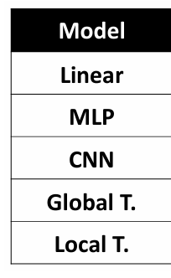
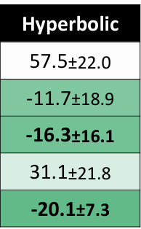
APPLICATIONS IN BIOINFORMATICS
Multiple Sequences Alignment
Guide tree construction can be done using the approximate distance matrix constructed from NeuroSEED embeddings followed by progressive alignment
Advantage
Time complexity to generate the pairwise distance matrix reduces from O((N² . M²)/log M) to O(N(M +N))
Observations
Improvement in alignment cost (lower the better) when using NeuroSEED heuristics over alignments obtained using ground truth distances
On a set of 1200 sequences from the RT988 dataset, alignment score obtained using NeuroSEED heuristics were not statistically different from those obatined using ground truth distances
Corso, G. Neural Distance Embeddings for Biological Sequences (2021)

Slide 19
APPLICATIONS IN BIOINFORMATICS
Finding the Steiner String
Definition: Given a set of strings S and another string S’ (need not belong to S) the consensus error of the string S’ relative to S is
E(S’) = Σ D(S’ , Si )
Si ϵ S
Definition: Given a set of strings S, an optimal Steiner string S* for S is a string that minimises E(S*) over all possible strings
Definition: Given a multiple alignment M of a set of strings S, the consensus character of column i of M is the character that minimizes the summed distance to it from all the characters in column i. Let d(i) denote that minimum sum in column i.
Definition: The consensus string S_{M} derived from alignment M is the concatenation of the consensus characters for each column of M
Chapter 14, Gusfield

Slide 20
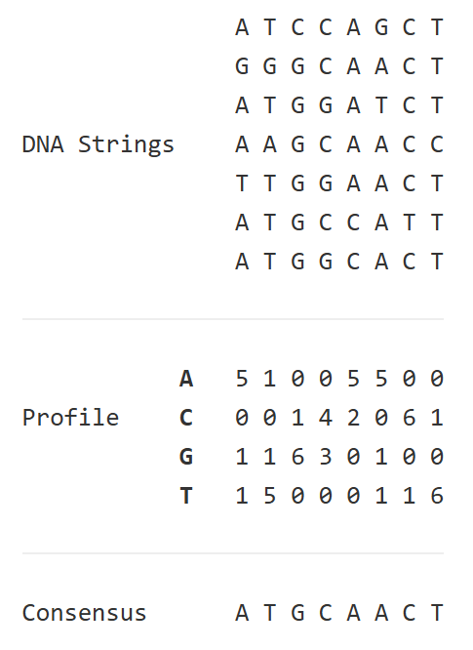
APPLICATIONS IN BIOINFORMATICS
Finding the Steiner String
For a scoring system that assigns a distance of 0 for matches and 1 for mistmatches, the consensus string is a concatenation of the most common character at each column of M
Relation between the Steiner String and the Consensus String
For a given set of sequences, a multiple alignment of the sequences (not unique!) may be represented by its consensus string S_{M}
The goodness of a multiple alignment can be measured by how well S_{M} behaves as a Steiner string for the set of sequences
Removal of gaps from an optimum consensus sequence (for an optimum MSA) results in the Steiner string
Chapter 14, Gusfield
Consensus String. Rosalind.info
Notes:
Consensus string may have gaps too!

Slide 21
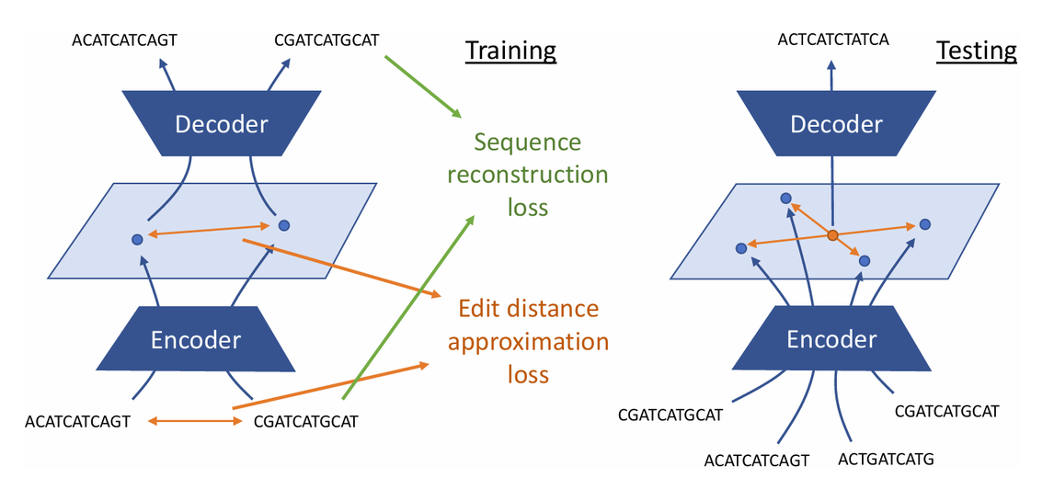
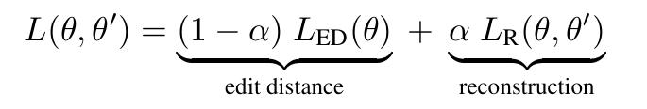

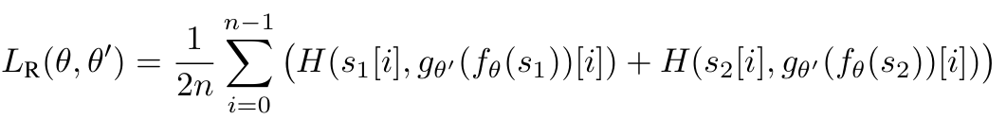
APPLICATIONS IN BIOINFORMATICS
Finding the Steiner String
A standard for goodness of an MSA
Employ NeuroSEED heuristics
An autoencoder may be trained to map sequences to a from a continuous space while preserving distance
An NP-complete problem
H(c, c’ )= c.log(1-c’) +(1-c).log(1-c’)
mean element-wise cross-entropy loss
Corso, G. Neural Distance Embeddings for Biological Sequences (2021)

Slide 22
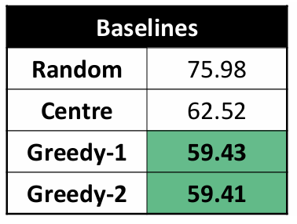
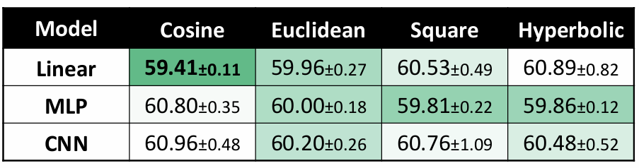
APPLICATIONS IN BIOINFORMATICS
Finding the Steiner String
Observations
The computational complexity for set S of N strings of size M is reduced from O(N²M²/logM) for the centre string and O(N²M) for previously devised greedy heuristics to O(NM) for the proposed method.
Encode
+
Determine Geometric mean
+
Decode
O(MN)
O(1)
O(MN)
Average consensus errors of obtained Steiner string
Centre string of a set S is a string belong to S that minimizes the consensus error relative to S
Corso, G. Neural Distance Embeddings for Biological Sequences (2021)

Slide 23
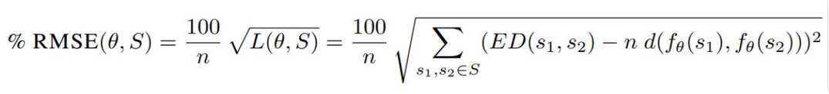
EXPERIMENT DETAILS: EDIT DISTANCE APPROXIMATION
Objective:
Reproduce the key results from the original NeuroSEED paper, with special emphasis on:
The importance of embedding geometry (Euclidean vs. Cosine vs. Hyperbolic)​
The advantage of learned (data-dependent) embeddings for fast and accurate distance approximation​
Datasets used:
Qiita, RT988 and Greengenes datasets of 16S rRNA subsequences.
Experimental Setup:
Test three encoder architectures: Linear, CNN, and Transformer​
Compare three embedding geometries: Euclidean, Cosine, and Hyperbolic​
Trained end-to-end using MSE loss on normalized edit distances​
Goal: Learn embeddings where geometric distance closely approximates true edit distance
Results
Reported as % RMSE (normalized Root Mean Squared Error) for easy comparison across datasets​

Slide 24
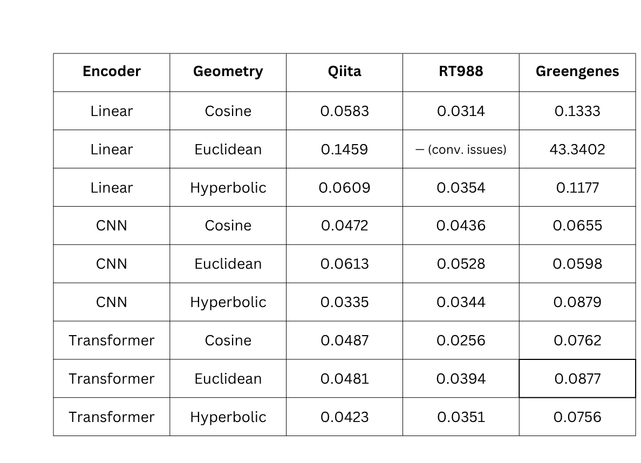
EXPERIMENT DETAILS: EDIT DISTANCE APPROXIMATION
Main Results: Real Biological Datasets​
OBSERVATION
Hyperbolic geometry consistently gives the lowest error, especially when paired with CNN or Transformer encoders.
MAPE for different geometries and encoders

Slide 25
EXPERIMENT DETAILS: EDIT DISTANCE APPROXIMATION
Results: Neural Embeddings vs. Data-Independent Baseline
Dataset​ | Best NeuroSEED (Learned)​ | Best k-mer​ | Improvement​
Qiita​ | CNN + Hyperbolic → 0.0335​ | k5 + Cosine → 0.1231​ | 3.7× better​
RT988​ | Transformer + Cosine → 0.0256​ | k4 + Cosine → 0.1150​ | 4.5× better​
Greengenes​ | Transformer + Hyperbolic → 0.0756​ | k2 + Hyperbolic → 0.3283​ | 4.3× better​
OBSERVATION
Hyperbolic Geometry almost wins on all real biological datasets​
Hyberbolic distances better preserve the hierarchical structure of evolutionary distances
CNN and Transformers outperform data-independent method (k-mer)​
Data-dependent neural embeddings are essential for accurate and scalable distance approximation on real biological data.​

Slide 26
EXPERIMENT DETAILS: EDIT DISTANCE APPROXIMATION
Main Results: Test MAPE on Synthetic Dataset
Method​ | Best Geometry​ | Test MAPE​
Linear​ | Cosine​ | 0.2284​
CNN​ | Cosine​ | 0.1359​
Transformer​ | Cosine​ | 0.1723​
k-mer baseline​ | Cosine (k=4)​ | 0.1370​
OBSERVATION
On synthetic data, the best k-mer baseline is almost as accurate as the best neural model (CNN + Cosine)
Depedence on real biological data and exploitation of the low dimensional manifold that characterises it is essential for the accuracy of NeuroSEED

Slide 27
EXPERIMENT DETAILS – CLOSEST STRING RETRIEVAL
Objective:
Given a query sequence R and a references set of sequences S, find the sequence in set S that is most similar to sequence R
Application:
Identify the culturable organism that is evolutionarily closest to an unculturable organism of interest
Dataset Structure:​
References (|S| = 10,000): Culturable 16S rRNA sequences (BioProject33175 + “culture collection”)​
Queries (|R| = 1,000): Unculturable 16S rRNA sequences (same BioProject but NOT “culture collection”)
All sequences cleaned, deduplicated, filtered (length ≥ 1200 bp),truncated/padded to fixed length 1500 bp​
Ground-truth closest reference computed using exact Levenshtein distance
Format: integer-encoded tensors (references, queries, and label indices)​
Models Tested:
Best encoders from edit-distance task: CNN and Transformer (with Euclidean / Cosine / Hyperbolic geometries)​
Strong baseline: k-mer frequency vectors (k=6) + same distance functions
Evaluation Metric: Top-k Recall (fraction of queries where the true closest reference appears in the top-k retrieved results)​

Slide 28
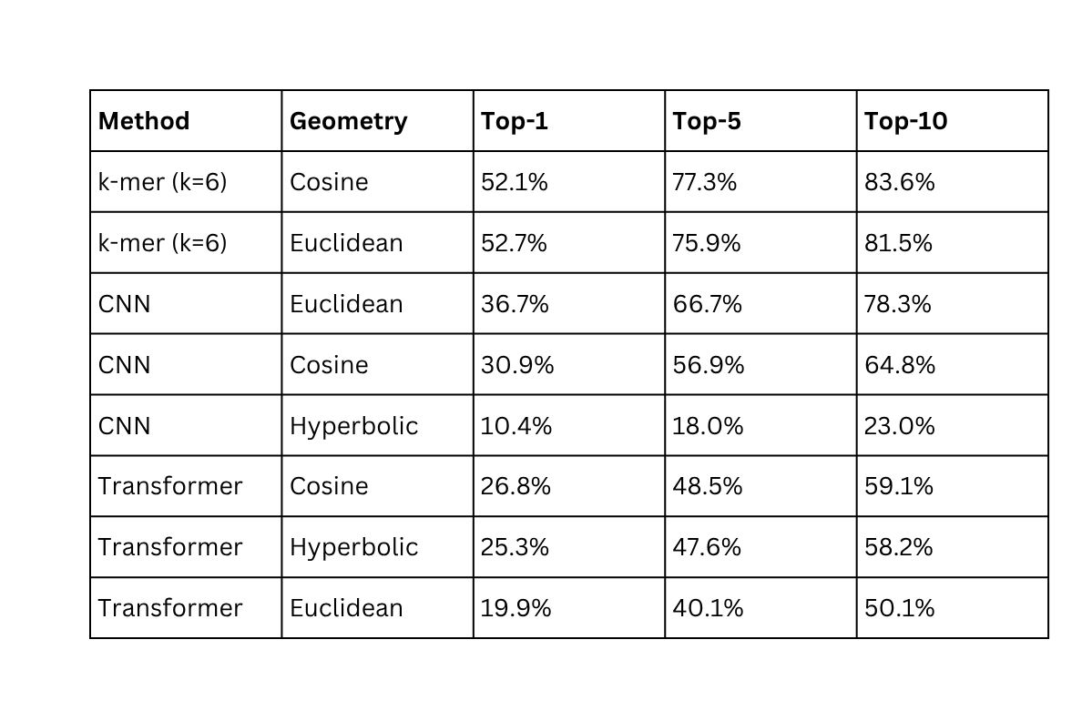
EXPERIMENT DETAILS – CLOSEST STRING RETRIEVAL
Results
OBSERVATION
k-mers are observed to be more accurate at closest string retrieval
This could be because sequences in the datasets used for training come from different hypervariable regions of the 16S rDNA.
This may have arisen as no hyperparameter tuning was done
Top-k Recall percentages for different geometries and encoders

Slide 29
LIMITATIONS
Dependence on Type of Sequences:
Sequences reads must belong to the same part of the genome.
Use of sequences from random parts of the genome is likely to generate embeddings on a low dimensional manifold where the hierarchical relationship of evolution is combined with the relationship based on the specific position in the whole genome. This may have resulted in the observed lower accuracy of closest string retrieval using embedding in our experiment.
This may require geometric spaces that better reflect these relations (eg: product spaces)
Dependence on Architecture:
Models used have been shown to work well for other types of sequences and tasks
Correct inductive biases that models should have to perform SEED are likely to be different to the ones used for other tasks and even dependent on the type of distance it tries to preserve

Slide 30
LIMITATIONS
Thank You!

