Slide 1
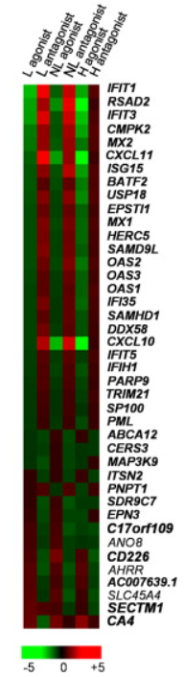
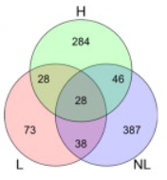
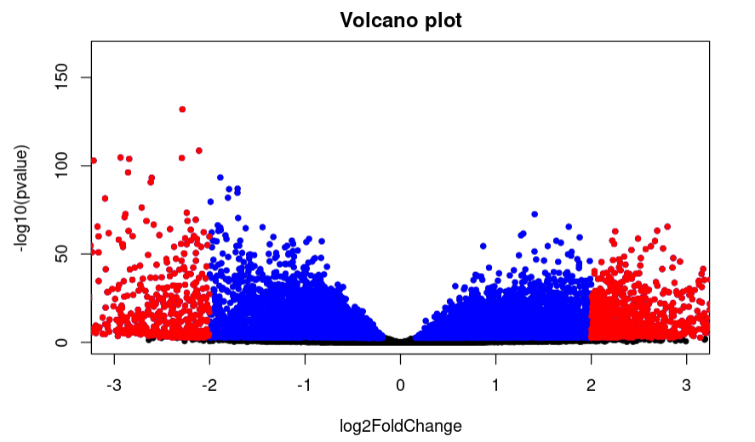

Environmental factors transmitted by aryl hydrocarbon receptor influence severity of psoriatic skin inflammation [RNA-Seq]
Introduction Environmental stimuli are known to contribute to psoriasis pathogenesis and that of other autoimmune diseases, but the mechanism is unknown. To find out, Analysis was performed on measurements of gene expression data relating to skin deceases affected by enviornmental factors. RNA was obtained from skin explants taken from psoriatic patients and healthy donors cultured in the presence of AhR agonist (FICZ) or antagonist (CH-223191) to see whether or not ryl hydrocarbon receptor (AhR), a transcription factor that senses environmental stimuli, modulates pathology in psoriasis. With this project there was an attempt to remake the results as closely as possible with the present dataset.
Materials and Methods
The dataset of 37.166 samples is split into skin biopsies obtained of lesion (L) and unaffected non-lesional (NL) skin from 8 psoriatic patients who had no systemic treatment and from 4 healthy subjects (N) serving as controls. In total, these are 84 samples. These sample data has then been normalized. The p-value theshold was set to <0.5 and the FC threshold of -5 ~ 5. FC value was calculated using the log2. There were a total amount of 28.985 samples removed after cleaning the dataset. Packages used were the bioconductor package with DESeq2 for plotting the figures.
Results
A: volcanoplot showing the log2FC over p-values.
B: Vemm diagram showing genes significantly regulated by either agonist or antagonist in at least one out of the three tissue types analyzed (L, NL, H)
C: Heat map of genes belonging to the “psoriasis transcriptome” (upregulated genes shown in bold) and modulated by agonist or antagonist. Genes are sorted by decreasing fold change for agonist effect on L skin.
Conclusion
DEG’s cannot be located from the volcano plot as there are no lables attached. The venn diagram shows that genes are related to antagonist in at least one of the three tissue types. However these figures alone are not enought to prove wether AhR has a role in modulating pathology in psoriasis. More time for research is needed on this subject.
Paper: https://pubmed.ncbi.nlm.nih.gov/24909886/
Isabella hofstede
Klas BFV2
i.s.hofstede@st.hanze.nl

