Slide 1

PHP
Ilona Shparii
Chingari Patel

Slide 2
Background
Invented by Rasmus Lerdorf in 1994
The very first version of PHP was a simple set of Common Gateway Interface (CGI) binaries written in C programming language.
The latest stable release is PHP 7.0.3 which was released on February 6th 2016

Slide 3
Introduction
Paradigm: Imperative, functional, object-oriented, procedural, reflective
Typing discipline: Dynamic, weak
Implementation language: C (primarily; some components C++)
OS: Unix-like, Windows
PHP- Hypertext Preprocessor
Server-side scripting language
Used for web development
Open- source
Multi-platform

Slide 4
Basic PHP syntax rules
PHP files can contain HTML, CSS, JavaScript and Php code
PHP script can be placed anywhere in the document.
It starts with <?php and ends with ?>
It is loosely typed language; it automatically converts the variable to the correct data type, depending on its value.
In PHP, all the keywords, classes, functions and user-defined functions are NOT case-sensitive

Slide 5
Code Sample
<!DOCTYPE html> <html> <body> <h1>PHP Presentation</h1> <?php echo "Hello Class!"; ?> </body> </html>
PHP Presentation
Hello class!

Slide 6
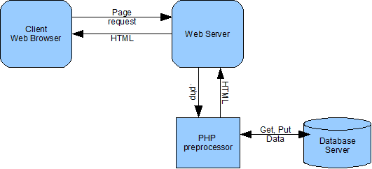
How PHP works

Slide 7
Companies that uses PHP
Facebook.com
Baidu.com
Wikipedia.org
Qq.com
Twitter.com
Taobao.com
Sina.com.cn
Vk.com
Pinterest.com
Wordpress.com
According to w3.techs.com

Slide 8
Frameworks written in PHP
RAD- Rapid Application Development
Content Management System
Zend Framework
Symphony 2
Laravel
Nette Framework
Yii2
CakePHP
Joomla
Wordpress
Drupal
SilverStripe
Magento
Moodle

Slide 9
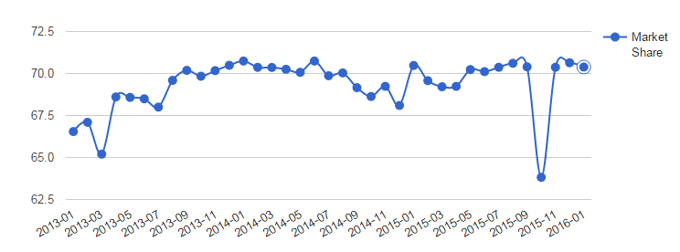
PHP Usage Trends and Statistics
W3Cook.com: The above chart shows the usage trends and statistics of PHP for the past year in the category of PROGRAMMINGLANGUAGE.The usage of PHP has decreased by -0.36% in the past two months.

Slide 10
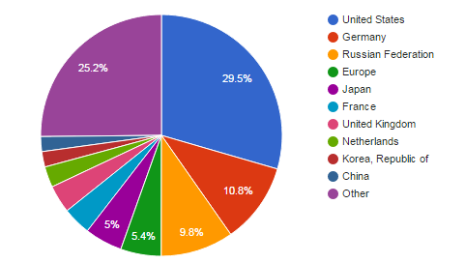
PHP Countries Distribution
W3Cook.com: The top two countries that use PHP are United States and Germany.

Slide 11
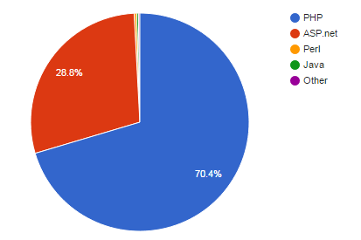
Programming Languages Market Share
W3Cook.com: The above table and chart show the usage statistics and market share and usage trends of server side programming languages. A server side programming language allows you to dynamically generate HTML when the page is loaded based on the parameters passed to it. They allow you to create powerful web applications by blending HTML code and software code in a single file. PHP is the most popular programming language used by more than half of the websites. Microsoft's ASP.net is the next very popular language. Perl, Java, Ruby, Python and Cold Fusion are used by a small set of websites.

Slide 12
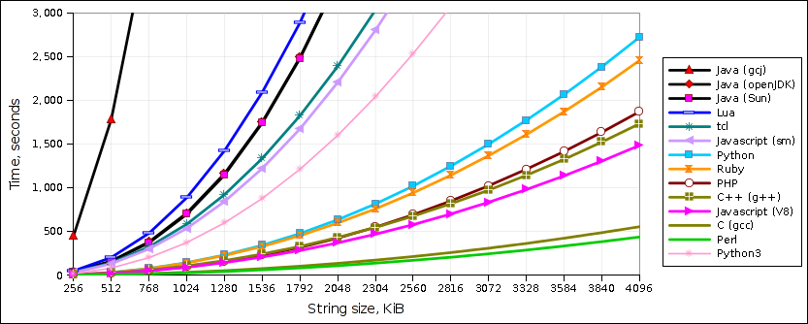
Time Performance Comparison
Speed tests fall into 4 categories:
Slowest: Java gcj (native executable)
Slow: Java (openJDK); Java (Sun); Lua
Not-so-fast: tcl; Javascript (spidermonkey)
Fastest: Python; Ruby; PHP; C++; Javascript V8; C; Perl5
raid6.com.au

Slide 13
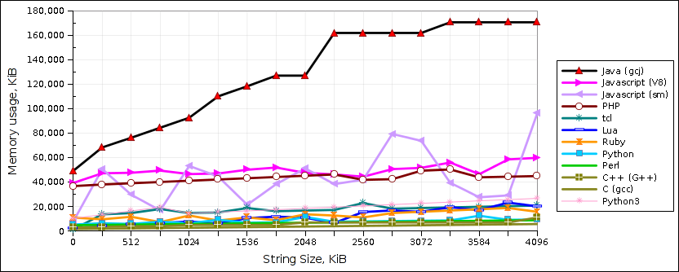
Memory Usage Comparison
Results fall into 5 categories:
Highest: Java OpenJDK, Java Sun
High:Java GCJ
Medium:Javascript V8, Javascript sm., PHP
Low:tcl, Lua, Ruby
Lowest: Python, Perl5, C++, C
raid6.com.au

Slide 14
Pros and Cons
Flexible programming language
Highly effective at accessing various database types
Perfect for web-based scripts
Not suitable for making desktop applications
Loosely typed language
Poor at error handling

Slide 15
Conclusion
PHP is a widely used, general-purpose scripting language that was originally designed for web development to produce dynamic web pages. It can also be used for command-line scripting and client-side GUI applications. PHP can be deployed on most web servers, many operating systems and platforms, and can be used with many relational database management systems. It is free of charge. PHP supports the imperative, procedural, object oriented, and the reflective programming paradigms.

Slide 16
Demo of PHP form

