Slide 1

OHA
Product description:
Home automation enabled by programmable sequences of notes played by a flute.

Slide 2
Key Features
Gain control on MIC
Programmable songs
Intuitive Display
RTOS to manage multiple threads can add more devices
Adjustable analog filter

Slide 3
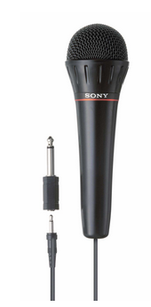
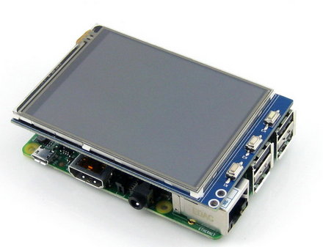
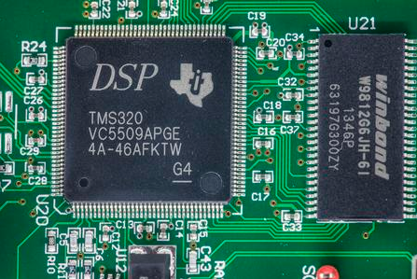
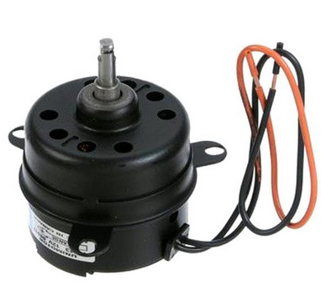
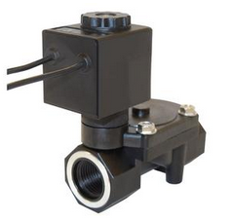
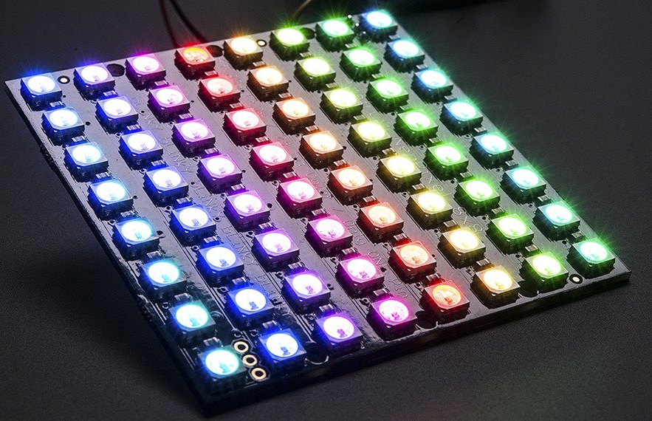
Product depiction

Slide 4
Hardware High Level
Microphone, TMS320F28335 TI DSP, Environmental temperature sensors, pressure sensors, LED arrays, Water pump, Fans, Wireless communications, LCD

Slide 5
Hardware low-level
ADC (TI ADS 8320) high MSPS low power maybe trade off power for higher Sampling rate
OPA134 opamp low noise for preamp
DSP chip with FFT accelerator
TL072 for a bandpass filter and an anti aliasing filter

Slide 6
Software High-level

Slide 7
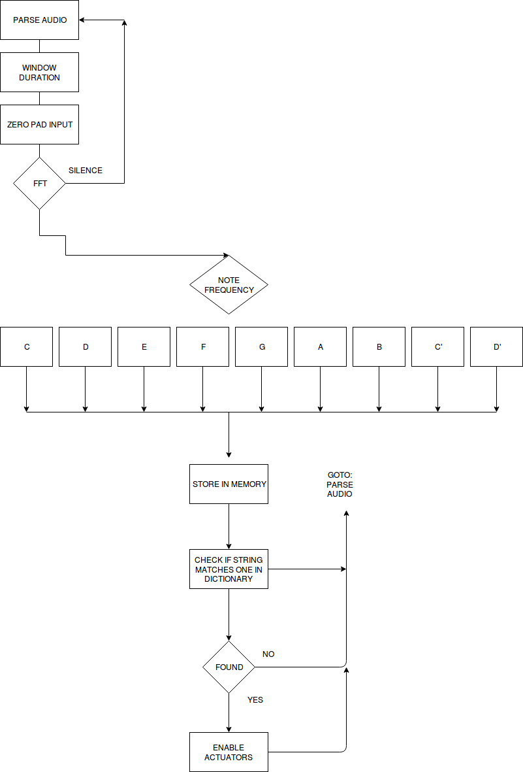
Software high-level

Slide 8
MATLAB PROTOTYPING
function freq = welch(x,N,fs)
% Choose FFT size and calculate spectrum
[Pxx,f] = pwelch(x,gausswin(N),N/2,N,fs);
% Plot frequency spectrum
plot(f,Pxx);
ylabel('PSD'); xlabel('Frequency (Hz)');
grid on;
% Get frequency estimate (spectral peak)
[~,loc] = max(Pxx);
freq = f(loc)
title(['Frequency estimate = ',num2str(freq),' Hz']);
>> [x,Fs] = audioread('ocarina_low_frequency.mp3');
>> Nsamps = 226303;
>> fsamp = 44100;
>> Tsamp = 1/fsamp;
>> t = (0:Nsamps-1)*Tsamp;
>> Nfft = 1024;
>> plot(t,x);
>> X = fft(x);
>> X = X(1:length(x)/2+1);
>> freq = 0:fsamp/length(x):fsamp/2;
>> plot(fsamp,abs(X))
% I ran welch function to verify findings as it is MATLAB’s best audio detection algorithm

Slide 9
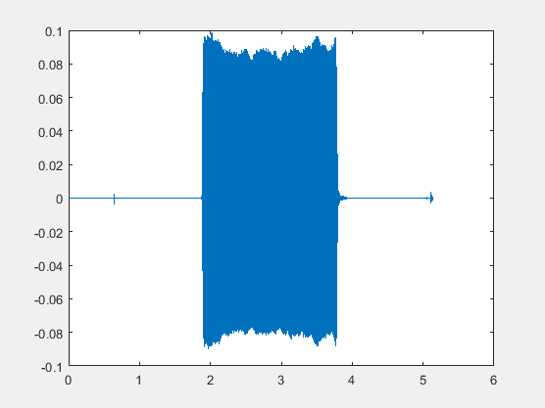
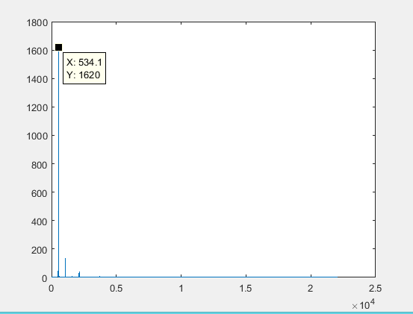
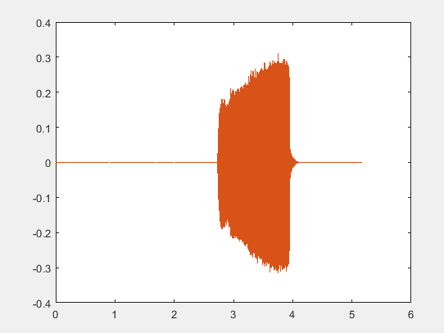
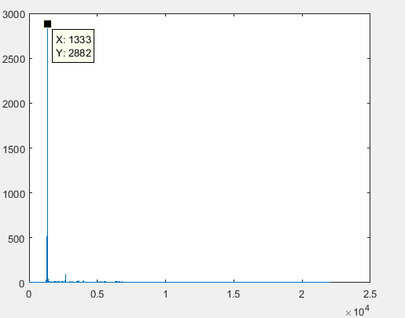
Figure 1: lowest reproducible note (C)
Figure 2: 512 point FFT frequency approximation of waveform
Figure 3: highest reproducible note (F’)
Figure 4: 512 point FFT frequency approximation of waveform

Slide 10
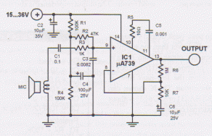
ANALOG CIRCUITS
RC low-pass set by R3 and C4:

Slide 11
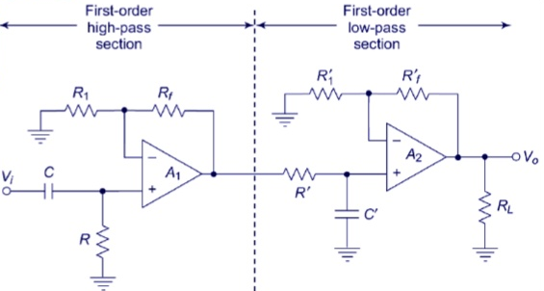
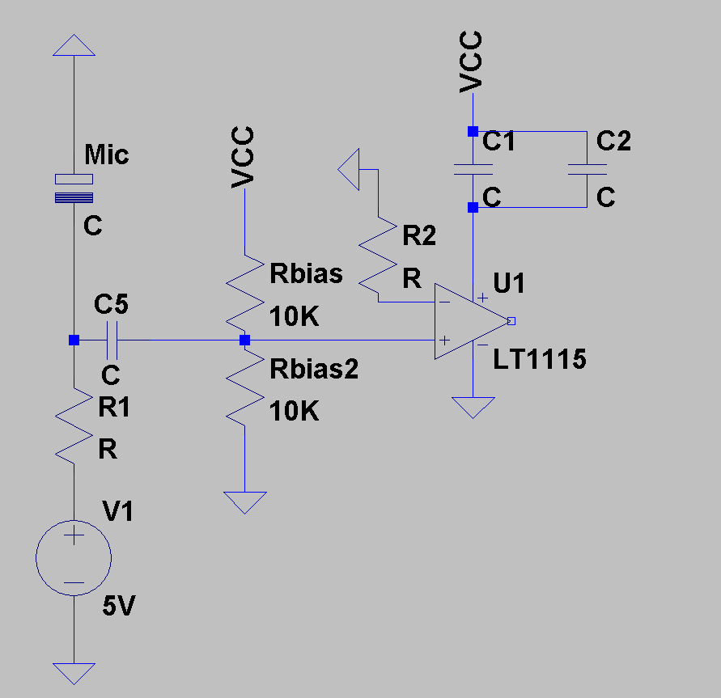
Preamplifier and Filter

Slide 12
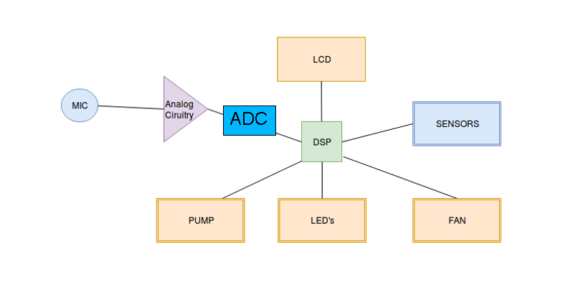
μP CONNECTIONS

Slide 13
BLOCK DIAGRAMS

Slide 14
Stretch Goals
Wi-fi module for the control unit
User-programmable sequences
Addition of one more motor?

Slide 15
TASKS DIVIDED
Gant-chart:

