Slide 1
Person Evaluation With Social Mining
Project Supervisor: Prof. Dr. K.M. Azharul Hasan
Developed By: Ishrak Islam Zarif (1307025)
Mahmudul Hasan (1307049)
Notes:
Good Morning Everyone. Assalawalikum..Our Project is about Person Evaluation with social mining. Our Project Supervisor is Prof…. And This Project is developed by me Mahmudul hasan and my partner ….

Slide 2
LAYOUTS
Our project layouts are:
Objectives
About Sentiment Analysis
Project overview
Required platform and tools
Limitations
Future plan
Notes:
In this project presentation we will go through these topics…..

Slide 3
Objectives
The Main objective of our project is to find out sentiment from Gmail.
Our project basically works on Gmail.
To be familiarize with Python, Machine Learning and Natural Language Processing.
Also to be familiarize with Data science and Data Visualization.

Slide 4
ABOUT SENTIMENT ANALYSIS
Sentiment analysis (also known as opinion mining) refers to the use of natural language processing, text analysis and computational linguistics to identify and extract subjective information in source materials. Sentiment analysis is widely applied to reviews and social media for a variety of applications, ranging from marketing to customer service.
Generally speaking, sentiment analysis aims to determine the attitude of a speaker or a writer with respect to some topic or the overall contextual polarity of a document. The attitude may be his or her judgment or evaluation, affective state (that is to say, the emotional state of the author when writing), or the intended emotional communication (that is to say, the emotional effect the author wishes to have on the reader).
Notes:
Now you might ask what is sentiment analysis?

Slide 5
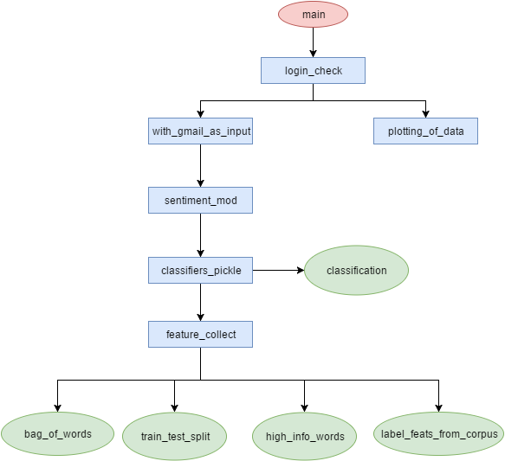
PROJECT WORKFLOW
Notes:
Take a look at our project workflow….
Our main function calls login_check module which uses two threads with_gmail_as_input and plotting_of_data.
With_gmail_as_input uses sentimod_mod module which finds out the sentiment value of gmail
Sentiment_mod module calls classifiers_pickle
Classifiers_pickle contains classifiers and saves the result model for faster computation.
Classifiers_pickle calls two functions classification class and feature_collect
And lastly feature_collect module provides bag…………………………... Functionalities.

Slide 6
UNDER THE HOOD
1
Data Preprocessing and making training and test sets
2
Calculating the Predictive Model
3
Visualization of Result
Notes:
Let’s go deep into our project and see what is going under the hood.
We divided our project into 3 phases.
Phase 1 ……
Phase 2 >>>
Phase 3 >>>>

Slide 7
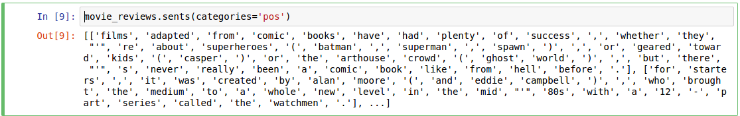
GETTING REQUIRED DATA
To train our machine learning classifiers we need to feed the model training data. These data are acquired from movie review corpus of nltk module of python. The sample of positive and negative training sets are given below:

Slide 8
GETTING REQUIRED DATA
Our Nltk “movie_review” corpus contains 1000 datasets of positive and negative texts. By using categorized corpus reader we read the dataset and used it for our model.

Slide 9
GETTING HIGH PRECISION WORDS
A high information word is a word that is strongly biased towards a single classification label. The low information words are words that are common to all labels. It may be counter-intuitive, but eliminating these words from the training data can actually improve accuracy, precision, and recall of our model.
To finding out high precision word we used nltk module’s bigram association measures chi square function. By chi square we can give quantitative values to the features related to each label. These function takes four parameters
n_ii: Frequency of the word for the label
n_ix: Total Frequency of the word across all labels
n_xi: Total Frequency of all words that occurred for the label
n_xx: Total Frequency for all words in all labels
Once we have the scores from chi square for each word in each label, we can filter out all words whose score is below the “min_score” threshold. We keep the words that meet or exceed the threshold and return all high scoring words in each label. Which is returned from this function.

Slide 10
Fetching Data from Gmail
For this we have used “imaplib” module which takes user “gmail” id and password and give access to individuals inbox.
From Inbox some mails are in plain text format and some mails are in html format. We have used “BeautifulSoup” module to find out if the text is in html format and if it is then this module parse this html into plain text.
Notes:
Thanks to my partner. I am Ishrak Islam Zarif. Assalamuwalikum. As my partner already described the how to get data. Let me get to the point how to fetching data from gmail…….

Slide 11

FEATURE DETECTION
By using “Bag_of_words” and “Bag_of_words_in_set” models we can extract features from our dataset. Examples are given below:
Notes:
Now see how we detect the features….
By using “Bag_of_words” and “Bag_of_words_in_set” models we can extract features from our dataset. Examples are given below:
Suppose a sentence is “The quick brown fox”
Then the result of bag of words will be a word dictionary where each words value is true. Which means that our corpus contains these words.
In “bag of set in set” function we used 2 parameters corpus and high information words which extracts high info words from the corpus and returns a dictionary.
From the figure we can see that “The quick brown fox” is our corpus and “fox” is our high info word which results in “fox” and its value is true.

Slide 12
TRAINING AND TEST SET
After getting the features we have to split the datasets into test and training sets. We have used 75:25 ratio splitting in Training and Testing set respectively. These datasets are split into two for measuring accuracy and other measuring metrics of our machine learning classifiers.

Slide 13
CALCULATING PREDICTIVE MODEL
We have used three machine learning classifier models to predict the positive and negative Gmail. So, these classifiers work as binary classifiers but with the help of one vs rest method these classifiers can be extended to multiple label classifiers. The three classifiers are following:
Naive Bayes
Support Vector Machine
Decision Tree
These models are ensembled into a module named “max_vote_classifier” which returns the maximum confidence value of text being positive or negative from those classifiers.

Slide 14
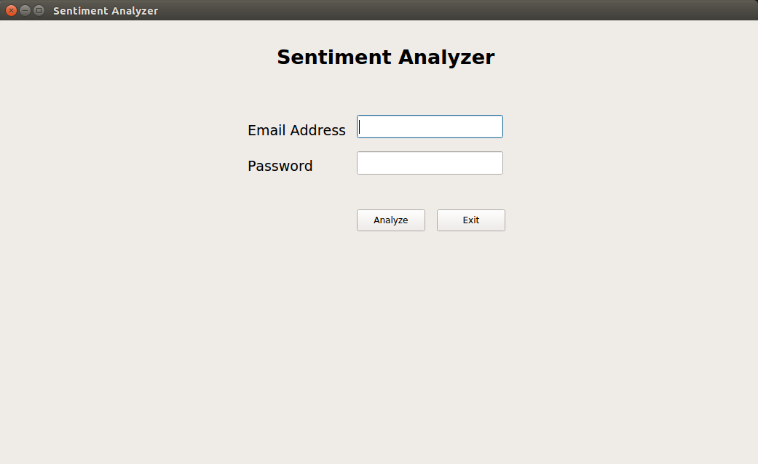
INPUT FIELD
Notes:
Now take a look at our user interface.
Our user interface contains …….

Slide 15
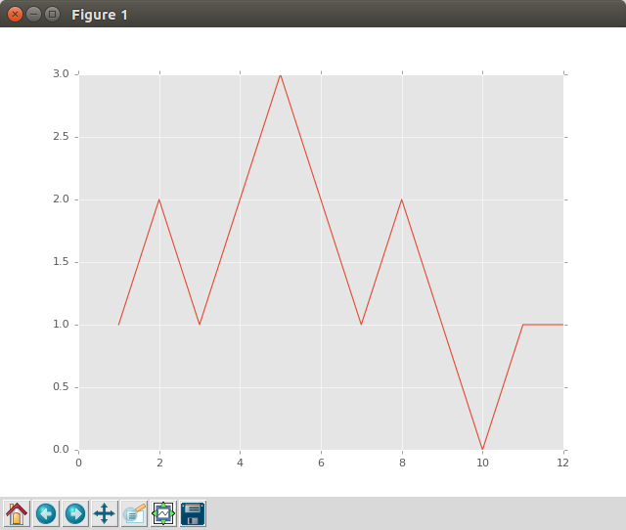
OUTPUT IN LIVE PLOT
Notes:
Lets take a look at our live plot.
The rising curve means that positive value and the falling curve means that negative value of mail.

Slide 16
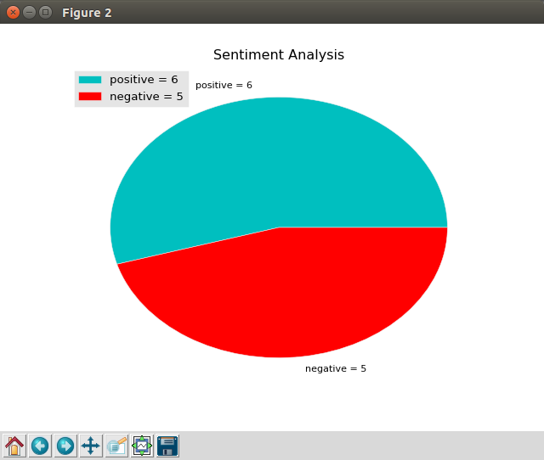
OUTPUT IN PIE-CHART
Notes:
We used pie-chart to show the outcome of our project.
We used demo mail which contains 6 positive and 5 negative mails.

Slide 17
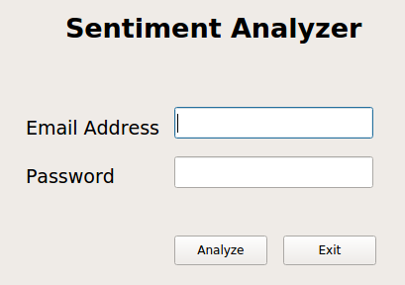
OUR PROJECT
Overall Project View
Input field
Output in live plot
Output in pie-chart
Notes:
Now take a look at the overall view of our project.
Input field,
Output in live plot and
Output in pie-chart.

Slide 18
REQUIRED PLATFORM AND TOOLS
Platform: Python 3.5, Pycharm IDE, Anaconda IDE, Jupiter notebook, Pyqt designer.
Tools:
NLTK
Sklearn
Pickle
Thread
Matplotlib
Imaplib
Beautifulsoup

Slide 19
LIMITATIONS
First of all our project uses “movie_review” datasets for getting sentiment of gmail. Which is a lack of our project. We should have fed gmail dataset to our classifiers.
Our models accuracy are not so high. They are below 90% and we have also used scikit learn’s classifiers for prediction. Which is a naive approach.
We can only fetch data from gmail.
We have shown only the binary classification.

Slide 20
FUTURE PLAN
For improving the accuracy of our project we intend to use “tensorflow” module.
For speed up purpose we’ll use gpu instead of cpu and parallel processing.
We’ll try to fetch mail from every mail service providers.
We’ll also try to fetch data from social sites.
We’ll upgrade these binary classifiers into multiple labels classifiers.

Slide 21

THANKS TO ALL
FOR BEING WITH US

