Slide 1
GPA
Counter
ID -160021056
ID -160021058
ID -160021048
ID -160021064
ID -160021074

Slide 2
Project Portrayal
Used Software – MATLAB R2018a
Overview : A program using GUI in MATLAB is generated to count the total grade of some given course. The GUI consists of edittextbox, statictextbox and pushbutton that we shall mainly use.
Firstly, We shall take the inputs like Attendance in percentage, Quiz Marks, Mid Marks and Semester Final marks of each given courses.
Then the total marks will be counted with respect to a pushbutton callback for each courses. And The ‘Grade’ push button will generate the grades for each course. In appropriate total number will give an ‘error’ to the grade output
And Finally the ‘Count GPA’ push button will generate GPA

Slide 3
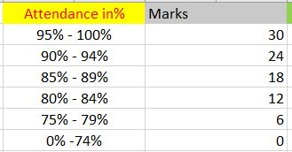
Attendance MARKS Count
TARGETED CUSTOMERS
• MASS PEOPLE

Slide 4
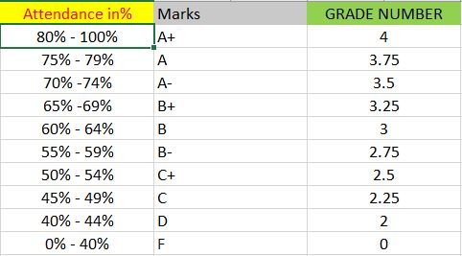
GRADE
DETERMINATION

Slide 5
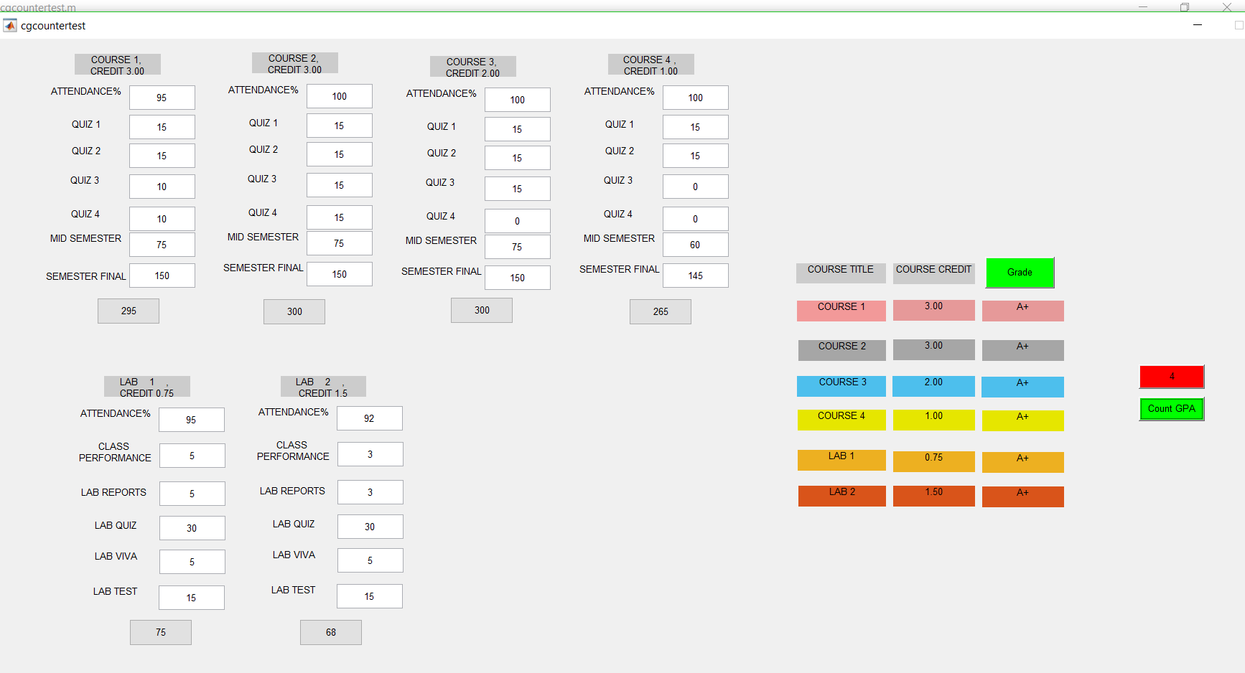
Input And Output interface (GUI)

