Slide 1
Forms Screenshots
Prepared By:
Ishraq AlDagamseh

Slide 2
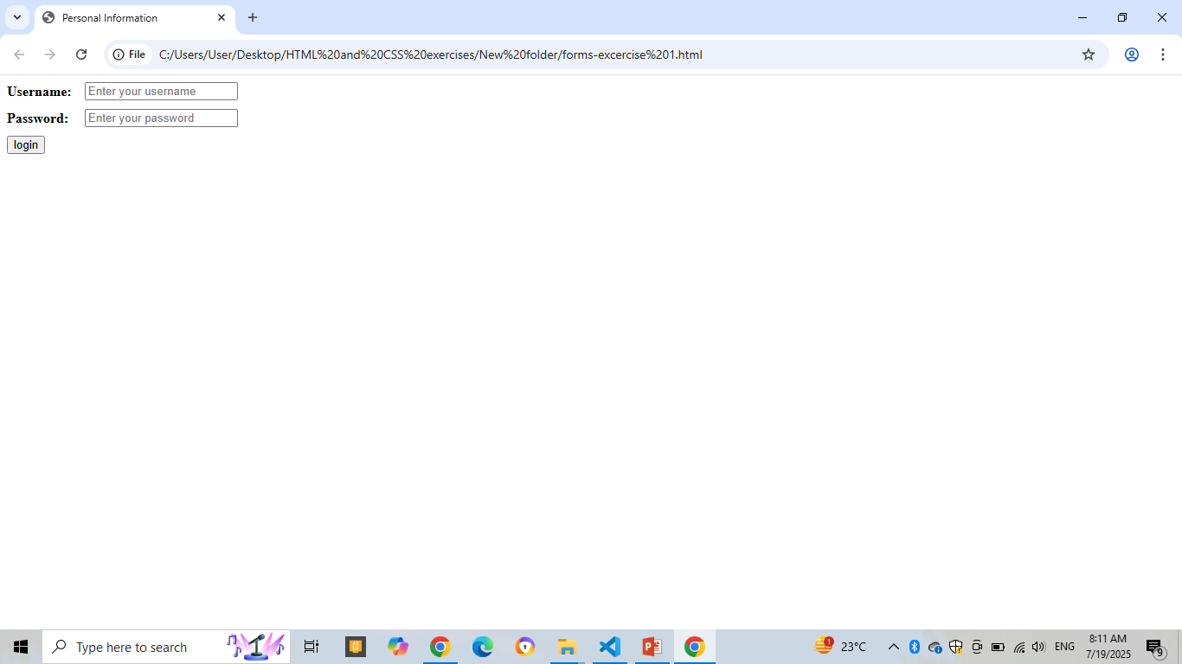
Exercise 1

Slide 3
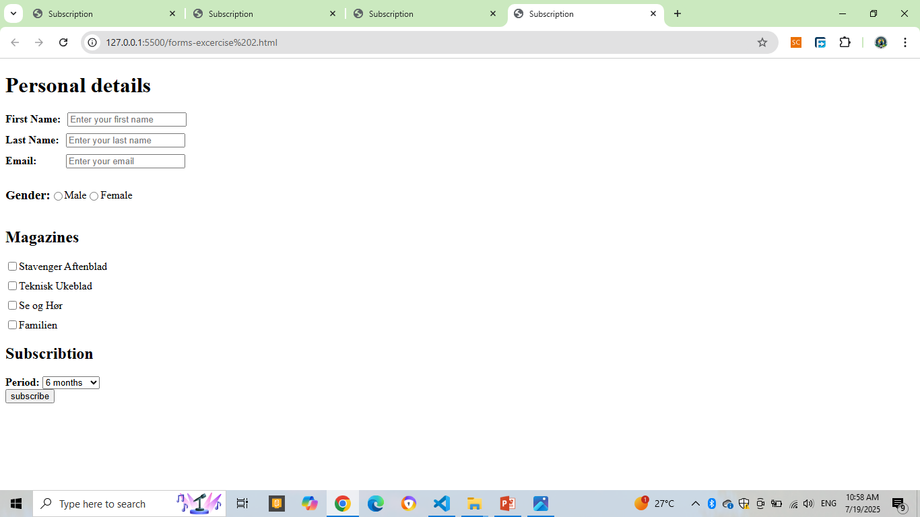
Exercise 2

Slide 4
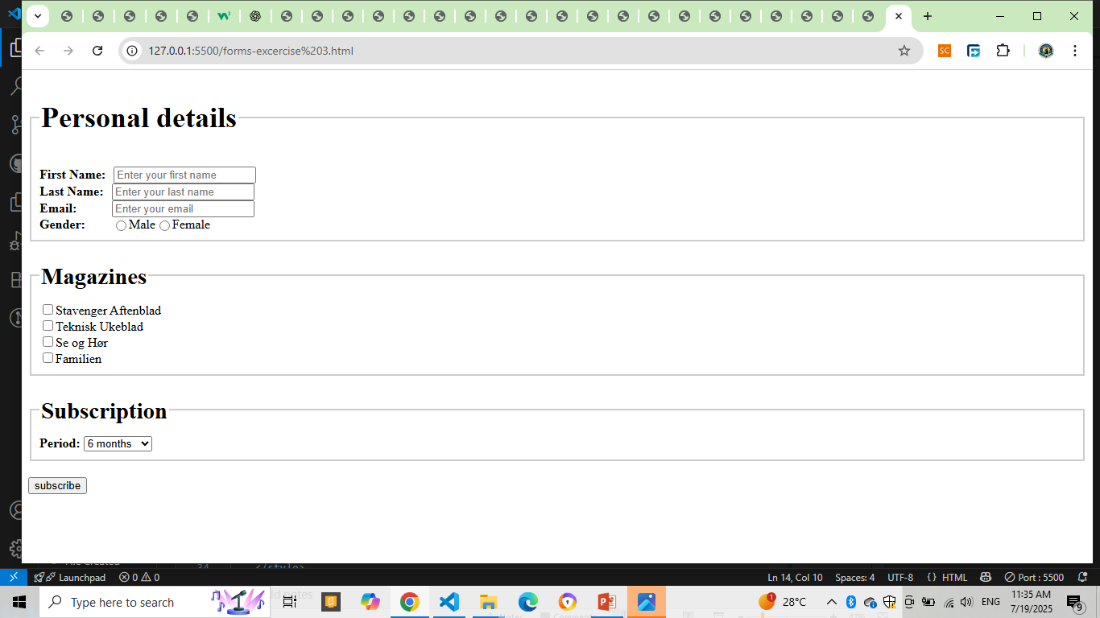
Exercise 3

Slide 5
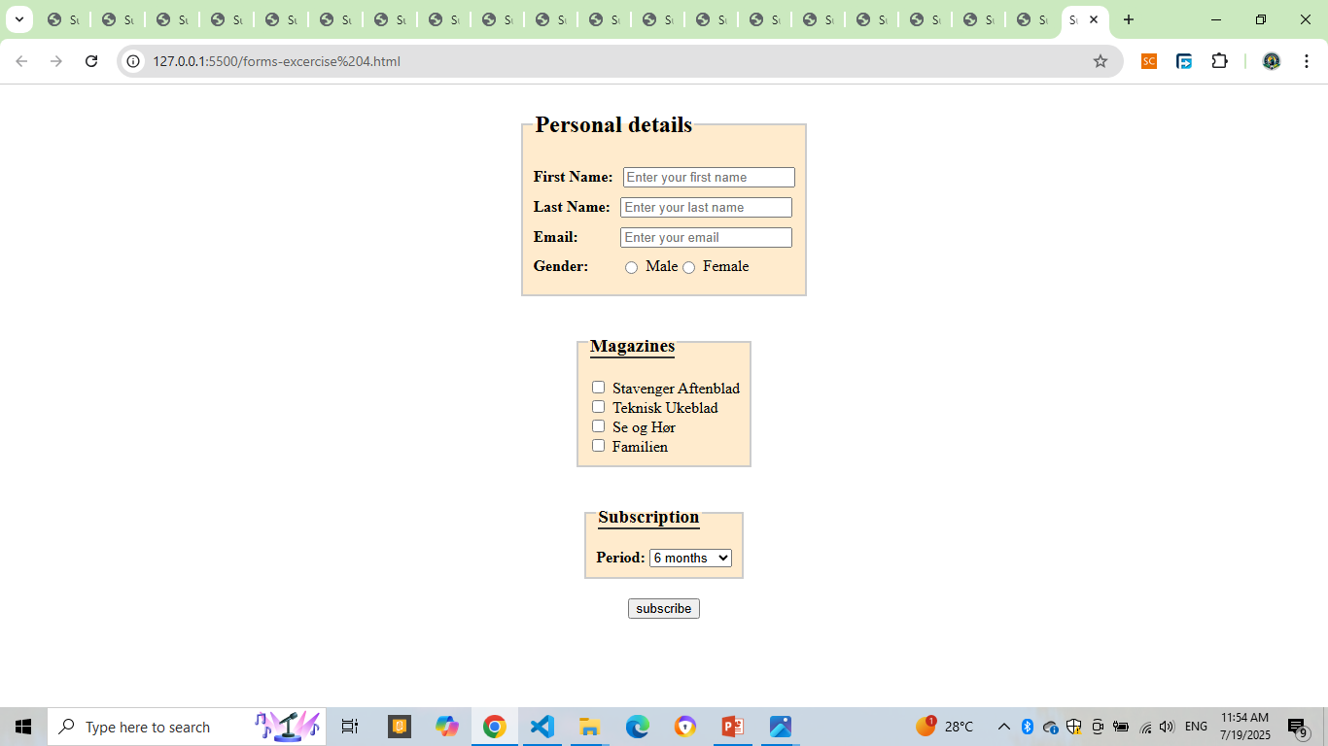
Exercise 4

