Slide 1
Screenshots for selectors section
Prepared By:
Ishraq AlDagamseg

Slide 2
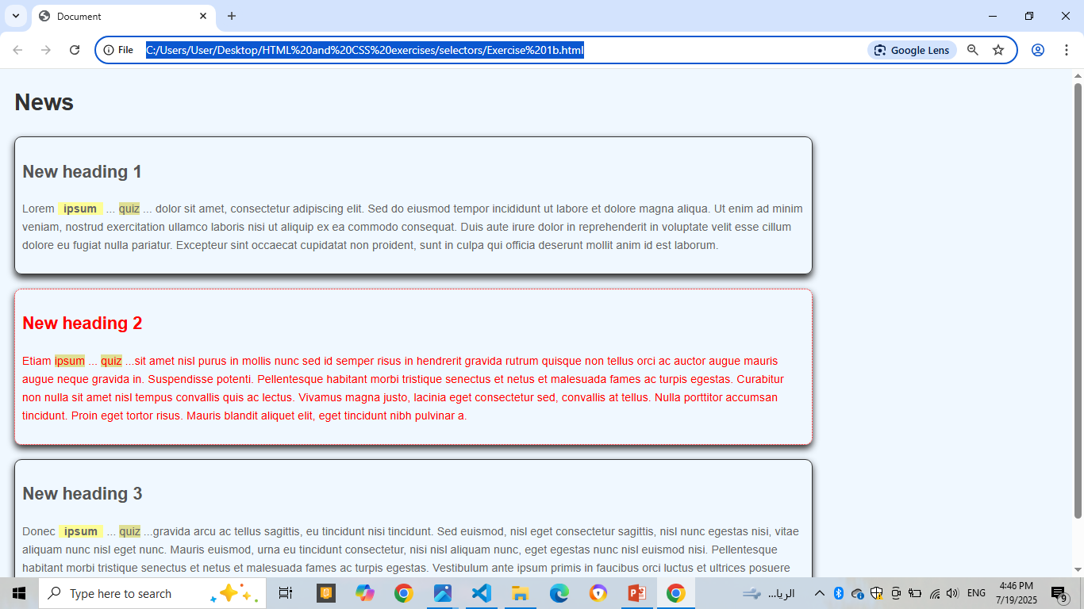
Exercise 1b

Slide 3
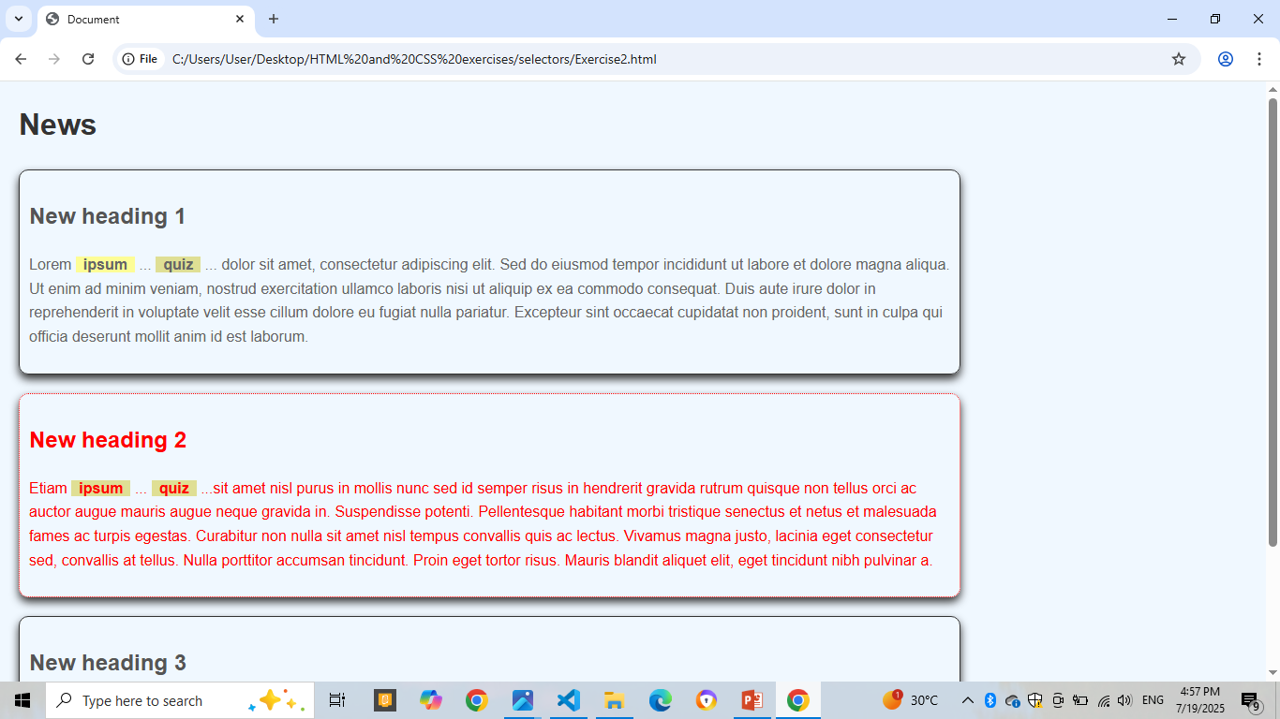
Exercise 2-with separate css file

Slide 4
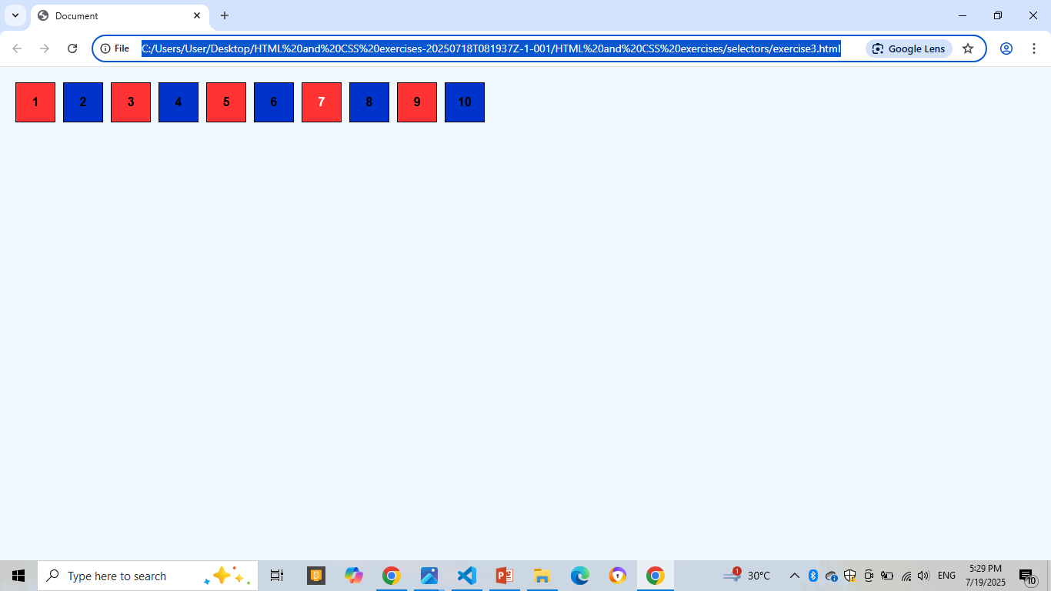
Exercise 3

Slide 5
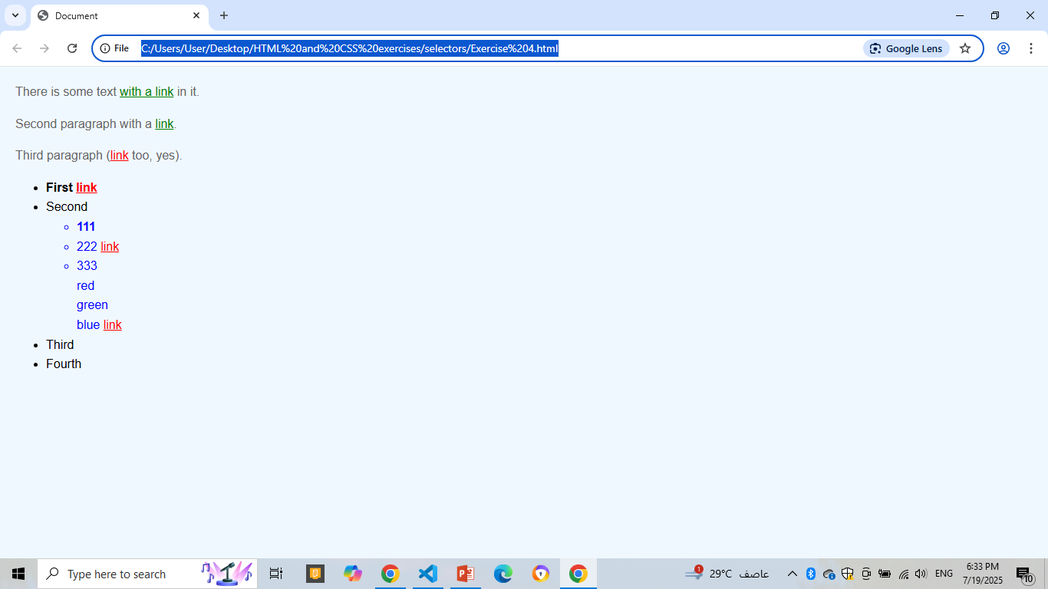
Exercise 4

