Slide 1
CISTRON
A Trajectory Based Single Cell Analysis Tool

Slide 2
Presented By Ishrat Jahan Emu BSSE0927

Slide 3
Supervised By
Dr.Sumon Ahmed
Assistant Professor
Institute of Information Technology, University of Dhaka

Slide 4
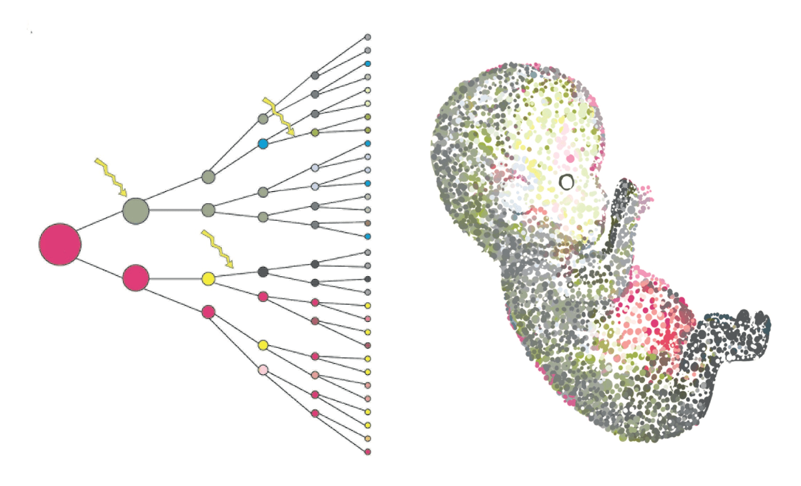
SINGLE CELL
All multicellular life starts from a
single cell.
With single cell genomics, we can explore in great detail what happens to the genome during the expansive processes of developing and sustaining life.

Slide 5
Single Cell Analysis
Single cell sequencing examines the sequence information from individual cells with optimized next-generation sequencing (NGS) technologies, providing a higher resolution of cellular differences and a better understanding of the function of an individual cell in the context of its microenvironment.

Slide 6
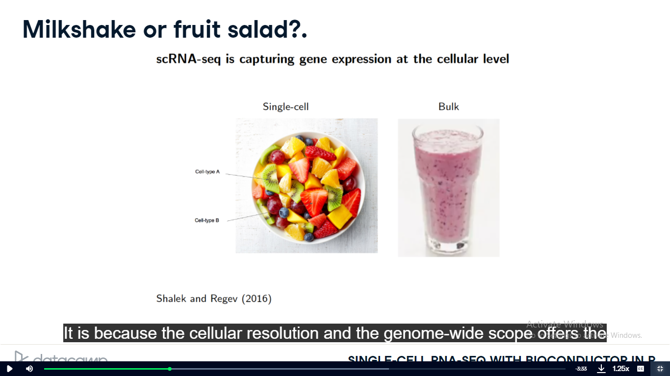
SC-RNA vs BULK RNA Sequencing

Slide 7
SC-RNA vs BULK RNA Sequencing
SC- RNA provides the cellular resolution and the genome-wide scope offers the unprecedented opportunity to investigate at the cellular level fundamental biological questions, such as stem cell differentiation or the discovery and characterization of rare cell types.
Using bulk sequencing, users get an averaged gene expression profile of all the cells in the sample. It is not possible to identify the different cell-types within one sample.

Slide 8
CISTRON
R Shiny Application
Upstream & Downstream Analysis
Standalone Application using Electron shiny js

Slide 9
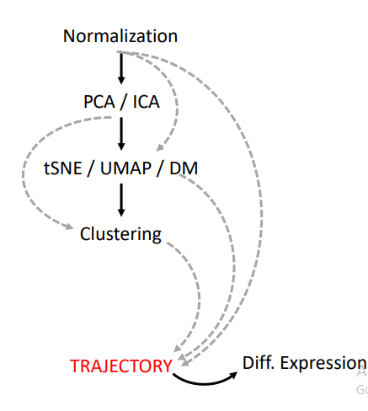
METHODOLOGY

Slide 10
METHODOLOGY
Normalised The Data
Upstream Analysis ( Using Different Trajectory Methods)
Downstream Analysis ( Marker Genes, Differential Expressions)

Slide 11
Upstream Analysis:TRAJECTORY
Trajectory inference is a computational technique used in Single Cell analysis to determine the pattern of a dynamic process experienced by cells.
Some Trajectory Interfaces Methods: Slingshot , Monocle, TSCAN etc

Slide 12
PSEDOTIME
Pseudotime – abstract unit of progress
Distance between a cell and the start of the trajectory

Slide 13
TSCAN
TSCAN uses a cluster-based minimum spanning tree (MST) approach to order cells.
Cells are first grouped into clusters and an MST is then constructed to connect cluster centers. Pseudo-time is obtained by projecting each cell onto the tree, and the ordered sequence of cells can be used to study dynamic changes of gene expression along the pseudo-time.
Clustering cells before MST construction reduces the complexity of the tree space. This often leads to improved cell ordering.
It also allows users to conveniently adjust the ordering based on prior knowledge.

Slide 14
SLINGSHOT
Slingshot was designed to model developmental trajectories in single-cell RNA sequencing data and serve as a component in an analysis pipeline after dimensionality reduction and clustering
It is flexible enough to handle arbitrarily many branching events and allows for the incorporation of prior knowledge through supervised graph construction.

Slide 15
MONOCLE
Monocle uses an algorithm to learn the sequence of gene expression changes each cell must go through as part of a dynamic biological process
Once it has learned the overall "trajectory" of gene expression changes, Monocle can place each cell at its proper position in the trajectory.

Slide 16
DOWNSTREAM ANALYSIS
Association of gene expression with pseudotime
Discovering progenitor marker genes
Discovering differentiated cell type markers
Discovering genes with different expression patterns

Slide 17
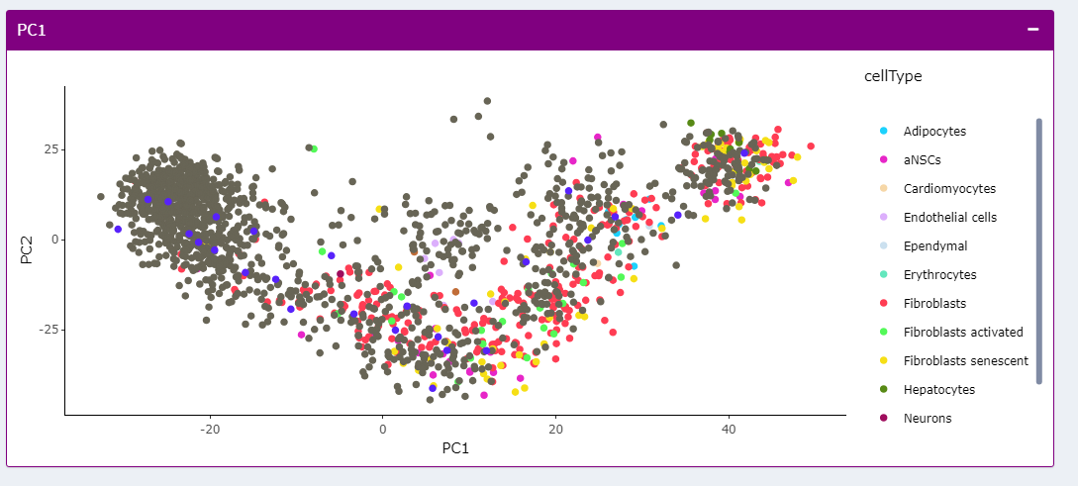
CURRENT PROGRESS (First Look)

Slide 18
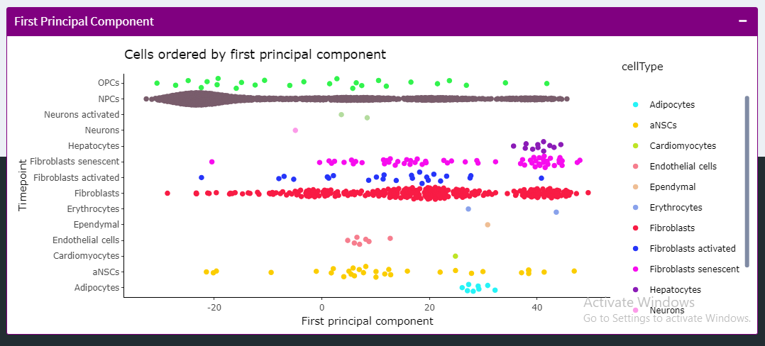
CURRENT PROGRESS(First Look)

Slide 19
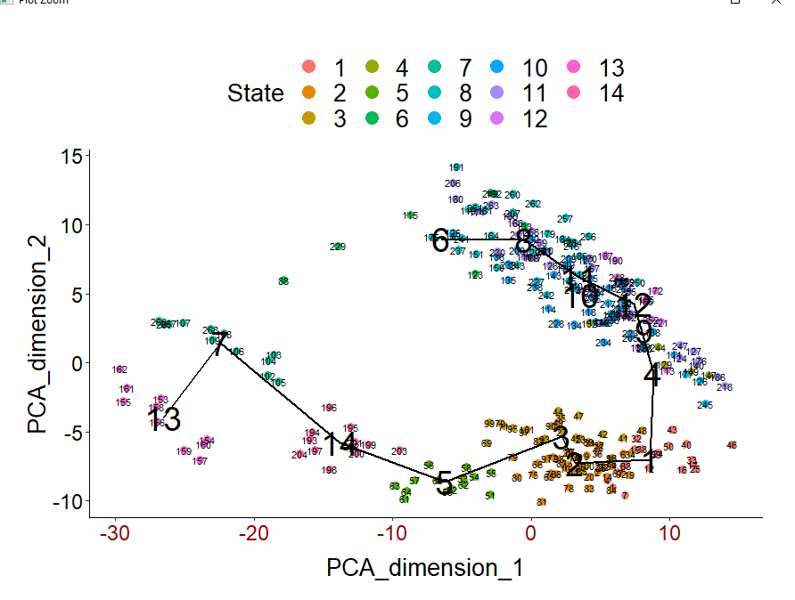
CURRENT PROGRESS(TSCAN)

Slide 20
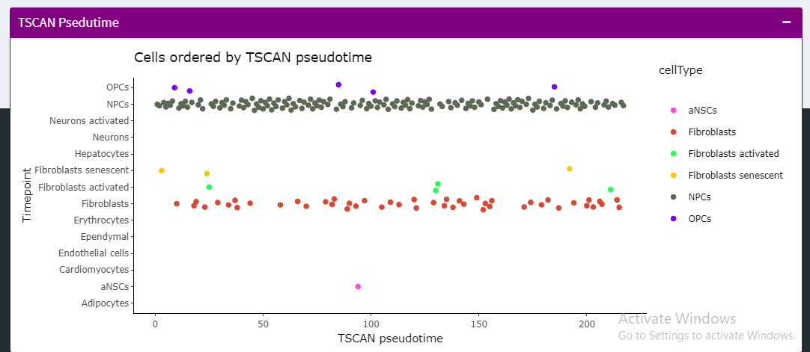
CURRENT PROGRESS(TSCAN)

Slide 21
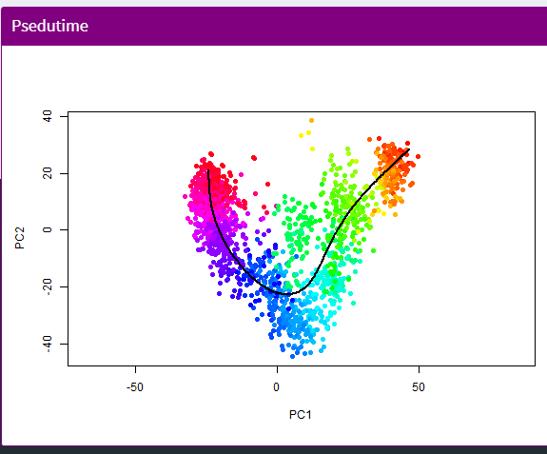
CURRENT PROGRESS(SLINGSHOT)

Slide 22
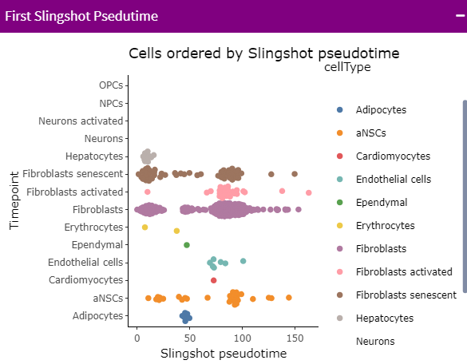
CURRENT PROGRESS(SLINGSHOT)

Slide 23
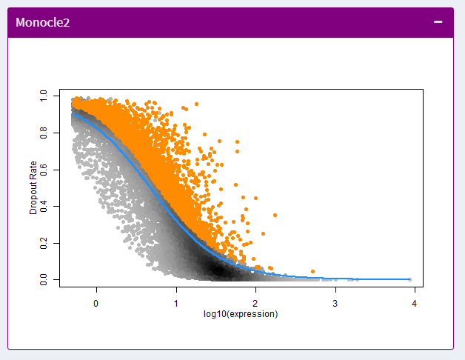
CURRENT PROGRESS(MONOCLE)

Slide 24
Tools
R STUDIO
R Shiny
Electron Shiny JS

Slide 25
PLATFORM
LINUX
MAC OS
WINDOWS

Slide 26
THANK YOU

