Slide 1
Camera Synchronization
An Android App

Slide 2
Supervised By
Dr. Naushin Nower
Associate Professor
Institute of Information Technology
University of Dhaka

Slide 3
S.M. Shahriyar
BSSE0902
Ishrat Jahan Emu
BSSE0927

Slide 4
Normal Requirements
Joining or creating own group to share
Allowing users to create hotspot
2 types connection require ( Online & Offline)
No editor is needed for this camera

Slide 5
Expected Requirements
User friendly
Color must be in RGB
Not need to show the whole profile ( Contact no only)
Users can be joined to the group by requesting or adding
Effective system
Storing user’s response time to join

Slide 6
Exciting Requirements
For online connection , there must have 4G connection
2. Can be able to connect with other channels ( for TV journalist)

Slide 7
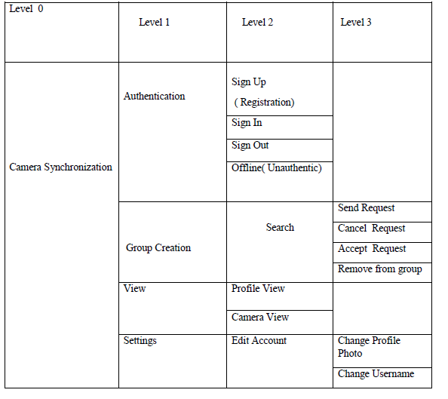
Use Case Scenario

Slide 8
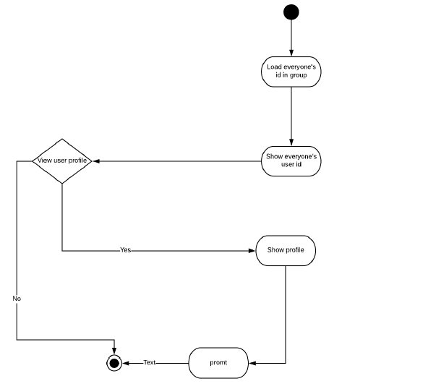
Activity Diagram for
Solving Puzzle

Slide 9
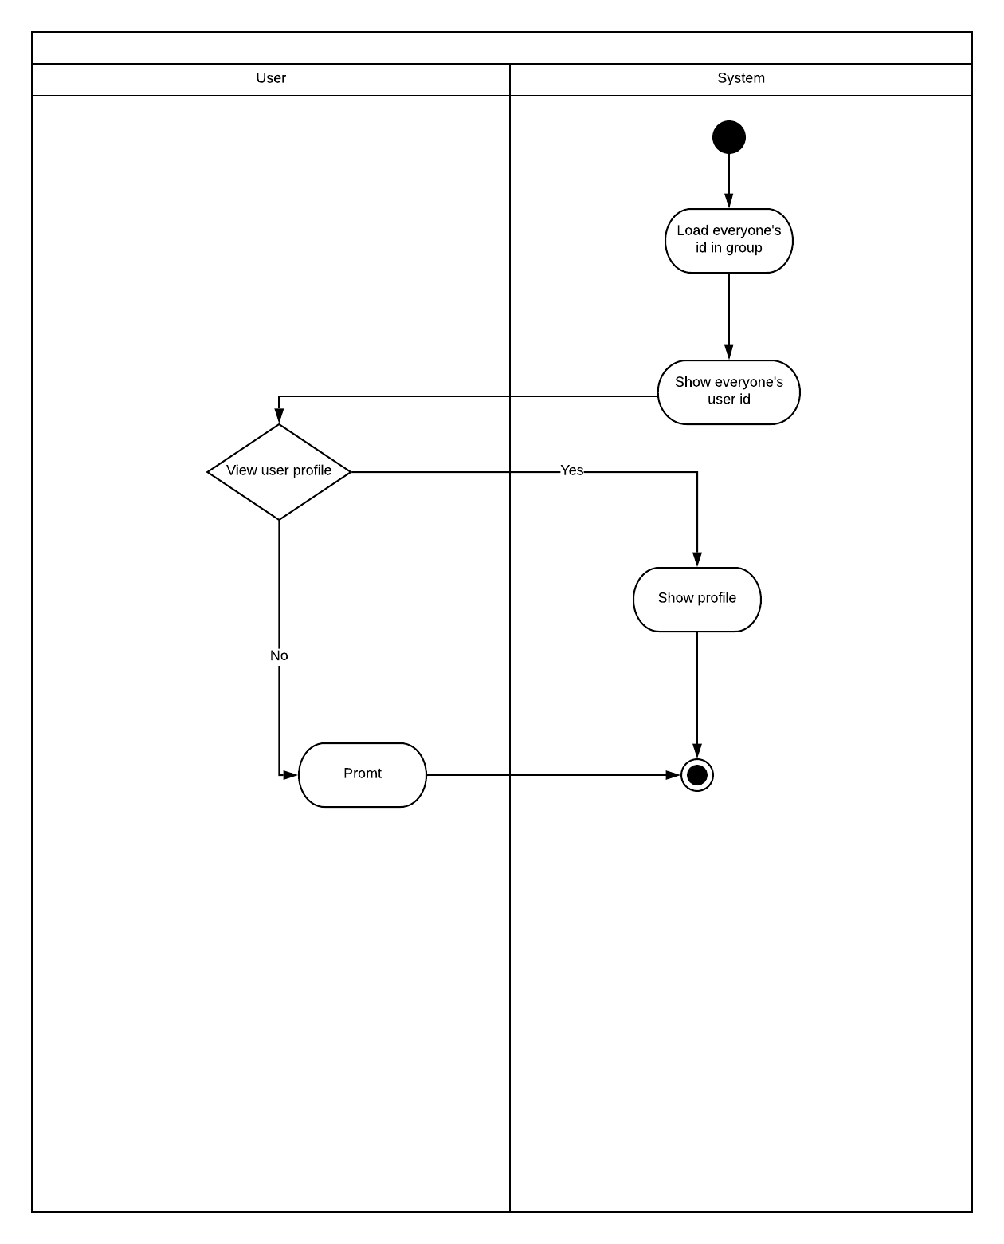
Swimlane Diagram for
Assess Eye-gaze for Social Responsive Objects

Slide 10
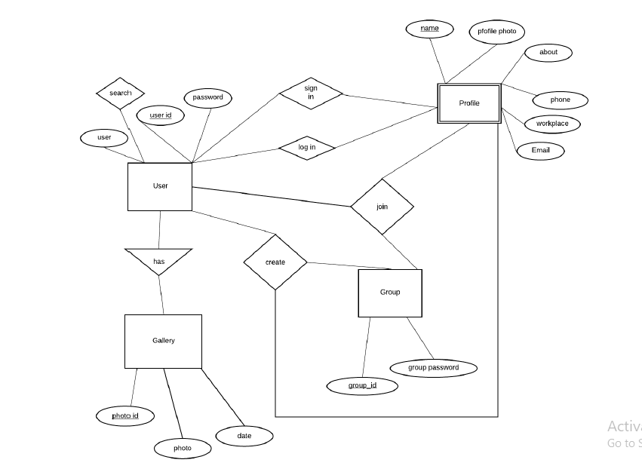
ER Diagram

Slide 11
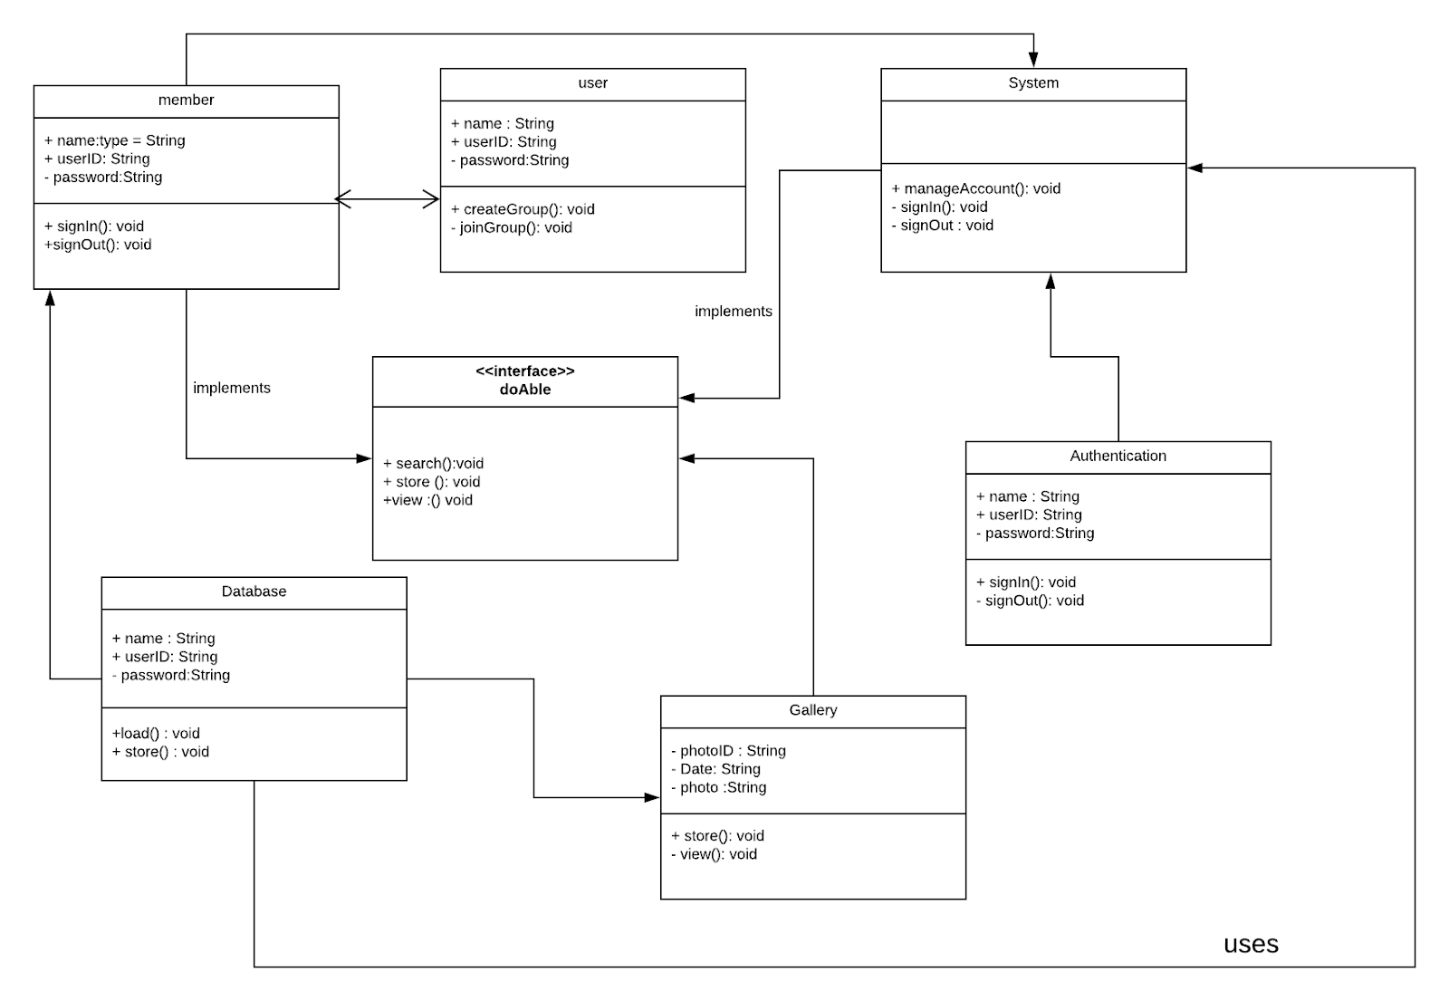
Class Diagram

Slide 12
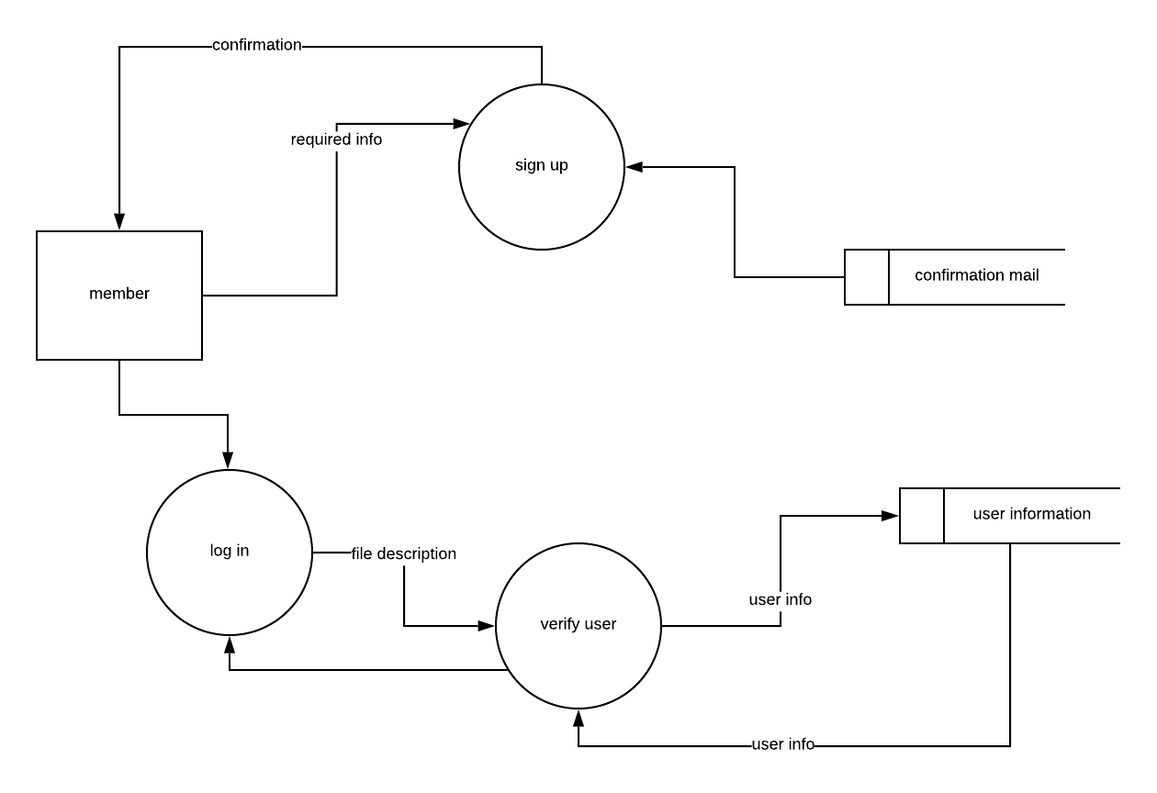
Data Flow Diagram

Slide 13
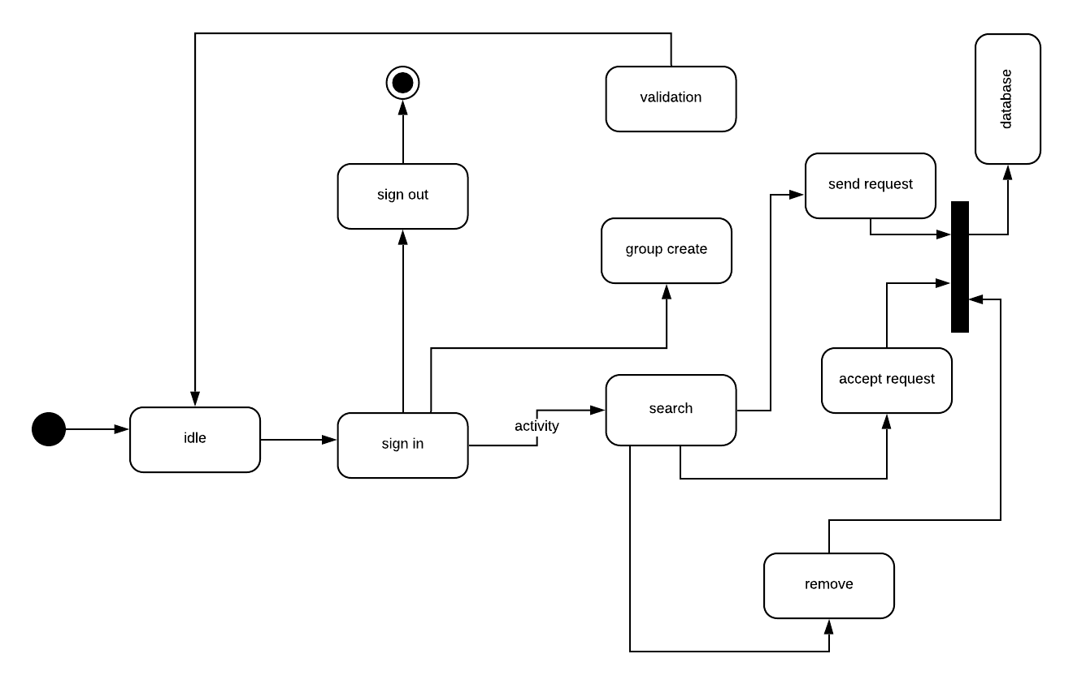
State Diagram

Slide 14
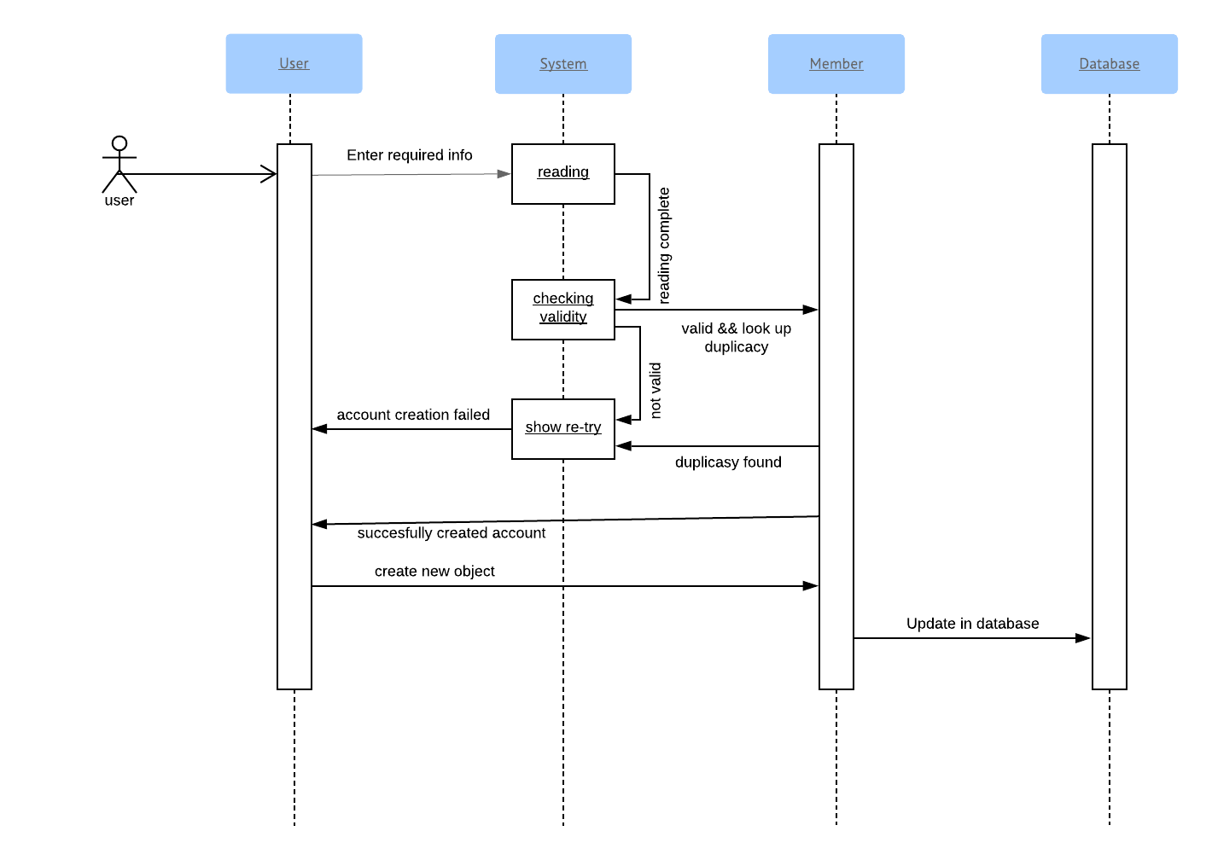
Sequence Diagram

