Slide 1
Mobile AR Diet Monitoring
Privacy-first update: fully on-device AI food recognition

Slide 2
Objective & Scope
Goal: privacy-preserving real-time diet monitoring with on-device AI
Two capabilities delivered:
On-device dish recognition — a 2,024-food TFLite classifier (Google AIY) identifies the meal locally.
On-device detection + counting — an SSD box detector finds items and counts them (e.g., 3 × apple).
SCAN resolves nutrition from an offline table — zero network calls; USDA is used only for typed text queries (PICK).
Graceful fallbacks so a scan is never a dead end.
interactive real-time diet monitoring
private on-device CV + nutrition in AR
2

Slide 3
DELIVERABLES
What Was Built
Two local TFLite models
SCAN flow rewired
UI: portion shown
LocalFoodClassifier.js · FoodBoxDetector.js
dish classifier (2,024 foods) + SSD box detector (counts items)
classifyFoodLocal() + detectFoodBoxes() via react-native-fast-tflite (JSI)
Runs offline — the image never leaves the phone
App.js onScan() = on-device only
Photo capture via device camera
Offline nutrition table (~70 foods) + fuzzy match
Unknown foods still shown, with confidence
AR overlay panel: "Portion ~Xg (Y kcal)"
Bottom bar: kcal / g summary
Details: scanned photo + counted items
Shows Recognized by: On-device AI (xx%)
Privacy hardening
Dependency added
Gemini & Google Vision code paths deleted
SCAN makes zero network calls
USDA only for typed text lookups (PICK)
react-native-fast-tflite + jpeg-js
Fast JSI inference + on-device JPEG decode
Autolinked, APK rebuilt & installed
3

Slide 4
ARCHITECTURE
SCAN Data Flow
1 · Capture
2 · On-device AI
3 · Offline table
4 · Risk + GI
5 · AR Overlay
▶
▶
▶
▶
System camera
snaps a still
classifier names dish
detector counts items
per-100g macros
+ typical serving
glycemic index
Panel pinned
in camera view
Fallback chain if a step has no result
Food not in the offline table → shown as UNKNOWN with a one-tap USDA text search (name only).
Portion = typical serving × detected item count; AR-geometry grams estimation is in progress.
4

Slide 5
Key Problem Solved
Symptom
Root cause
Meal photos were uploaded to Google servers for recognition.
A privacy risk for users and for human-subjects research (Goal 3).
Cloud dependence: no offline use; API rate limits.
Recognition ran in the cloud (Gemini multimodal).
Every scan meant an image upload to external servers.
Privacy/IRB expectations require meal images to stay on the device.
The fix
Replaced cloud AI with two local TFLite models (dish classifier + box detector) running on the phone via JSI.
All cloud-vision code deleted — SCAN works in airplane mode.
Photos stay in app-private storage — nothing ever leaves the phone.
5

Slide 6
RESULT
Verified On Device
Built & installed on Moto G 5G (Android 15); ARCore active; camera permission granted.
Both TFLite models verified live on-device (192×192 classifier · SSD box detector).
Live scan returns recognition + portion + GI + risk — fully offline:
LIVE SCAN OUTPUT
3 × apple
284 kcal for 546 g portion
GI 36 (low glycemic index)
SAFE
6

Slide 7
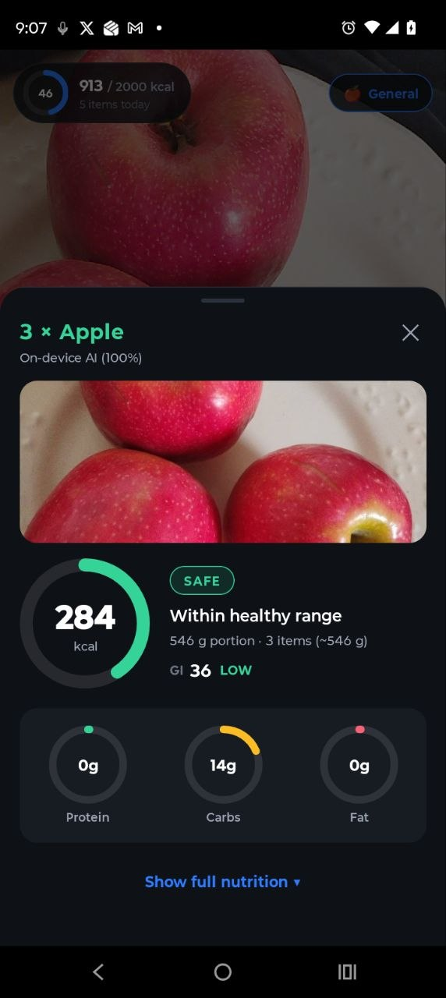
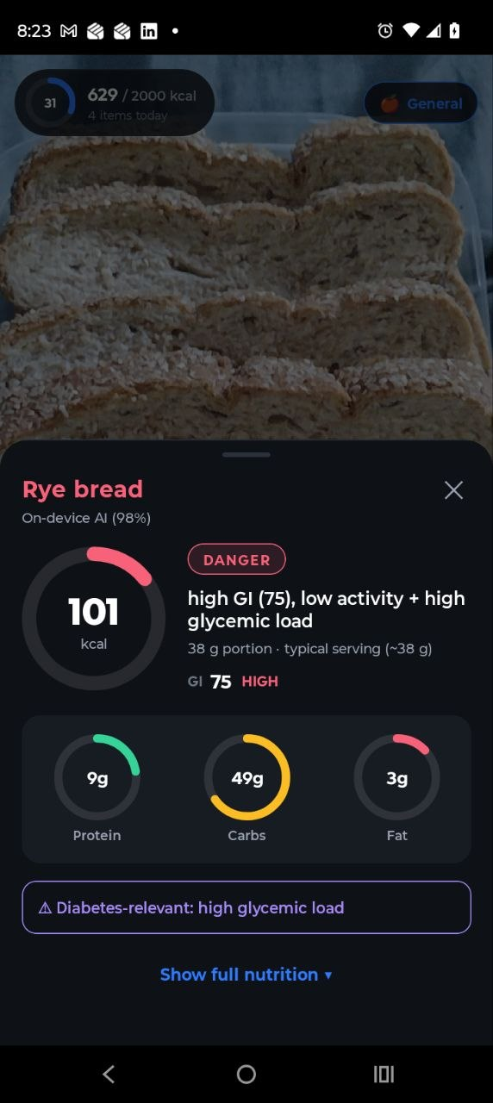
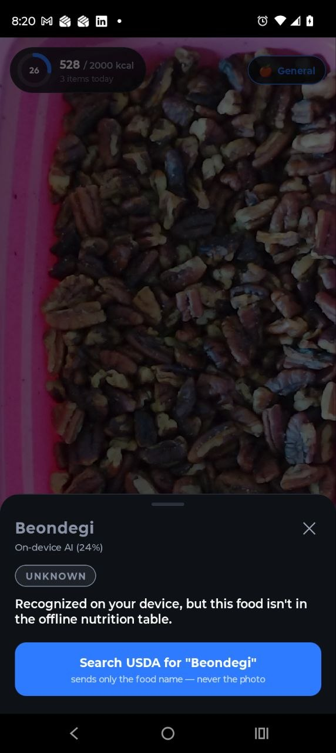
LIVE RESULTS
On-Device Recognition in Action
3 × Apple — detector counts items (100%)
Rye bread— GI 75 risk flag
Out-of-vocabulary → UNKNOWN
6b

Slide 8
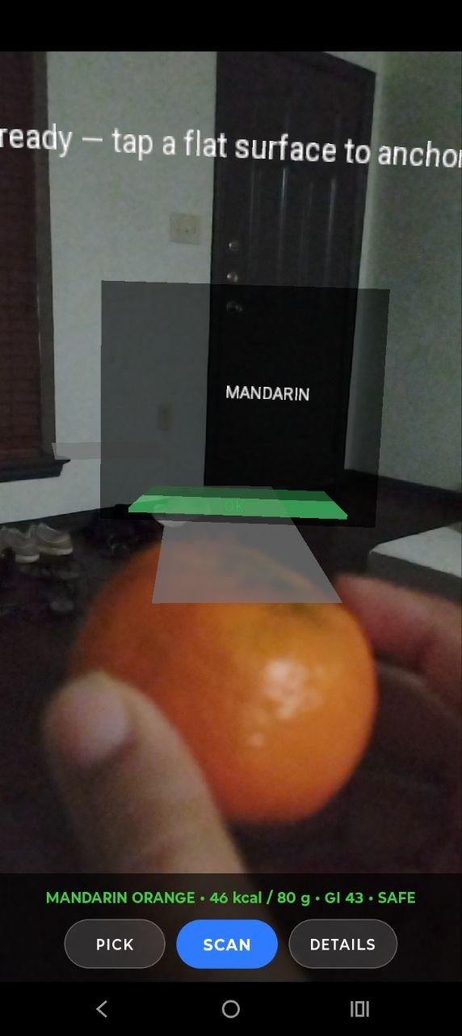
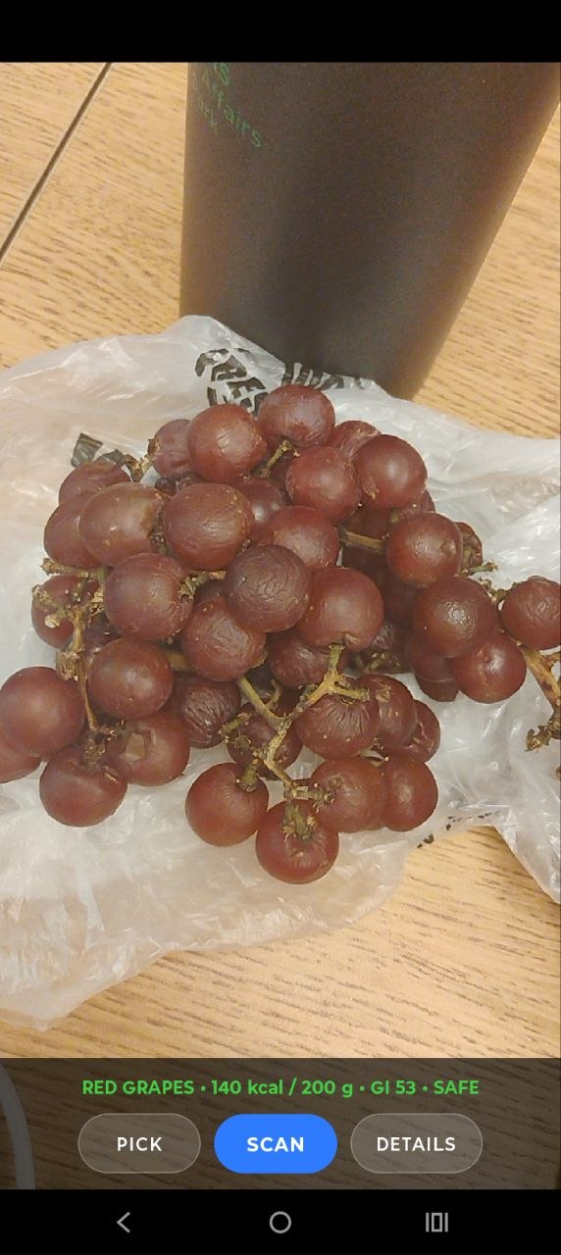
Previous output

Slide 9
STATUS
Known Limitations
Known limitations
Next steps
Classifier vocabulary = 2,024 prepared dishes; loose packaged snacks (e.g., peanuts in a container) are out-of-vocabulary.
Box detector counts 15 food types (fruits, bread, pizza…) — counting is limited to those.
SCAN opens the camera to take a photo (not an instant live-frame grab) — a workaround for the GL-surface capture limit.
PICK flow still uses USDA per-100g only (no portion).
One food panel per scan (multi-item plate = stretch goal).
Show "healthier alternative" as an AR overlay
Per-item detection & multiple AR panels per plate.
AR-geometry portion estimation (box size × plane distance → grams).
Wire iOS HealthKit alongside Google Fit.
Fine-tune a detector on a broader food set (incl. snacks & packaged foods).
User testing for recognition accuracy & AR usability (Goal 3).
7

Slide 10
Summary
Scan a meal → on-device AI identifies it and counts items → offline table provides nutrition → GI + risk → AR overlay. Nothing leaves the phone. Delivered: two local TFLite models · privacy-hardened SCAN pipeline · item counting · scanned photo in details · unknown-food handling.

