Slide 1

Stock market price prediction using ARIMA-LSTM hybrid model
Supervised By
Sunanda Das
Assistant Professor
Department of Computer Science and Engineering
Presented By
Pushan Paul (Roll:1707065)
Umme Israt Afroz (Roll:1707043)
Department of Computer Science and Engineering
Khulna University of Engineering & Technology, Khulna

Slide 2
Outlines
Introduction
Problem Statement
Objectives
Methodology
Result Analysis
Deployment
Conclusion

Slide 3
Introduction
Stock market and Cryptocurrency is an aggregation of stockbrokers and traders who can buy and sell shares of stocks.
Stock data is non-stationary, chaotic, random and depends on several technical parameters.
Since statistical approaches are linear in nature, it hampers prediction performances in case of sudden rise or fall of prices of the stocks.
In modern days of artificial intelligence, machine learning plays an important role in time series predictions.

Slide 4
Problem Statement
In this project, an ARIMA-LSTM based hybrid model has been proposed, which predict the closing price of bitcoin in a 1-day interval. For evaluating the performance of the proposed model, a comparison has been made with LSTM, and ARIMA models using different errors like RMSE and MAE.

Slide 5
Objectives
To predict stock prices using both statistical and deep learning approaches.
To find a better approach, which predicts prices of the stocks more accurately.
To apply deep learning on the predictions of statistical model to obtain more accurate predictions over the actual data.
To deploy the hybrid model in the form of an web app for smooth user experience.

Slide 6
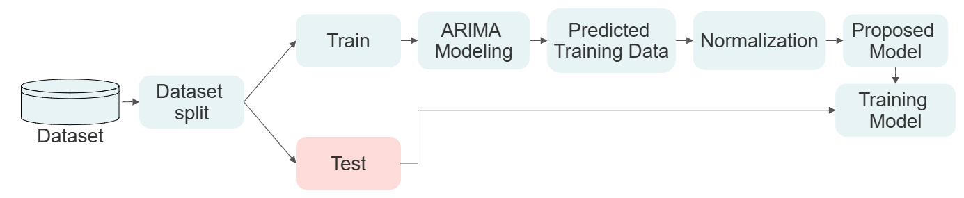
Methodology
Fig: Workflow of the proposed system

Slide 7
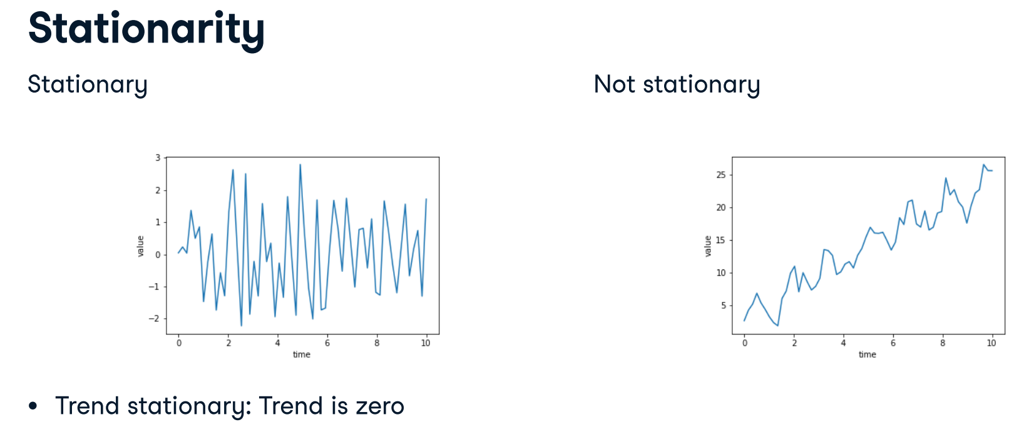
ARIMA Model (Stationarity)

Slide 8
ARIMA Model (The augmented Dicky-Fuller test)
Tests for trend non-stationarity
Null hypothesis is time series is non-stationary
Doing the test we get a value
If p-value is small (<0.05) → reject null hypothesis. Reject non-stationary.

Slide 9
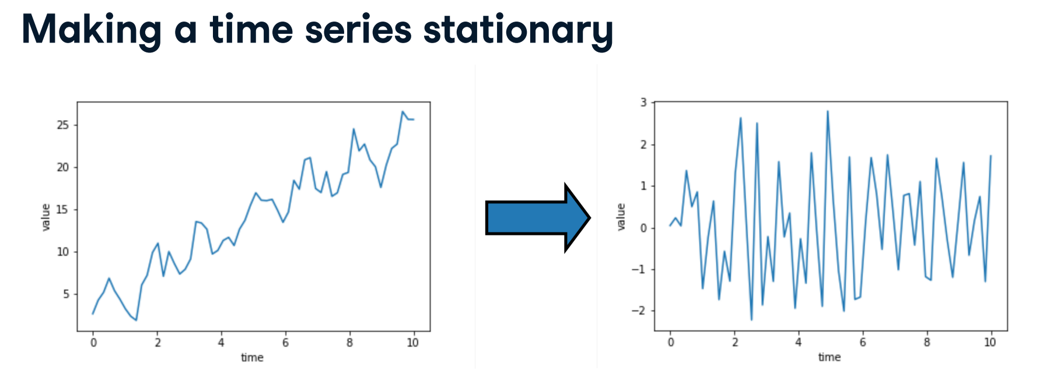

ARIMA Model (Making time series stationary)

Slide 10
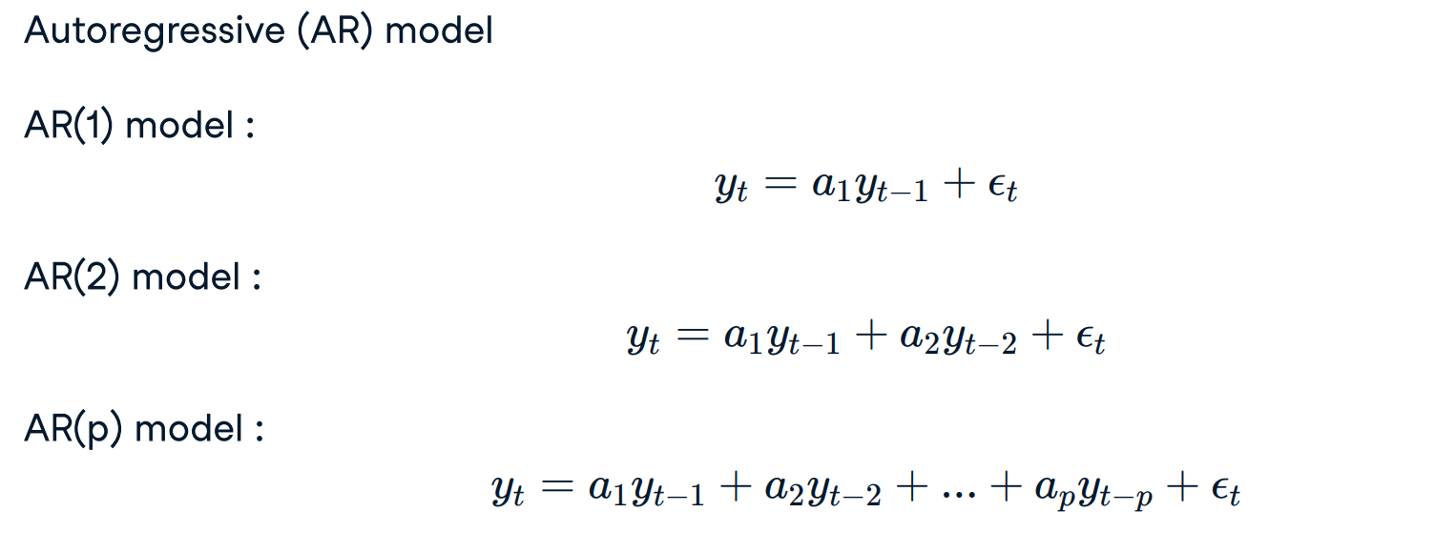
ARIMA Model (AR Models)

Slide 11
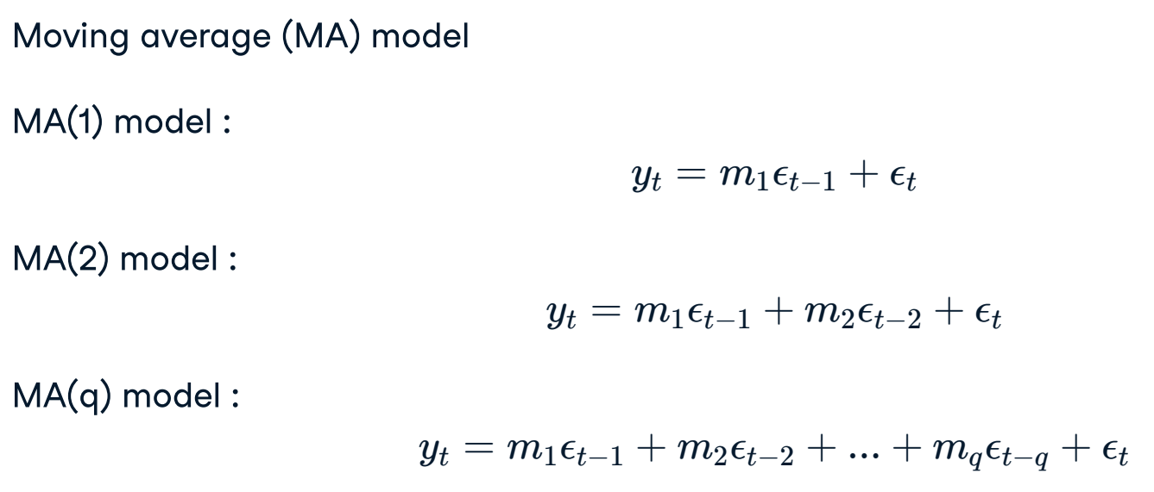
ARIMA Model (MA Models)

Slide 12
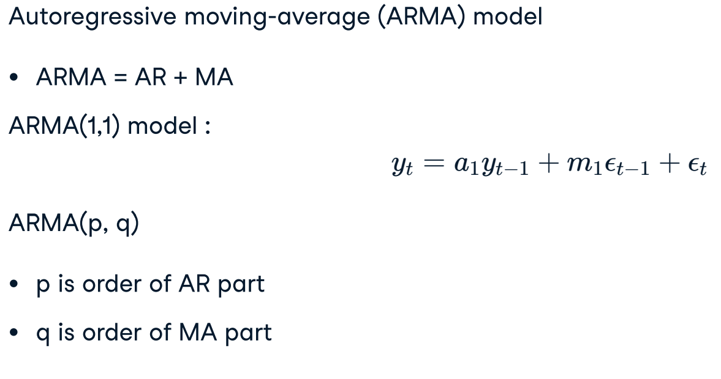
ARIMA Model (ARMA Models)

Slide 13
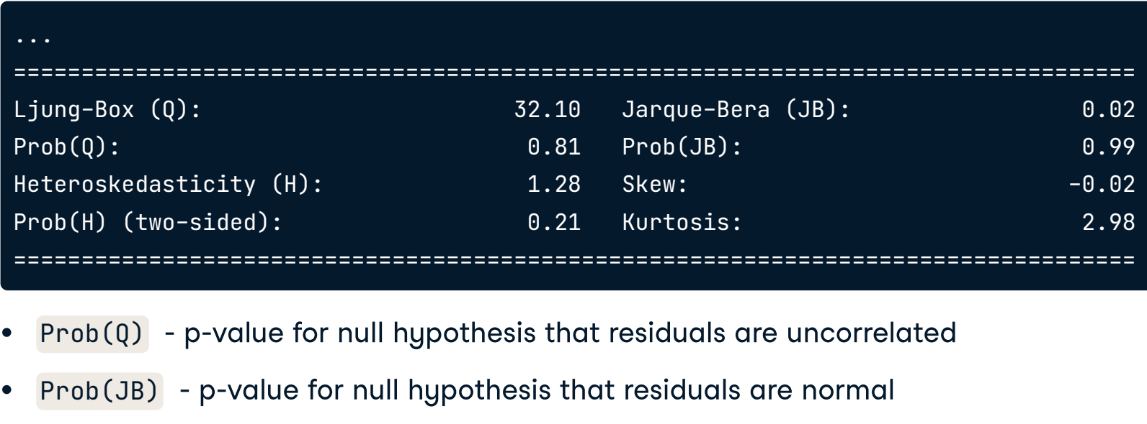
ARIMA Model (Summary)

Slide 14
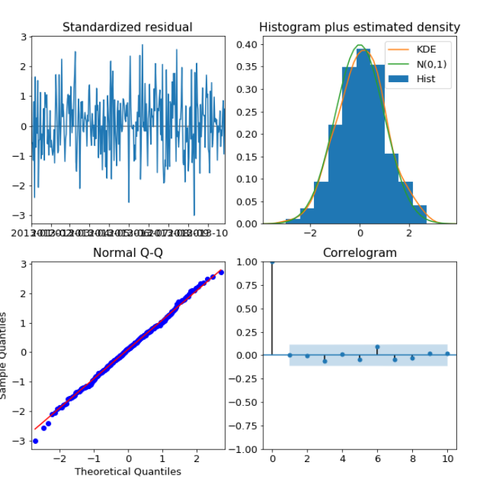
ARIMA Model (Analysis)

Slide 15

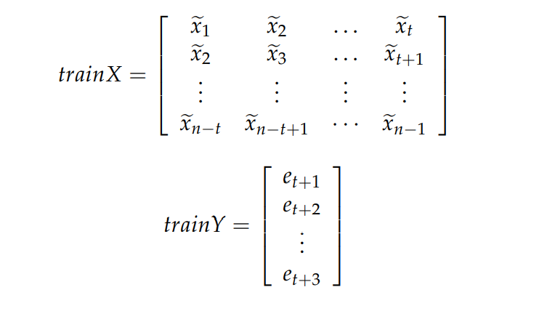
Proposed System
Construct the optimal ARIMA model. Bayesian Information Criteria (BIC) are used to obtain the optimal parameters of ARIMA.
Layers | Output Shape | Activation
Bi-LSTM | 128 | none
Dense | 128 | relu
Dense | 1 | none

Slide 16
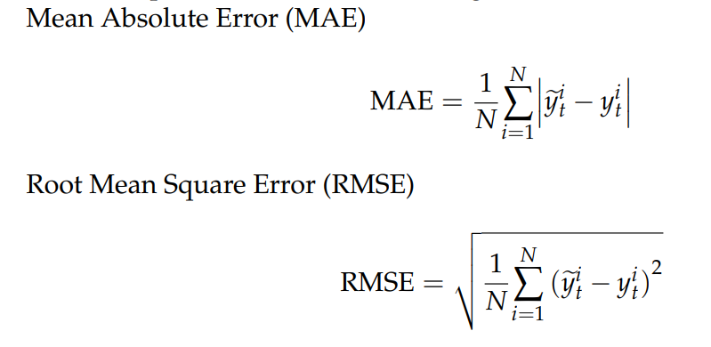
Performance Measures

Slide 17
Dataset
Bitcoin Historical Price
Start: 17-12-2018
End: 17-12-2022
Days: 1460
Index: Date
Column: Closing Price

Slide 18
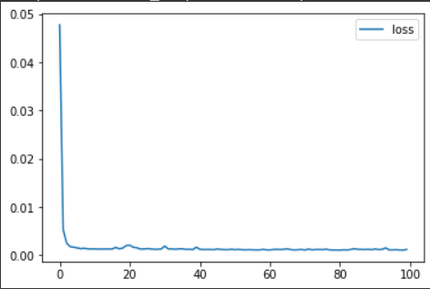
Model Analysis
Fig: Loss vs Epoch curve

Slide 19
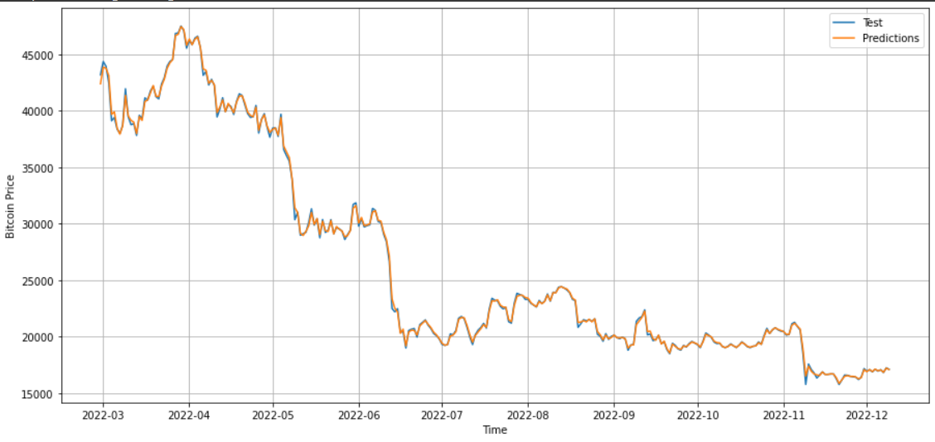
Result Analysis
 | ARIMA | ARIMA-LSTM
MAE | 626.03 | 53.23
RMSE | 432.1 | 22.35
Table: Performance
Measures
Fig: Test data and Predictions comparison graph

Slide 20
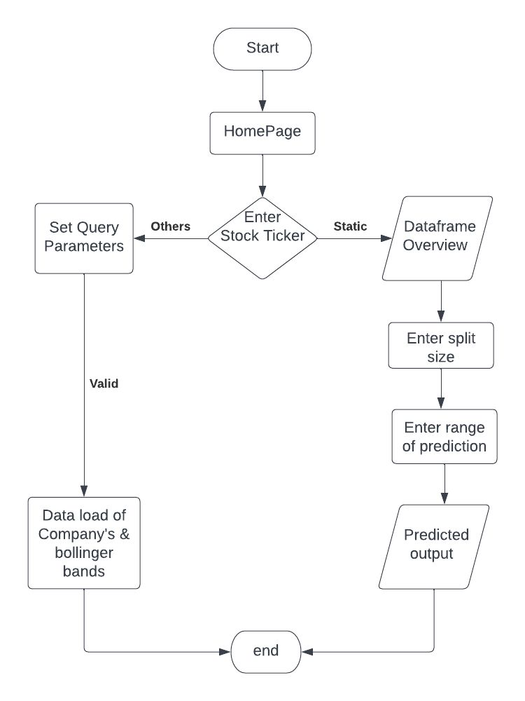
Fig:Flow chart for the deployment

Slide 21
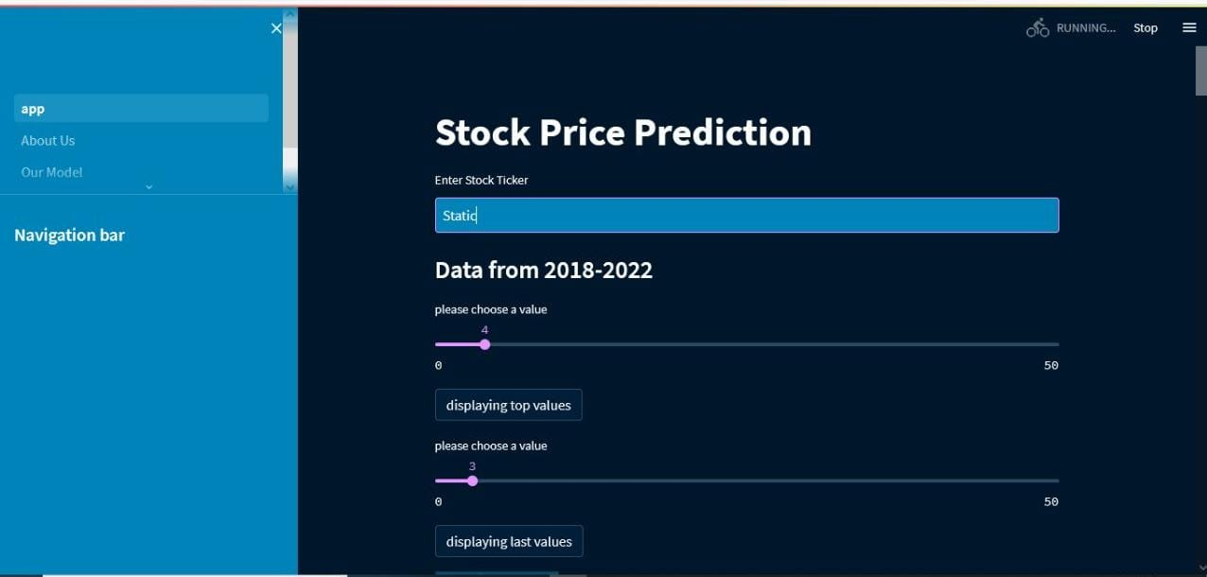
Fig:Home page screen

Slide 22
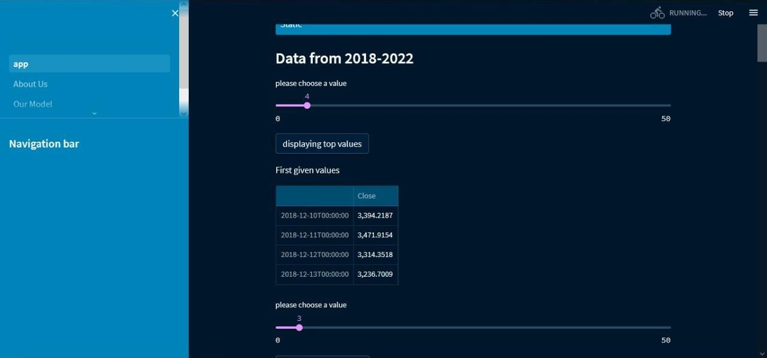
Fig: determine value by using slider

Slide 23
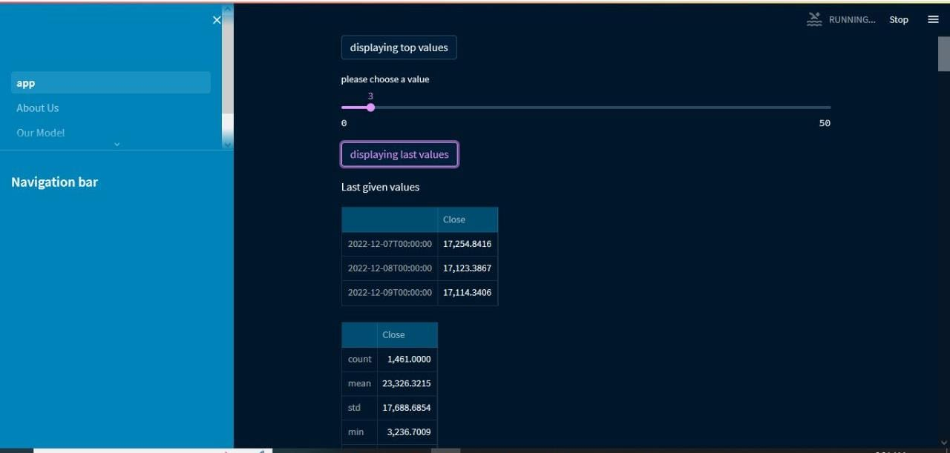
Fig: displaying tail values by clicking button

Slide 24
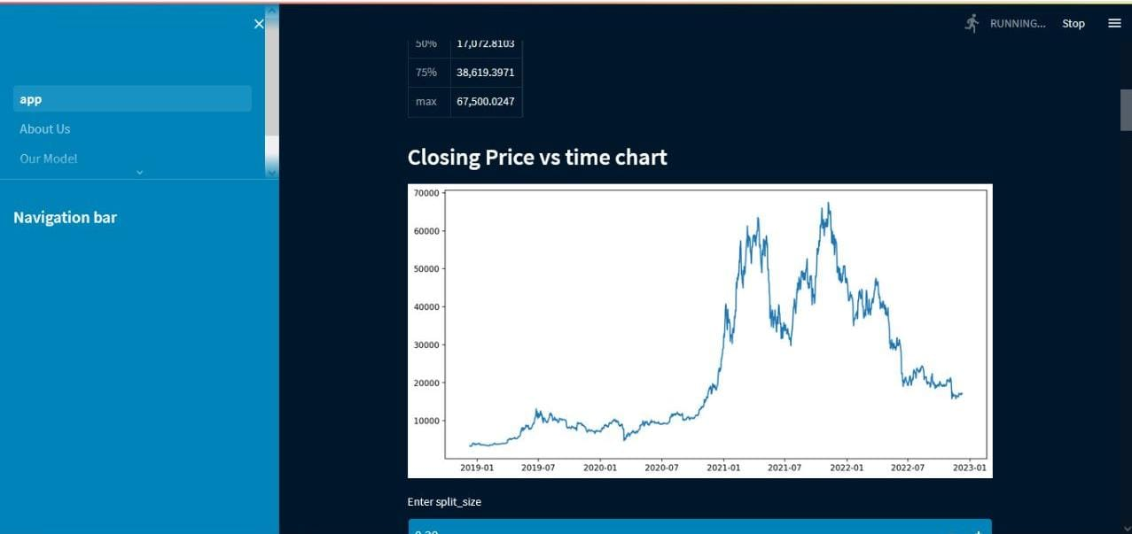
Fig: Closing price vs time chart

Slide 25
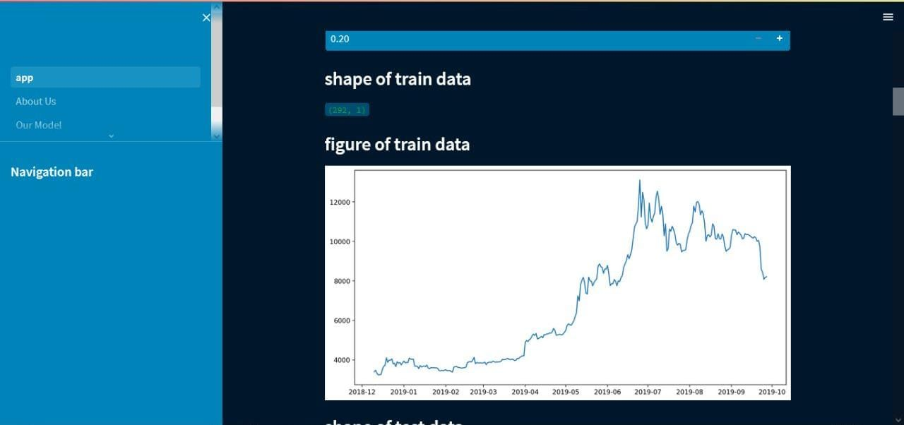
Fig: splitting size and shape and figure of train data

Slide 26
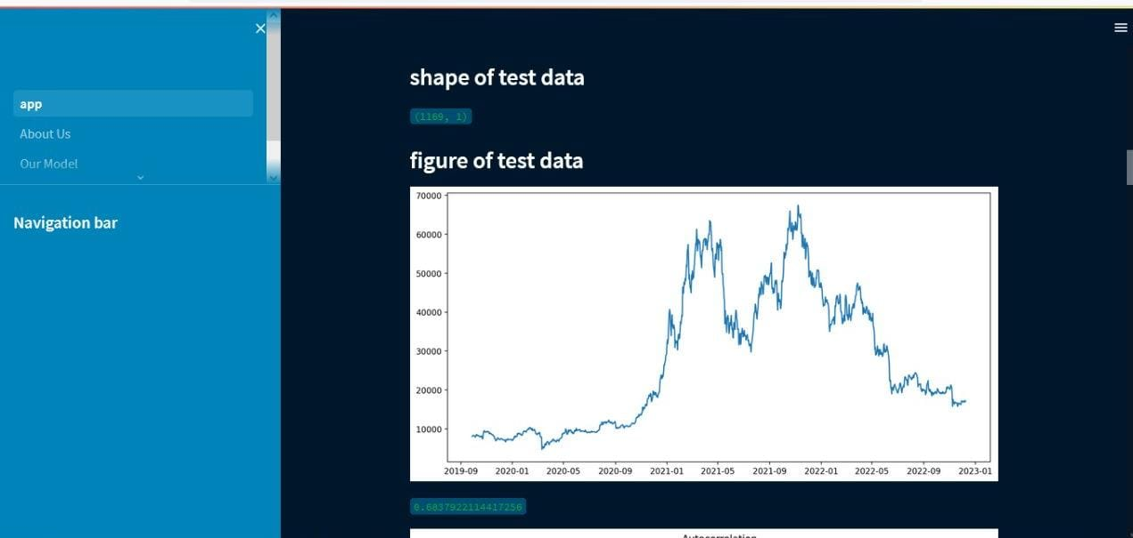
Fig: Shape of train and test data

Slide 27
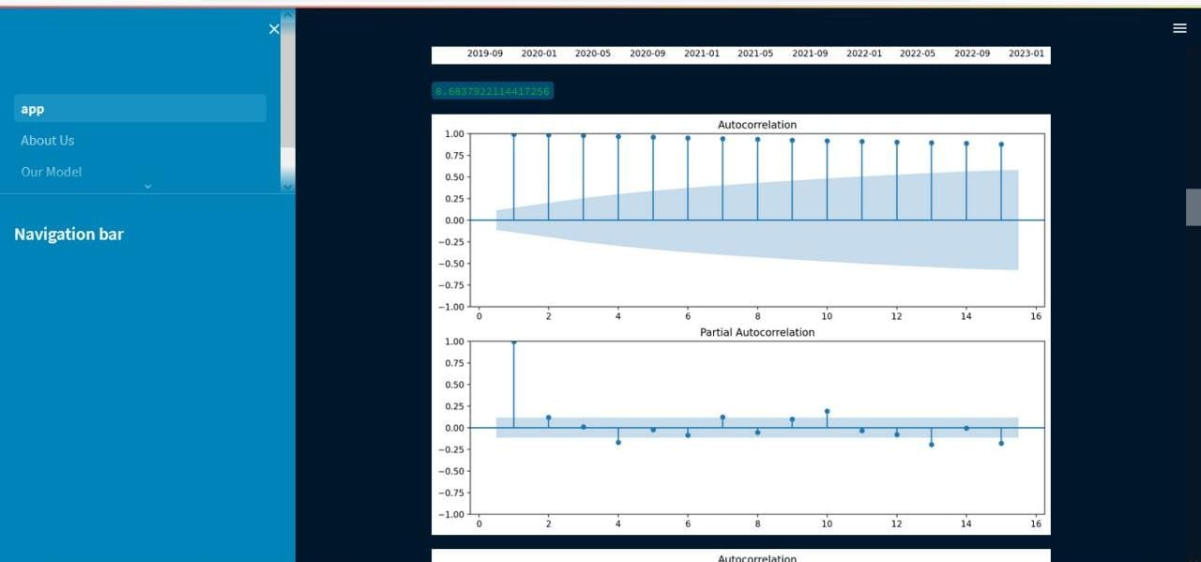
Fig:ACF and PACF plot

Slide 28
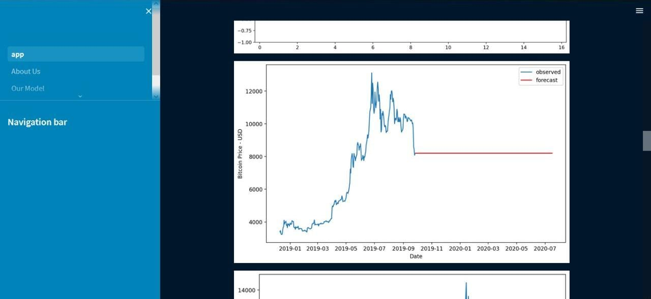
Fig: Observed vs forecast of ARIMA model

Slide 29
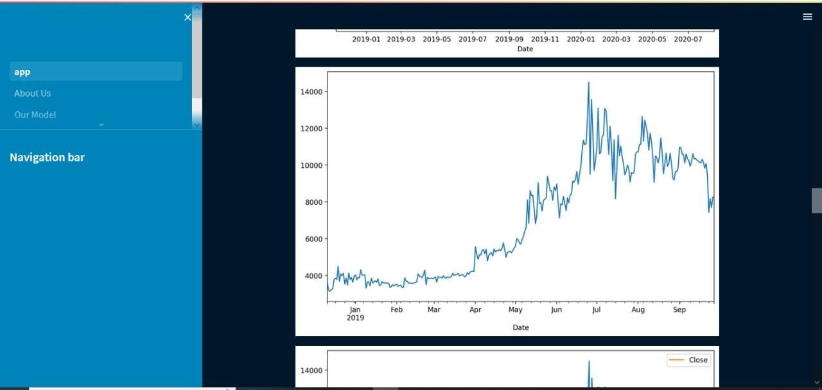
Fig: Arima prediction closing price

Slide 30
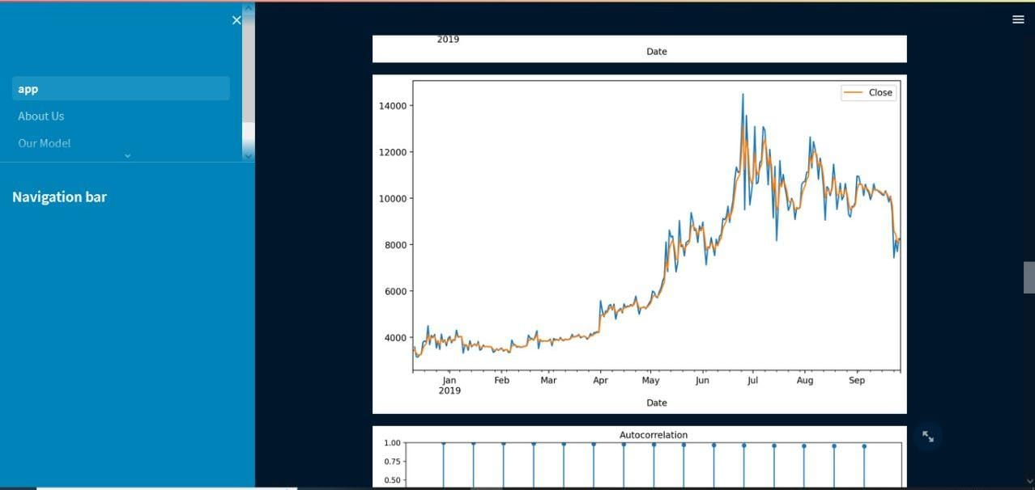
Fig:Arima Prediction for the train data

Slide 31
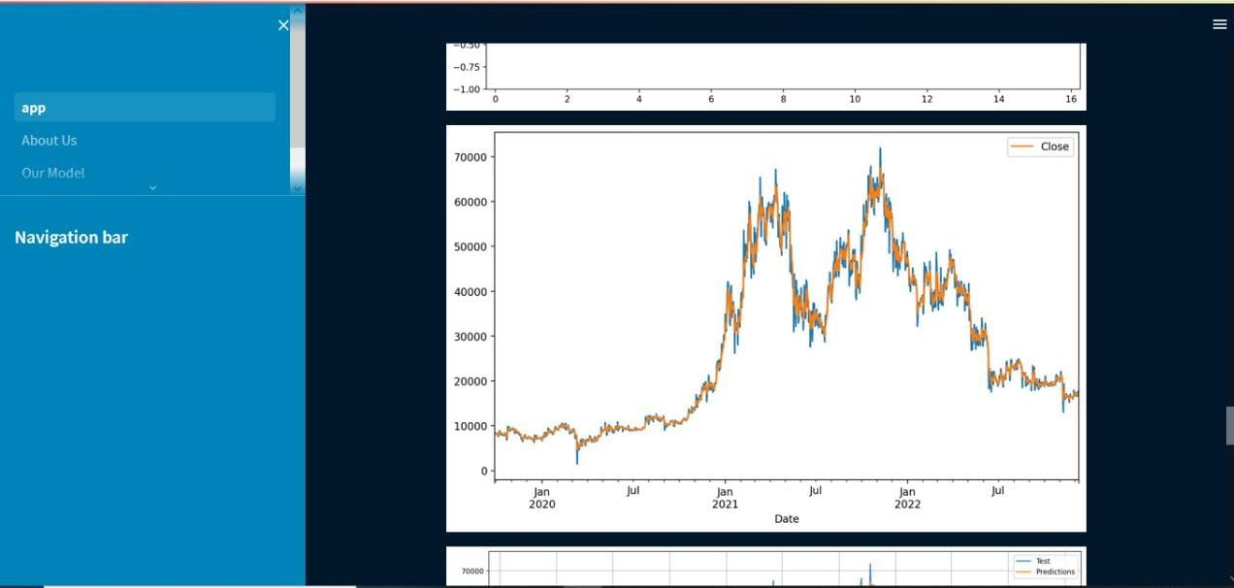
Fig:Arima prediction against test data

Slide 32
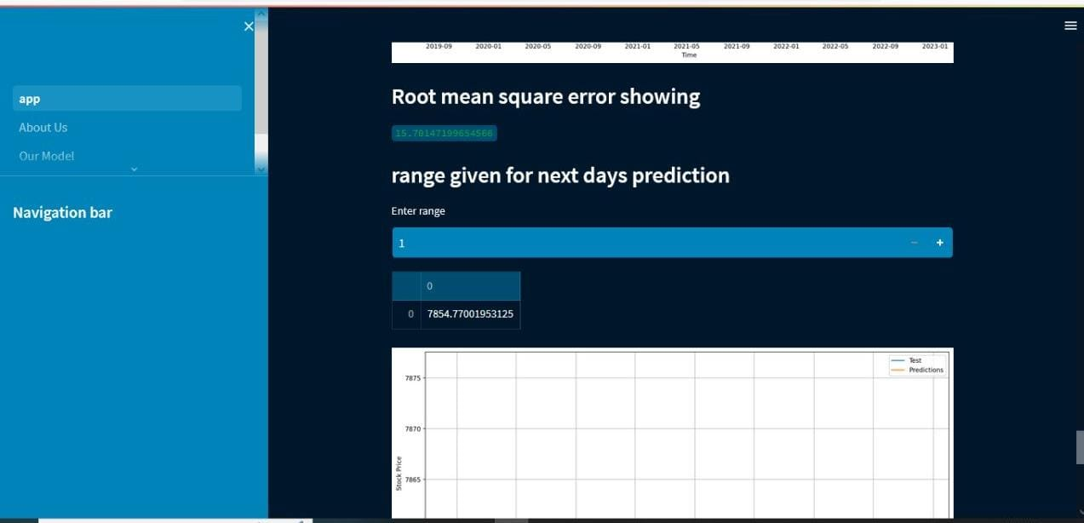
Fig: Enter range for prediction

Slide 33
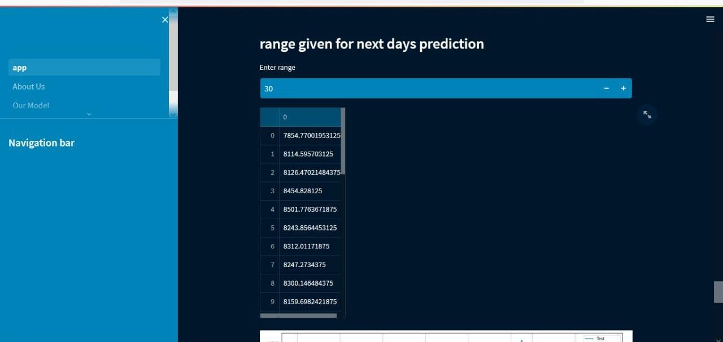
Fig: Showing prediction for the given range

Slide 34
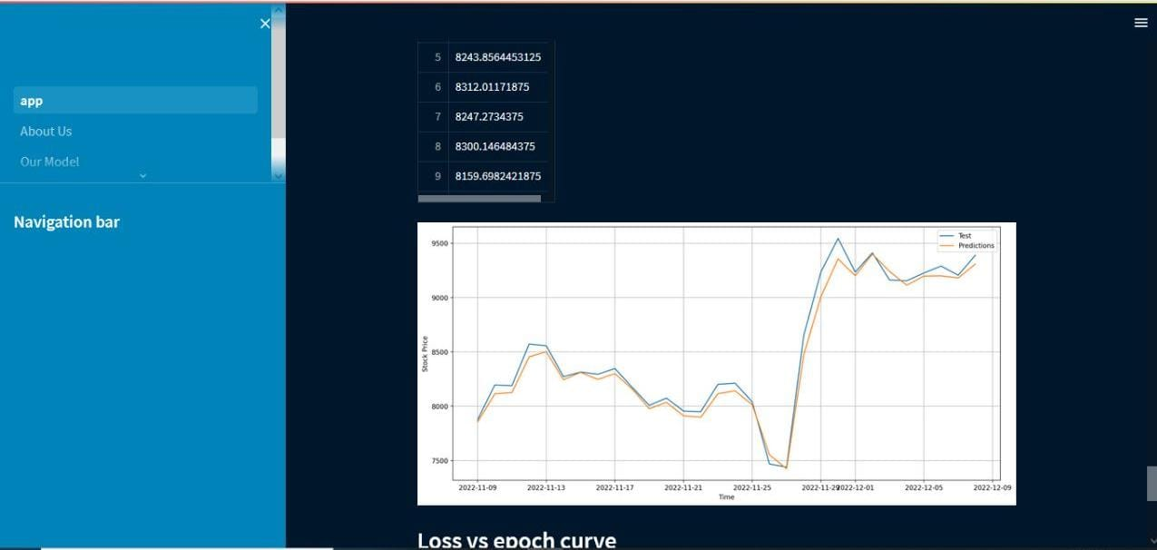
Fig:Prediction vs test for the given range

Slide 35
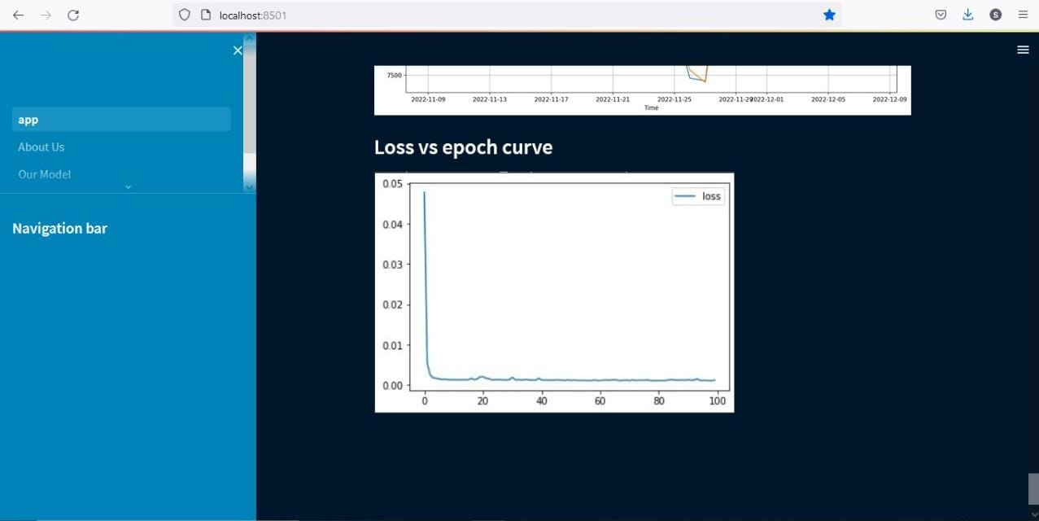
Fig: Loss vs epoch curve

Slide 36
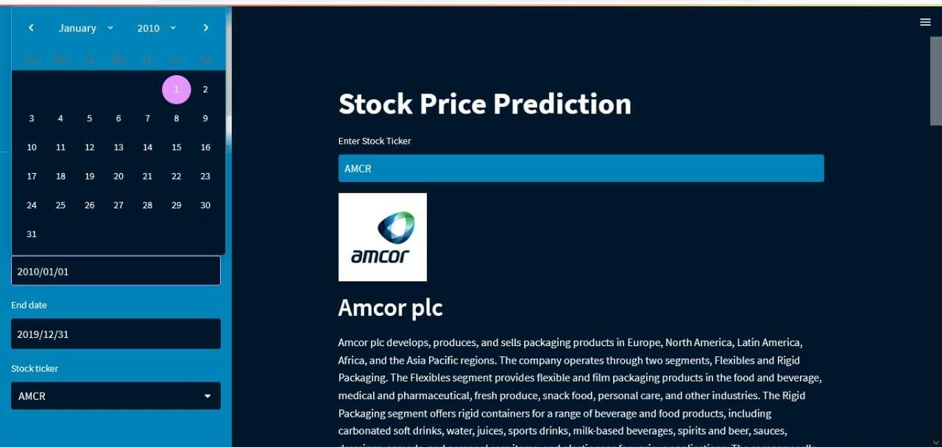
Fig: Query Params showing and details about company

Slide 37
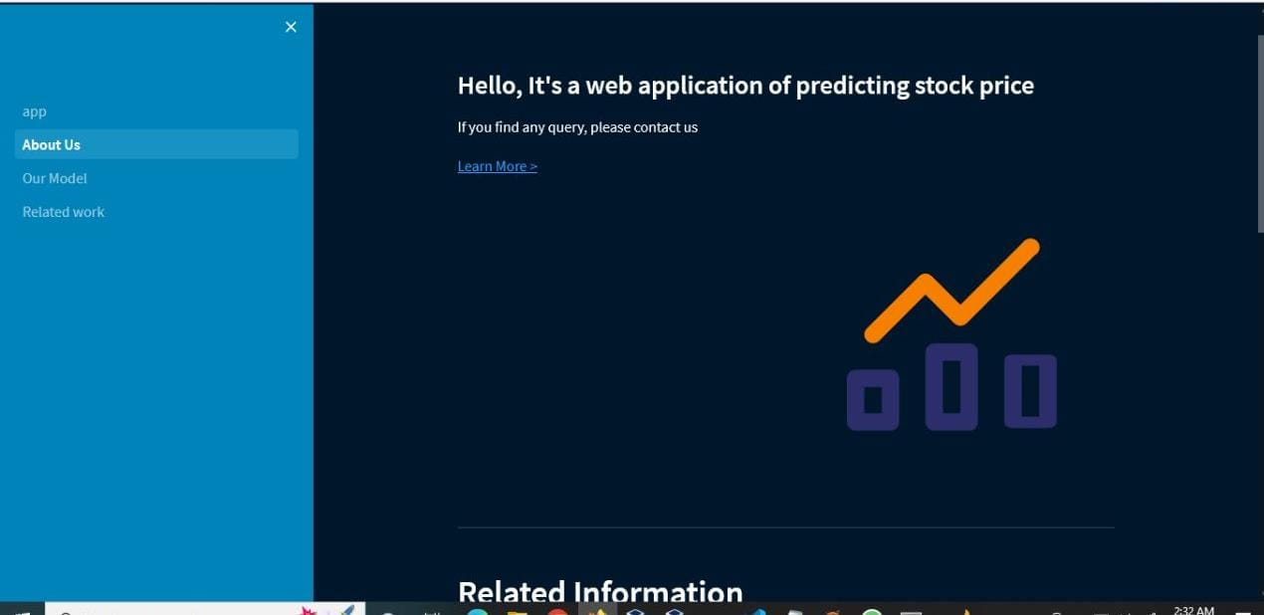
Fig: Providing Information and queries

Slide 38
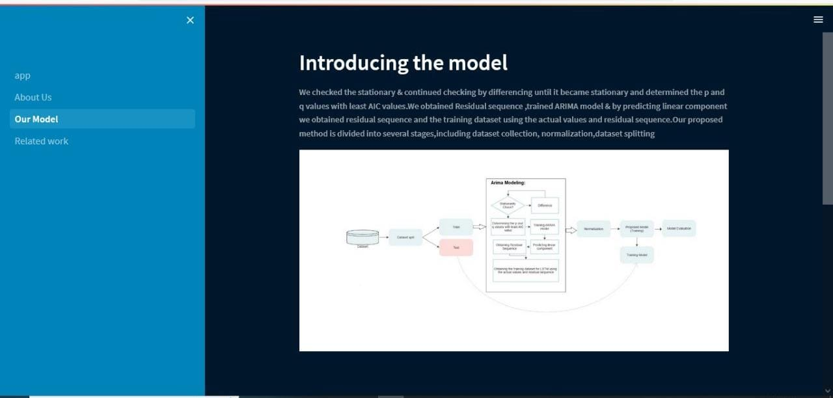
Fig: Model overview by clicking from the navigation bar

Slide 39
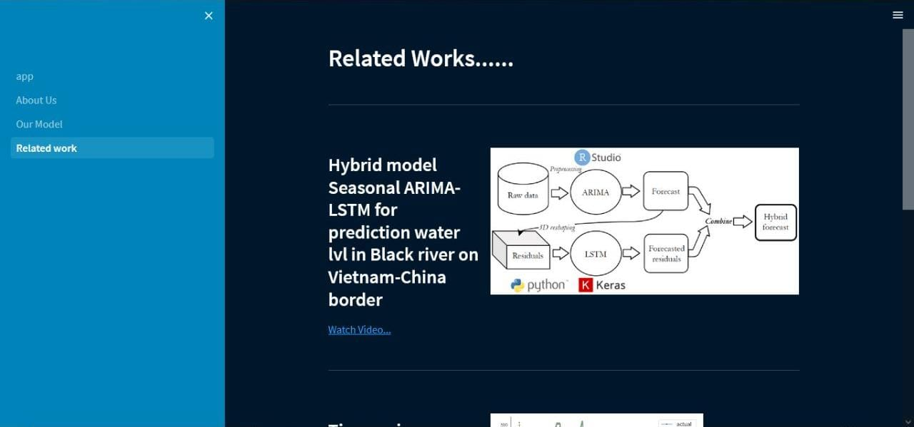
Fig: Related Work showing

