Slide 1


Slide 2
Minor Project – II Digitalization of Land Record using Blockchain
MEMBER’S NAME | ROLL NUMBER | SAP ID | BRANCH
Ishan Agarwal | R103219007 | 500076372 | CSE BAO B1
Sachin Kedia | R103219013 | 500075932 | CSE BAO B1
Sharique Ahmad Khan | R103219016 | 500075119 | CSE BAO B1
Under the guidance of
Mr. Deepak Kumar Sharma

Slide 3
Challenges
Problem with current land record management system:
Errors in public records affects ownership rights and cause financial strain
Illegal deeds by not documenting prior titles in the chainage may affect the ownership
Forged or fabricated documents affect the ownership
Undiscovered encumbrances (Ongoing Cases)
Unknown easements affects right to enjoy the property
Boundary Disputes

Slide 4
Introduction
Possible Solution:
Use blockchain to maintain land records
A peer-to-peer distributed ledger which can be easily accessible by anyone to check land information
All transactional data will be cryptographically secured and immutable

Slide 5
Objective
Securing Land Records by implementing a distributed ledger over a peer to peer network.
Sub Objectives:
Buy and Sell ability to all users.
Implementing Proof Of Authority based Consensus mechanism
Securing plot transactions using digital signature and hashing techniques.
Implementing a peer to peer network to enable distributed ledger

Slide 6
Dataset and Input Format
Project is being prepared for a fictitious small scale area
A mock data will be created
Datasets:
Users dataset
Plot Dataset
Transaction Dataset
Transactions will be stored as blocks in blockchain

Slide 7
How will it work?
Block Chain
Initiate Transaction
Buyer Approval
Seller
Buyer
Block 1
Mempool
Block 2
Unverified Transactions
Admin
Block N
Verified Transactions
Transaction Verification

Slide 8
Project Features
Distributed Ledger:
A distributed ledger is a consensus of replicated, shared, and synchronized digital data geographically spread across multiple nodes.
LEDGER
Ledger
Ledger
Ledger
Ledger

Slide 9
Peer to Peer Network:
As the network will be a peer-to-peer network, there will be a direct communication between buyer and seller.
No mediator will be present

Slide 10
Hashing:
A hash function is any function that can be used to map data of arbitrary size to fixed-size values. The values returned by a hash function are called hash values, hash codes, digests, or simply hashes.
Transaction Detail1
Transaction Detail2
Transaction Detail3
Transaction Detail4
e5ae4373812b38de6086516891db1c7a852f918218027154e0cb550bbfc84965
Ledger
Hash(Ledger)

Slide 11
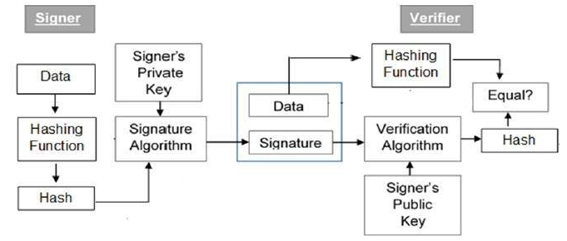
Digital Signature:
Reference: https://www.tutorialspoint.com/cryptography/cryptography_digital_signatures.htm

Slide 12
Implementation Benefits
Blockchain provides consolidated, consistent dataset and reduces errors
Provides near real-time access to Land records.
Increases trust through shared processes and recordkeeping
Lower cost of audit and regulatory compliance
Increase the speed of execution with reduced cost
Reduces risk – Tampering, fraud and cybercrime

Slide 13
Information Stored
User Database
Username
User ID
Aadhar Number
Address
Contact
Pan Card
Father’s Name
Property Details database
Property Id
Geo-Co-ordinates (latitude/longitude)
Plot No.
Dimensions
Allotted Area
Land Use
Boundary Information
User ID
Blockchain headers:
Block Height
Transactions
Prev Hash
Current Hash
Timestamp
No. Of transactions

Slide 14
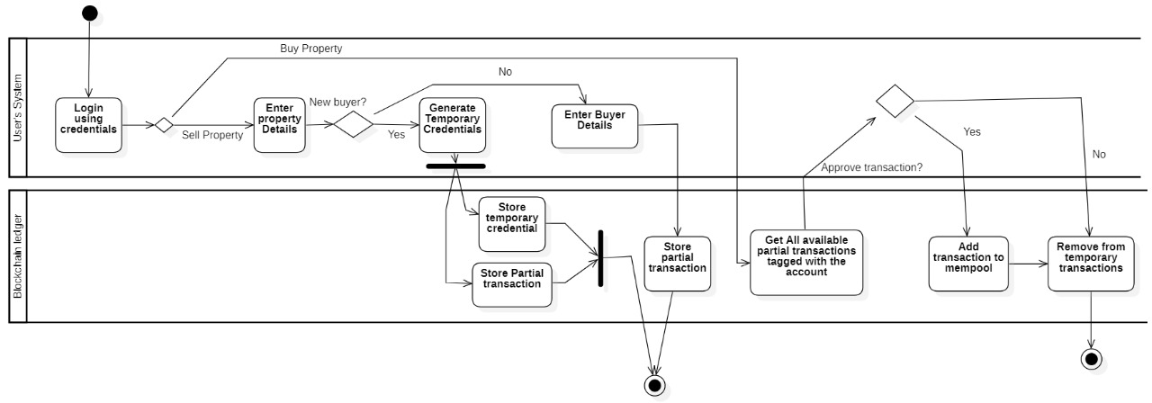
flowchart
Interaction between User and Blockchain:

Slide 15
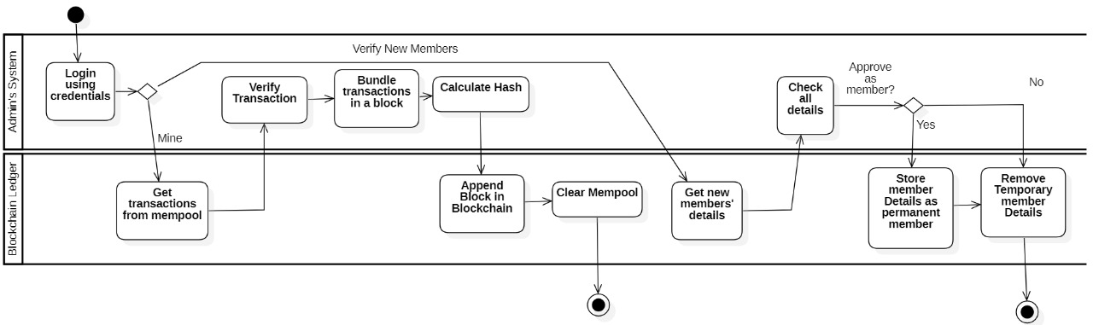
Interaction Between Admin and Blockchain:

Slide 16
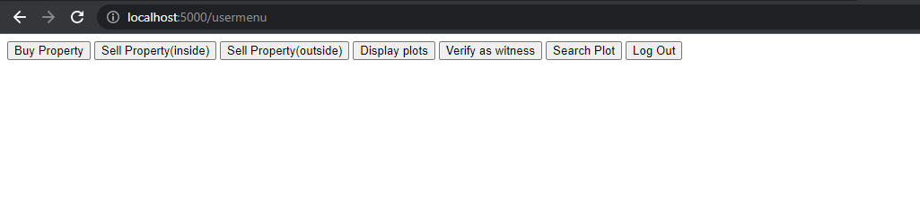
Working Model
User Menu

Slide 17
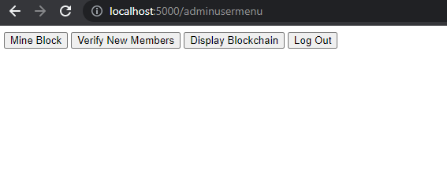
Admin Menu

Slide 18
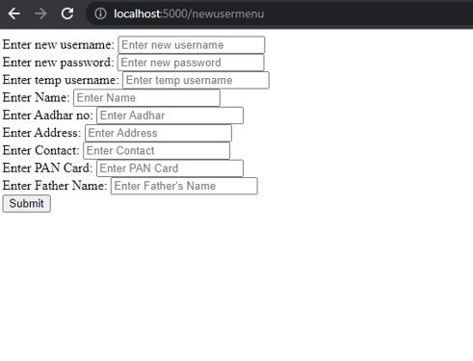
New member Interface

Slide 19
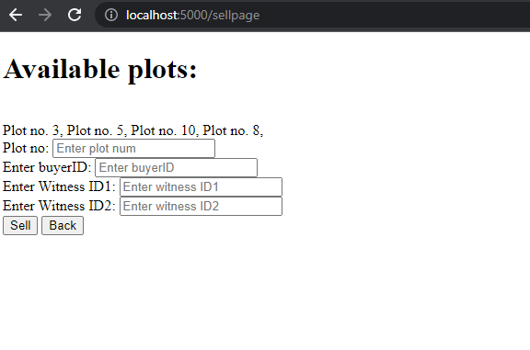
Sell Page

Slide 20
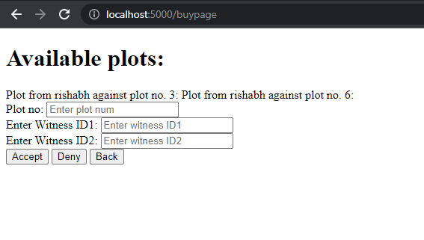
Buy page

Slide 21
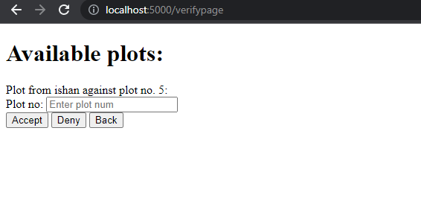
Witness interface

Slide 22
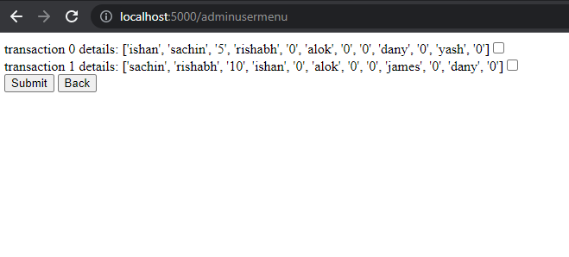
Mining Interface

Slide 23
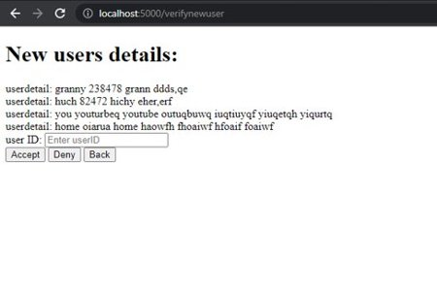
New User Verification

Slide 24
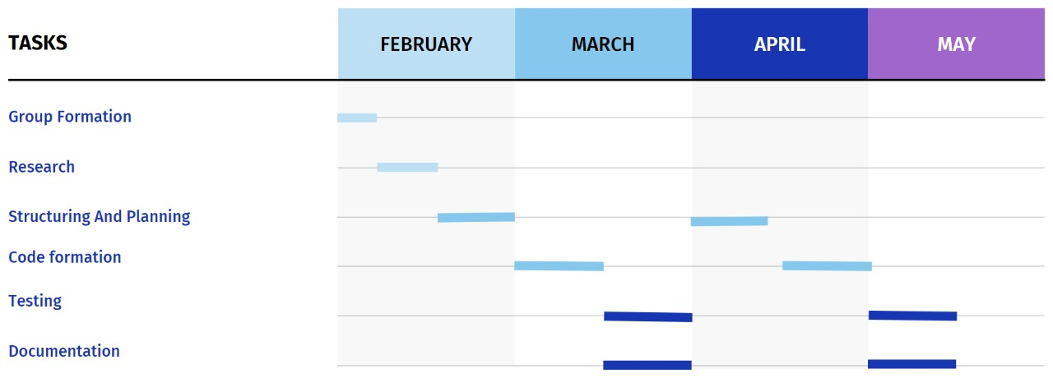
Plan of Work

Slide 25
Future Scopes & Application
Blockchain for maintaining land records can be used Nationwide which will ultimately help in reducing Land disputes.
Smart Contracts can be introduced in blockchain which can automate the task of Agreement between Seller and Buyer.
Government can easily monitor and audit the Land Ownership through blockchain.
Buyer can easily verify the land status with the help of blockchain without any brokerage.

Slide 26
References
https://www.tutorialspoint.com/cryptography/cryptography_digital_signatures.htm
https://aphrdi.ap.gov.in/documents/Trainings@APHRDI/2020/feb_2/Citizen%20Centric%20Services/Block%20Chain%20Technology.pdf
https://www.investopedia.com/terms/b/blockchain.asp
https://www.tutorialspoint.com/blockchain/blockchain_chaining_blocks.htm

