Slide 1
Odin MySQL Assignment

Slide 2
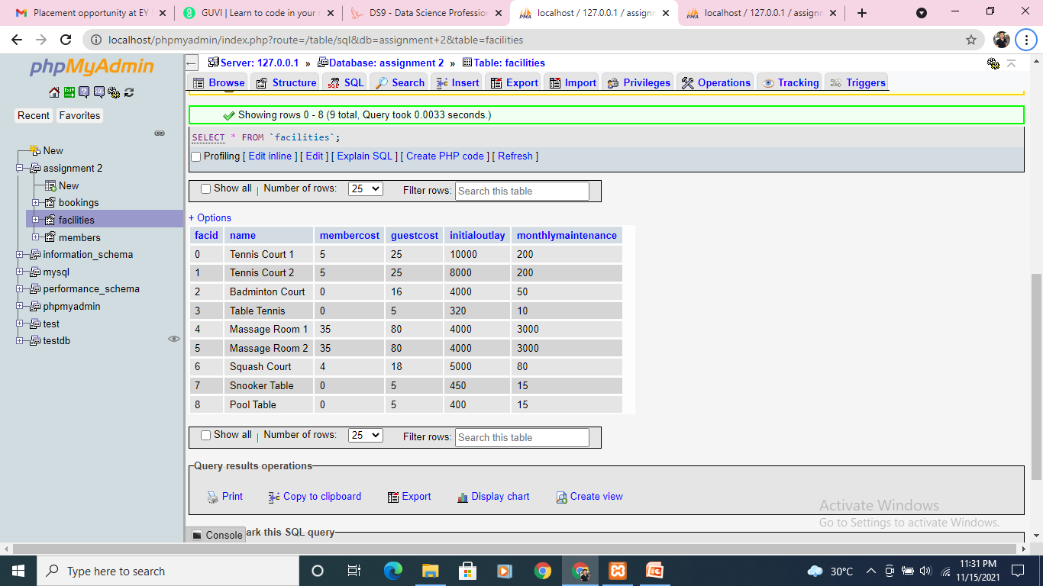
How can you retrieve all the information from cd.facilities table

Slide 3
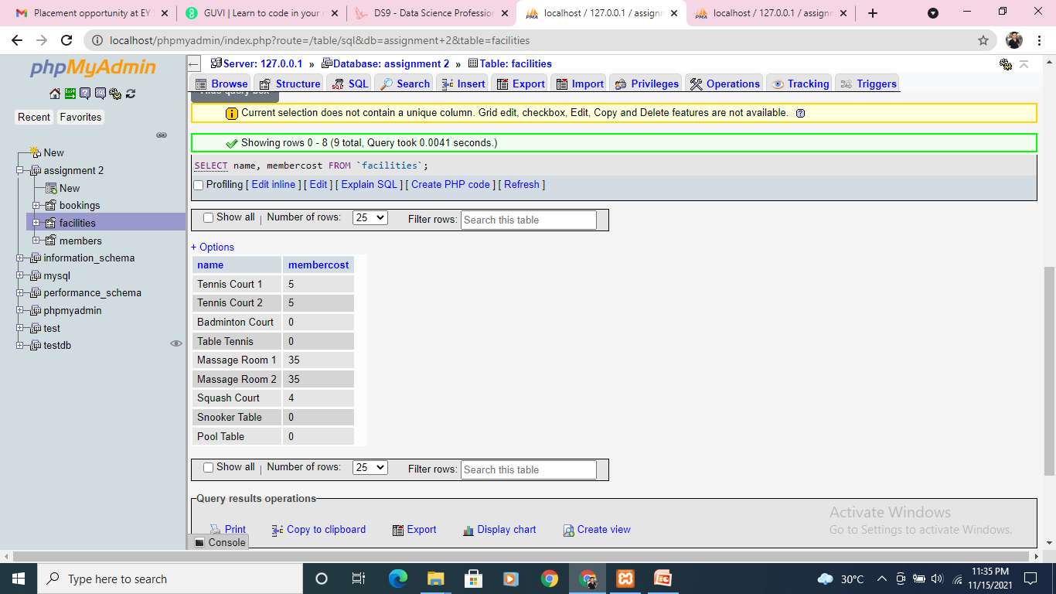
Q. You want to print out a list of all of the facilities and their cost to members. How would you retrieve a list of only facility names and costs?

Slide 4
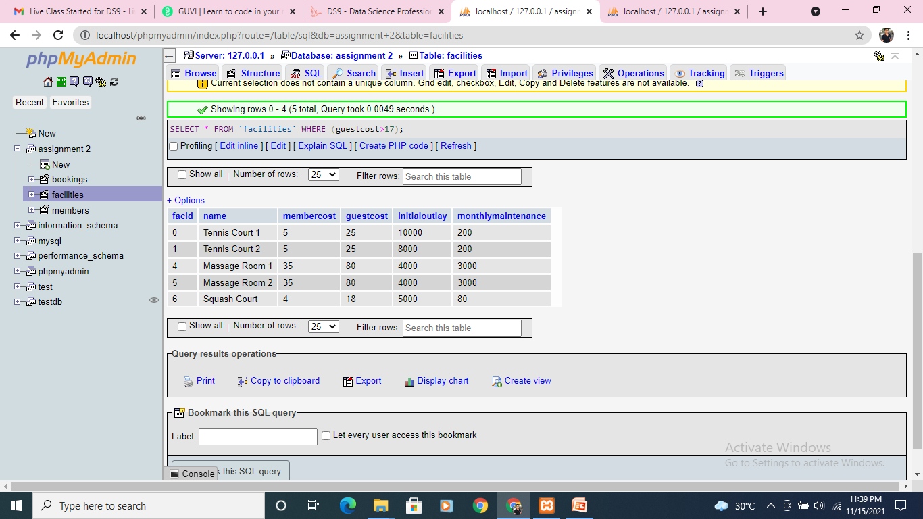
Q. How can you produce a list of facilities that charge a fee to members? Expected Results should have just 5 rows:

Slide 5
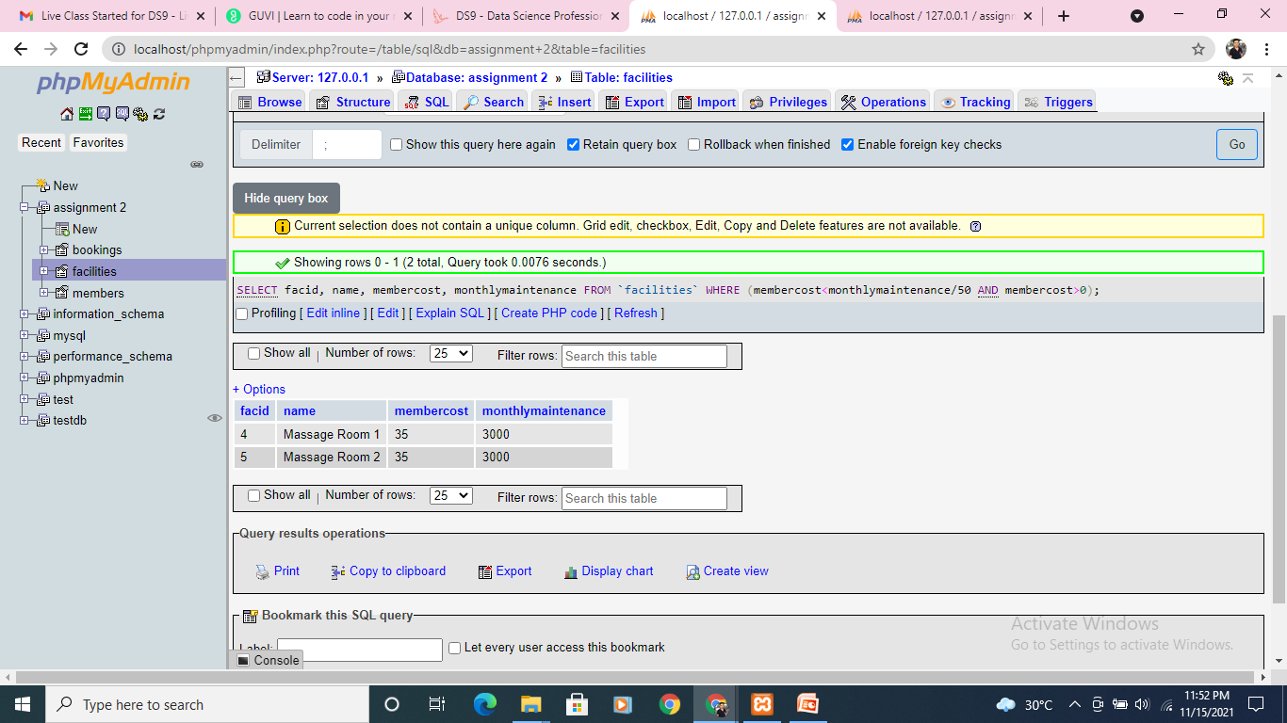
Q. How can you produce a list of facilities that charge a fee to members, and that fee is less than 1/50th of the monthly maintenance cost? Return the facid, facility name, member cost, and monthly maintenance of the facilities in question.

Slide 6
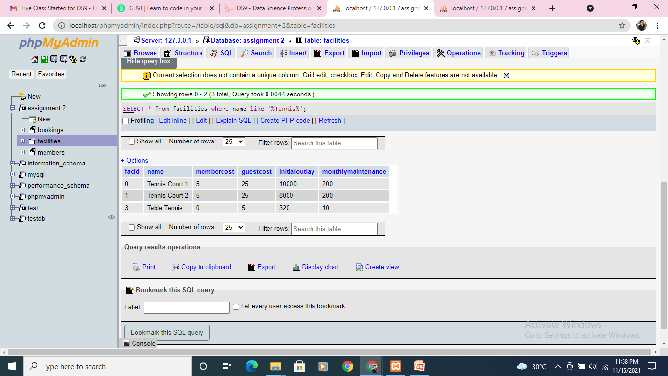
How can you produce a list of all facilities with the word 'Tennis' in their name? Expected Result is 3 rows

Slide 7
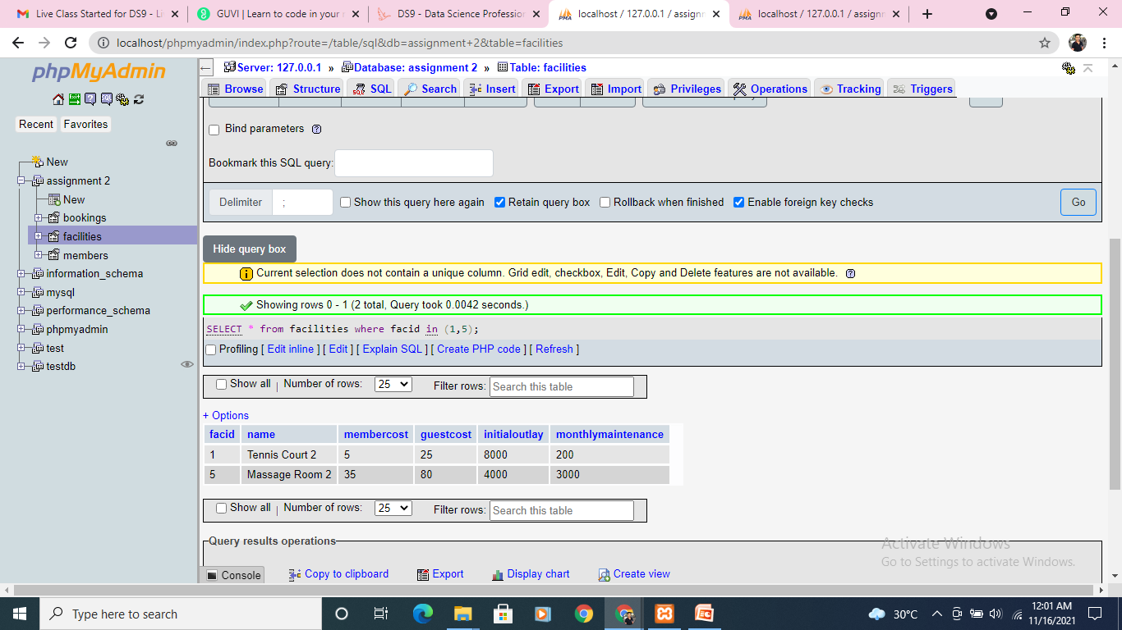
How can you retrieve the details of facilities with ID 1 and 5? Try to do it without using the OR operator. Expected Result is 2 rows

Slide 8
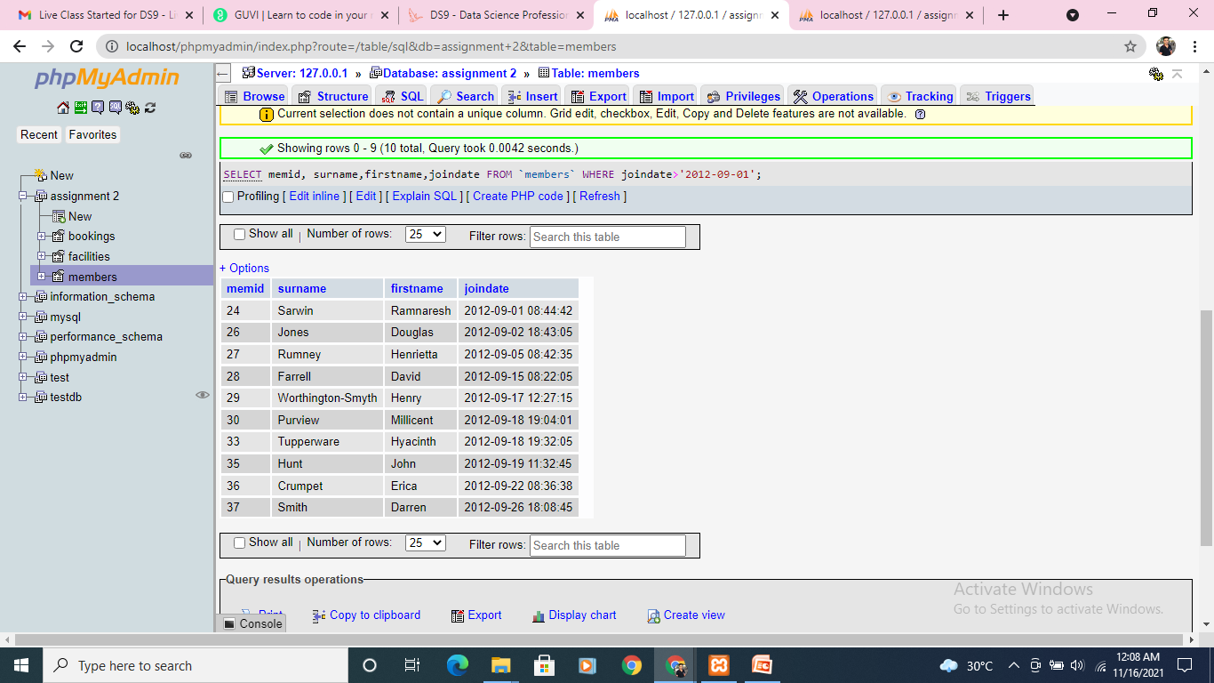
How can you produce a list of members who joined after the start of September 2012? Return the memid, surname, firstname, and joindate of the members in question. Expected Result is 10 rows (not all are shown below)

Slide 9
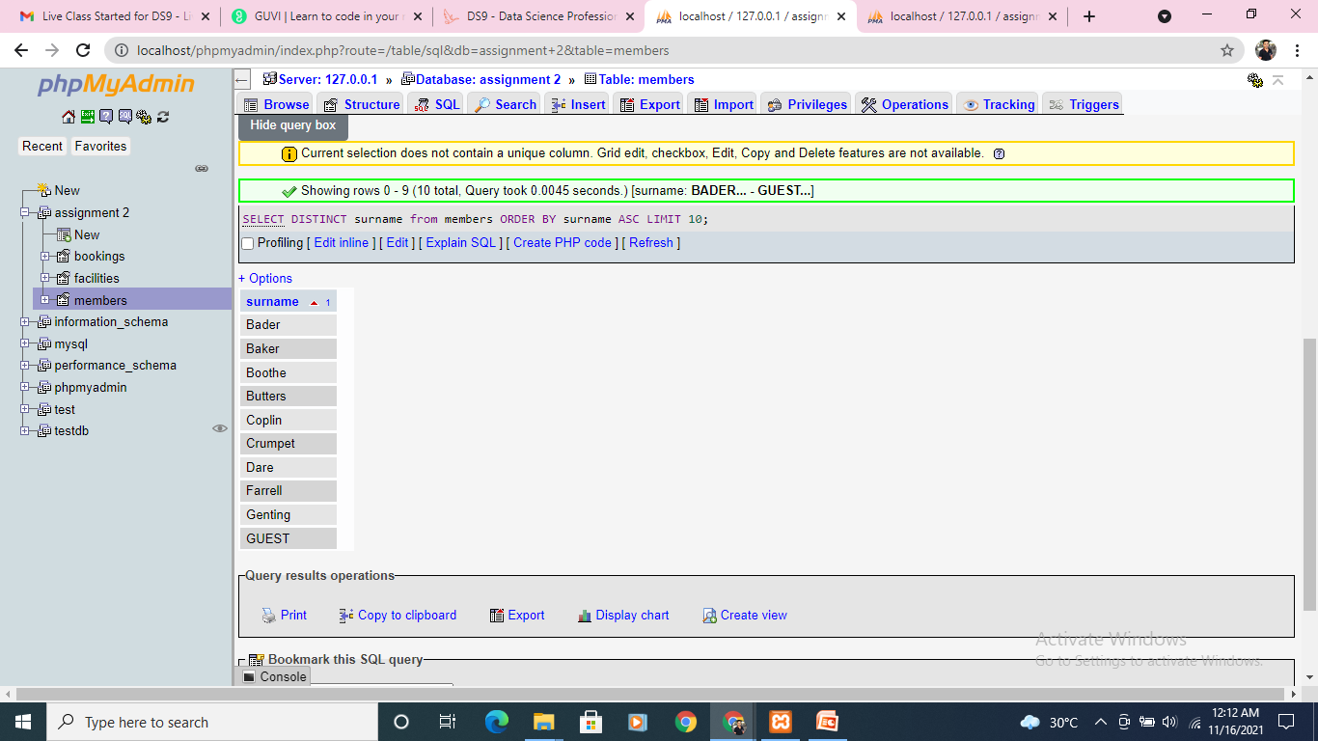
How can you produce an ordered list of the first 10 surnames in the members table? The list must not contain duplicates. Expected Result should be 10 rows if you include GUEST as a last name

Slide 10
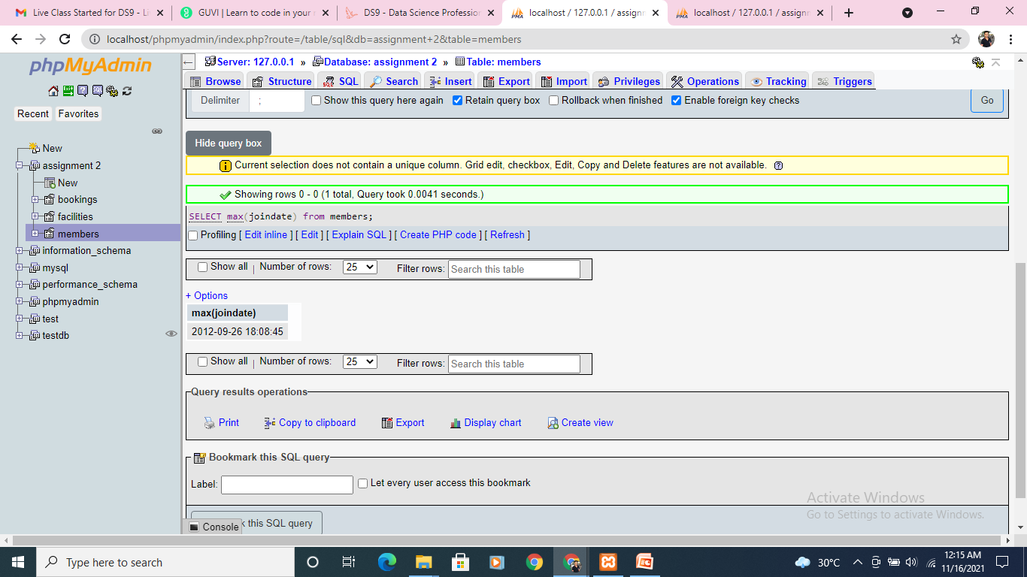
You'd like to get the signup date of your last member. How can you retrieve this information? Expected Result 2012-09-26 18:08:45

Slide 11
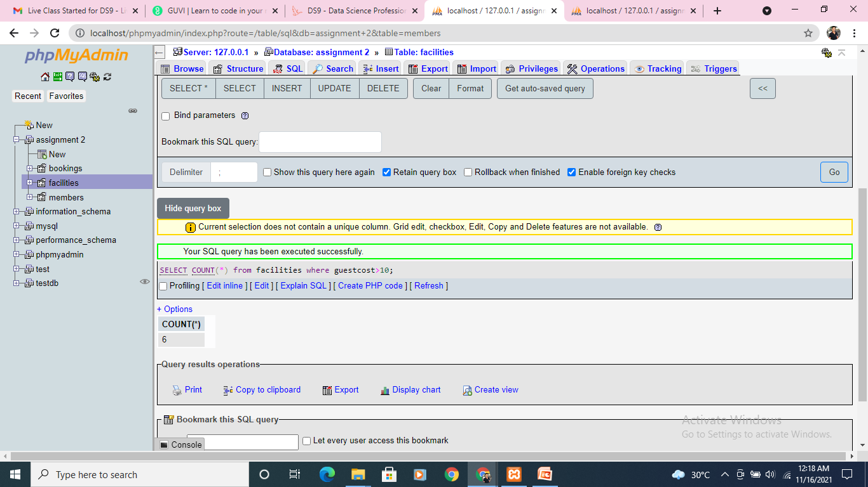
Produce a count of the number of facilities that have a cost to guests of 10 or more. Expected Result 6

Slide 12
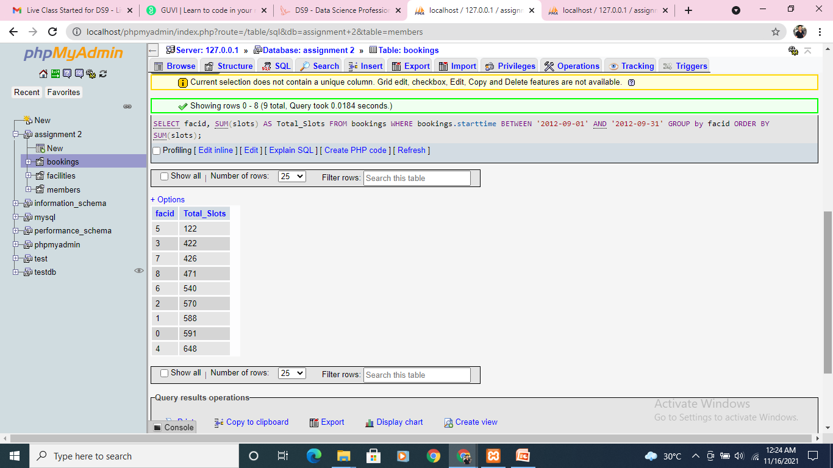
Produce a list of the total number of slots booked per facility in the month of September 2012. Produce an output table consisting of facility id and slots, sorted by the number of slots. Expected Result is 9 rows

Slide 13
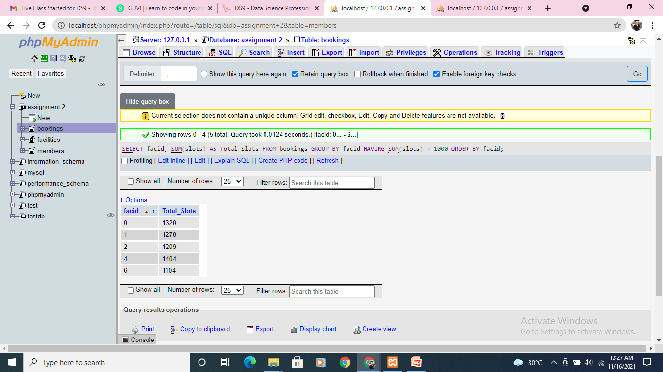
Produce a list of facilities with more than 1000 slots booked. Produce an output table consisting of facility id and total slots, sorted by facility id. Expected Result is 5 rows

Slide 14
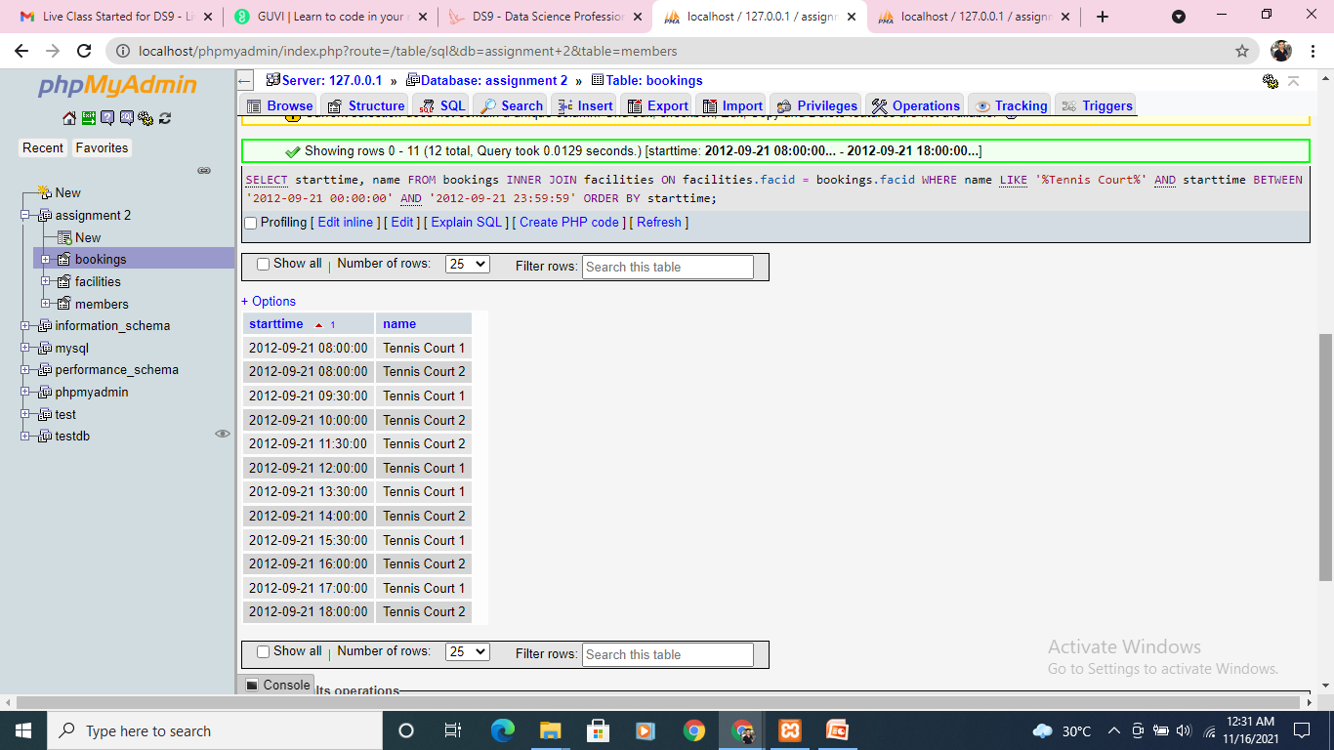
How can you produce a list of the start times for bookings for tennis courts, for the date '2012-09-21'? Return a list of start time and facility name pairings, ordered by the time. Expected Result is 12 rows

Slide 15
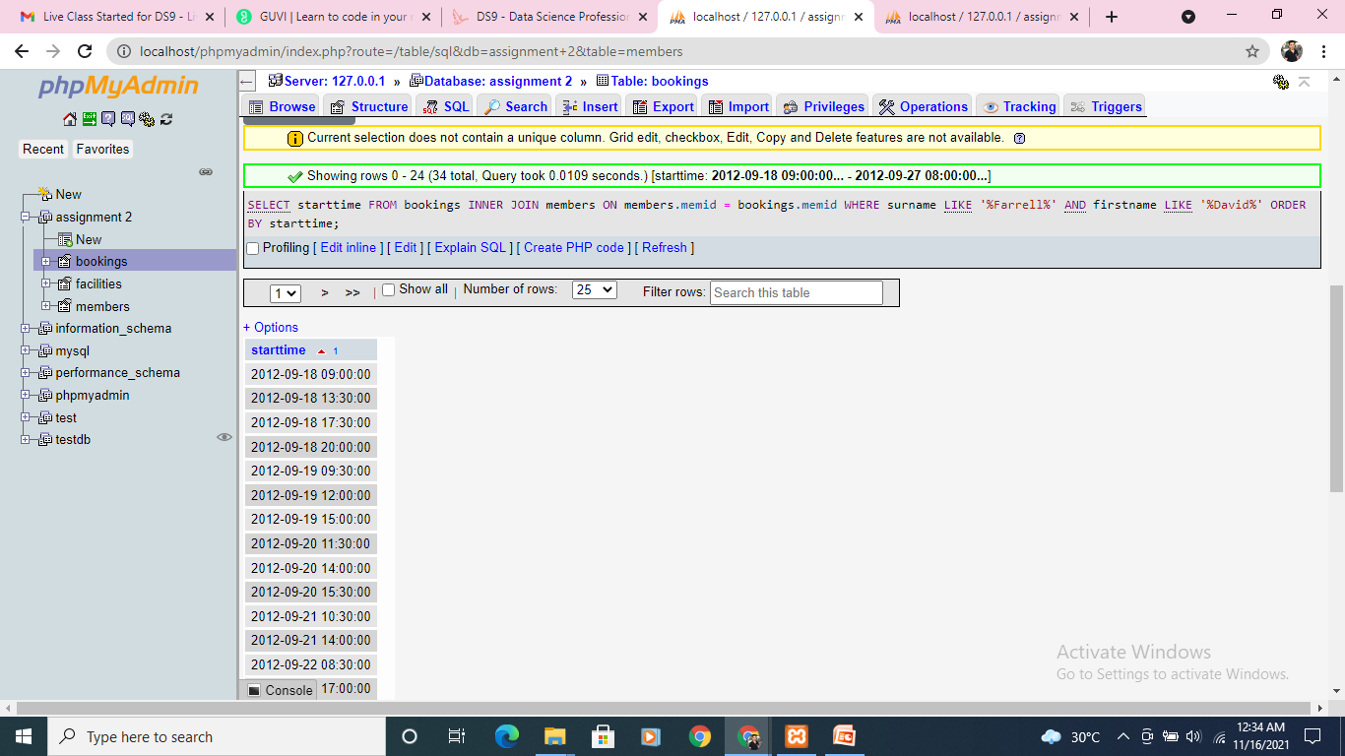
How can you produce a list of the start times for bookings by members named 'David Farrell'? Expected result is 34 rows of timestamps

Slide 16
Task 2
Create a new database called "School" this database should have two tables: teachers and students.
The students table should have columns for student_id, first_name,last_name, homeroom_number, phone,email, and graduation year.
The teachers table should have columns for teacher_id, first_name, last_name, homeroom_number, department, email, and phone.
The constraints are mostly up to you, but your table constraints do have to consider the following:
We must have a phone number to contact students in case of an emergency.
We must have ids as the primary key of the tables
Phone numbers and emails must be unique to the individual.
Once you've made the tables, insert a student named Mark Watney (student_id=1) who has a phone number of 777-555-1234 and doesn't have an email. He graduates in 2035 and has 5 as a homeroom number.
Then insert a teacher names Jonas Salk (teacher_id = 1) who as a homeroom number of 5 and is from the Biology department. His contact info is: jsalk@school.org and a phone number of 777-555-4321.

Slide 17
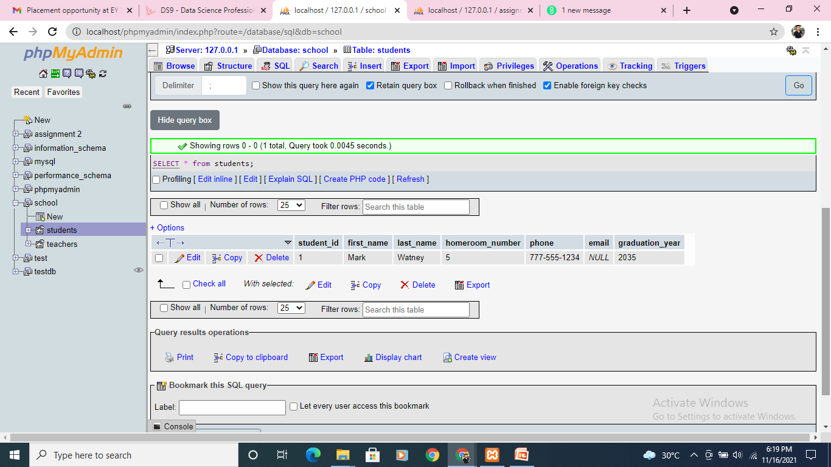
Students table
I have displayed all the outputs related to students table in one go.
Students table is under school database

Slide 18
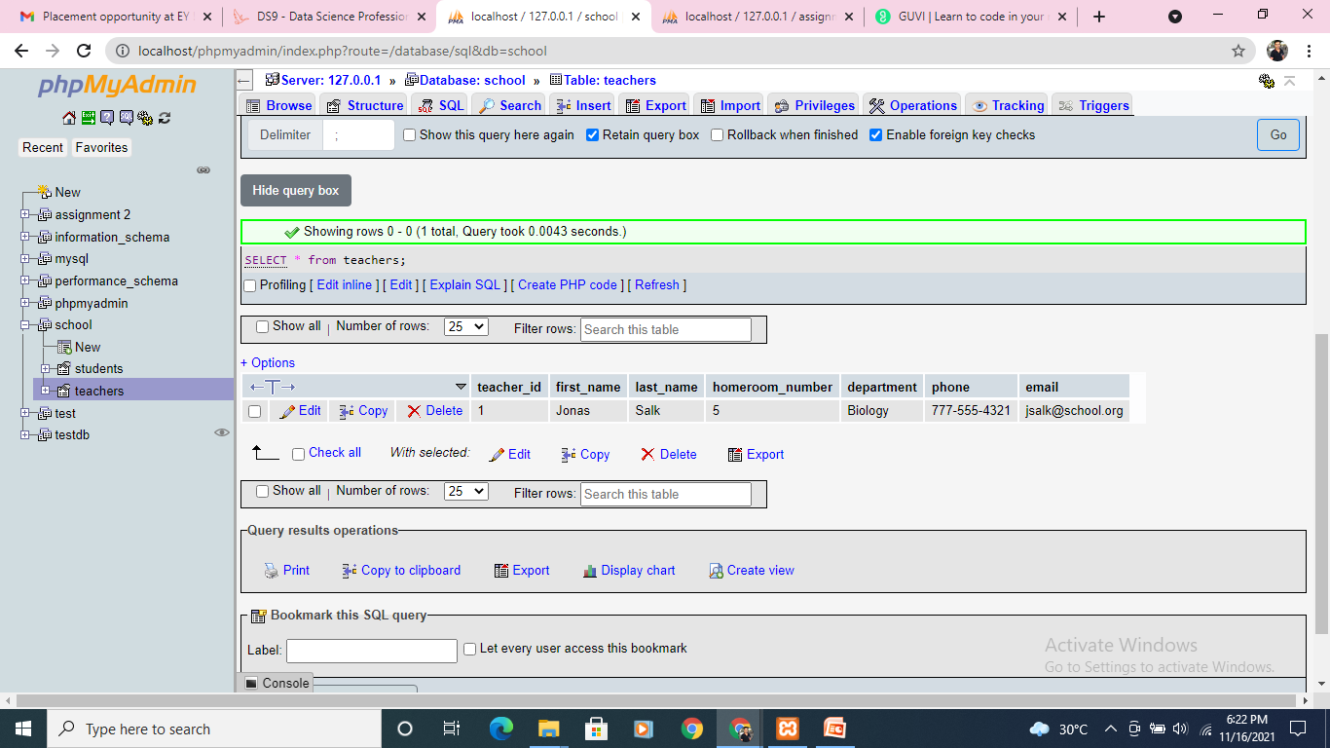
Teachers table
A pictorial output of teachers table after executing the needful.

