Slide 1
Adult neurogenesis : subgranular zone
Student members
. Esra habib . Ayeh najad . Aia khashim . Dalia awad

Slide 2
Outline
Introduction
Development stages
Molecular pathways
conclusion

Slide 3
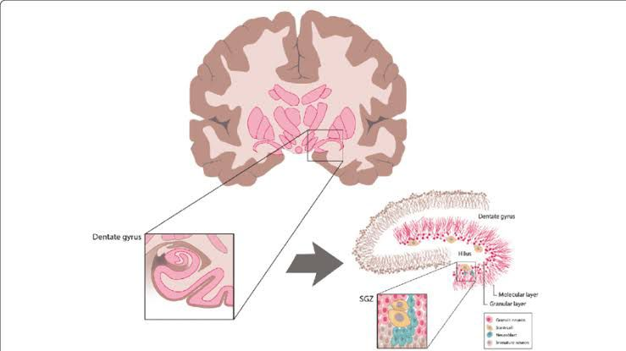
SGZ location
In the human brain, the sub granular zone (SGZ) is located within the hippocampus, specifically within the dentate gyrus—a structure deep within the temporal lobe. Positioned between the granule cell layer and the hilus, the SGZ is where adult neurogenesis occurs

Slide 4
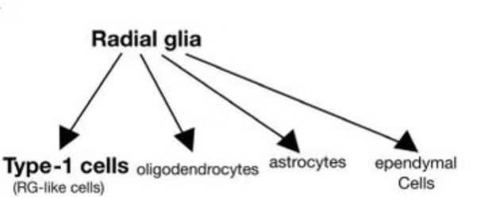
Origin of Neural Progenitor Cells
Neuroepithelial cells in the developing neural tube undergo symmetrical cell divisions during embryonic development, producing proliferating neuroepithelial cells.
Some neuroepithelial cells transform into radial glia (RG) later in embryonic development, which can generate neurons, oligodendrocytes, astrocytes, and ependymal cells.
RG and a subset of astrocytes act as stem cells, producing both glial cells and neurons in the adult brain.

Slide 5
Hormonal Regulation of Neurogenesis
Estrogen
Estradiol, the dominant estrogen, enhances cell proliferation and survival in the subgranular zone.
Testosterone
Testosterone and its metabolite dihydrotestosterone also appear to regulate adult hippocampal neurogenesis.
Stress Hormones
Glucocorticoids like cortisol generally have an inhibitory effect on hippocampal neurogenesis.
Thyroid Hormones
Thyroid hormones help promote the survival of newly formed neurons in the adult hippocampus.

Slide 6
Development of adult neurogenesis
Location & Identity:
Reside in specific brain regions called “niches”.
Maintained in a state of irreversible cell cycle arrest.
Also known as radial glia-like cells (RGLs), “quiescent neural stem cells,” or “type 1 cells”.
Recognizable by a triangular soma and an apical process projecting into the granule cell layer from the subgranular zone (SGZ).
Activation & Progeny:
Initial mitotic divisions produce progeny with reduced self-renewal but increased lineage restriction and proliferative potential.
Progeny include:
  Type 2a cells: Glial phenotype, extend short processes tangential to SGZ.
  Type 2b cells: Neuronal phenotype, express genes for fate specification, morphologically similar to Type 2a but not proliferating.

Slide 7
Development of adult neurogenesis
Immature Neurons:
Early neurons (Type 2b cells) stimulated by GABAergic inputs despite GABA being inhibitory in mature neurons.
High chloride ion levels in immature neurons’ cytoplasm facilitate this stimulation.
Stimulated immature neurons undergo maturation, extending dendrites into the molecular layer.
Further Differentiation:
Type 2b cells differentiate into neuroblasts (Type 3 cells).
Type 3 cells adopt a polarized morphology:
  Dendrites extend from the apex of the soma into the dentate molecular layer.
  Axons project from the base of the soma into the dentate hilus and eventually to the CA3 pyramidal cell layer.

Slide 8
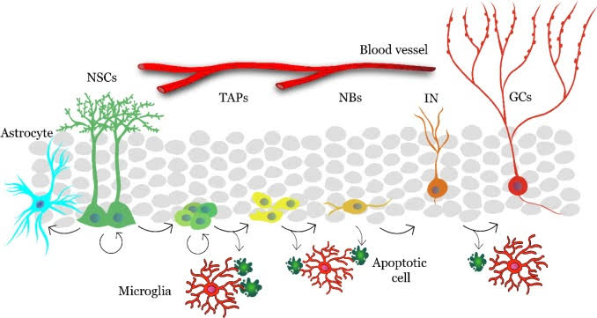
Development of adult neurogenesis

Slide 9
The Role of Astrocytes in Adult Neurogenesis
Astrocytes in the dentate gyrus play a central role in supporting the different stages of adult neurogenesis, from stem cell maintenance to neuronal maturation and integration.
Supportive Role
Astrocytes release and regulate various signaling molecules, including Wnts, cytokines, and ephrins, that influence neural stem cell proliferation, differentiation, and synapse formation.
Signaling Molecules

Slide 10
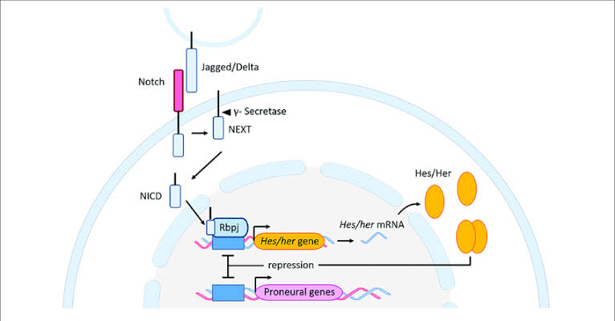
Notch
the effects of Notch signaling on adult neurogenesis are dependent on the context. in the adult hippocampus, the Notch 1 signaling pathways were shown to be required for self-renewal, cell differentiation, and expansion of Nestin-expressing NSCs. It also can modulate dendritic morphogenesis.
  transmembrane Notch receptors binding to cell-bound ligands (delta, jagged in mammals) can lead to intramembranous cleavage in the receptor by γ-secretase and release active Notch intracellular domain (NICD).
  NICD translocates into the cell nucleus and finally associates with RBPJ to activate transcription.
The Notch signalling pathway inactivation, leading to the initiation of increase the hippocampal neurogenesis through premature differentiation of Sox2-positive progenitors. Finally, the inactivation of RBPj resulted in the depletion of the progenitor cell pool and therefore suppression of adult neurogenesis in the hippocampal formation.
The expression of Sox2 is highly in type 1 and type 2a cells and it is involved in the control of the multipotency and proliferative capacities of NSCs.

Slide 11
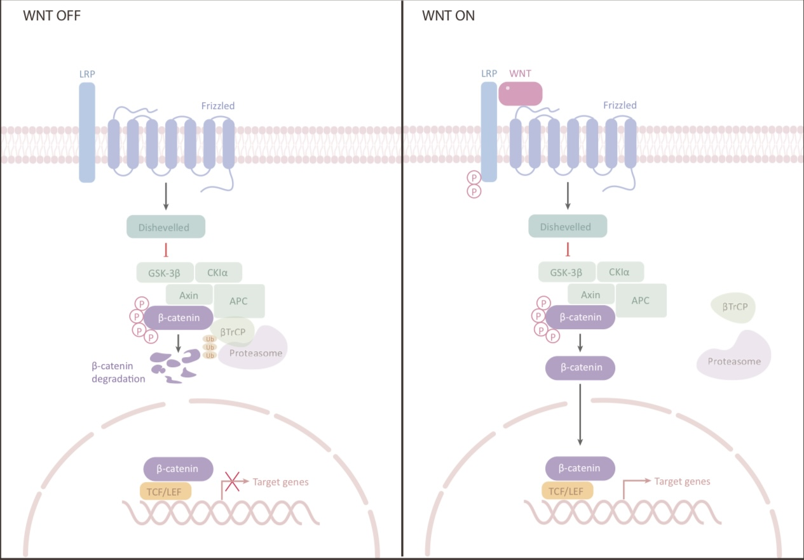
WNT
One of the main molecular pathways is the Wnt/β-Catenin signaling pathway which has an important role in promoting the proliferation of adult NSCs , enhancing the differentiation of neuronal precursor cells and self-renewal. Additionally, it controls late phases of adult neurogenesis like dentinogenesis and migration.
The Wnt signaling pathway as a powerful factor can promote synaptogenesis during development but is also necessary for synapse maintenance in the adult brain.
  β-catenin-dependent pathway (Wnt canonical pathway)
    Binding of wnt and β-catenin stabilization .
    Entrance into the nucleus, and binds to T-cell factor/lymphoid enhancer-binding factor (TCF/LEF) transcription factors.
    Activation of Wnt target genes.
Wnt signalling pathway are release from astroglial cells niche, and they exert paracrine effects on NSCs/NPCs.

Slide 12
WNT
The Wnt activity during development is countered by secret inhibitory factors like secreted frizzled-related proteins (Sfrps) and Dickkofp-1(Dkk1) which directly bind and sequester Wnts and Wnt co-receptor low-density lipoprotein receptor-related proteins (LRP 5/6).
Under normal conditions, in the mature hippocampus, the expression of these Wnt inhibitors is very low, but in the DG granular cells, the expression of Sfrp3 and Dkk3 is high.
With age, there is an increase in the expression of the Wnt inhibitors sFRP3 and Dkk1 in the hippocampus, which impairs object recognition memory consolidation.
Sfrp3 secreted by DG cells, and ablation of Sfrp3 can activate the quiescent radial NSCs and a subsequent increase in dendritic complexity

Slide 13
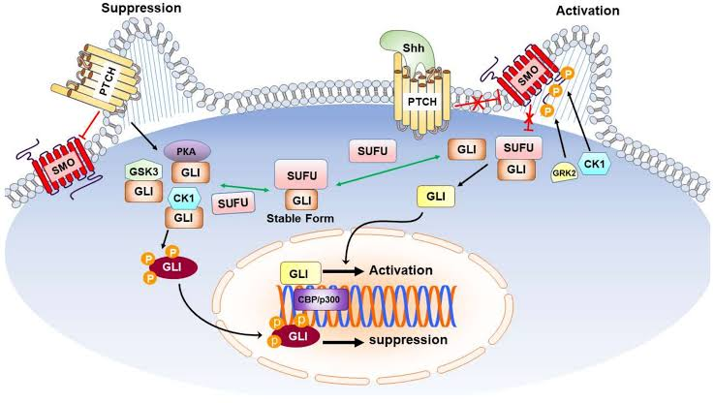
SHH
nteraction between the Shh and Patch’s receptor can lead to a decrease in the inhibitory effect of Patch on the SMO receptor which results in the activation of the SMO as a downstream molecular pathway via binding to COS2.
the interaction of SMO with COS, from the COS2 complex Fu can release and the freed Fu combines to the SUFU to release GLI from SUFU complex.
the freed GLI goes to the cell nucleus and with some transcription factors like CBP/p300, can combine with the promoters of target genes which results in regulating their expression

Slide 14
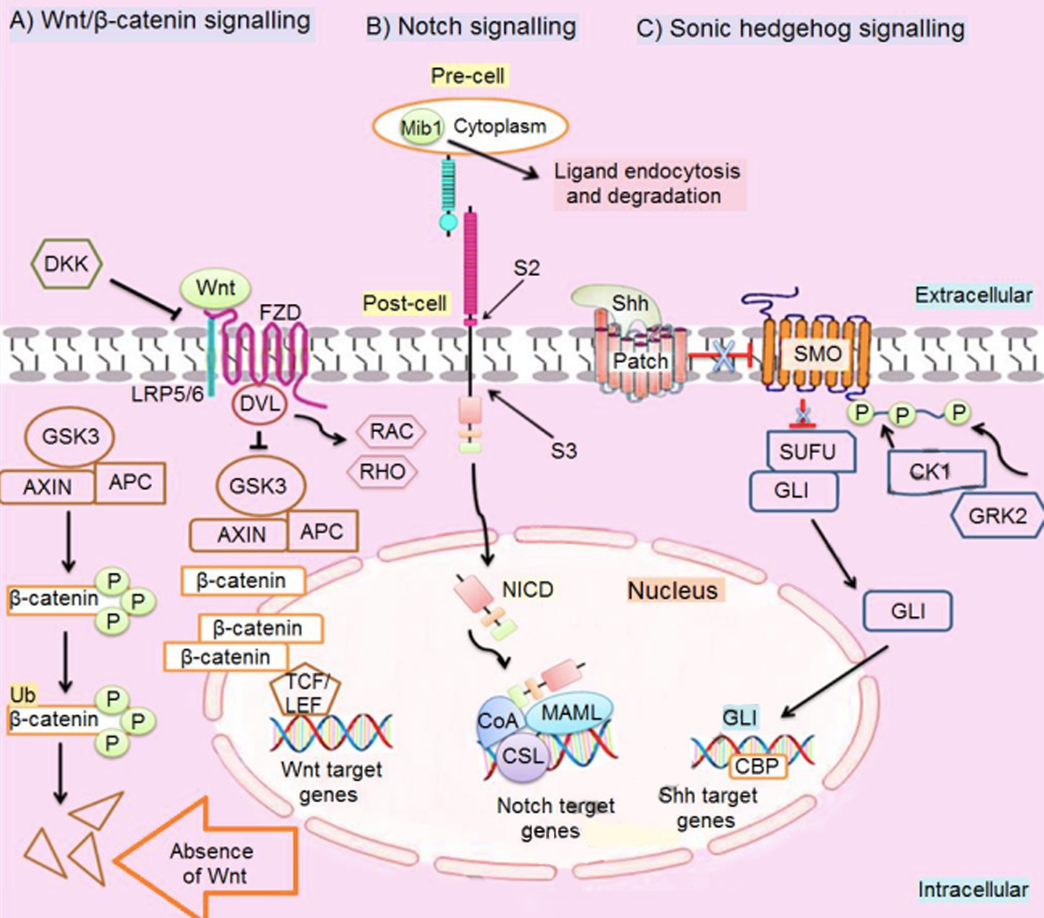

Slide 15
BMP
BMPs are chronically secreted by granule neurons, NSCs, and other niche cells and are essential for regulating the equilibrium between proliferation and quiescence.
BMPs can regulate the behavior of NSCs in embryonic and adult neurogenesis stages. Though, in the embryo, this molecular pathway can keep stem cell proliferation, while in the adult brain it can promote quiescence to the prevention of stem cell exhaustion
Negative regulation of BMP activity can be achieved through Chordin, Noggin, and Neurogenesin-1, which bind and antagonize BMPs directly in the extracellular space.

Slide 16
Conclusion
Disorders
Alterations in adult neurogenesis are associated with several neurological disorders such as Alzheimer’s disease (AD), Parkinson’s disease (PD), and Huntington’s disease (HD). Animal models of PD were shown to have decreased neurogenesis, primarily due to an increase in cell death. Neurogenesis was also reduced in models of HD due to decreased proliferation of neuronal progenitors, although no defects were found in neuronal differentiation.
Factors
alteration in extrinsic factors during adult hippocampal neurogenesis, including environmental conditions, diet compositions, and regulatory factors of metabolism can regulate adult hippocampal neurogenesis. For instance, physical exercise can improve metabolism-enhanced adult hippocampal neurogenesis, hippocampus-related cognitive function, and synaptic plasticity.
Hormones and experience.
A versive experiences have been shown to decrease the production of immature granule cells, whereas enriching experiences, including learning, have been demonstrated to enhance the survival of new hippocampal cells.

Slide 17
Questions
What are adult neural stem cells (aNSCs) and where are they located in the brain?
What is the role of Notch signaling in adult neurogenesis?
Explain the differences between Type-2a and Type-2b cells in terms of morphology and function.

Slide 18
What are adult neural stem cells (aNSCs) and where are they located in the brain?
Adult neural stem cells (aNSCs) are stem cells located in the adult brain that have the ability to self-renew and differentiate into various neural cell types, including neurons, astrocytes, and oligodendrocytes. They are crucial for the maintenance and repair of the nervous system. aNSCs are primarily found in two specific regions of the brain:
. Subventricular Zone (SVZ): This region is located along the walls of the lateral ventricles.
. Subgranular Zone (SGZ): This area is found within the dentate gyrus of the hippocampus.

Slide 19
What is the role of Notch signaling in adult neurogenesis?
Notch signaling plays a critical role in regulating adult neurogenesis by influencing the self-renewal, differentiation, and maintenance of neural stem cells (NSCs) and progenitor cells. The activation of Notch signaling involves the binding of Notch receptors to ligands (such as delta or jagged), which triggers the cleavage and release of the Notch intracellular domain (NICD). This domain translocates to the nucleus and associates with RBPJ to activate transcription of target genes. The specific roles of Notch signaling in adult neurogenesis include:
Promoting self-renewal: Notch signaling helps maintain the pool of NSCs by promoting their self-renewal and preventing premature differentiation.
Regulating cell differentiation: It influences the fate of progenitor cells, directing them towards specific neural lineages.
Modulating dendritic morphogenesis: Notch signaling affects the development and complexity of dendrites, which are essential for neuron function and connectivity.

Slide 20
Explain the differences between Type-2a and Type-2b cells in terms of morphology and function.
Type-2a cells:
Morphology: Type-2a cells have a few short, stubby processes that are oriented tangentially to the length of the SGZ. Their nuclei often exhibit an irregular shape.
Function: Type-2a cells are highly proliferative intermediate progenitors with a glial phenotype. They play a crucial role in the amplification of the progenitor cell population and are involved in the early stages of neurogenesis.
Type-2b cells:
Morphology: Type-2b cells are morphologically similar to Type-2a cells but with a more defined orientation. They start to exhibit a more polarized morphology and prepare for further differentiation.
Function: Type-2b cells are less proliferative than Type-2a cells and begin to express genes associated with neuronal fate specification. They transition from a glial phenotype to a neuronal phenotype, progressing towards becoming neuroblasts (Type-3 cells), which will further differentiate into mature neurons.

Slide 21
References

