Slide 1
Project – I : VocabFlash App
A simple lightweight Vocabulary Flashcards App

Slide 2
Project-I : VocabFlash Course Code: ICT 1200
SUBMITTED BY,
SUPERVISED BY,
ISHTIAK AHMED AYON
ID: IT24039
SANJITH SAHA
ID: IT24044
DR. ZIAUR RAHMAN
ASSOCIATE PROFESSOR,
DEPT OF ICT

Slide 3
TABLE OF CONTENTS
01
02
03
04
05
06
INTRODUCTION
OBJECTIVES
TOOLS AND TECH USED
APPLICATION LOGIC
FEATURES & INTERFACE DESIGN
CODE
06
CONCLUSION

Slide 4
TABLE OF CONTENTS
07
08
OUTPUT EXAMPLES
CONCLUSION & FUTURE SCOPE

Slide 5
INTRODUCTION
01

Slide 6
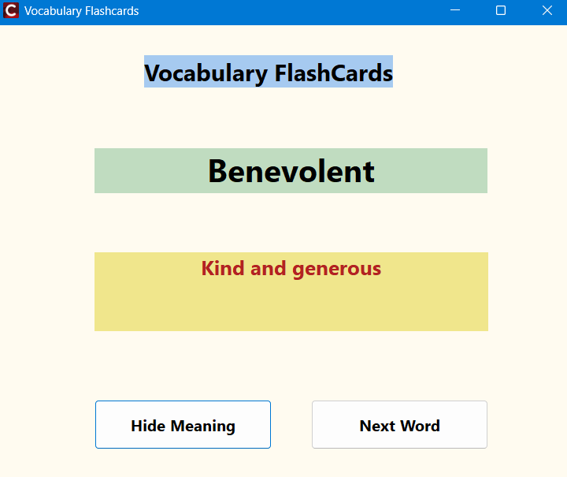
INTRODUCTION
VocabFlash App
The Vocabulary Flash Card App is a desktop learning tool that displays
random English words along with their meanings.It is a small educational
project developed using C++ Builder’s Visual Component Library (VCL)
for building GUI applications.

Slide 7
Main Ideas OF VocabFlash:
Show One Word At A Time
Reveal Meaning
Move To Next Word

Slide 8
OBJECTIVES
02

Slide 9
OBJECTIVES
To apply file handling concepts (fstream) in a real project.
To understand GUI-based event handling using C++ Builder.
To create a simple but meaningful educational application.
To demonstrate random word generation and data management in C++.

Slide 10
TOOLS & TECH USED
03

Slide 11
TOOLS & TECHNOLOGIES USED:
IDE: Embarcadero C++ Builder (Community Edition)
Language: C++
Framework: Visual Component Library (VCL)
Operating System: Windows 11
External Files: vocab1.txt, vocab2.txt, vocab3.txt, vocab4.txt, etc.
Why C++ Builder?
It allows drag-and-drop interface design and combines GUI controls with powerful C++ code, making it ideal for quick, beginner-friendly projects.

Slide 12
04
APPLICATION LOGIC

Slide 13
APPLICATION LOGIC
MAIN FUNCTIONS :
LoadVocabularyFiles() Loads all text files, reads each line, and stores word-meaning pairs.
ShowRandomWord() Selects a random word using random() and displays it on the form.
ButtonRevealClick() Toggles the meaning visibility and updates button text (Reveal/Hide).
ButtonNextClick() Loads another random word from the list.

Slide 14
APPLICATION LOGIC
PROGRAM FLOW:
App starts → Constructor runs
Form created → FormCreate() runs
Load files → LoadVocabularyFiles() reads all vocab
Show word → ShowRandomWord() picks random word
User clicks "Reveal" → ButtonRevealClick() toggles visibility
User clicks "Next" → ButtonNextClick() → ShowRandomWord()
Loop steps 6 until app closes

Slide 15
Features & Interface Design:
05

Slide 16
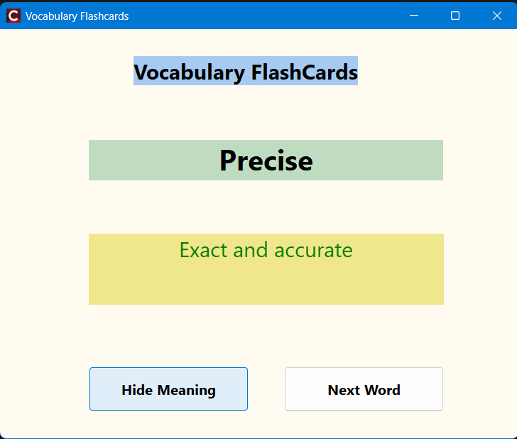
Features & Interface:
Interface Components:
LabelWord: Displays the selected vocabulary word.
LabelMeaning: Shows the meaning (hidden initially).
ButtonReveal: Reveals or hides the meaning.
ButtonNext: Displays a new random word.
User Experience:
On startup, the app shows “Loaded X words!”
The user clicks “Reveal Meaning” to study.
“Next Word” refreshes the screen with a new word.
If no files are found, a message alerts the user

Slide 17
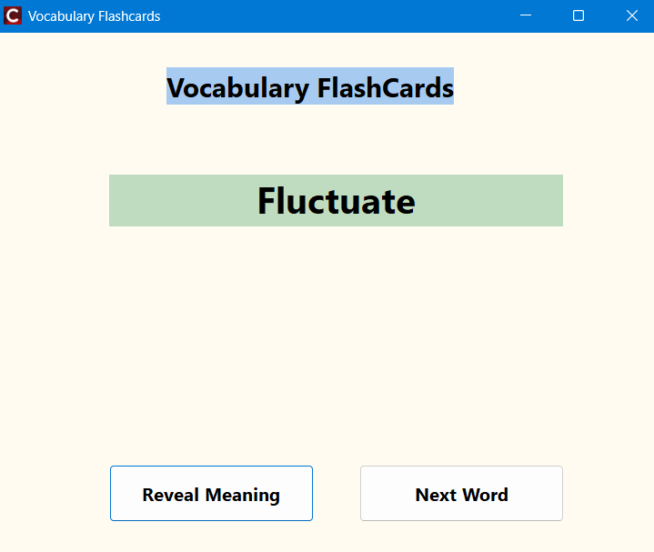
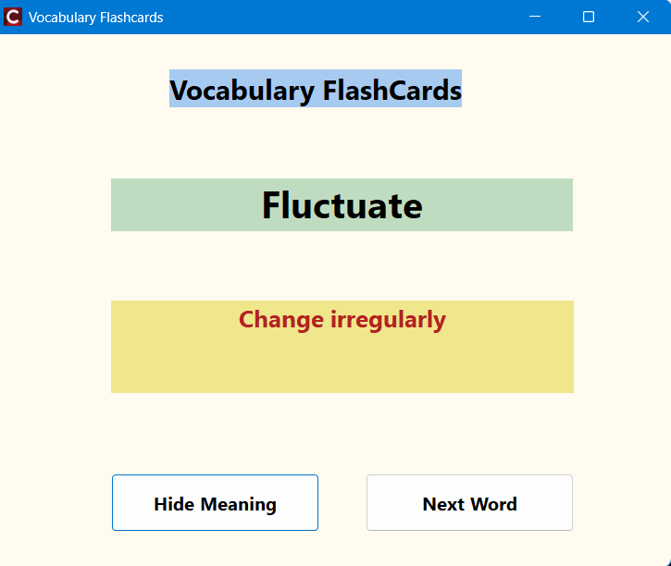
Features & Interface:

Slide 18
06
File Handling and Data Structure

Slide 19
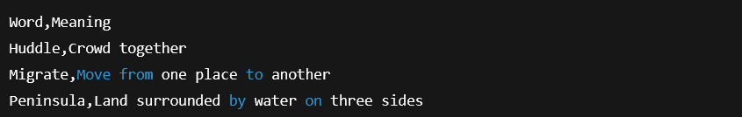
File handling & Data Structure:
File Storage: All vocabulary files are stored base directory or a given directory. Each file contains multiple lines in the format:

Slide 20
File handling & Data Structure:
How It Works:
The program uses ifstream to open each file.
Reads every line and separates the word and meaning using the comma (',').
Each pair is stored in a vector<VocabWord> list for easy access.
Total words loaded are displayed with a message box.

Slide 21
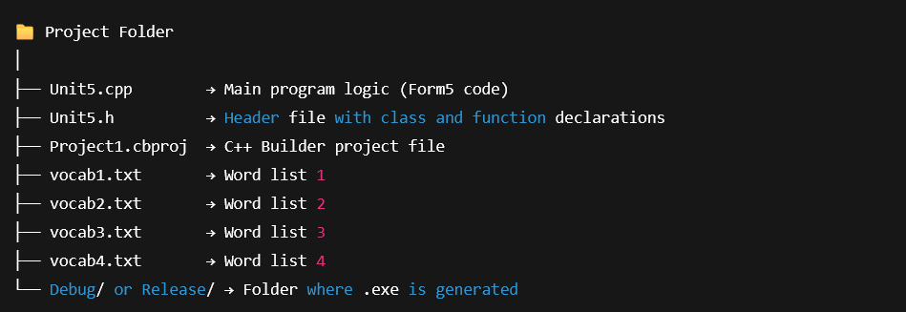
File handling & Data Structure:
File Organization:

Slide 22
07
OUTPUT EXAMPLE

Slide 23
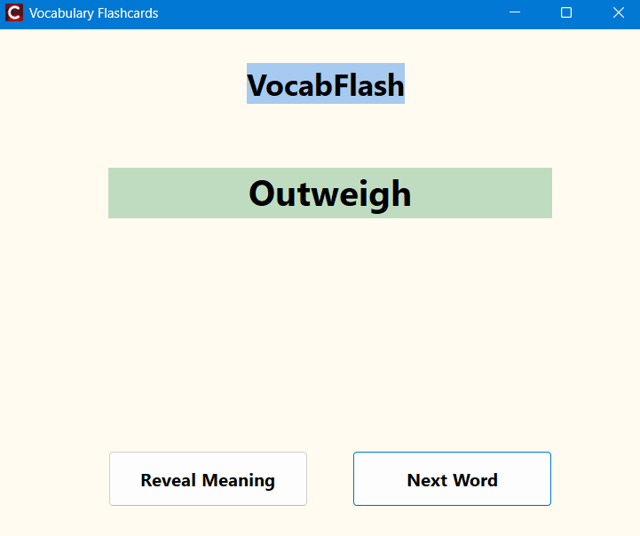
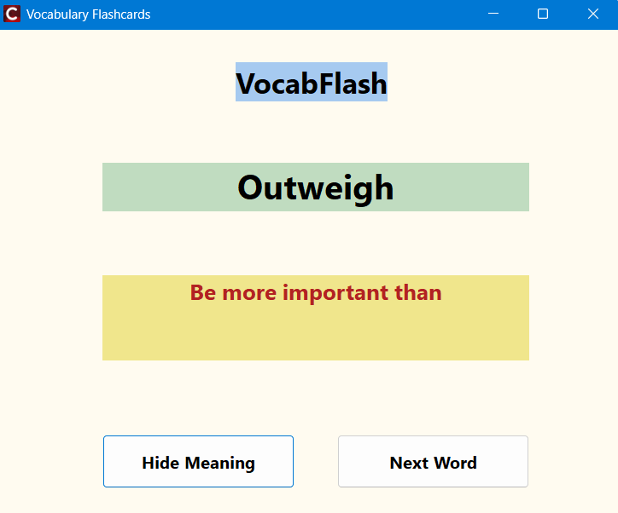
OUTPUT EXAMPLES:
ON START-UP:
AFTER CLICKING REVEAL BUTTON

Slide 24
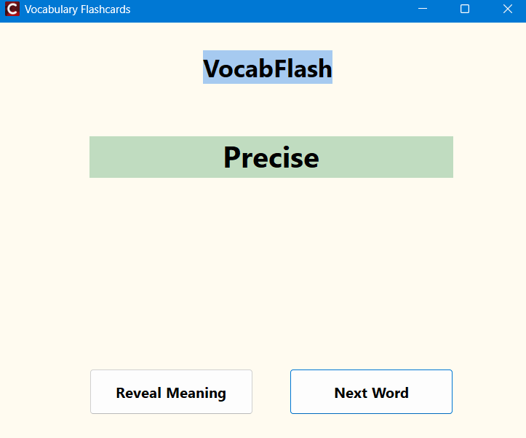
OUTPUT EXAMPLES:
AFTER CLICKING NEXT BUTTON:

Slide 25
07
CONCLUSION & FUTURE SCOPE

Slide 26
CONCLUSION & FUTURE SCOPE
The Vocabulary Flash Card App is a simple yet practical educational project. It demonstrates how C++ Builder can be used to create user-friendly applications that combine logic and visual design.It also helps in learning essential programming concepts like file handling, randomization, and event-driven GUI programming.
Future Enhancements:
Add progress tracking or scoring for correct answers.
Allow users to add or edit custom word lists.
Implement search and category-based filtering.
Modernize UI with animations or sound feedback.

Slide 27
THANKS

