Slide 1
Ns Tutorial: Case Studies
John Heidemann (USC/ISI)
Polly Huang (ETH Zurich)
March 14, 2002

Slide 2
Road Map
Simple examples
TCP
web traffic
Case Study
Impact of HTTP and TCP parameters to Web performance
Hidden structure behind aggregated Web traffic
Provide an entry point
Show case ns’s functionality and relevance to the CN program

Slide 3
Presentation Style
Slides
Script walk-through
Live demos with nam (Network AniMator)

Slide 4
Example I: TCP
n0
n1
set ns [new Simulator]
set n0 [$ns node]
set n1 [$ns node]
set ftp [new Application/FTP]
$ftp attach-agent $tcp
$ns at 0.2 "$ftp start"
$ns at 1.2 ”exit"
$ns run
$ns duplex-link $n0 $n1 1.5Mb 10ms DropTail
set tcp [new Agent/TCP]
set tcpsink [new Agent/TCPSink]
$ns attach-agent $n0 $tcp
$ns attach-agent $n1 $tcpsink
$ns connect $tcp $tcpsink

Slide 5
Example II: Web Traffic
A Web session – a series of page downloads
Number of pages
Inter-page time
Page size (number of embedded objects)
Inter-object time
Object size (KB)
5 random variables

Slide 6
Case Study I: Web Performance
Impact of TCP and HTTP parameters
Try to answer:
Will the proposed changes work in a variety of conditions?
Should TCP Sack be deployed?
Should persistency or pipelining be deployed?
Which parameters are more cost effective to tune?

Slide 7
Methodology
Methodology
Select performance critical parameters
Use most commonly used values as the base case
Tune parameter values to compare to the base case
Toward a systematic and exhaustive evaluation
Enabled by ns
rich library of workload and protocol implementations
Contributed code from a huge user/developer community

Slide 8
Parameters and Values
TCP
HTTP
Packet size
576, 1460
Delayed ack
on, off
Congestion avoidance
NewReno, Tahoe, Reno, Sack
Initial retransmission timeout
3, 6 sec
Timer granularity
100, 500 msec
Timestamp option
on, off
Initial window size
2, 4
Connection type
persistent, simple, pipelined
Number of parallel connections
2, 1, 4

Slide 9
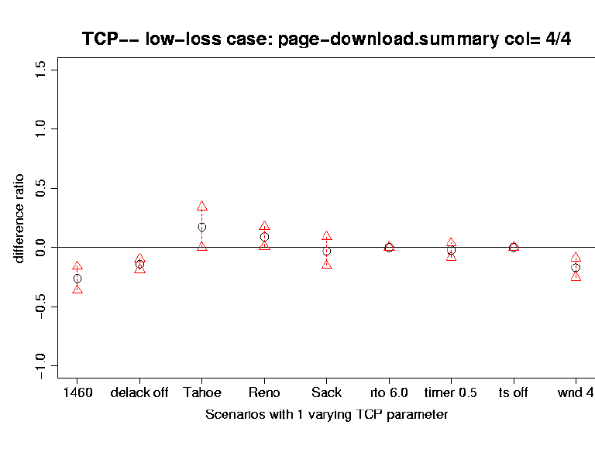
Page Download Time – TCP
Sack, NewReno, Reno, Tahoe, gradually better
Timer-related parameters, no significant impact

Slide 10
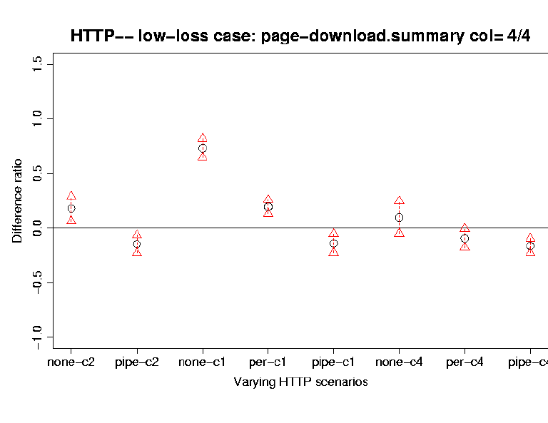
Page Download Time - HTTP
Simple, persistent, and pipelined connections, gradually better
Higher the number of parallel connections, Smaller the range of improvement

Slide 11
TCP vs. HTTP
TCP
HTTP
Impact of TCP Sack is relatively small.

Slide 12
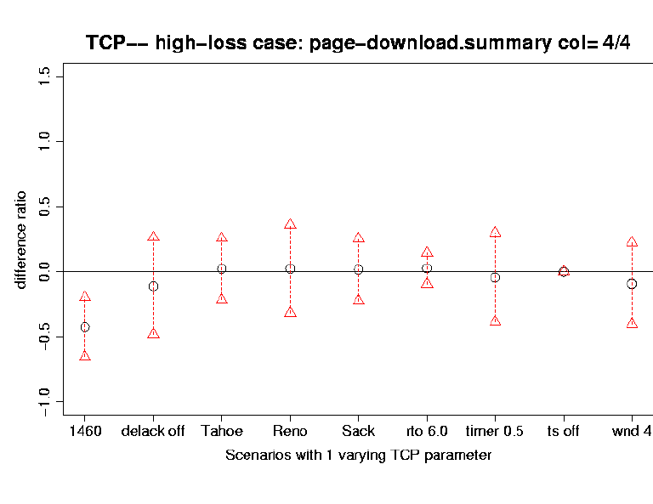
Low vs. High loss - TCP
Low loss
High loss
That tiny bit of advantage in TCP Sack disappears in high-loss case.

Slide 13
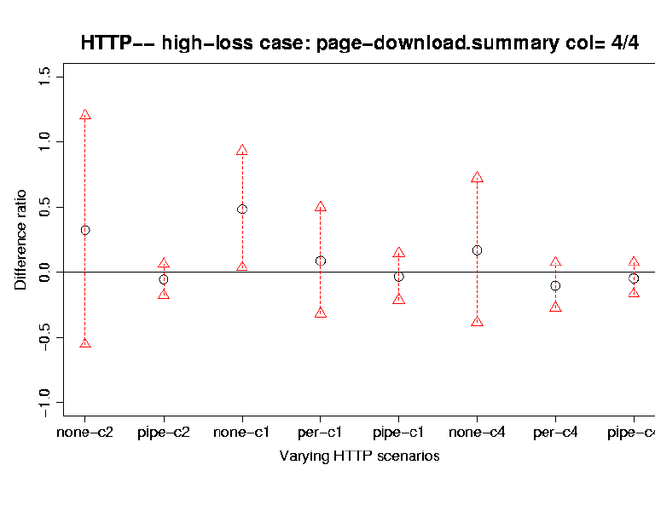
Low vs. High loss - HTTP
Pipelining loses its advantage when # of parallel connections is high.

Slide 14
Preliminary Findings
Will the proposed changes work in a variety of conditions?
Not really
TCP Sack and HTTP pipelining
Should TCP Sack be deployed?
Maybe not, if deployment cost is high
Should persistency or pipelining be deployed?
Maybe yes, but doesn’t make sense to work with too many parallel connections

Slide 15
The Real Message
Design decisions need to be validated in the context of the Internet.
Layers of protocols, tremendous amount of unknown dynamics
Simulation tools like ns can help us track the complexity (within a layer or across layers)
Ns en-powers such studies
A rich library base
A large community contributing to the base

Slide 16
Case Study II: Web Traffic
Web traffic is not exact self-similar
How does it diverge from exact self-similar?
Why is there this divergence?

Slide 17
Self-similarity
Distributions of #packets/time unit look alike in different time scale

Slide 18
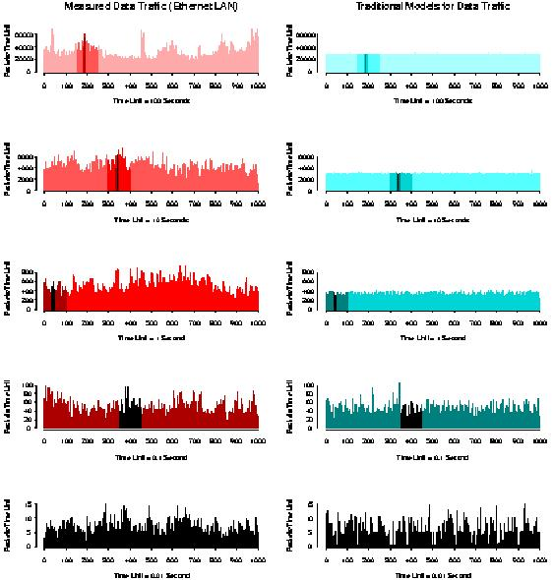

Slide 19
Wavelet Analysis
FFT - frequency decomposition d_{j}
WT - frequency and time decomposition d_{j,k}
∑_{k}(d_{j,k}²) / N_{j} ≡ E_{j} = 2^{j(2H-1)} C
log₂E_{j} = (2H-1) j + log₂C
Self-Similar
log₂E_{j}
j

Slide 20
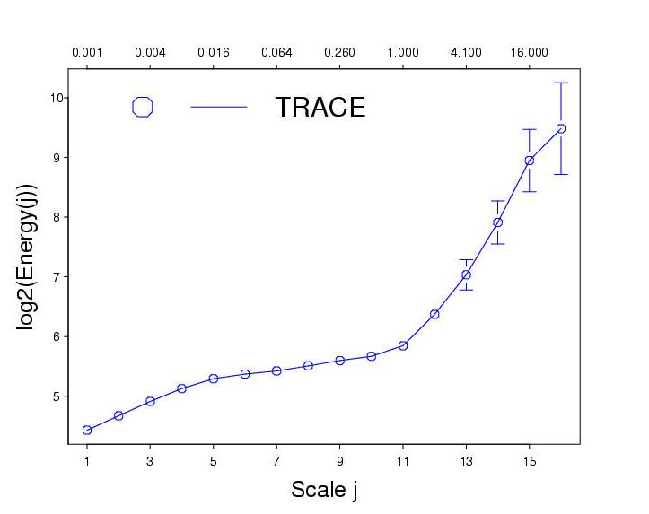
Global Scaling - Trace
Round Trip Time

Slide 21
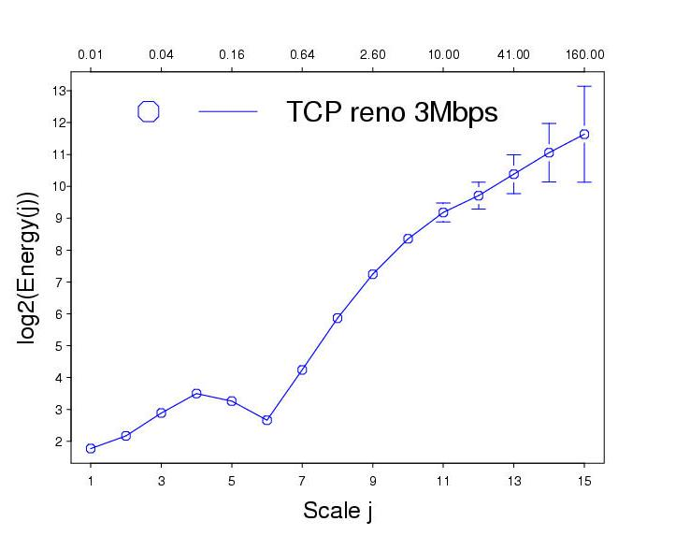
Global Scaling - Simulation

Slide 22
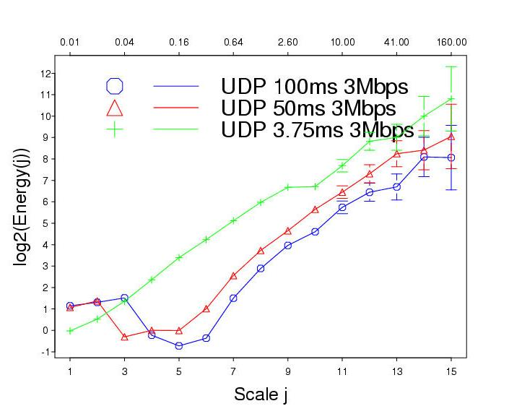
UDP

Slide 23
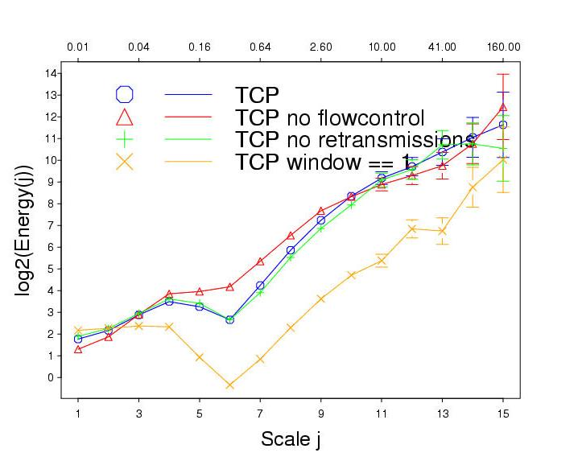
TCP

Slide 24
Findings
Periodicity emerges at round-trip time scales
That periodicity dominates the traffic behavior at those scales
TCP ack clocking plays a critical role
Need to be cautious when to use or not use mathematical self-similar models

Slide 25
The Real Message
Proposed (traffic) models need to be validated in the context of the Internet.
Mechanisms can influence Internet characteristics in a surprising way
Simulation tools like ns can help us track the implicit complexity
Ns en-powers such studies
A rich library base
A large community contributing to the base

Slide 26
Concluding remarks
Learning ns
video recording (huang@tik.ee.ethz.ch)
on-line tutorials (audio and slides)
tons of info from the ns web site
Research with ns
promote sharing and confidence

