Slide 1

Big Data Programming Project
Ishu Goyal
igoyal1@student.gsu.edu

Slide 2
Datasets
https://coinmarketcap.com/currencies/bitcoin/historical-data/
https://coinmarketcap.com/currencies/ethereum/historical-data/
https://coinmarketcap.com/currencies/xrp/historical-data/
https://coinmarketcap.com/currencies/litecoin/historical-data/
https://coinmarketcap.com/currencies/polygon/historical-data/
https://www.kaggle.com/nishanthsalian/gold-analysis/data

Slide 3
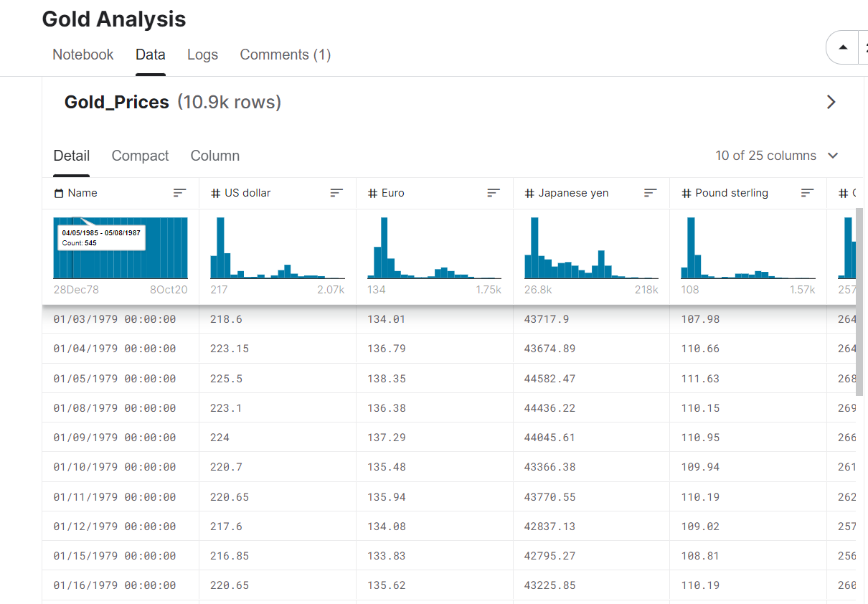
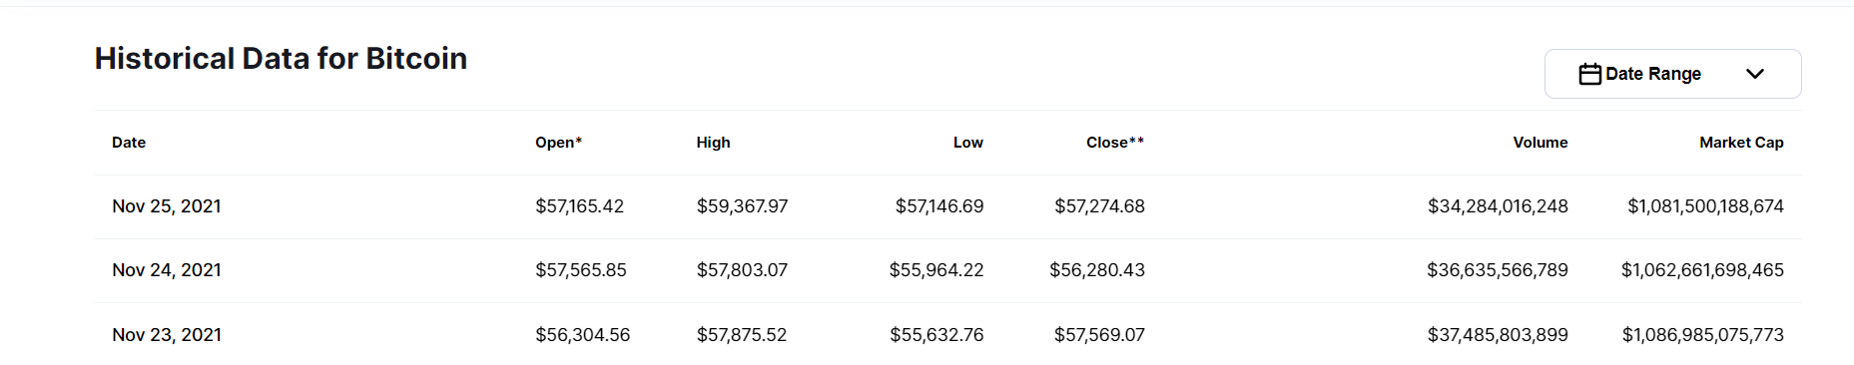
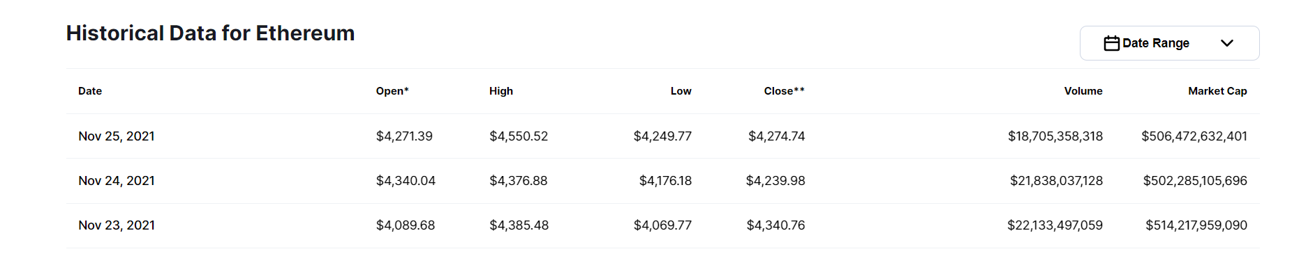
Datasets Before

Slide 4
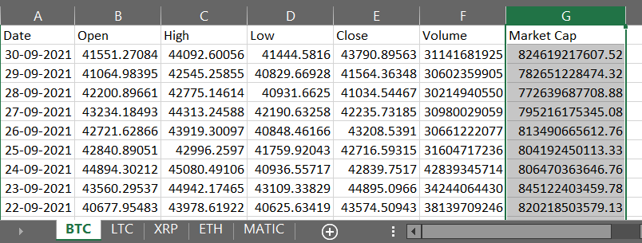
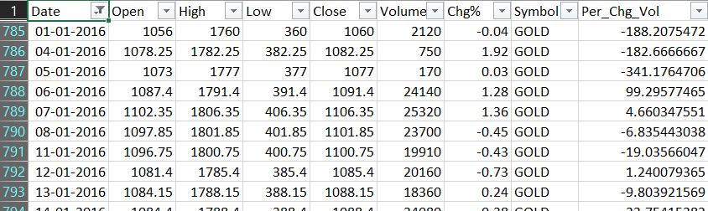
Datasets After

Slide 5



Tools/ Technology Used:

Slide 6

Hypothesis
Cryptocurrency is the new way forward.
Over the year people have invested into various fields and assets to get most earning, to multiple their money as fast as possible. This has always led people to invest in share market, real state etc. and the most recent trend is toward investment in cryptocurrency.
Due to crypto currencies being a relatively new domain. General public does not have enough knowledge for the same although various success stories have led to inspire public to hope for good result.

Slide 7
Finding Similar to Cryptocurrency
To prove hypothesis, one needs to compare growth, demand and trading of cryptocurrency with something in which people are investing similar to crypto
And one such thing is GOLD.
People are investing in gold from 1970s i.e. even before when there was no such thing as cryptocurrency

Slide 8
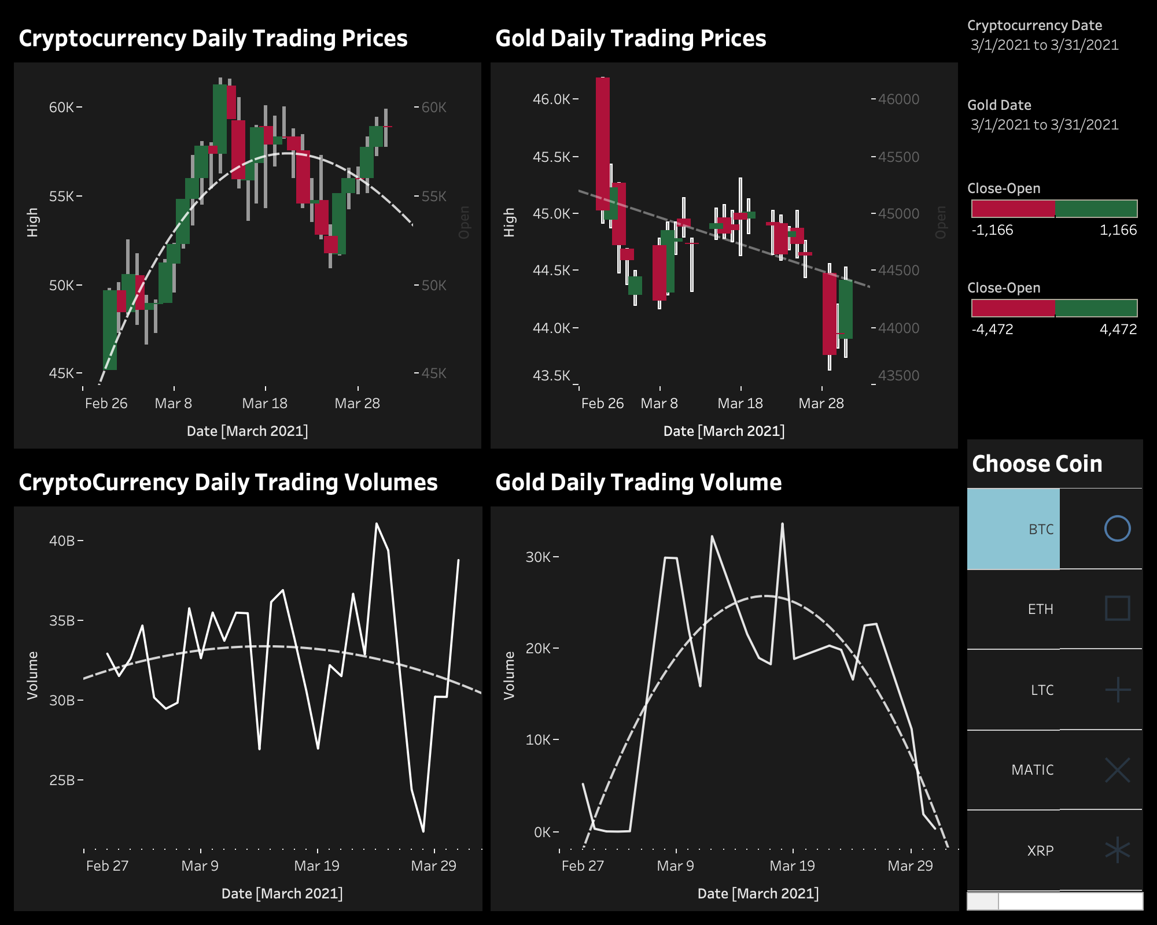
How to compare Gold and Crypto
There is no direct way to compare these two side by side.

Slide 9
Proxy Metrics
But these two can be compared based on their metrics such as:
Annual Volume Percentage Change
Annual Market Capitalization Percentage Change

Slide 10
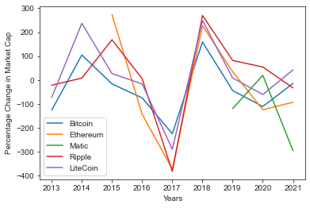
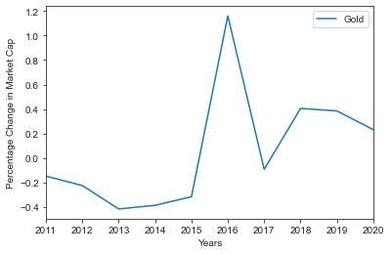
Annual Percentage Change in Market Capitalization
It can be clearly seen, that the market capitalization for gold has increased in points i.e 0.2% to 0.4% whereas in other plot for most of the cryptocurrencies it has increased by 100%

Slide 11
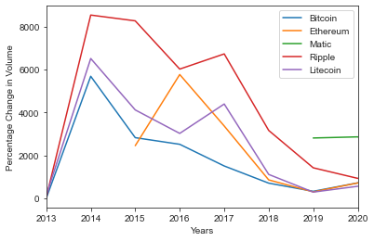
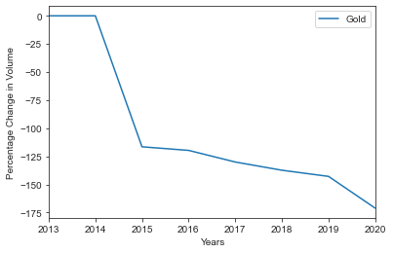
Annual Percentage Change in Volume
It can be clearly seen, that the change in volume plot for gold has been decreased continuously over the years whereas in other plot for most of the cryptocurrencies it has started to rise again as compared to gold

Slide 12
Conclusions
Based on these plots shown in these slides.
Hence, Hypothesis “Cryptocurrency is the new way forward” is proved

Slide 13
References
https://www.kaggle.com/nishanthsalian/gold-analysis

