Slide 1
PoEWAL : A light weight consensus mechanism for Blockchain in IoT
Shubham Kumar
M.Tech 2020IS-09

Slide 2
About the research Paper
Received 31st January 2020
Received in revised form 1st November 2020
Accepted 5th November 2020
Available online 7th November 2020
Authors:
Raghav
Nitish Andola
S.Venkatesan
Shekhar Verma
Pervasive and Mobile Computing 69,
2020 Published by Elsevier B.V.

Slide 3
What is IoT?
The Internet of Things is the interconnected sphere of physical devices with the Internet and other networks through uniquely identifiable IP addresses, whereby data is gathered and communicated through embedded sensors, electronics devices and software.
Physical Object + Controller, Sensors and Actuators + Internet = Internet of Things

Slide 4
Challenges for IoT
A centralized IoT lacks privacy of transactions, authentication of the users, and scalability.
Few IoT Devices have limited resources
The existing security techniques are impractical for the IoT environment in terms of computation overhead and energy consumption.
IoT demands privacy, scalability, low resource consumption, and decentralized functioning to secure the network and devices.

Slide 5
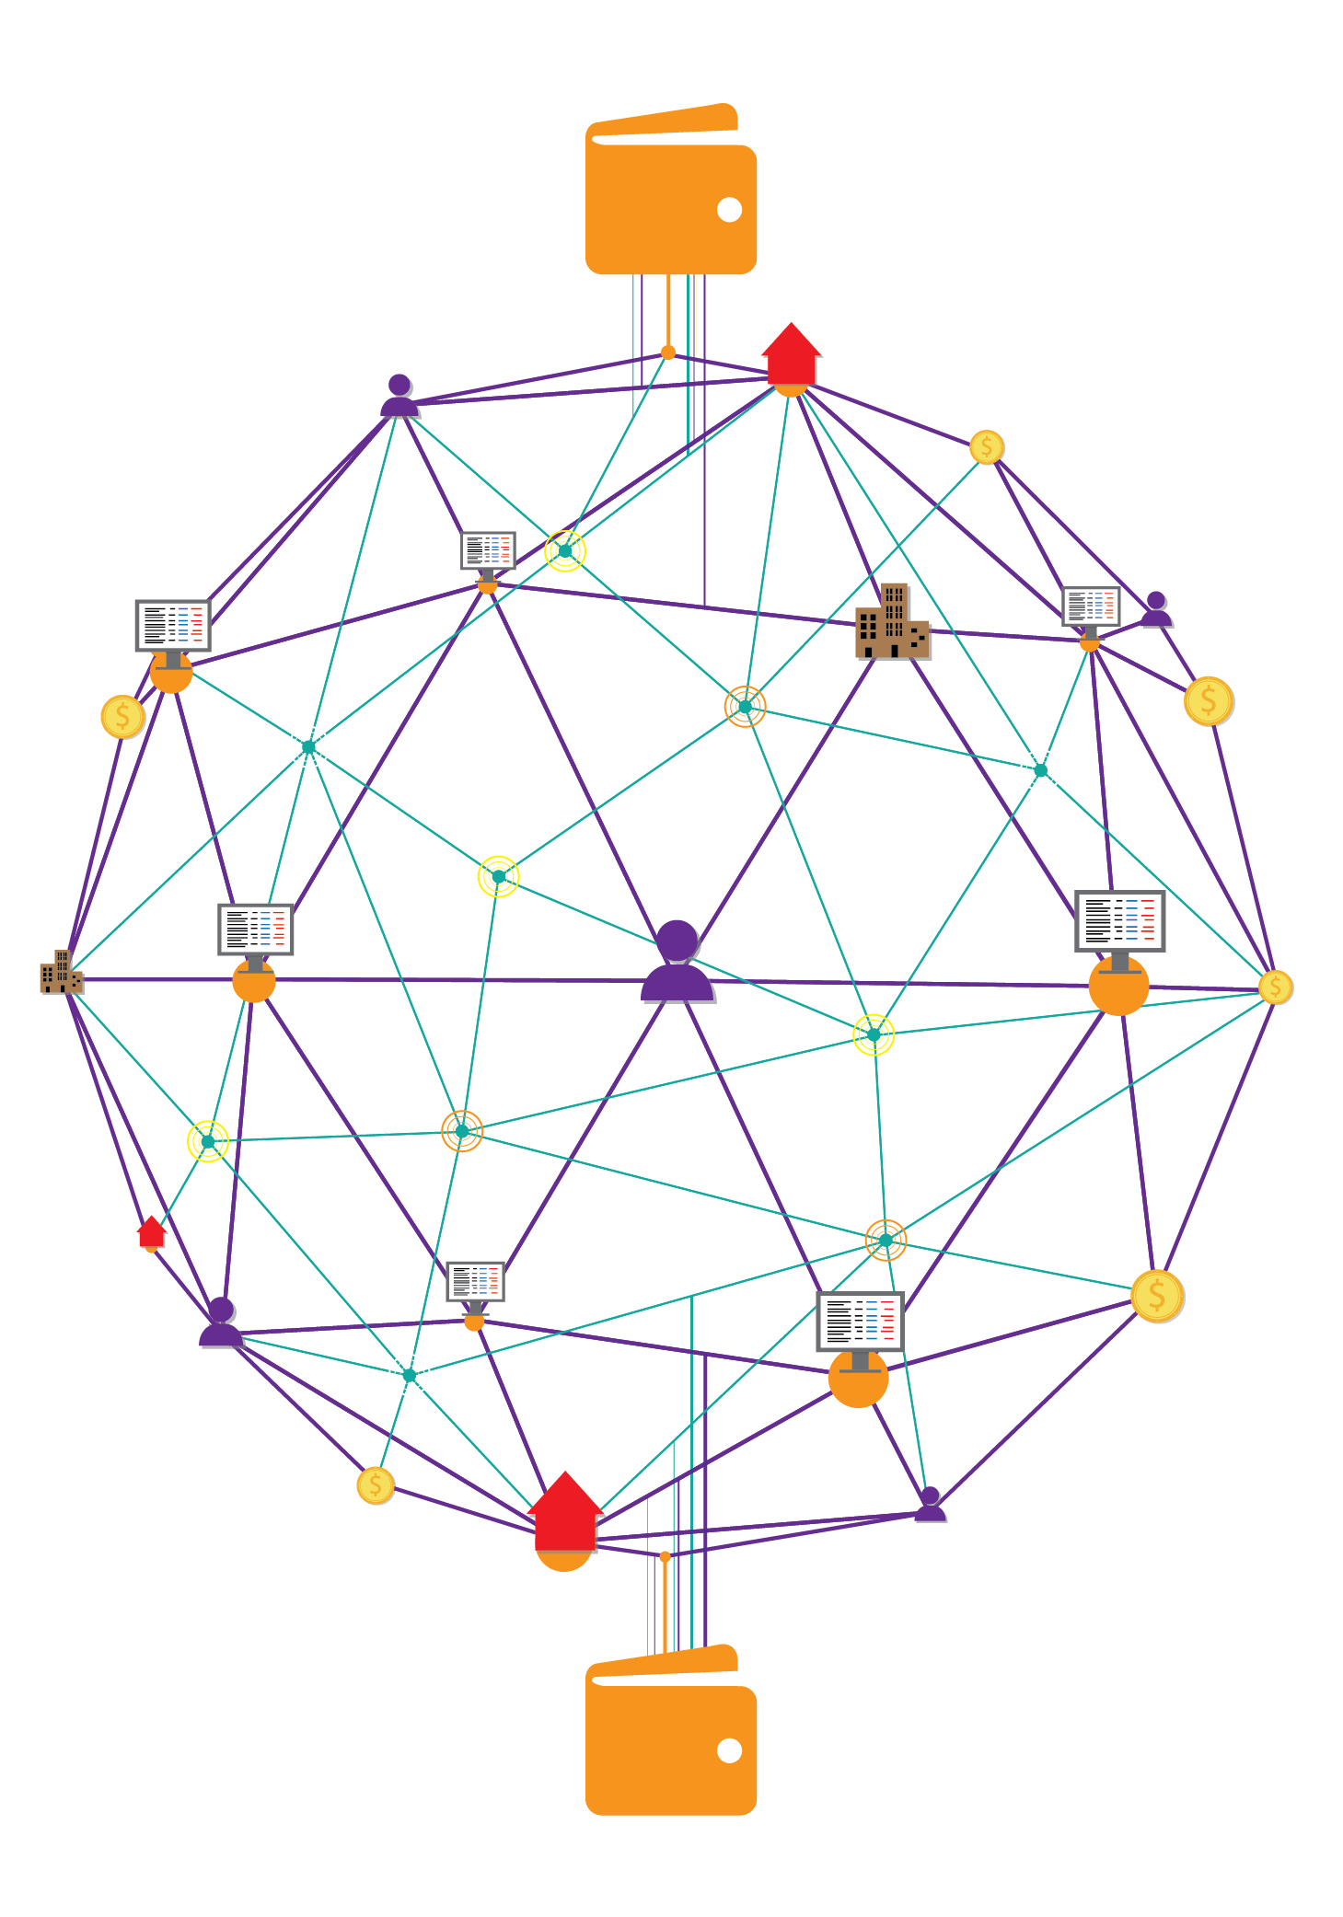
Introduction to Blockchain
Blockchain technologies is not just only single one technique, but contains Cryptography, mathematics, Algorithm and economic model, combining peer-to-peer networks and using distributed consensus algorithm to solve traditional distributed database synchronize problem, it’s an integrated multi field infrastructure construction
The blockchain technologies composed of six key elements.
Decentralized
Transparent
Open Source
Autonomy
Immutable
Anonymity

Slide 6
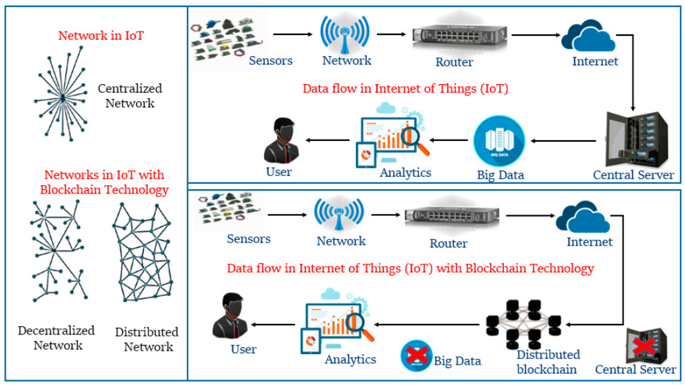
Blockchain & IoT

Slide 7
Research Contributions
They have proposed a lightweight probabilistic consensus algorithm which can be used in the non-cooperative IoT environment. The PoEWAL consensus algorithm has less energy consumption, latency and consensus time for mining and sending transactions to other nodes.
PoEWAL has been implemented in a simulated environment on resource-constrained devices using a Contiki-Cooja simulator to verify its resource efficiency and feasibility for IoT. The method has been benchmarked against probabilistic consensus schemes (PoW, PoA, Algorand, PoS, PoAu) for parameters like energy consumption, consensus time and latency.

Slide 8
Consensus Mechanism
Consensus function is a mechanism that make all blockchain nodes have agreement in same message, can make sure the latest block have been added to the chain correctly, guarantee the message that stored by node was the same one and won’t happened “fork attack”, even can protect from malicious attacks.

Slide 9
PoW
Interested in Finding the number of zeroes from the hit and trial method on block hash with random nonce. The first one to find it gets to add to the ledger.
Proof of capacity is a consensus mechanism algorithm used in blockchain that allows for mining devices in the network to use their available hard drive space to decide mining rights and validate transactions.
PoC
In PoS, the miner node is generated by the monetary system to mine a new block. The miner is chosen based upon the proportional stake of the miner.
PoS
PoB
It operates on the principle of allowing miners to “burn” virtual currency tokens.
Related Work
It is used to ensure that all transactions occurring on the blockchain are genuine, as well as to ensure that all miners arrive at a consensus
PoA

Slide 10
Algorand
The users mine the new block using byzantine agreement.
Stellar, or Stellar Lumens, is an open source, decentralized protocol for digital currency to fiat money transfers which allows cross-border transactions between any pair of currencies.
Stellar
Every node in the network generates random time. And after this every nodes goes to sleep for that random time. Whoever wakes first can mine the block.
PoET
It uses trust in consensus method over IoT blockchain, here nodes mines the blocks accordingly with their behaviour.
PoXr
Related Work
It is used in trust based environment. It provides scalable IoT business blockchain which validates trade and block with reduced computation time.
PoBT
It is designed for cooperative blockchain in which the miner node has to reveal its identity to mine a block. The identity is used as a stake.
PoAu

Slide 11
Problem Descriptions
IoT is a non-cooperative distributed environment in which devices may not trust one another. Blockchain network in IoT requires an IoT device compatible consensus method, which needs low energy and computation power to mine a block so that every device in the network can participate.
Due to the large number of messages exchanged in any IoT network, the consensus method should provide high scalability, high throughput as the number of transactions is high. The latency must be low so that a proposed transaction can be updated quickly. The network needs to have a large life time and must be able to perform its designated work for a long period without human intervention. Thus, the maintenance of the blockchain network must be resource-efficient so that the energy of IoT devices are not drained quickly. This entails that consensus must be reached quickly with minimal energy consumption at the IoT devices.

Slide 12
PoEWAL
Consensus
Mechanism

Slide 13
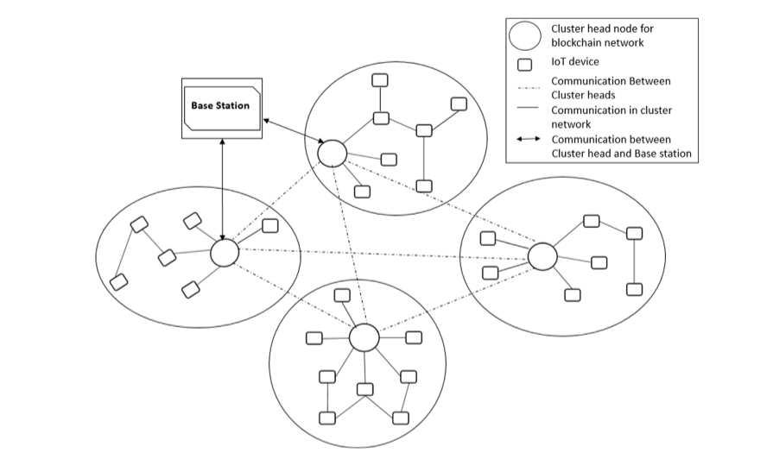
System Architecture

Slide 14
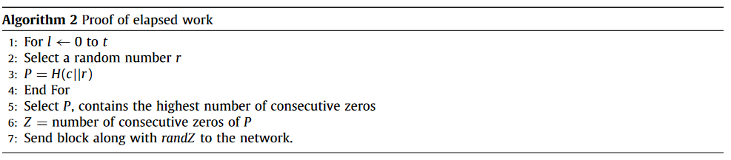
PoEWAL Methodology

Slide 15
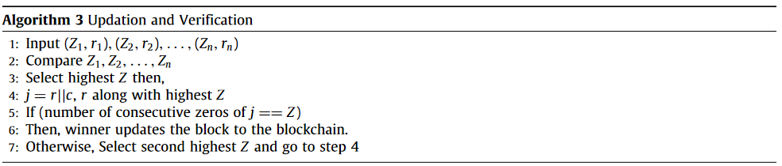
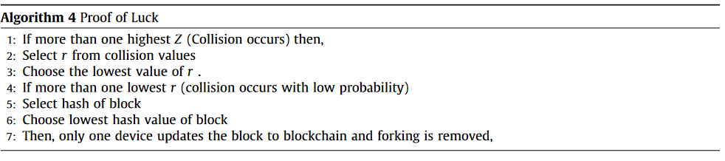
PoEWAL Methodology

Slide 16
Incentive for mining
In an energy strapped environment, energy saving is a significant incentive and can be used to motivate the IoT devices for mining. A successful miner can be given two energy-saving incentives.
First, it may be given priority in transmission, thereby, reducing the probability of collision in contention-based communication.
Second, the IoT device may be exempted from being a part of routing nodes. This reduces energy dissipation drastically as communication is an energy-intensive process. These incentives may be given for a fixed time period.

Slide 17
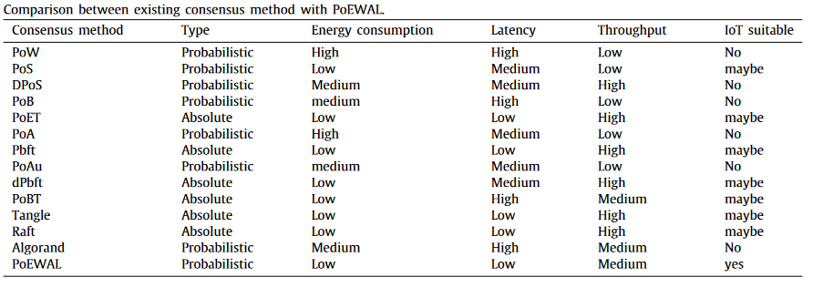
Analysis and Comparison

Slide 18
Performance
Evaluation

Slide 19
Experimental Setup
The experiments were conducted with the help of the Contiki-COOJA simulator.
Tmote Sky sensor mote were taken because of limited storage and processing capability.
The setup details of a node include a). 250kbps 2.4GHz IEEE 802.15.4 Chipcon Wireless Tran receiver b). 8MHz Texas Instruments MSP430 microcontroller (10k RAM, 48k Flash) c). Integrated ADC, DAC, Supply Voltage Supervisor, and DMA Controller d).Integrated onboard antenna with 50m range indoors / 125m range outdoors e). Each node contains a TinyOS that supports mesh networking and communication implementation. Each experiment was conducted 100 times.
The experiments were partitioned into four phases.
The first phase is solely related to PoEWAL.
In the second phase, initially, each consensus algorithm is simulated in the Contiki-COOJA simulator. The consensus time is calculated using different algorithms with a single instance of an algorithm running at a time.
The third phase evaluates the variation in energy consumption with the transactions mined.
In the fourth phase, each consensus algorithm was simulated successively.

Slide 20
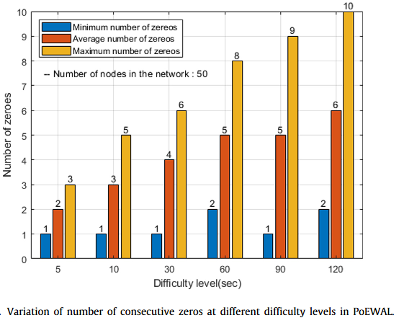
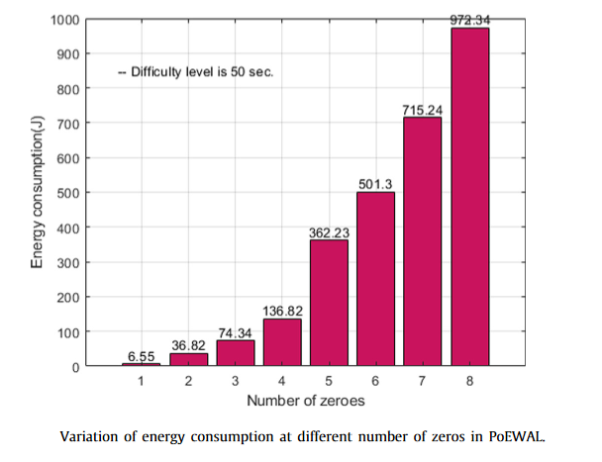
Results

Slide 21
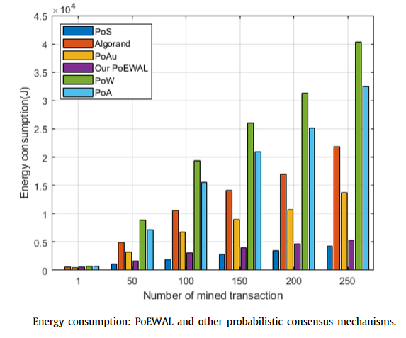
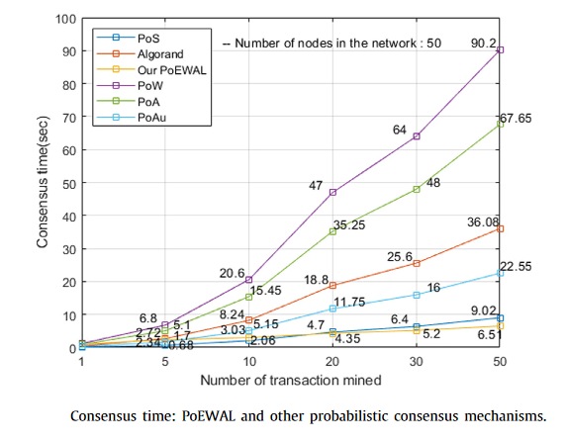
Results

Slide 22
Conclusion
Proof of Elapsed Work And Luck consensus method for IoT blockchain, method emphasizes that consensus can be reached by partially solving a problem in fixed time rather than completely solving a problem in variable time.
There is no exponential increase in energy consumption with an increase of difficulty level. The results also show that there is a trade-off between the possibility of forking and energy consumption.
PoEWAL was compared with other probabilistic consensus methods in terms of consensus time, energy consumption, and network latency. The results showed that PoEWAL consumes low energy consumption with less consensus time and latency of the network. By dynamically tuning the time period of solving the puzzle, PoEWAL can avoid forking and excessive energy consumption, and can be a viable candidate as a probabilistic consensus method for IoT blockchain.

Slide 23
References
https://www.sciencedirect.com/science/article/abs/pii/S1574119220301279
https://www.researchgate.net/publication/325661355_Blockchain_technology_for_security_issues_and_challenges_in_IoT
https://www.researchgate.net/publication/312218574_Blockchain_for_IoT_Security_and_Privacy_The_Case_Study_of_a_Smart_Home
https://www.google.com/url?sa=t&rct=j&q=&esrc=s&source=web&cd=&ved=2ahUKEwjXlJWPh_7vAhXCzDgGHdI5DRoQFjABegQIAxAD&url=https%3A%2F%2Fbitcoin.org%2Fbitcoin.pdf&usg=AOvVaw05-4mYD7EyyKjwcHh8i0Vw
http://ijns.jalaxy.com.tw/contents/ijns-v19-n5/ijns-2017-v19-n5-p653-659.pdf

