Slide 1
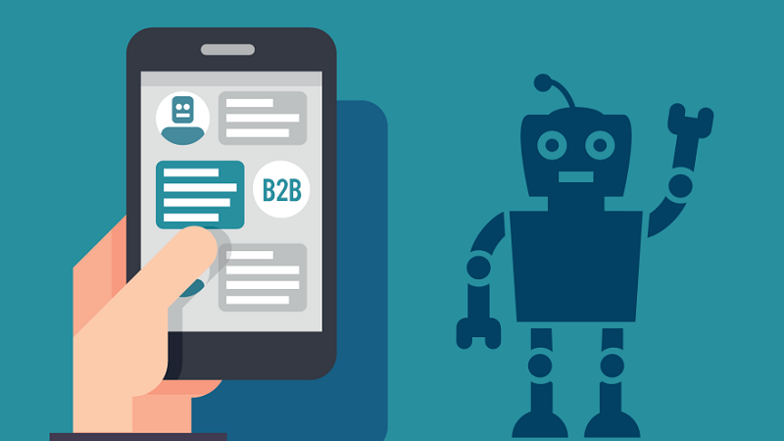
Chat Bot
By:-
Shubham Kumar

Slide 2
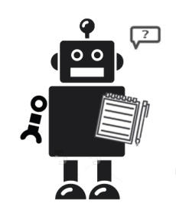
History
ELIZA
Developed in the 1960s
Looks for pronouns and verbs
‘You’ becomes ‘I’ and vice versa
User: You are a dork.
ELIZA: What makes you think I am a dork?
PARRY (1972)‏
Simulated a paranoid schizophrenic
Tested in the early 1970s using a variation of the Turing Test
RACTER
Generates English language prose at random .

Slide 3
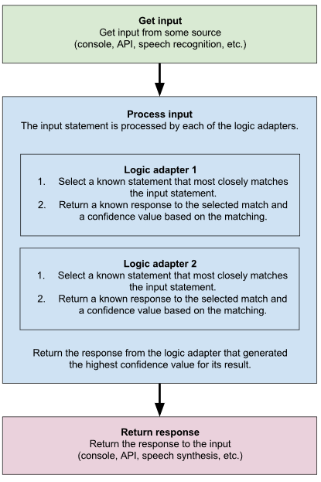
ChatterBot
ChatterBot is a Python library that makes it easy to generate automated responses to a user’s input.
ChatterBot uses a selection of machine learning algorithms to produce different types of responses. This makes it easy for developers to create chat bots and automate conversations with users.

Slide 4
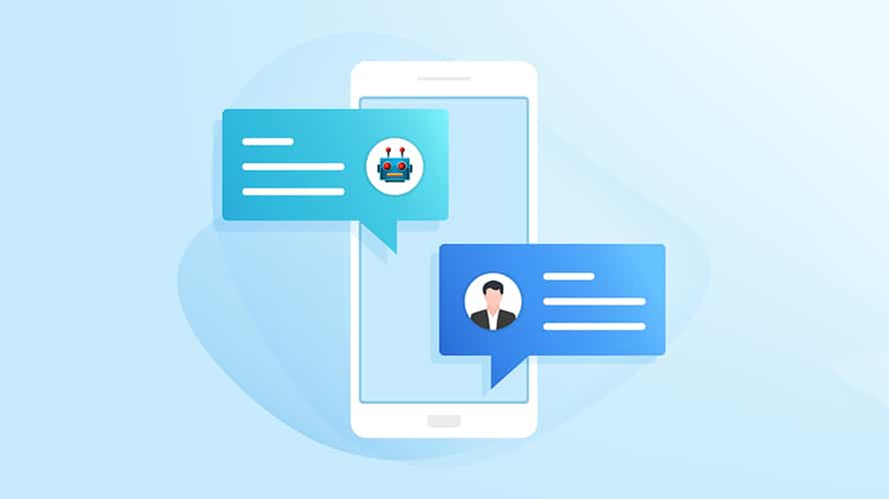
What is chat bot?
ChatBot: A computer program that can talk to humans in natural languages.
Uses Artificial Intelligence Markup Language (AIML) to represent knowledge.
Can replace a human for monotonous jobs of answering queries, e.g. E-help desk. Racter

Slide 5
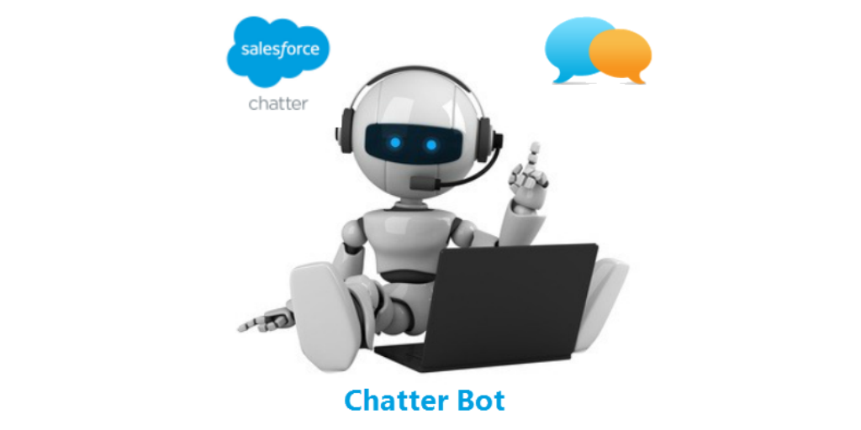
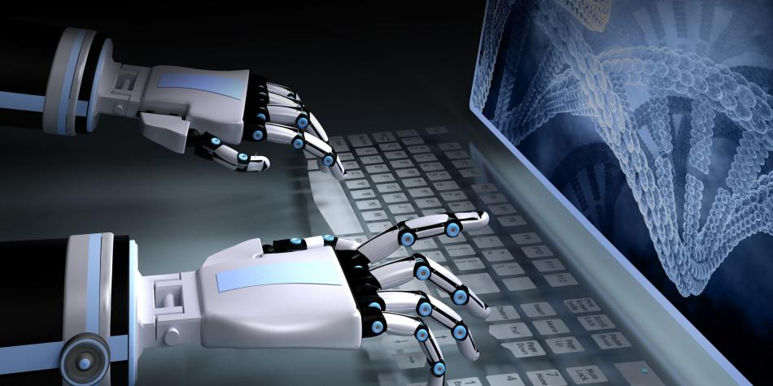
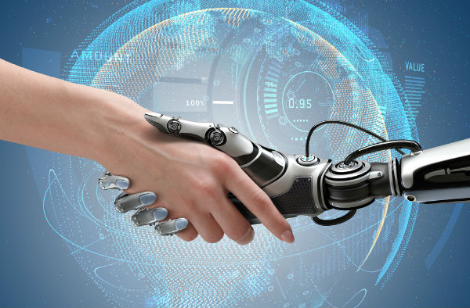
How does it respond
Looks for certain patterns of words in the user's input.
Replies with pre-determined output, if the pattern is matched.
Needs to have an idea of what the user will chat
Has suitable responses defined in the AIML file

Slide 6

Architecture of a Chat Bot
Responder
AIML Interpreter
AIML Objects
A Chat Bot

Slide 7
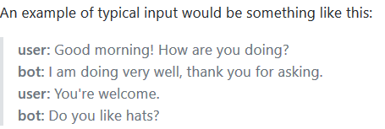
How to build a bot of your own
Install Chatterbot package .
Add an extension data of training file.
The brain is the AIML file, that defines patterns and corresponding replies
A bot can be trained to be an Expert System about a special theme – large data!

Slide 8
What is a ChatBot useful for?
A chatbot will communicate with a real person, but applications are being developed in which two chat bots can communicate with each other.
Chat bots are used in applications such as ecommerce customer service, call centers and Internet gaming.
Chat bots used for these purposes are typically limited to conversations regarding a specialized purpose and not for the entire range of human communication.

Slide 9
References
https://chatterbot.readthedocs.io/en/stable/
https://media.readthedocs.org/pdf/chatterbot/latest/chatterbot.pdf
The Anatomy of A.L.I.C.E.: Dr. Richard S. Wallace, http://www.alicebot.org/anatomy.html
Artificial Intelligence Markup Language (AIML), A.L.I.C.E. AI Foundation, http://alicebot.org/TR/2001/WD-aiml/
AIML Interpreter Overview 2004, http://www.aimlbots.com/en/aiml-interpreters.html
Computing machinery and intelligence, Alan Turing [1950], http://www.abelard.org/turpap/turpap.htm
Using Dialogue Corpora to Train a Chatbot (Bayan Abu Shawar, Eric Atwell) http://www.comp.leeds.ac.uk/andyr/research/papers/techreport2003_02.pdf

Slide 10
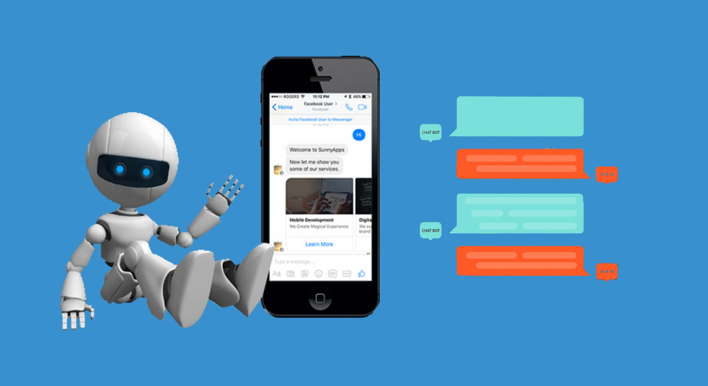
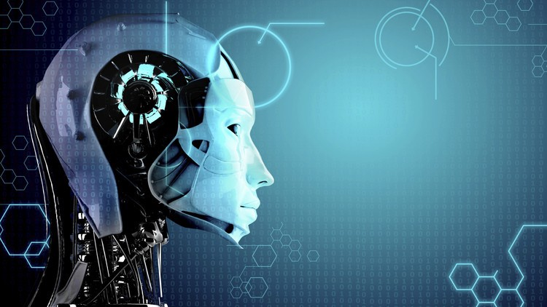
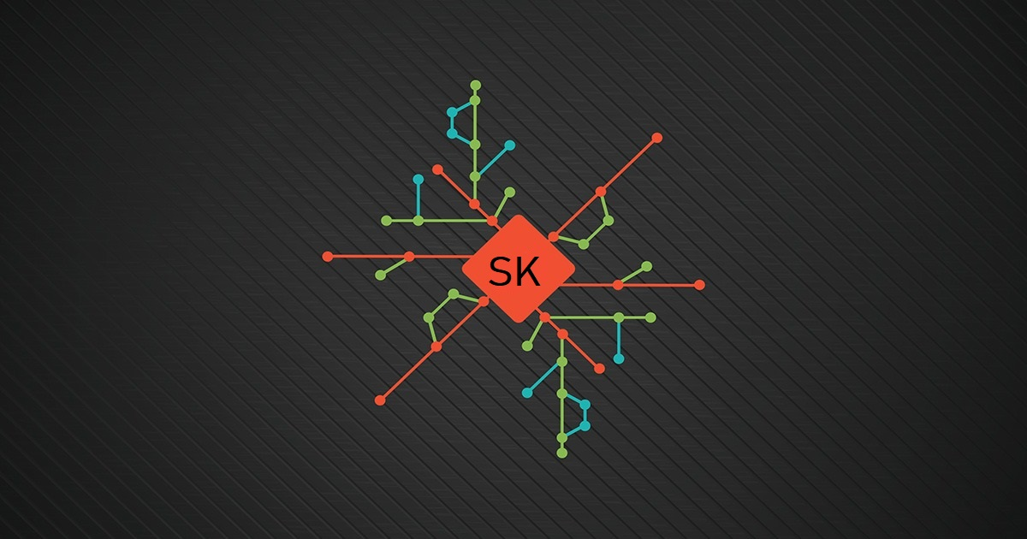

Thank You
Shubham Kumar

