Slide 1
Plant Identifications using Plant Leaf

Slide 2
Introduction
Plant Leaf Identification is a system which is able to classify different species of plants on the basis of their leaves using digital image processing techniques. The images are first preprocessed and then their shape, color and texture based features are extracted from the processed image.
The aim of the project is to develop a Leaf recognition program based on specific characteristics extracted from photography. Hence this presents an approach where the plant is identified based on its leaf features such as area, histogram equalization and edge detection and classification. The main purpose of this program is to use MATLAB resources.

Slide 3
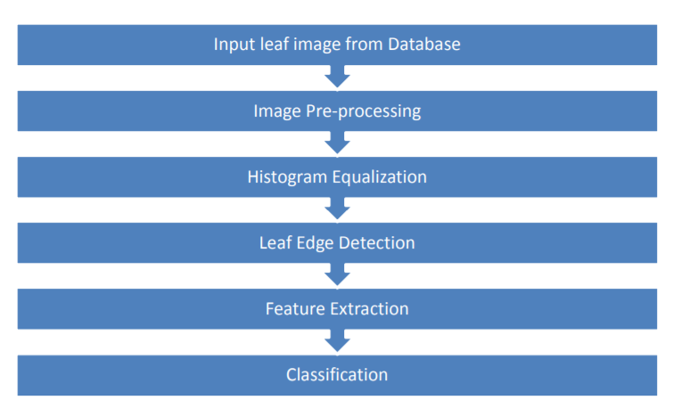
Flow Chart Of Image Processing

Slide 4
Steps involved in Image Identifier For Leaf
1. Pre-processing
The following steps were followed for pre-processing the image:
Conversion of RGB to Grayscale image
Smoothing image using Guassian filter
Adaptive image thresholding using Otsu's thresholding method
Closing of holes using Morphological Transformation
Boundary extraction using contours
2. Feature extraction
Variou types of leaf features were extracted from the pre-processed image which are listed as follows:
Shape based features : physiological length,physological width, area, perimeter, aspect ratio, rectangularity, circularity
Color based features : mean and standard deviations of R,G and B channels
Texture based features : contrast, correlation, inverse difference moments, entropy
3. Model building and testing
Once the features have been extracted, then these features are to be used to classify and identify an object using SVM classifier to classify plants based on shape-related features of leaf such as aspect ratio, rectangularity, area ratio of convex hull, perimeter ratio of convex hull, sphericity, circularity, eccentricity, form factor and invariant moments. In general pattern recognition systems, there are two steps in building a classifier: training and testing (or recognition).

Slide 5
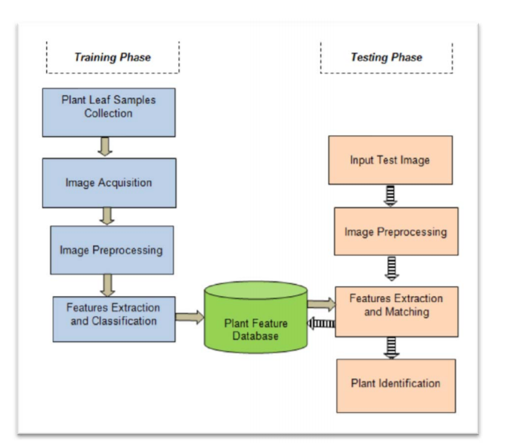
Image processing steps of leaf

Slide 6
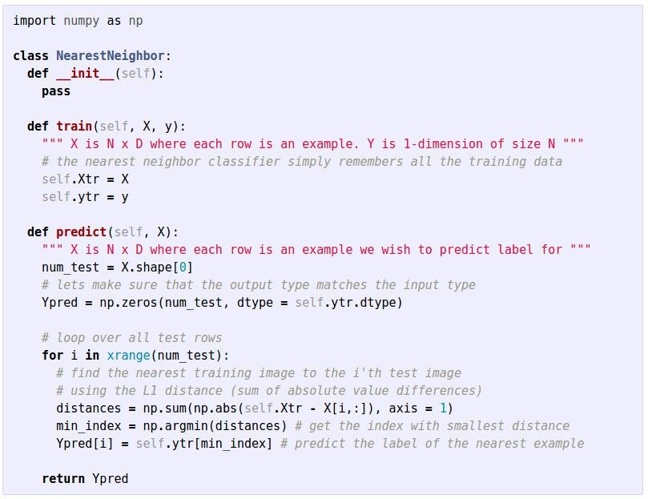
Nearest Neighbor classifier
Q: With N examples, how fast are training and prediction?
A: Train O(1), predict O(N)

Slide 7
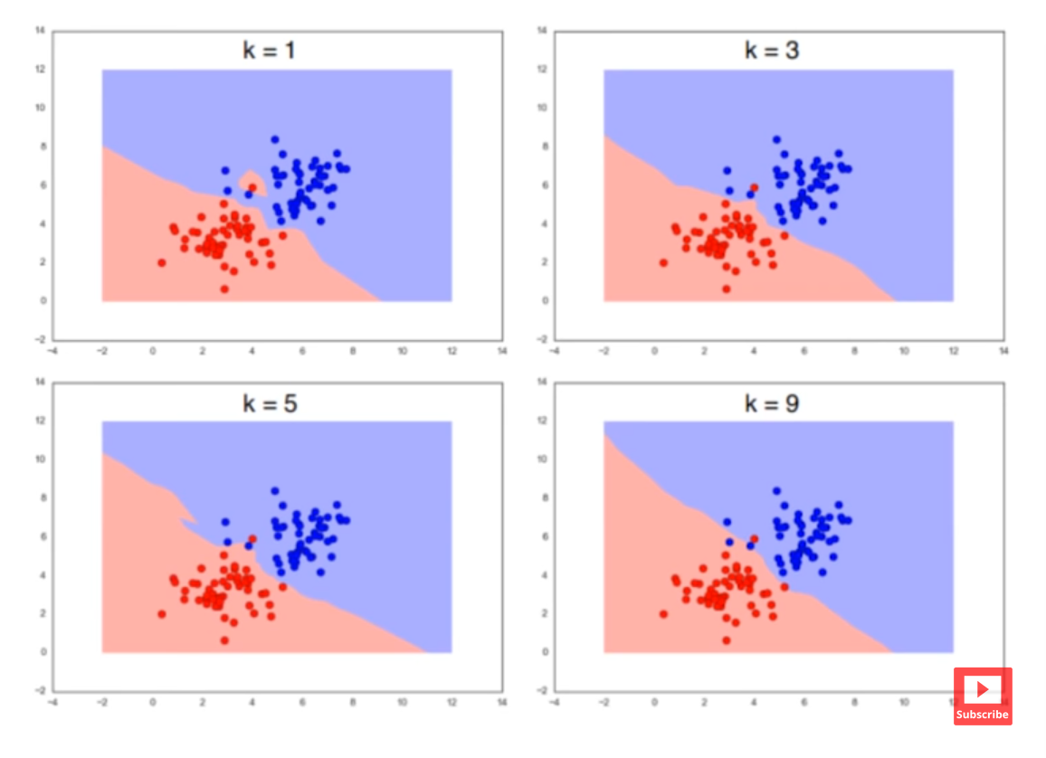
What is KNN Algorithm?
“K Neatrest Neighbour is a simple algorithm that store all the available cases and cassifies the new data or case based on similarity measures.”

Slide 8
Project Benefits
The project allows users with relevant pieces of information about the objects and their relationships.
It can be used in learning purpose as anyone can click pictures of plants. and they can get information about it.

Slide 9
Project Uniqueness
The project uses two algorithm, which will be better for identifying accuracy.
NB and KNN algorithm both uses two different approach for identification so data extraction will be more accurate.

Slide 10
Future Scope
The future of image processing will involve scanning the heavens for other intelligent life out in space. Also new intelligent, digital species created entirely by research scientists in various nations of the world will include advances in image processing applications. Due to advances in image processing and related technologies there will be millions and millions of robots in the world in a few decades time, transforming the way the world is managed.
With increasing power and sophistication of modern computing, the concept of computation can go beyond the present limits and in future, image processing technology will advance and the visual system of man can be replicated. The future trend in remote sensing will be towards improved sensors that record the same scene in many spectral channels.

Slide 11
Thank You

