Slide 1
Review -1 Website structure & Flowchart
Team V-Rides

Slide 2
AGENDA
Topic of Project
Problem statement, Objective and Scope
Hardware / Software Requirement
Architecture Diagram / Process flow
Usability / Application
​Contribution of each member
References

Slide 3
Topic of Project
V-Rides, college bicycle rental system is designed to provide an efficient and convenient way for VIT students to rent bicycles on time basis. It includes features such as QR code-based locking - unlocking, flexible rental durations, payment options, bicycle health monitoring, user profiles, pre-booking, and multiple bicycle bookings. The system aims to promote sustainable transportation on campus while ensuring a seamless user experience.

Slide 4
Problem Statement / objective

Slide 5
In VIT campus, students transition to online studies every 6 months. Purchasing a bicycle for this period and subsequently selling it has proven to be inconvenient. Additionally, the academic block is located 1.5 km away from the hostels, making daily commuting costly and cumbersome. To address these challenges and promote cost-effective campus mobility, we aim to introduce the "V-Rides" bicycle rental system.
Our objective is to develop the "V-Rides" bicycle rental system to provide an efficient and cost-effective means of transportation for students within the VIT campus. This system will offer flexible bicycle rentals, eliminating the need for students to buy and sell bicycles every semester, and will facilitate convenient travel between hostels and the academic block. Ultimately, "V-Rides" aims to enhance the overall campus experience by simplifying transportation for students.

Slide 6
Hardware / Software Requirement
The primary hardware requirement for V-Rides is the bicycles themselves. These bicycles will be equipped with QR codes that can be scanned by students using their mobile devices, such as smartphones or tablets. Additionally, it may be necessary to set up QR code signage at designated parking spots on the campus to facilitate easy scanning.
Website: The central platform for V-Rides will be a user-friendly website accessible from various web browsers. The website will provide features for user registration, bicycle booking, QR code scanning, payment processing, and user interactions.
QR Code Scanner: The website will incorporate a QR code scanner that can be accessed through standard web browsers. Users can scan the QR code on the bicycles using their device's camera or external QR code scanning tools like Google Lens. This web-based scanner will serve as the primary means for unlocking and locking bicycles.
Server: The server hosting the website will manage user accounts, bicycle availability, booking processes, payment processing, and data storage for bicycle health monitoring.
Database: A secure database will store user profiles, booking history, and bicycle health data. This database ensures data integrity and accessibility.
Payment Processing: Integration with secure online payment processing systems will be essential to facilitate user payments for bicycle rentals directly through the website.

Slide 7
Architecture Diagram

Slide 8
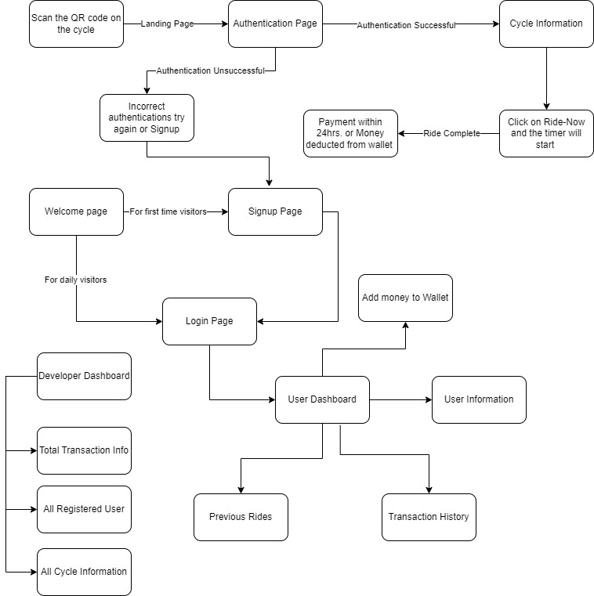

Slide 9
Process flow

Slide 10
Scan QR Code on Bicycle
Leads to the authentication page.
Authentication Page
User enters their username and password.
If incorrect, user can try authentication again or proceed to signup.
Signup Page
New users can create an account.
They can also add money to their wallet.
Welcome Page
Welcomes visitors to the V-Rides website.
User Dashboard
Displays user information, including previous rides and transaction history.
Total Transaction Info
Provides an overview of all transactions.

Slide 11
All Cycle Information
Lists details of available bicycles.
Login Page
Registered users can log in here.
User Dashboard (After Login)
Displays user information and options for previous rides and transaction history.
Previous Rides
Shows details of past bicycle rentals.
User Information
Provides user profile details.
Transaction History
Lists all past transactions related to bicycle rentals.
Click on "Ride Now"
Allows users to select a bicycle for the current ride.
The timer will start, and payment will be due within 24 hours or deducted from the wallet.

Slide 12
Usability:
V-Rides offers a range of user benefits that enhance the overall campus experience. First and foremost, it brings unmatched convenience to students by providing an efficient and readily accessible means of transportation. With the elimination of the need to buy and sell bicycles every semester, V-Rides simplifies campus commuting, saving students both time and money. Moreover, by promoting the use of bicycles, it contributes to sustainability efforts, reducing the carbon footprint on campus and promoting a healthier lifestyle. The user-friendly interface and flexible rental options make V-Rides an indispensable tool for students seeking a hassle-free way to get around the campus.

Slide 13
Application:
V-Rides can be seamlessly integrated into various scenarios and contexts within the campus community. For daily commuting, it becomes an essential mode of transportation, making the 1.5 km journey to the academic block a breeze. Students can also utilize V-Rides for group rides, whether it's exploring the campus with friends or participating in group activities. Additionally, V-Rides is an ideal solution for those who prefer renting bicycles for occasional use rather than owning one. It complements the campus lifestyle by offering an eco-friendly, cost-effective, and convenient transportation option for all students.

Slide 14





MEET OUR TEAM
Shubh
gupta
Akshat rastogi
Sunnam mehta
Wrishita paul
Tamsa
karwa
Manages server, database, and payments.
Optimizes server performance and handles data management.
Basic Frontend, styling of pages, colour theory
Focuses on visuals and ensures smooth QR code integration.
Enhances user experience and manages site navigation.

Slide 15
THANK YOU

