Slide 1
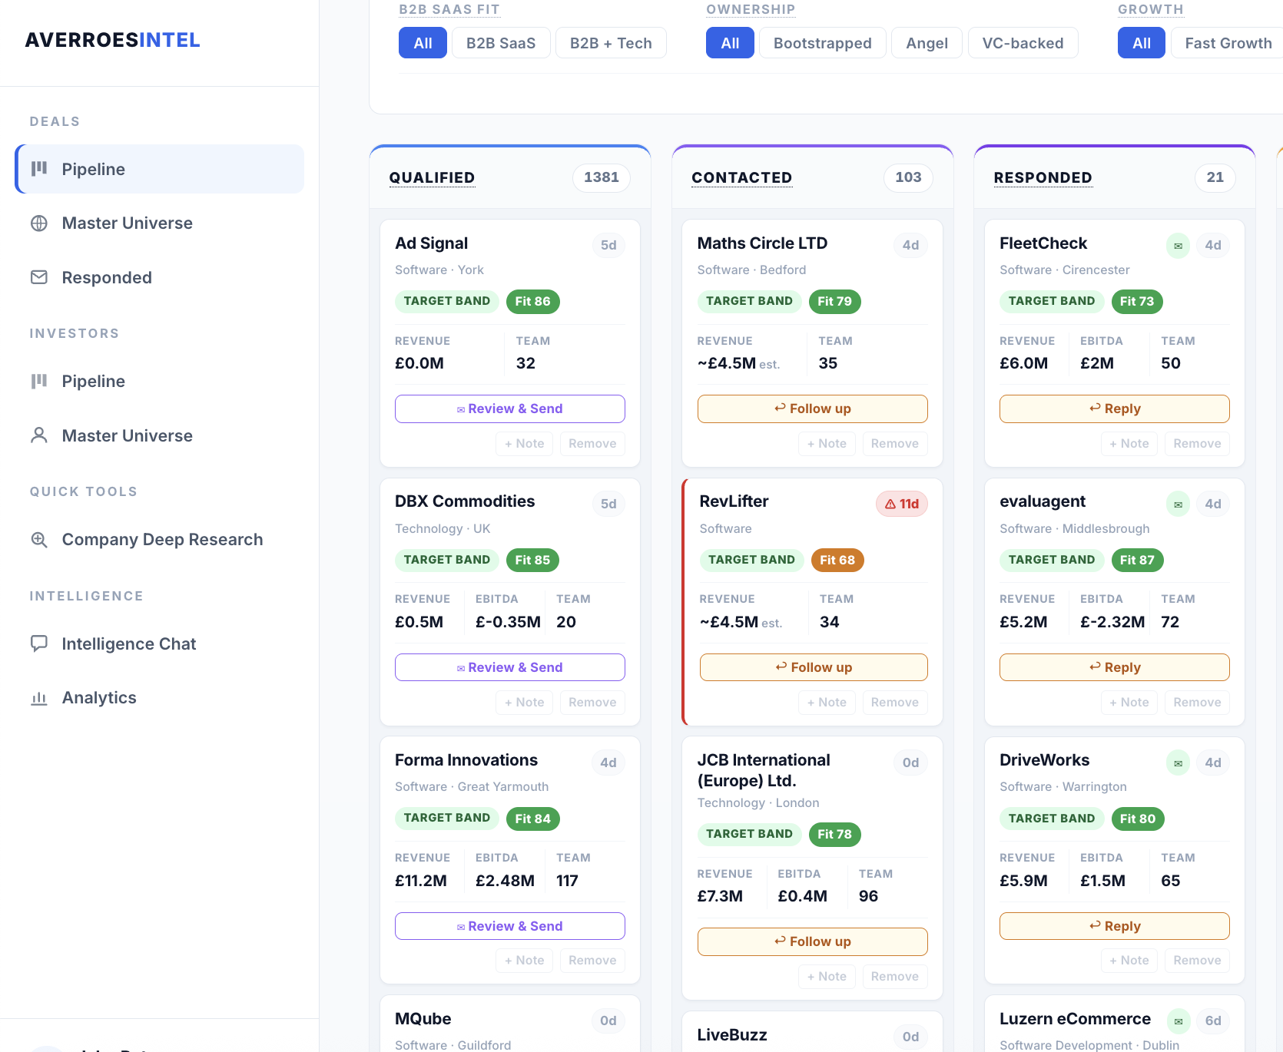
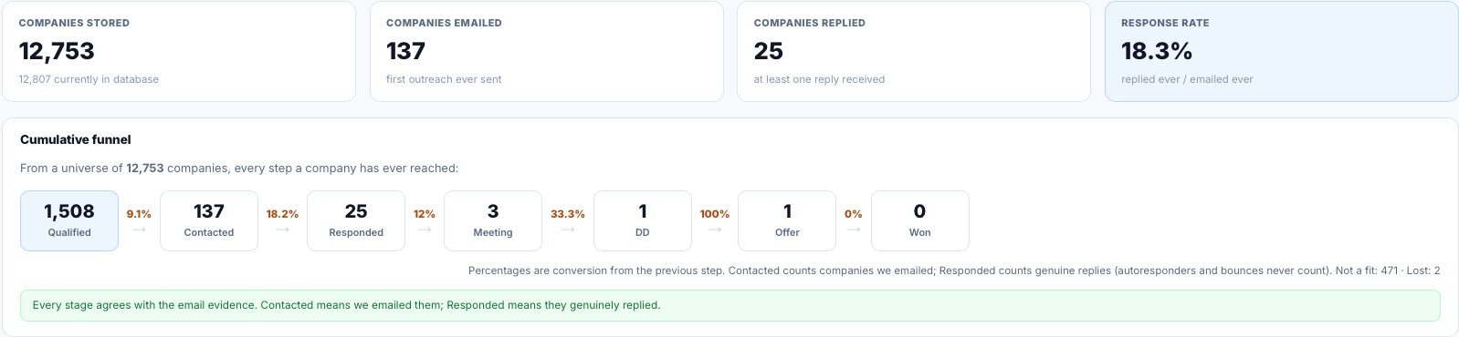
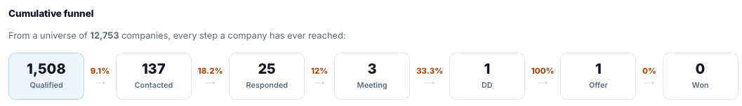
4. Deal Origination Platform
IR
Deal origination platform
We have developed an in-house AI platform, AverroesIntel, whose core is a deal origination pipeline. It ingests companies from multiple sources (PitchBook, Inven, Gain, tech conferences), enriches each with Companies House financials, and scores them against Averroes' investment criteria.
Outreach is automated end to end: the platform finds the right founder's email address, drafts a personalised, human-sounding email, sends it from a dedicated mailbox in Bea's name, and follows up automatically - keeping all outreach contained and easy to monitor.
Every reply is classified by AI, and autoresponders or bounced emails never count as a response, so the numbers below are honest. Genuine conversations enter a manual phase, nurtured by Bea, Issam and Marianna towards a first call.
The result is a 17.5% response rate on cold outreach (typically under 1%), at ~£4/day in AI cost - intermediary-quality deal flow without the intermediary.
Portfolio Intelligence Platform
Built, then paused following the Glow acquisition. Current focus is a centralised data warehouse for Glow and Averroes, modelled on Journey, to create a single source of KPI data. More detail next quarter.
The live pipeline: every card carries the company's financials, fit score and its next outreach action.
COMPANIES STORED
12,807
sourced into the universe
COMPANIES EMAILED
143
first outreach ever sent
COMPANIES REPLIED
25
at least one genuine reply
RESPONSE RATE
17.5%
replied ever / emailed ever
1,566
Qualified
9.1%
→
143
Contacted
17.5%
→
25
Responded
12.0%
→
3
Meeting
33.3%
→
1
DD
100%
→
1
Offer
Live from the platform's analytics, 26 Aug 2026. Cumulative - companies that have ever reached each stage; percentages are conversion from the previous stage.
Notes:
Introduces AverroesIntel to the board. Right box: what the tool does. Left: the live pipeline. Bottom: cumulative volumes from the platform's analytics (26 Aug 2026); replies exclude autoresponders and bounces.

