Slide 1
FITBUDDY
AI-Powered Personalized Fitness Planning System
FastAPI • Jinja2 • SQLite/SQLAlchemy • Gemini AI
Project Presentation & Main Coding Walkthrough
7
Days per plan
3
AI outputs
4
Core layers
SQLite
Persistence
Prepared from the supplied FitBuddy project source and screenshots

Slide 2
1. Project Overview
What FitBuddy is designed to do
Core capabilities
• Collects a user's basic fitness profile: name, age, weight, goal and intensity.
• Generates a structured 7-day workout plan with warm-up, exercises, cooldown and safety guidance.
• Produces a concise nutrition/recovery suggestion.
• Allows the user to submit feedback and revise the saved workout plan.
• Stores users and workout plans in SQLite through SQLAlchemy.
• Provides browser pages plus JSON API endpoints.
Technology stack
• FastAPI backend
• Jinja2 HTML templates
• Pydantic validation
• Gemini service layer
• SQLite database
• Demo/local fallback when AI is unavailable
FitBuddy • AI Fitness Plan Generator
2

Slide 3
2. System Architecture
Clean separation between UI, API, persistence and AI
Browser / UI
Jinja2 + CSS + JS
FastAPI Routes
Forms + JSON APIs
Service Layer
Gemini + fallback
Database
SQLite + SQLAlchemy
End-to-end flow
• Request → Pydantic validation → workout/nutrition generation → database save → result page/API response.
• Gemini is treated as an enhancement rather than a hard dependency: local deterministic fallback keeps the demo usable.
• Feedback reuses the stored original plan and profile, then saves the revised plan.
FitBuddy • AI Fitness Plan Generator
3

Slide 4
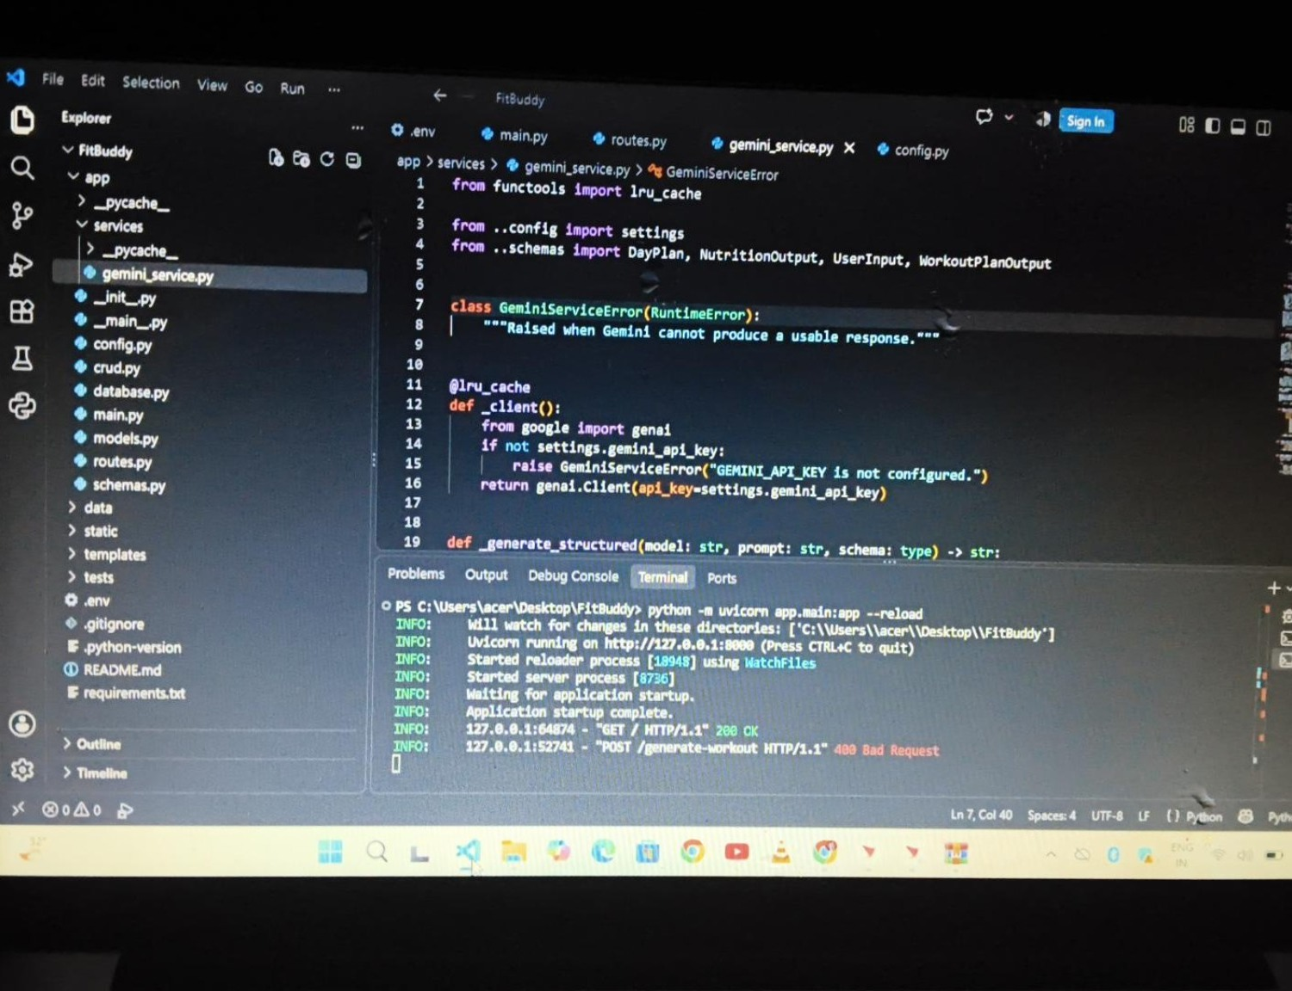
3. Main Application Coding
FastAPI application setup and lifecycle
Key code
@asynccontextmanager
async def lifespan(app):
init_db()
yield
app = FastAPI(
title=settings.app_name,
description="AI-powered
personalized fitness planning
with Gemini.",
version="1.0.0",
lifespan=lifespan,
)
app.mount("/static", ...)
app.include_router(router)
FitBuddy • AI Fitness Plan Generator
4

Slide 5
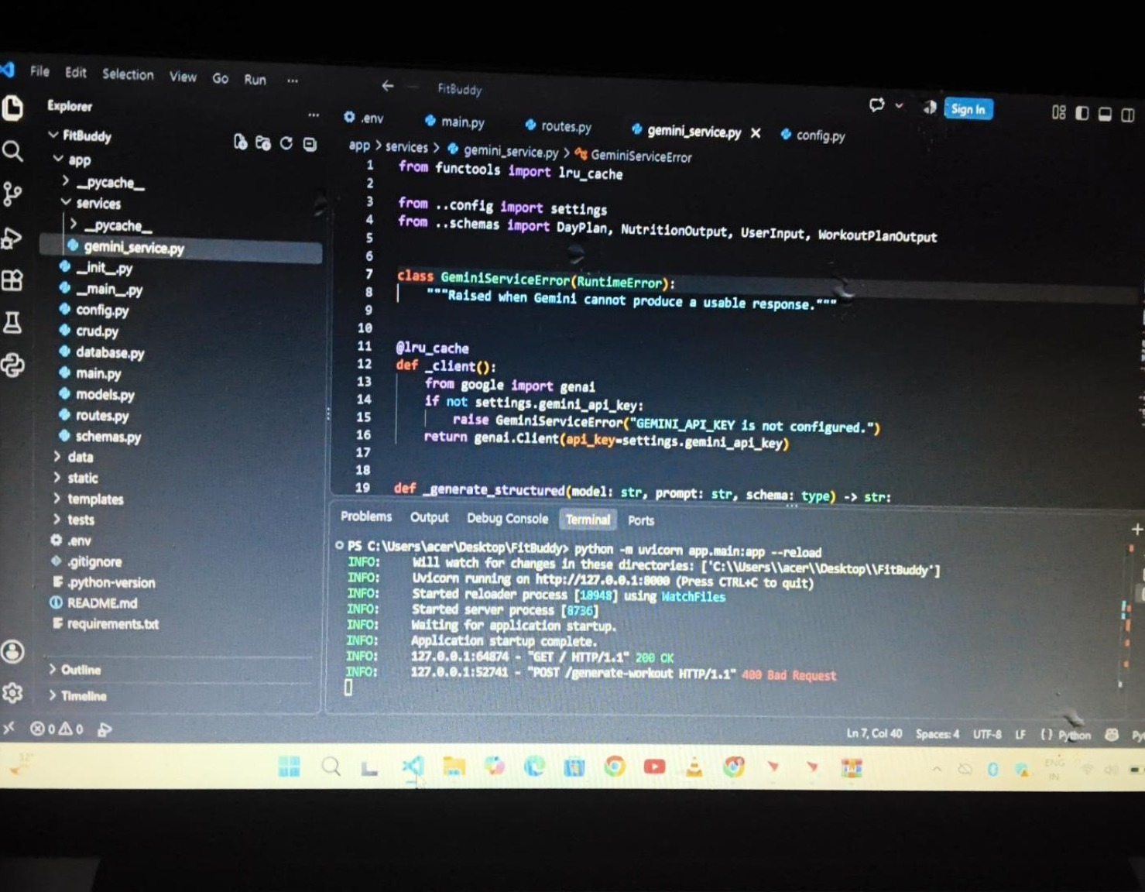
4. Gemini Service Layer
Structured AI output + safe local fallback
Important reliability logic
def generate_workout_gemini(data):
if settings.demo_mode or not settings.gemini_api_key:
return demo_workout(data)
try:
return _generate_structured(
settings.workout_model,
prompt,
WorkoutPlanOutput,
).strip()
except GeminiServiceError:
return demo_workout(data)
# Similar fallback is used for
# nutrition and plan updates.
FitBuddy • AI Fitness Plan Generator
5

Slide 6
5. Routes & API Layer
Browser forms and JSON endpoints
Main browser workflow
@router.post("/generate-workout")
def generate_workout(...):
data = UserInput(
user_id=user_id,
name=name,
age=age,
weight=weight,
goal=goal,
intensity=intensity,
)
workout = generate_workout_gemini(data)
nutrition = generate_nutrition_tip_with_flash(data)
user = save_user(db, data)
plan = save_plan(db, user, workout, nutrition)
return templates.TemplateResponse(
request, "result.html",
_result_context(request, user, plan)
)
Available endpoints
• GET / — landing page
• POST /generate-workout — form-based plan generation
• POST /submit-feedback — revise a saved plan
• GET /view-all-users — admin/coach view
• GET /api/health — service health
• POST /api/generate-workout — JSON API
• POST /api/submit-feedback — JSON API
• GET /api/users — stored user list
FitBuddy • AI Fitness Plan Generator
6

Slide 7
6. Validation & Data Model
Pydantic schemas protect the application boundary
UserInput schema
Goal = Literal[
"weight loss",
"muscle gain",
"general wellness",
"flexibility",
"endurance",
]
Intensity = Literal[
"low", "medium", "high"
]
class UserInput(BaseModel):
user_id: str = Field(
min_length=2, max_length=50
)
name: str = Field(
min_length=2, max_length=100
)
age: int = Field(ge=13, le=100)
weight: float = Field(gt=25, le=350)
goal: Goal
intensity: Intensity
Why validation matters
• Name is cleaned before use.
• Age is restricted to a defined safe input range.
• Weight has lower and upper validation limits.
• Goal and intensity use Literal values, preventing unexpected strings.
• WorkoutPlanOutput requires exactly 7 day entries.
• NutritionOutput keeps the AI response concise and structured.
FitBuddy • AI Fitness Plan Generator
7

Slide 8
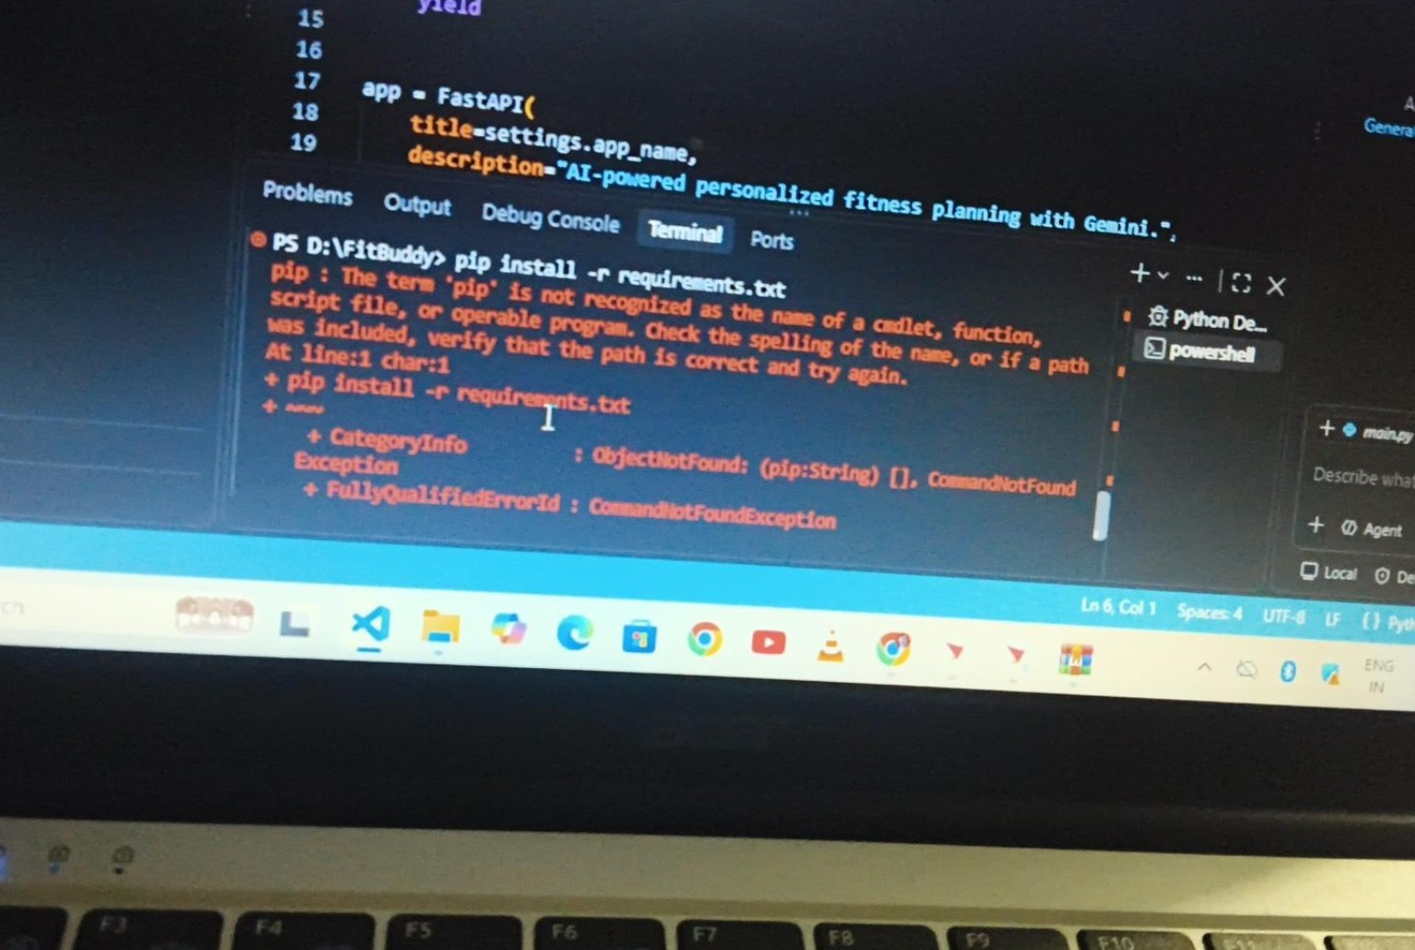
7. Error Encountered During Setup
The screenshot shows a Windows command-resolution issue
Fix
• Observed message: 'pip is not recognized...'
• This is a Python/PowerShell environment PATH issue, not a FastAPI route error.
• Use the Python launcher/module form so pip is resolved through the installed Python.
• Recommended: py -m pip install -r requirements.txt
• Then run: py -m uvicorn app.main:app --reload
FitBuddy • AI Fitness Plan Generator
8

Slide 9
8. Clean Windows Setup Commands
Use these commands from the FitBuddy project root
Recommended PowerShell flow
cd D:\FitBuddy
py --version
py -m pip --version
py -m pip install -r requirements.txt
py -m uvicorn app.main:app --reload
# Optional: run automated tests
pytest -q
# Open in browser
http://127.0.0.1:8000
http://127.0.0.1:8000/docs
• If 'py' is also not recognized, install Python 3.11+ and enable 'Add Python to PATH' during installation.
FitBuddy • AI Fitness Plan Generator
9

Slide 10
9. Reliability & Testing
Design goal: the UI should remain usable even when Gemini is unavailable
LOCAL
Workout fallback
LOCAL
Nutrition fallback
LOCAL
Feedback fallback
PYDANTIC
Validation
Reliability strategy
• Demo mode can run without a Gemini API key.
• Gemini network, quota, model-response or API failures are caught in the service layer.
• A deterministic local plan is returned instead of breaking the browser flow.
• The API layer still keeps a final 503 guard for unexpected service-level failures.
• Automated tests are included under tests/ and are intended to run with demo mode.
FitBuddy • AI Fitness Plan Generator
10

Slide 11
10. Final Project Summary
FitBuddy combines AI generation with a practical local web application
What the project delivers
• Personalized 7-day workout planning
• Nutrition/recovery guidance
• Feedback-driven plan revision
• SQLite persistence
• FastAPI + Jinja2 web interface
• JSON API endpoints
• AI fallback for resilient demos
Demo checklist
• Open the project in VS Code
• Install dependencies with python/py -m pip
• Configure .env when Gemini is required
• Run Uvicorn
• Test the UI and /docs
• Use pytest -q for automated checks
Thank You
FitBuddy • AI Fitness Plan Generator
11

