Slide 1
01
BIKE SHARING
DEMAND
ANALYSIS
Insights from an Excel dashboard
Usage patterns • Weather • Time trends • Customer segments
PROJECT PRESENTATION
BIKE SHARING DEMAND ANALYSIS • EXCEL DASHBOARD
1

Slide 2
Project Overview
02
What the dashboard is designed to answer
Understand how bike-sharing demand changes across days, dates, and hours.
Compare registered and casual customers to see different usage patterns.
Explore how weather categories relate to rental activity.
Turn raw rental data into a compact, filterable Excel dashboard.
BIKE SHARING DEMAND ANALYSIS • EXCEL DASHBOARD
2

Slide 3
Dashboard at a Glance
03
Key values displayed in the supplied dashboard screenshot
TOTAL CLIENT
AVERAGE REGISTERED
AVERAGE CASUAL
TOP DATE VALUE
58,304
1,186
109
1,985
Interpretation
Registered customers are the larger segment in the displayed summary.
Casual demand is lower on average than registered demand.
The dashboard provides multiple views, so users can filter the analysis by weekday, weather, and date.
BIKE SHARING DEMAND ANALYSIS • EXCEL DASHBOARD
3

Slide 4
Demand Over Time
04
Illustrative trend based on the shape of the dashboard line chart
Summary
Demand varies noticeably across periods.
Peaks and dips suggest that time-related factors matter.
Use the dashboard date filter to inspect specific periods.
BIKE SHARING DEMAND ANALYSIS • EXCEL DASHBOARD
4

Slide 5
Weekday & Weather Situation
05
Summary
The dashboard compares weekday demand by weather category.
Some days show a larger gap between weather groups.
Confirm the pattern with source data before making business claims.
When weather situation is good than customers on peak.
BIKE SHARING DEMAND ANALYSIS • EXCEL DASHBOARD
5

Slide 6
Hourly Demand Pattern
06
The dashboard’s time-wise chart highlights changes through the day
Summary
There is a huge rush of customers daily from 9 am to 18 pm.
There are very few customers during night time and evening time.
Time Based Analysis
19--24 | Evening Time
0--8 | Night Time
9--18 | Day Time
Note: Values are illustrative because the screenshot does not expose the underlying data.
BIKE SHARING DEMAND ANALYSIS • EXCEL DASHBOARD
6

Slide 7
Casual Customers CASUAL CUSTOMERS DAILY DATA
07
Summary
The dashboard shows average registered = 1,186 and average casual = 109.
Registered average is about 10.9 times the casual average, based on the displayed figures.
CASUAL CUSTOMERS DAILY DATA
BIKE SHARING DEMAND ANALYSIS • EXCEL DASHBOARD
7

Slide 8
Top Dates by Client Activity
08
The dashboard displays five high-value dates
Summary
The highest displayed value is 1,985.
The next values are 1,927, 1,746, 1,712, and 1,708.
Check date formatting and data definitions before presenting these as daily totals.
BIKE SHARING DEMAND ANALYSIS • EXCEL DASHBOARD
8

Slide 9
Interactive Filters & Business Questions
09
Use slicers and charts to investigate patterns
Weekday slicer: compare Monday–Sunday demand.
Weather filter: examine how weather categories align with rentals.
Date timeline: focus on a selected month or period.
Hourly chart: locate likely peak periods.
Customer split: compare registered and casual behaviour.
BIKE SHARING DEMAND ANALYSIS • EXCEL DASHBOARD
9

Slide 10
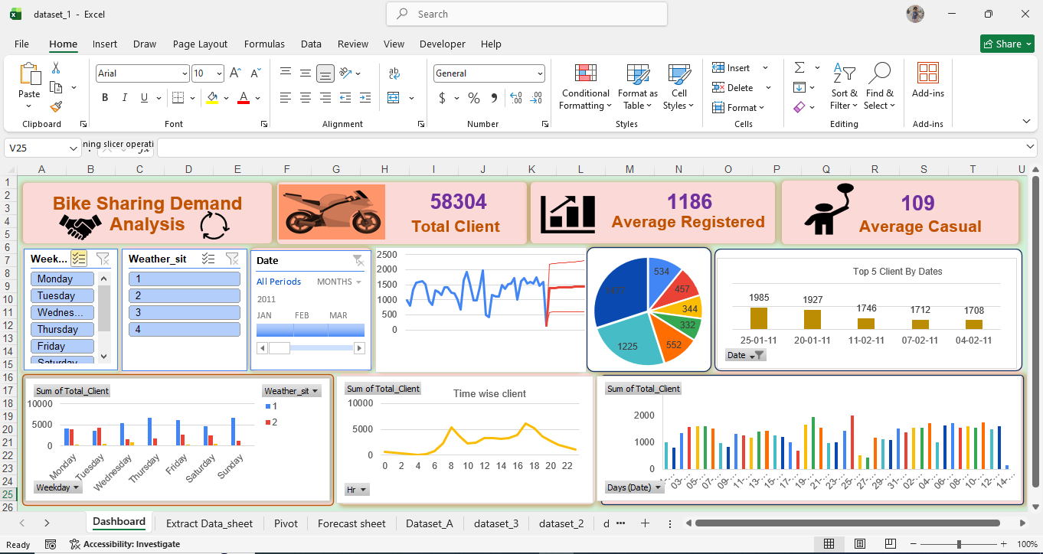
BIKE SHARING DEMAND ANALYSIS • EXCEL DASHBOARD
10
10

Slide 11
Conclusion
11
From dashboard visuals to practical decisions
The dashboard brings key customer, date, weekday, weather, and hourly views into one place.
Displayed KPIs indicate a higher registered-customer average than casual-customer average.
Time and weather comparisons can guide deeper demand analysis.
Thank you
Created By
ISHWAR PRAJAPATI
BIKE SHARING DEMAND ANALYSIS • EXCEL DASHBOARD
10

