Slide 1
All-in-One
Scientific Calculator
One Scientific Calculator for calculations, conversions,
date utilities and everyday financial estimates.
1234.5678
sin
cos
tan
√x
PYTHON
TKINTER
AST SAFE EVAL
7
8
9
÷
4
5
6
×
1
2
3
-
A practical multi-tool calculator project
ALL-IN-ONE SCIENTIFIC CALCULATOR
01 / 06

Slide 2
PRODUCT OVERVIEW
Six useful tools. One simple workspace.
A tab-based desktop interface keeps related tasks organised and easy to access.
01
Scientific Calculator
02
Calculation History
03
Unit Converter
Arithmetic, powers, roots, logarithms,
trigonometry and constants.
Review previous calculations and
reuse a selected result.
Convert length, weight, area, volume,
speed, time and temperature.
04
Age Calculator
05
Finance Calculator
06
Date Calculator
Calculate age, total days lived and
the countdown to the next birthday.
Estimate interest, loan EMI, FD and
recurring-deposit maturity.
Find date differences and add or
subtract days from a start date.
ALL-IN-ONE SCIENTIFIC CALCULATOR
02 / 06

Slide 3
EVERYDAY UTILITIES
Built for quick answers beyond arithmetic.
Three dedicated tabs handle conversions, age details and date planning.
UNIT CONVERTER
AGE CALCULATOR
DATE CALCULATOR
↔
🎂
▦
Length • Weight • Area
Enter date of birth
Compare two calendar dates
Volume • Speed • Time
Get years, months and days
Get total day difference
Temperature: °C, °F, K
See total days lived
Add or subtract a day count
Convert between units using
Calculate next birthday
Display the resulting date
base-unit factors.
and days remaining.
in DD-MM-YYYY format.
DESIGNED AS SEPARATE TABS
ALL-IN-ONE SCIENTIFIC CALCULATOR
03 / 06

Slide 4
FINANCE & HISTORY
Understand results Keep useful calculations close
FINANCE MODES
CALCULATION HISTORY
Simple Interest
P × r × t
25 × 4 = 100
Compound Interest
P × (1 + r)ᵗ
√81 = 9
EMI Calculator
Monthly loan repayment
sin(30) = 0.5
2⁸ = 256
FD Maturity
Quarterly compounding estimate
RD Maturity
Monthly deposit accumulation
Use result
Clear history
ALL-IN-ONE SCIENTIFIC CALCULATOR
04 / 06

Slide 5
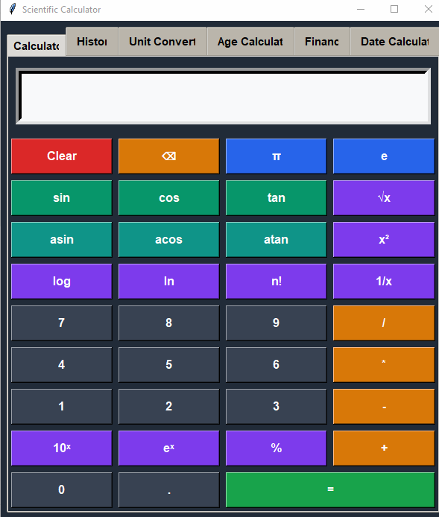
SCIENTIFIC CALCULATOR — LIVE
ALL-IN-ONE SCIENTIFIC CALCULATOR
05 / 06

Slide 6
THANK YOU
Scientific Calculator
Built with Python • Tkinter • Math & Date Utilities
Created By
ISHWAR PRAJAPATI
ALL-IN-ONE SCIENTIFIC CALCULATOR
06 / 06

