Slide 1
HR ANALYTICS
EMPLOYEE ATTRITION REPORT
A dashboard-led overview of workforce trends, attrition patterns,
and employee satisfaction

Slide 2
01 | Executive Summary
A quick snapshot of workforce size and employee attrition
Employee Count
Attrition Count
Attrition Rate
Active Employees
Average Age
1,470
237
16.12%
1,233
37
Key takeaways
• The dashboard reports 1,470 employees in total.
• 237 employees have left, representing a 16.12% attrition rate.
• 1,233 employees remain active; the reported average age is 37.
• Department, age, education, gender and job satisfaction views help identify where to investigate further.
02 / 10

Slide 3
02 | Attrition by Department
Department mix of employees who left
What the chart shows
• R&D contributes 133 exits (56.12%).
• Sales contributes 92 exits (38.82%).
• HR contributes 12 exits (5.06%).
• R&D and Sales together account for most recorded attrition.
03 / 10

Slide 4
03 | Employee Count by Age Group
Age distribution shown in the dashboard
Highlights
• The largest age value in the displayed chart is 32, with 274 employees.
• The next largest groups are ages 28 (245) and 36 (219).
• Counts are lower at the youngest and oldest ends of the displayed range.
04 / 10

Slide 5
04 | Attrition by Gender
Recorded attrition counts split by gender
Interpretation
• The dashboard records 150 male attrition cases.
• The dashboard records 87 female attrition cases.
• Counts alone do not show group-specific attrition risk; workforce denominators are needed to compare rates fairly.
• Consider reviewing role, tenure and department mix alongside gender.
05 / 10

Slide 6
05 | Attrition by Education Field
Attrition counts across education specializations
Key observations
• Life Sciences has the highest displayed count (89).
• Medical follows with 63 cases.
• Marketing and Technical Degree show 35 and 32 cases.
• These are counts, not rates; compare with each field's employee population before drawing conclusions.
06 / 10

Slide 7
06 | Job Satisfaction Ratings
A role-by-rating matrix from the dashboard
How to read this
• The matrix compares satisfaction ratings 1–4 across job roles.
• Sales Executive has the largest visible total (292).
• Research Scientist shows high counts in ratings 3 and 4.
• Use this view to prioritize role-level follow-up, not to assume causes.
07 / 10

Slide 8
07 | Attrition Rate by Gender and Age Band
Rate labels reproduced from the dashboard
Insights to investigate
• The 25–34 age band has the highest displayed rate (18.14%).
• Under 25 is shown at 7.59%; 35–44 at 5.91%.
• 45–54 and Over 55 are shown at 3.80% and 1.27%.
• Validate calculation definitions and group sizes before using these rates for decisions.
08 / 10

Slide 9
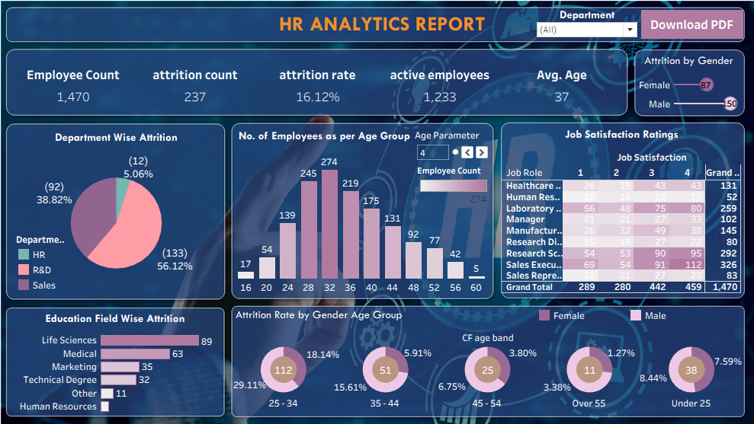
08 | Full HR Analytics Dashboard

Slide 10
THANK YOU
Questions & Discussion
HR Analytics Report | Employee Attrition & Workforce Insights

