Slide 1

Exploratory Data Analysis
Project: Bank Marketing Campaign
Name: Ishwar Balasaheb Bankar
Batch Code: LISUM28
Specialization: Data Science

Slide 2

Problem Statement Dataset
Agenda
EDA
Recommendations

Slide 3
Problem Statement
ABC Bank wants to sell it's term deposit product to customers and before launching the product they want to develop a model which help them in understanding whether a particular customer will buy their product or not (based on customer's past interaction with bank or other Financial Institution). This is an application of the organization’s marketing data.
Objective: Build a Classification ML model to shortlist customers who are most likely to buy the term deposit product. This would allow the marketing team to target those customers through various channels.

Slide 4
bank-additional-full.csv: 20 inputs (+1 target variable) and 41118 observations
https://archive.ics.uci.edu/ml/datasets/Bank+Marketing
Dataset
Assumptions:
‘Duration’ feature is dropped as suggested in the dataset
description
A frequently occurring missing value ‘unknown’ is considered
as another category for the categorical features.
Duplicate rows were deleted from the dataset.

Slide 5
EDA

Slide 6
EDA
1. Univariate Analysis

Slide 7
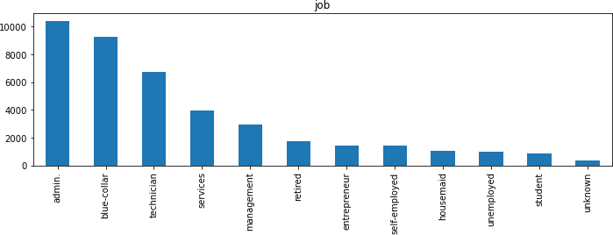
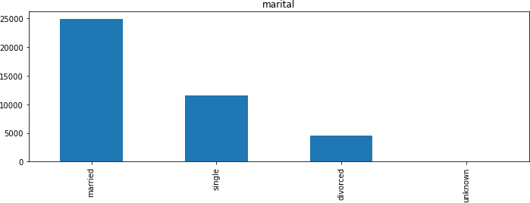
In Jobs, most of the customers are administrative staffs and technicians.
Married customers have been communicated more for subscription to the deposit more compared to single

Slide 8
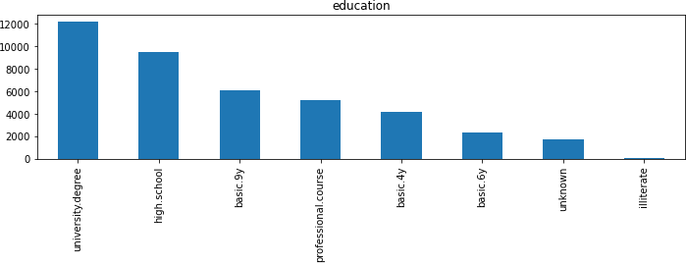
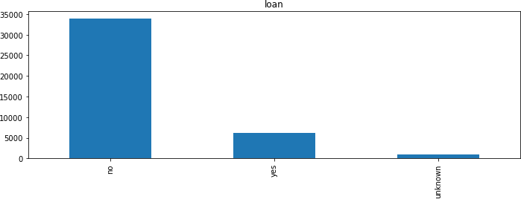
Most of the customers are university graduates followed by high school degree
Majority of the customers do not have a personal loan

Slide 9
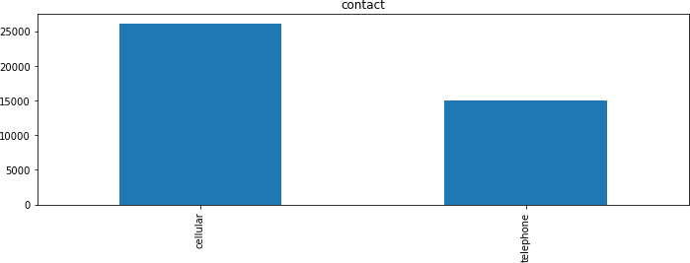
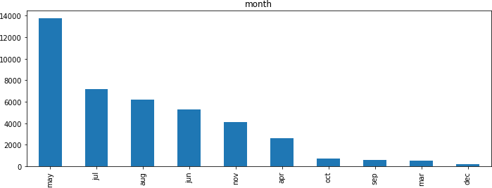
The type of communication used to contact customers is mostly cellular compared to telephone
May seems to be the month with most contacts made

Slide 10
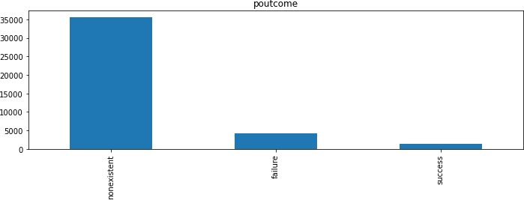
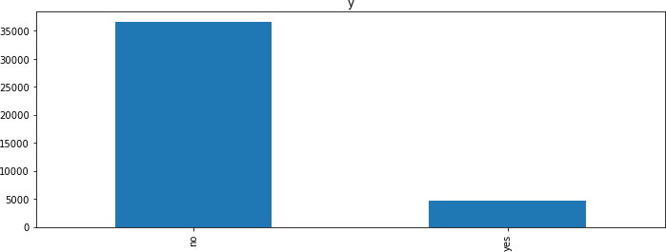
Most of the previous campaign results whether succeeded or failed is non existent
In the previous campaign, the percentage of people who subscribed to the deposit is less to those who did not.

Slide 11
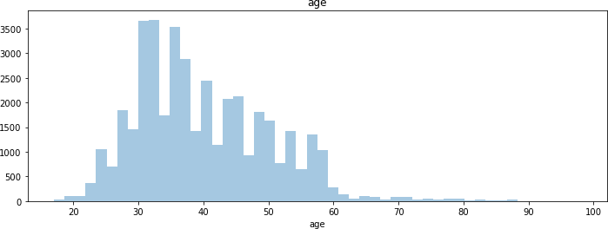
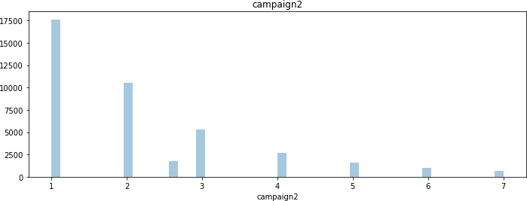
The age group of customers contacted mostly fall between 20 to 60
Number of follow ups made to a customer is less in the previous campaign

Slide 12
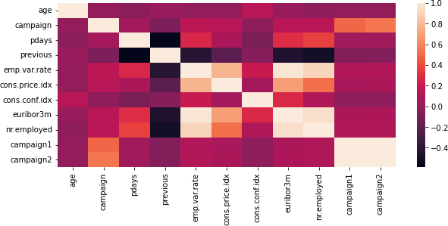
Correlation map

Slide 13
EDA
2. Bivariate Analysis

Slide 14
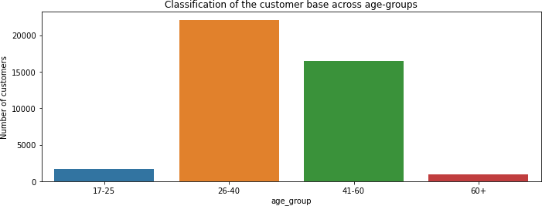
Classification of the customer base across age-groups

Slide 15
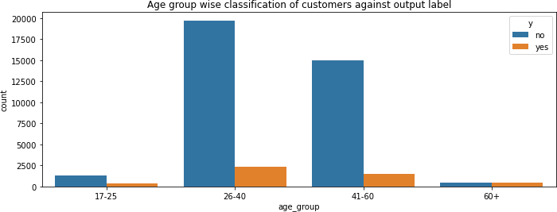
Looking at relation between different age groups and the output label y
In the age-groups of 26-40 and 41-60 yrs, majority of the people are not subscribed to the term deposit plan

Slide 16
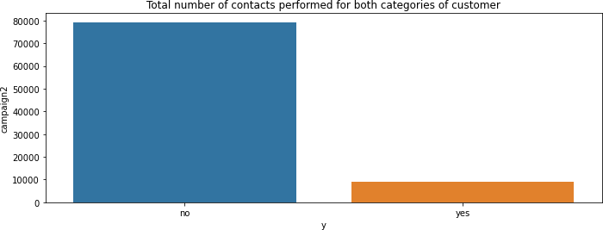
Looking at relation between Number of contacts made to the customer (campaign) and the output label y
When a greater number of contacts is made to the customer, they haven't subscribed to the term deposit plan

Slide 17
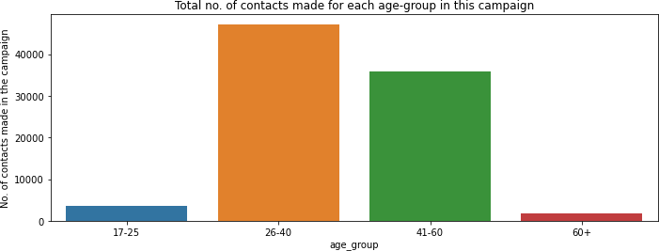
Looking at relation between 'age_group' and 'campaign' that is number of contacts performed for each age group
The 26-40 and 41-60 age-groups witness majority of the contacts made in this campaign. These two age-groups seem to the target groups for the bank.

Slide 18
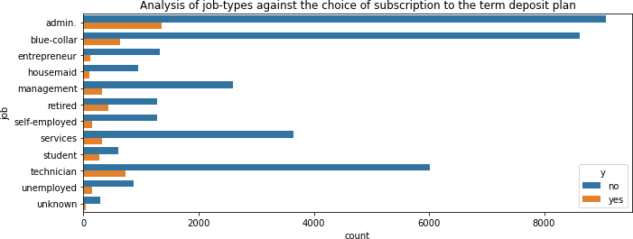
Looking at relation between job and the output label y
Looking at the jobs, 'admin', 'blue-collar' and 'technician' are the prominent jobs and most of the customers in these jobs have rejected the term deposit plan.

Slide 19
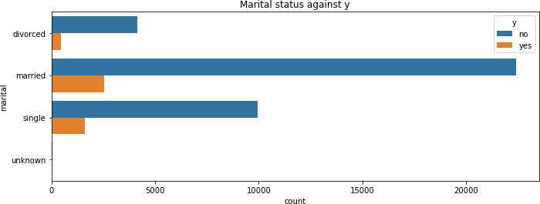
Analysing marital status and the output label
married and single customers are the majority of the customer base and comparatively married customers have taken the term deposit

Slide 20
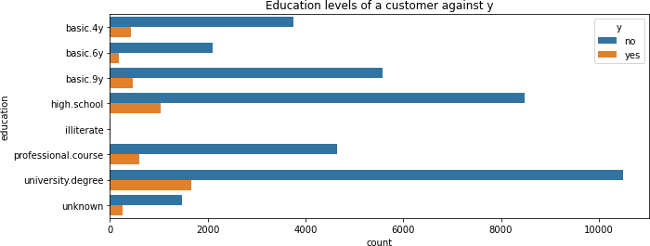
Analysing the different education levels of a customer against the choice of subscription
Customers with university degree have subscribed to the term deposit more

Slide 21
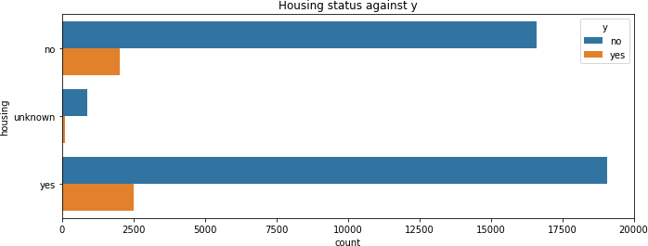
Analysing housing status and y
Number of customers who have subscribed to the term deposit is comparatively more for those with housing loan

Slide 22
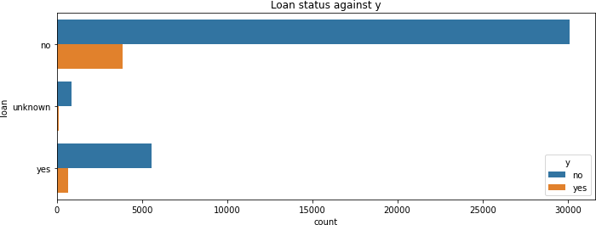
Analysing loan status and y
Number of customers who have subscribed to the term deposit is comparatively less for those with personal loan

Slide 23
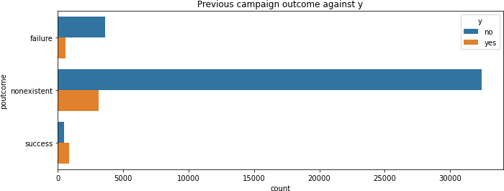
Analysing poutcome and y
The success rate of previous marketing campaign has resulted in more number of people subscribing to the term deposit

Slide 24
May is the most effective month to contact customers
Increase the time of contacts made per customer
Give more focus on university graduate students and high
school degree students
age-groups of 26-40 and 41-60 have a higher proportion among customers, therefore these groups present a profitable target for the marketing team.
Target the admins and technicians for more subscriptions
Recommen dation to improve campaign

Slide 25
Logistic Regression
Naïve Bayes
Decision Tree
Random Forest Ada Boost
Recommen
ded models ^{5.}
for this dataset
Hyper parameter tuning and model evaluation will be performed in order to determine the best model and the important features

Slide 26

Thank You

