Slide 1





Case Study Title:
AI-Powered Sustainable Crop Recommendation System
College : Symbiosis Institute Of Technology,Nagpur
Members:
Ishwari Kakade 22070521183 (Team Leader)
Jay Chafale 22070521145
Sem VI-B

Slide 2
Problem Statement :
Brief Overview:
Agriculture is a backbone of many economies, yet farmers often struggle with selecting the right crops for their land.Farmers often struggle to choose the right crop for their land due to a lack of information on soil conditions, environmental factors, and market trends. This leads to reduced yields and unsustainable farming practices.
Traditional farming methods rely heavily on intuition or limited data, leading to:
Unsuitable crop choices.
Overuse of resources like fertilizers and water.
Low agricultural productivity.
Key Objectives:
To build an AI/ML model that analyzes soil, weather, and environmental factors to recommend the most suitable crop, promoting sustainable agricultural practices and improving productivity.
Provide accurate crop recommendations based on input parameters such as soil nutrients, weather, and rainfall.
Enhance agricultural productivity and reduce risks associated with crop failure.
Facilitate data-driven decision-making for farmers and agricultural advisors.
Promote sustainability in agriculture through efficient land use.

Slide 3
Dataset Overview
Title: Crop Recommendation Dataset
Source: Link.
Dataset Overview:
Total Records: 2200+ rows of data.
Features: 7 input features and 1 target variable (crop type).
Purpose: To recommend the best-suited crop based on soil and environmental parameters
Features in the Dataset:
Nitrogen (N): This feature indicates the nitrogen content in the soil, which is essential for plant growth. High levels of nitrogen typically favor crops like wheat or maize.
Phosphorus (P): Represents the phosphorus content in the soil, vital for root development and flowering. Balanced levels are critical for healthy crop yields.
Potassium (K): Reflects the potassium levels in the soil, crucial for plant health and resistance against diseases.
Temperature: The average temperature of the environment in Celsius. This factor significantly impacts crop selection as different crops thrive in specific temperature ranges.
Humidity: Denotes the percentage of atmospheric moisture. Humidity levels are crucial, as crops like rice require high moisture, whereas crops like maize prefer moderate levels.
pH: A measure of soil acidity or alkalinity. Crops like coffee thrive in acidic soil, whereas grapes require slightly alkaline conditions.
Rainfall: The amount of rainfall in millimeters. Rainfall is an essential feature, as water-intensive crops like rice demand substantial rainfall, whereas crops like millet can survive with less.
Target Variable
The target variable in the dataset is the crop type.

Slide 4
Methodology
Approach:
Data Collection:
Gathered a dataset with features like soil nutrients (N, P, K), temperature, humidity, pH, rainfall, and crop types from Kaggle.
Data Preprocessing:
Cleaned missing data, normalized numerical features, and encoded crop types into numerical labels. Split the data into 80% training and 20% testing sets.
Exploratory Data Analysis:
Visualized feature distributions and identified correlations to guide feature selection, focusing on impactful variables like nitrogen and pH.
Model Building:
Algorithm Used: Random Forest Classifier was chosen due to its robustness and ability to handle both categorical and numerical data efficiently.
Training: The model was trained using the training dataset to identify patterns and relationships between input features and crop types.
Hyperparameters such as the number of trees and maximum depth were optimized for better performance.
Testing: The model was evaluated using the testing dataset to assess its predictive accuracy and generalization capabilities.
Trained a Random Forest Classifier, optimized hyperparameters, and used it for crop prediction due to its high accuracy and robustness.
Model Evaluation:
Achieved 97.31% accuracy. Evaluated the model using precision, recall, and F1-score to ensure reliability.
Deployment:
Created an interactive system for real-time crop recommendations based on user inputs like soil and weather parameters.
This concise approach highlights the critical steps in building the crop recommendation system efficiently.

Slide 5
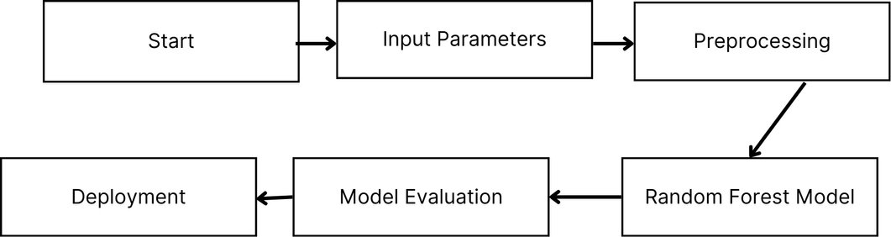
Methodology(Continued)
Algorithms Used:
Random Forest Classifier
The Random Forest Classifier is an ensemble learning algorithm particularly well-suited for handling large datasets efficiently. It has the capability to process both categorical and numerical data, making it ideal for diverse agricultural datasets. By employing ensemble learning, Random Forest significantly reduces the risk of overfitting, which is common in single decision tree models. One of its notable features is its ability to provide feature importance, allowing us to identify the most critical factors, such as Nitrogen (N) and pH, that influence crop selection.
Flowchart of the Process
1. Input Layer: User provides data: Nitrogen, Phosphorus, Potassium, Temperature, Humidity, pH, Rainfall.
2. Data Preprocessing: Normalize features, encode categorical variables, and clean data.
3. Model Training: Random Forest Classifier is trained on the dataset.Multiple decision trees are built using random subsets of data.
4. Model Prediction: For each user input, every tree in the forest makes a prediction.Predictions are aggregated using majority voting to determine the most suitable crop.
5. Output Layer: The recommended crop is displayed to the user.

Slide 6
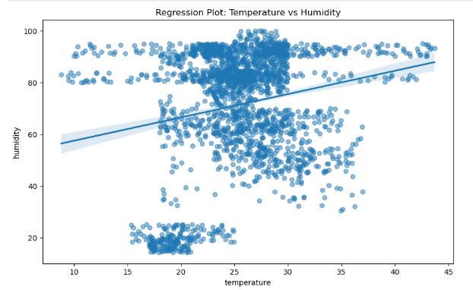
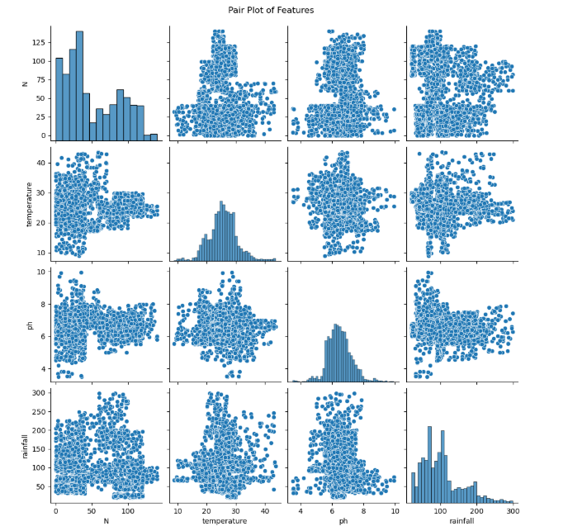
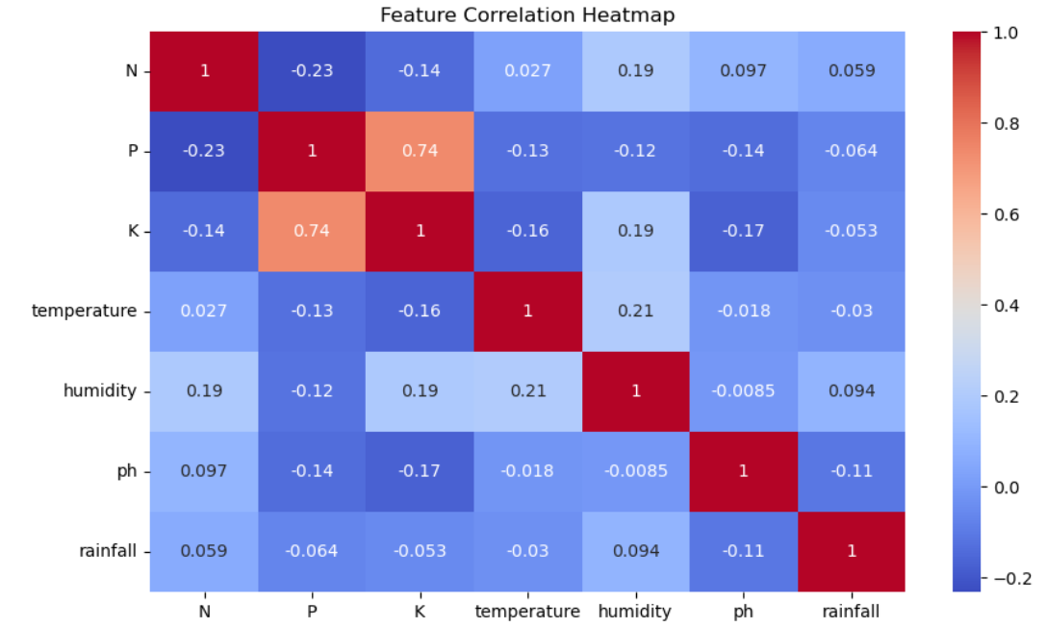
Data visualization:

Slide 7
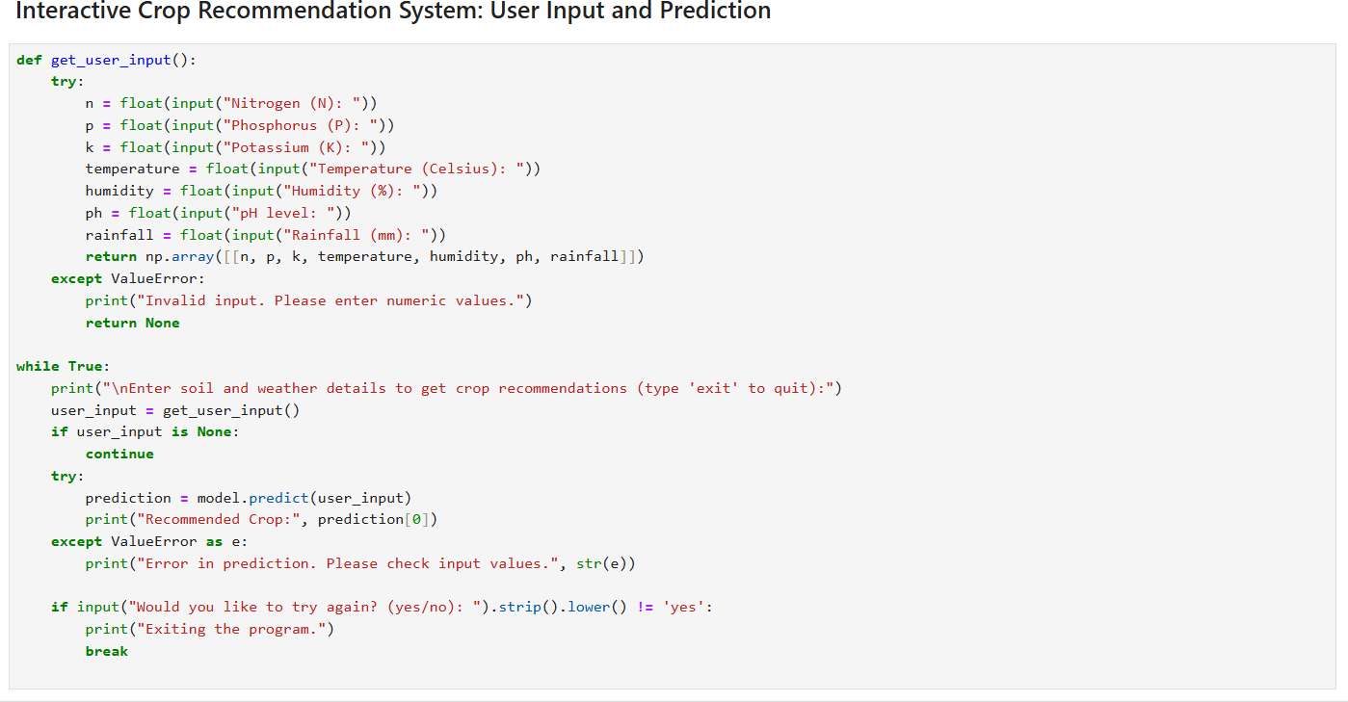
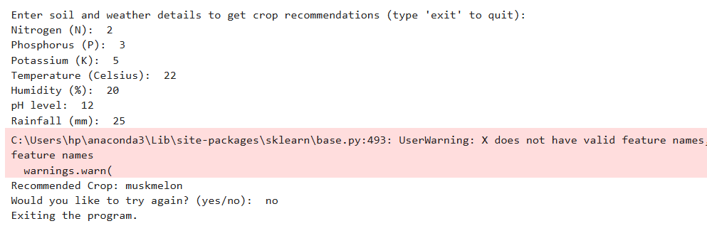
Model Building:
Output:
How my model works:
The Random Forest Classifier is trained using soil nutrients (N, P, K), temperature, humidity, pH, and rainfall to predict crop types.
During training, multiple decision trees are built using random subsets of data to ensure diversity and reduce overfitting.
For predictions, input data is processed through all trees, and the final crop recommendation is determined via majority voting.
Hyperparameters like the number of trees and tree depth are optimized using grid search for better performance.
The model identifies key features, such as Nitrogen and pH, as highly influential for accurate predictions, ensuring reliability and interoperability.
Model Link: https://github.com/ishwari04/Crop_Recommendation_System

Slide 8

Conclusion
Summary:
The Random Forest model demonstrates exceptional accuracy in predicting the most suitable crops based on soil and environmental conditions. By providing reliable recommendations, it empowers farmers with actionable insights, reducing their dependence on traditional trial-and-error methods and enhancing agricultural productivity.
Future Work:
To further improve the system, additional parameters like pest infestation and market trends can be integrated into the model. A user-friendly mobile application can be developed to make the recommendations more accessible. Moreover, incorporating IoT sensors for real-time data collection will enhance the system’s adaptability and accuracy, ensuring more precise and timely predictions.

Slide 9
References
Dataset source: Link.
Documentation: Scikit-learn.
Model Link: Link.

Slide 10
Thank You

