Slide 1
Smart Traffic Violation Pattern Detector
Project by: Ishwari Deshmukh
Generated automatically for presentation

Slide 2
Dataset Summary
Rows: 4000
Columns: 37
Sample rows shown (first 5):

Slide 3
Sample Data (first rows)
Violation_ID: VLT100000 | Violation_Type: Overloading | Fine_Amount: 4544 | Location: Karnataka | Date: 2023-01-01 00:00:00 | Time: 23:02
Violation_ID: VLT100001 | Violation_Type: Driving Without License | Fine_Amount: 2776 | Location: Punjab | Date: 2023-01-02 00:00:00 | Time: 00:42
Violation_ID: VLT100002 | Violation_Type: Using Mobile Phone | Fine_Amount: 4785 | Location: Maharashtra | Date: 2023-01-03 00:00:00 | Time: 04:32
Violation_ID: VLT100003 | Violation_Type: No Seatbelt | Fine_Amount: 1138 | Location: Uttar Pradesh | Date: 2023-01-04 00:00:00 | Time: 15:06
Violation_ID: VLT100004 | Violation_Type: Over-speeding | Fine_Amount: 1610 | Location: Karnataka | Date: 2023-01-05 00:00:00 | Time: 06:57

Slide 4
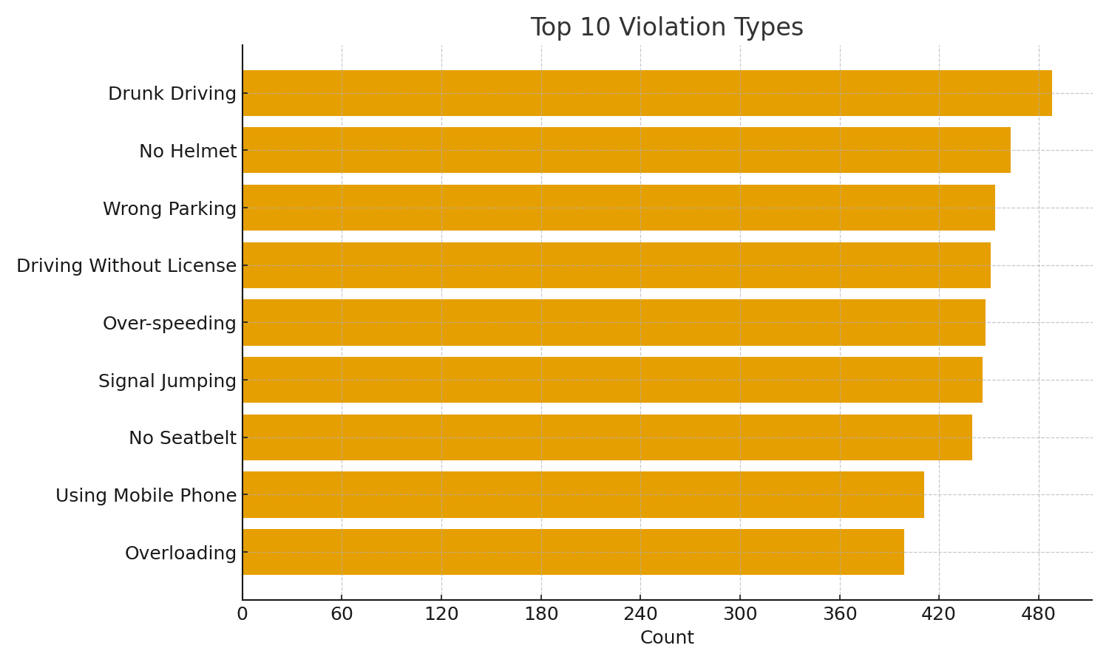
Top 10 Violation Types
Shows the most frequent violation categories (top 10).
Useful for prioritizing enforcement and education.

Slide 5
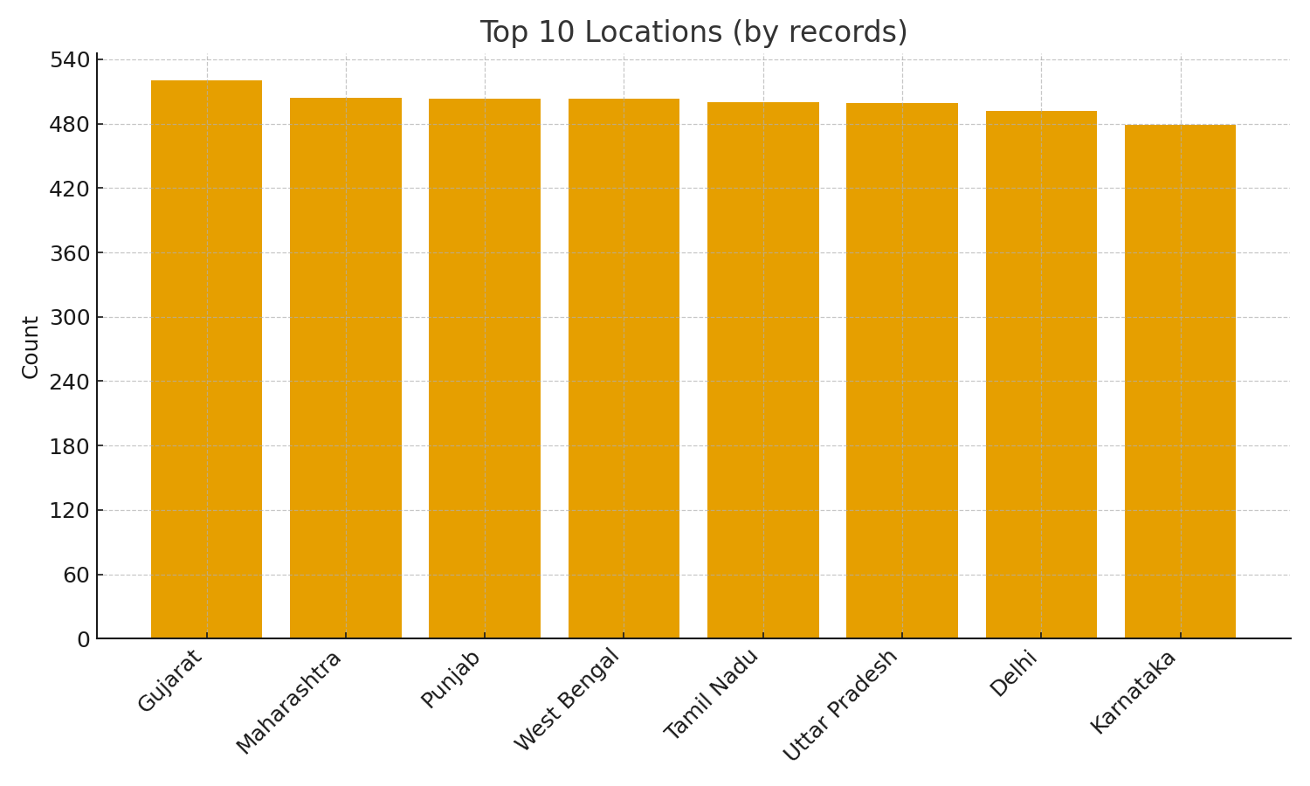
Top 10 Locations
Locations with highest number of recorded violations.
Helps identify hotspots for resource allocation.

Slide 6
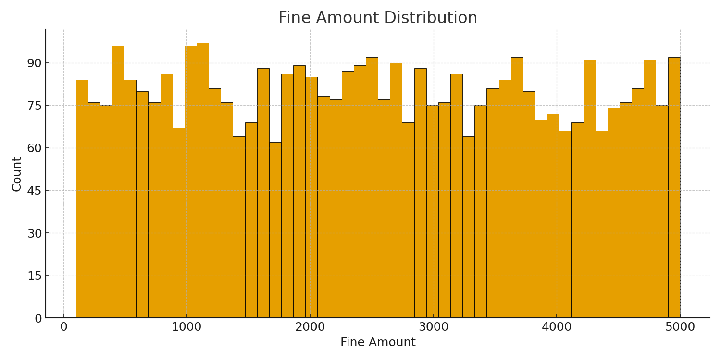
Fine Amount Distribution
Histogram of fine amounts to understand common penalties.
Check for outliers and data-entry issues.

Slide 7
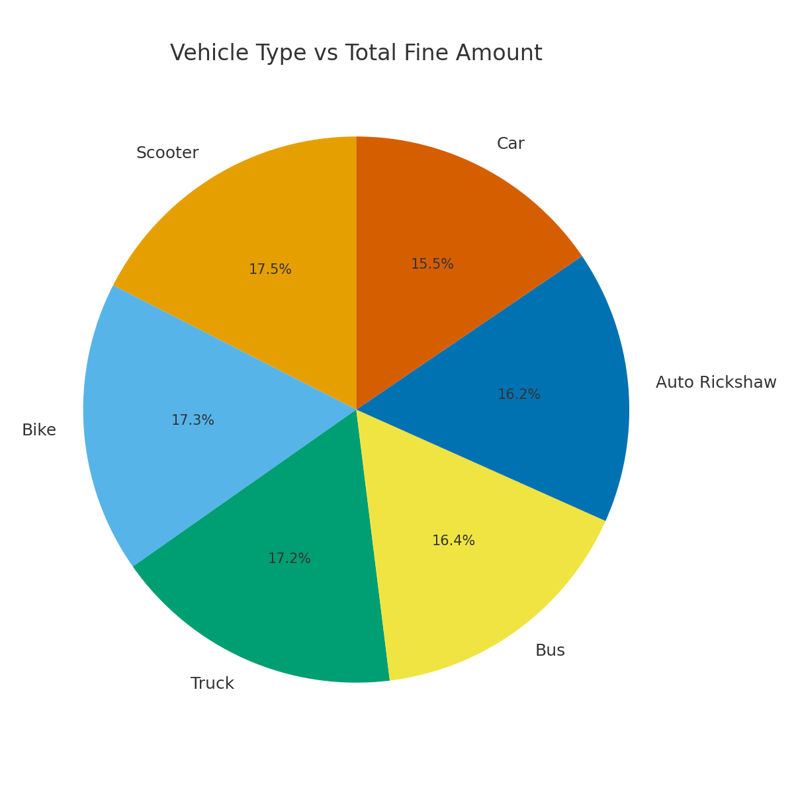
Vehicle Type vs Total Fine Amount
Shows which vehicle types contribute most to total fines.
Can inform targeted campaigns or policy.

Slide 8
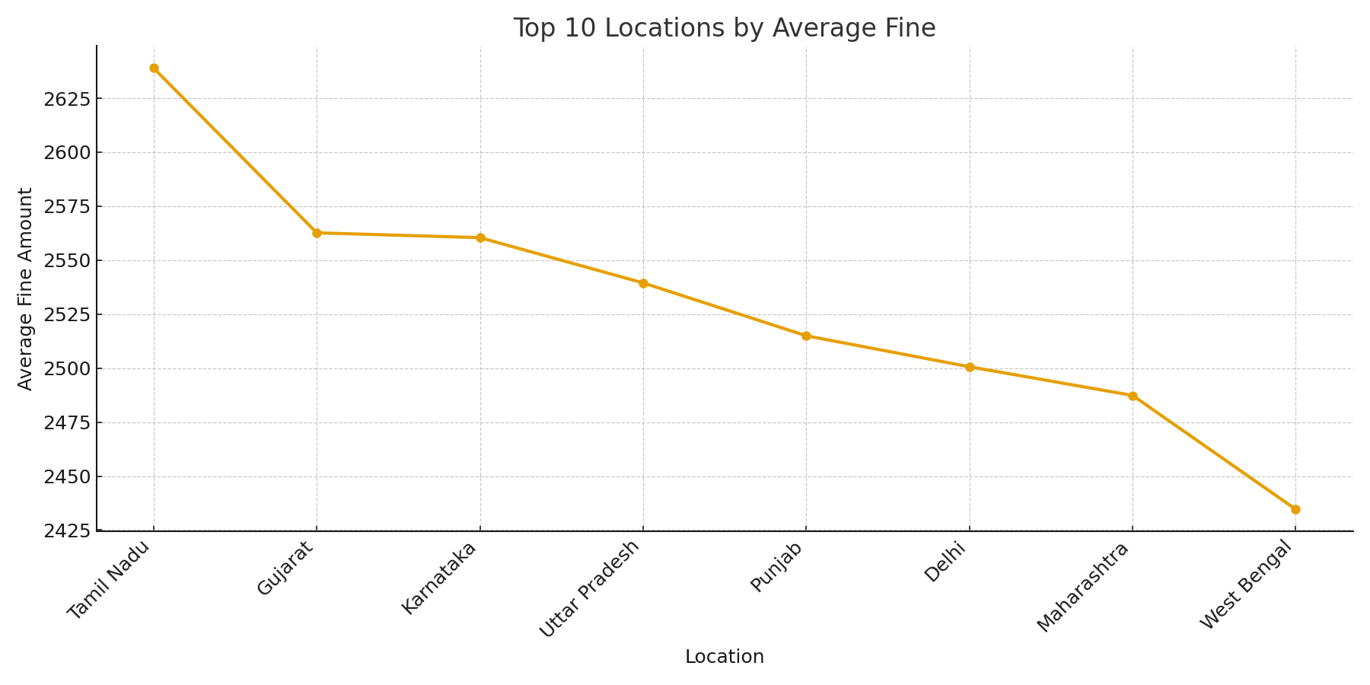
Top Locations by Average Fine
Average fine per location — highlights where fines are higher on average.
May indicate stricter enforcement or more severe violations.

