Slide 1
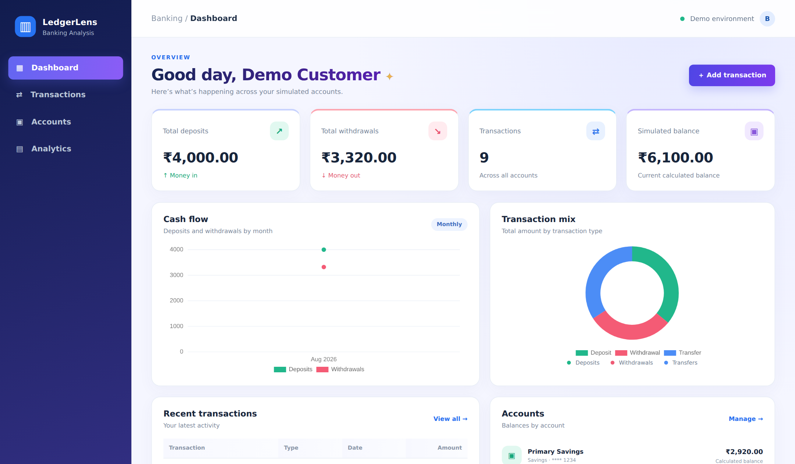

LedgerLens
PROJECT PRESENTATION
Banking Transaction Analysis Dashboard
Flask
SQLAlchemy
Supabase
Vercel
Chart.js
banking-flask-project.vercel.app

Slide 2




What is LedgerLens?
A Flask web app for tracking bank accounts, recording deposits, withdrawals and transfers, and spotting unusual activity with simple rule-based checks.
Track
Accounts and balances in one place
Analyse
Synthetic data only — an educational simulation, not connected to any real bank.
Cash-flow and mix charts
Validate
Server-side checks on every entry
3
9
₹6,100
Deploy
Accounts
Sample txns
Total balance
Runs locally or on Vercel + Supabase

Slide 3





Key features
Dashboard cards
Cash-flow charts
Transaction CRUD
Deposits, withdrawals, count and balance at a glance
Monthly line chart plus transaction-mix doughnut
Add and delete with validation and balance check
Search & filter
Review flags
Account summaries
Find by reference, description, account or type
Rule-based alerts for large or high-value amounts
Create accounts and see calculated balances

Slide 4




Architecture
SQLite
local
Browser
Vercel
Flask app
SQLAlchemy
Supabase
Postgres
Jinja2 HTML + CSS
Chart.js charts
Serverless Python
api/index.py
Routes, models,
review rules
ORM layer
Flask-SQLAlchemy
Routes exposed by app.py
/
/transactions
/transactions/add
/transactions/<id>/delete
/accounts
/accounts/add
/analytics
/health
Local runs use SQLite; production sets DATABASE_URL to Supabase.

Slide 5
Database design
customers
accounts
transactions
1 : N
1 : N
id
PK
id
PK
id
PK
name
account_number
UK
reference
UK
email
UK
name
account_id
FK
created_at
account_type
txn_type
opening_balance
amount
customer_id
FK
description
created_at
txn_date
created_at
One customer has many accounts; one account has many transactions. Deleting a parent cascades to its children. Postgres schema adds CHECK constraints (valid types, amount > 0).

Slide 6
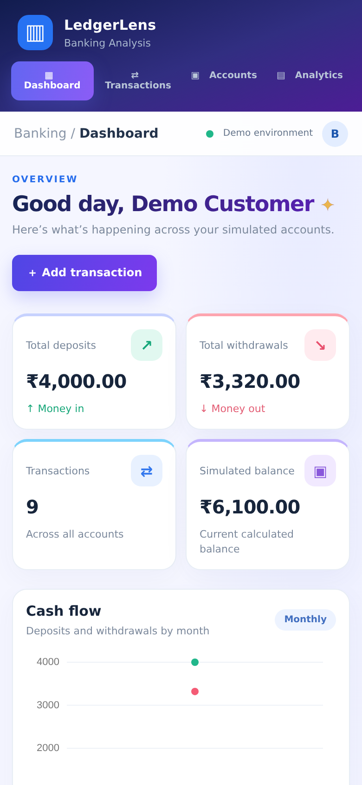
Dashboard — money at a glance
Desktop
Mobile

Slide 7
Charts & key numbers
₹4,000
₹3,320
9
₹6,100
Total deposits
Total withdrawals
Transactions
Simulated balance

Slide 8
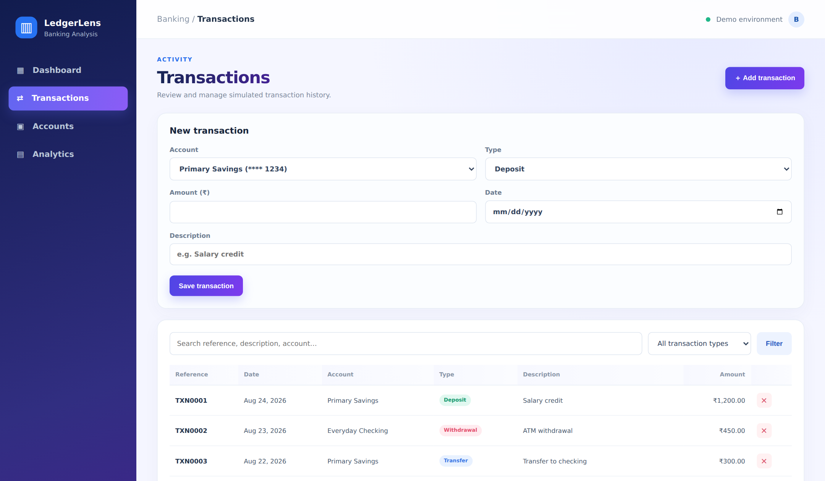



Transactions — add, search, review
Add with validation
Positive amount, valid type, date, description
Search
Reference, description or account name
Filter by type
Deposit, Withdrawal or Transfer
Delete safely
Browser confirm before removal

Slide 9
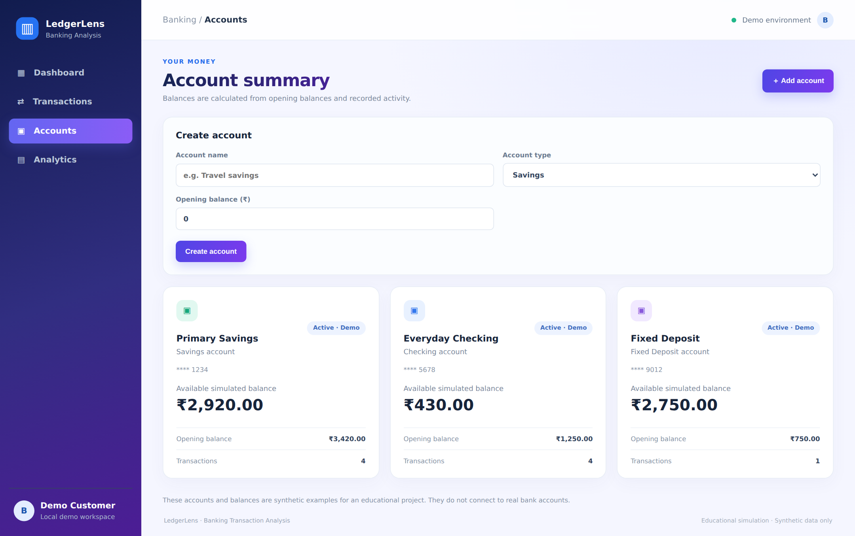
Accounts & balance logic
Balance = Opening + Deposits − Withdrawals
Primary Savings
₹2,920
3,420 + 2,000 − 2,500
Everyday Checking
₹430
1,250 − 820
Fixed Deposit
₹2,750
750 + 2,000
Transfers are recorded but do not change balances.

Slide 10

Validation flow & review rules
Submit form
Validate input
Balance check
Save with TXN ref
Flash + redirect
Invalid input or a withdrawal larger than the balance stops at the red flash message.
Large withdrawal
High-value transaction
Withdrawal ≥ ₹2,000
Any type ≥ ₹5,000
Sample data: only TXN0008 (₹2,500 cash withdrawal) is flagged. Flags are review prompts, not fraud decisions.

Slide 11
Run locally, deploy on Vercel
LOCAL
venv + pip install
python app.py
SQLite auto-created
Seed data loaded
PRODUCTION
GitHub repo
Vercel build
Env vars set
Supabase Postgres
Set DATABASE_URL and FLASK_SECRET_KEY in Vercel, run supabase/schema.sql once, then redeploy.

Slide 12
Limitations & next steps
Current limitations
Next steps
No login — one demo customer
User authentication per customer
Transfers don’t move balances
Double-entry transfers
Flags are simple rules only
Anomaly scoring with pandas
Needs Supabase for persistence
Pagination, CSV export, tests
Thank you · banking-flask-project.vercel.app

