Slide 1
Cryptocurrency portfolio tracker
CMPE 280 – Web UI Design and Development
Team: Web Ninjas
Ishwarya Varadarajan - 011549473
Nishchay Madan - 011824501
Sowmya Viswanathan - 011432668
Suhel Mehta - 011550942

Slide 2
Introduction
It is an application to track and trade cryptocurrencies
Provides users’ with option to trade 6 currencies – bitcoin, ripple, Ethereum, stellar, cardano, lite coin
Price of the currencies are retrieved using an online API: https://min-api.cryptocompare.com/data/price?fsym=BTC&tsyms=USD

Slide 3
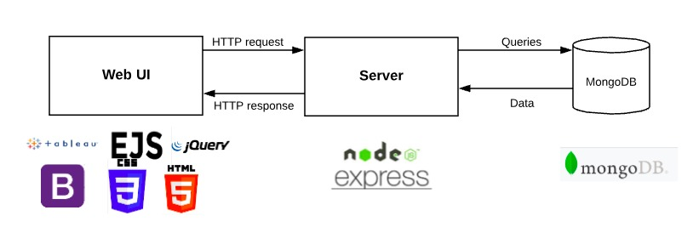
System Architecture

Slide 4
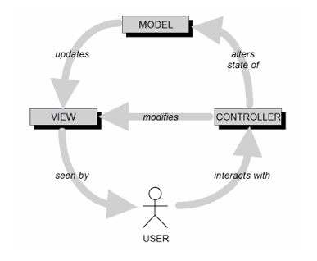
MVC Architecture
Implementations are kept separate without much dependencies
Model – data is maintained in MongoDB
View – represents the Web UI html pages
Controller – the application flow is maintained in the router.js and main.js files

Slide 5
Application functionalities
Login/Register – User can login/register to use this application
Dashboards – User can view the daily/monthly/years prices of cryptocurrencies
Add to Wallet – User can add currencies to wallet by giving in the quantity
My Wallet – User can view the list of currencies in his wallet and can choose to buy all of them
My History – User can view his transaction history
My Profile – User can view his profile information
Edit Profile – User can edit his information
Logout – User can logout from the application

Slide 6
Demo

Slide 7
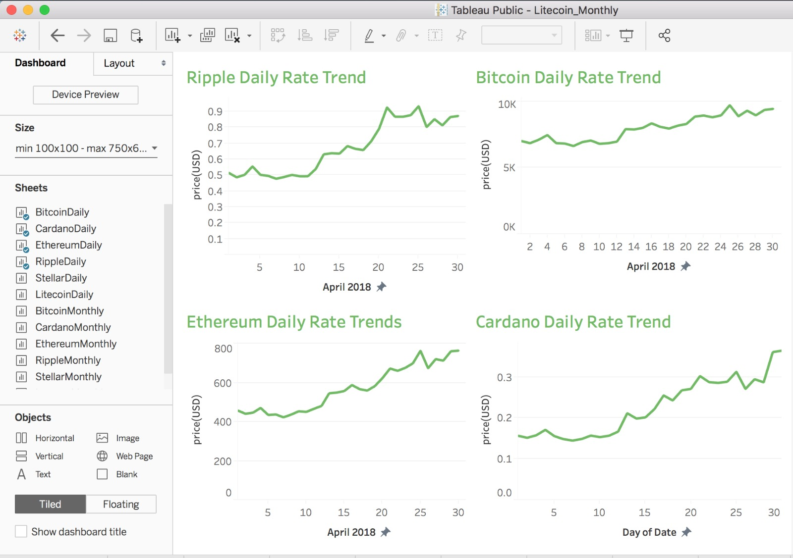
Tableau for Data Visualization
Integrated Tableau inside our Web Application to visualize currency rates data.
User can visualize daily, monthly as well as yearly currency rates in graphical representation.
Implemented Dashboard Design Pattern for showing various currencies rates.

Slide 8
UI Design Patterns used:
Organization Design Pattern – Dashboard
Navigation Design Pattern – Fully Connected
Page Layout Design Pattern – Grid of Equals

Slide 9
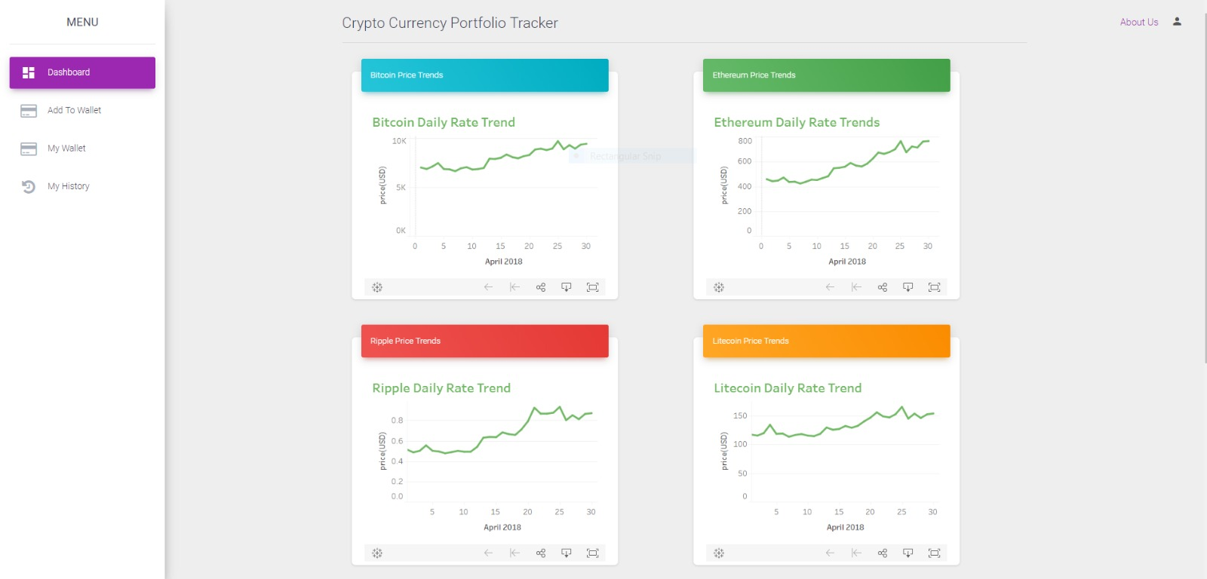
Organization Design Pattern – Dashboard
What
Single page that provides a lot of information about the currency price
When
Currency price changes, and there is an incoming flow of information
Why
User can monitor the currency values

Slide 10
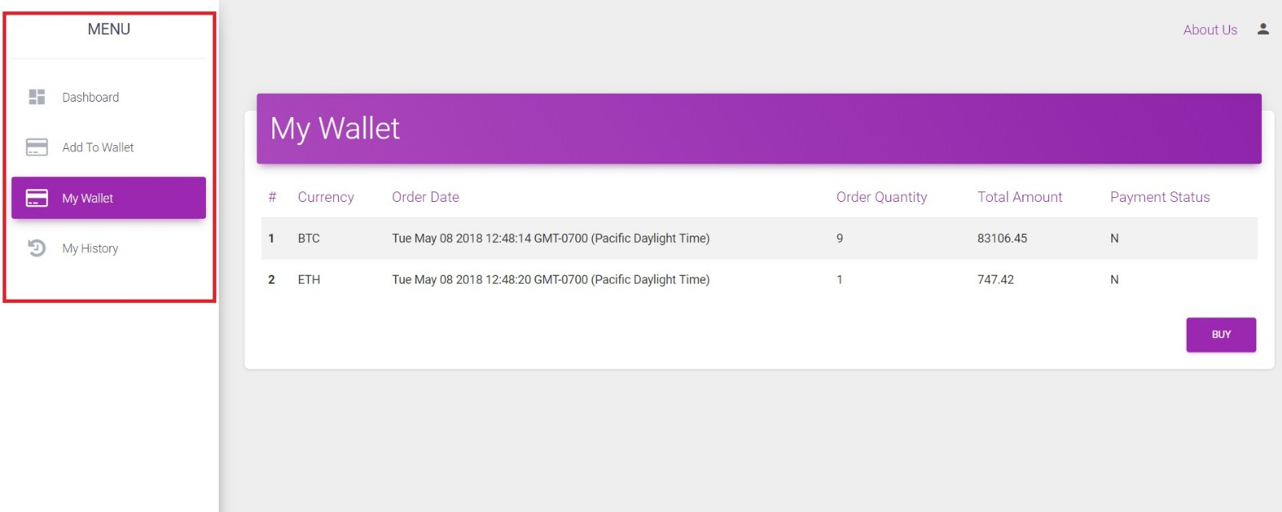
Navigation Design Pattern – Fully Connected
What
Each page is connected to every other page
When
First time users will have an easier time navigating
Why
Easier navigation from one page to another.

Slide 11
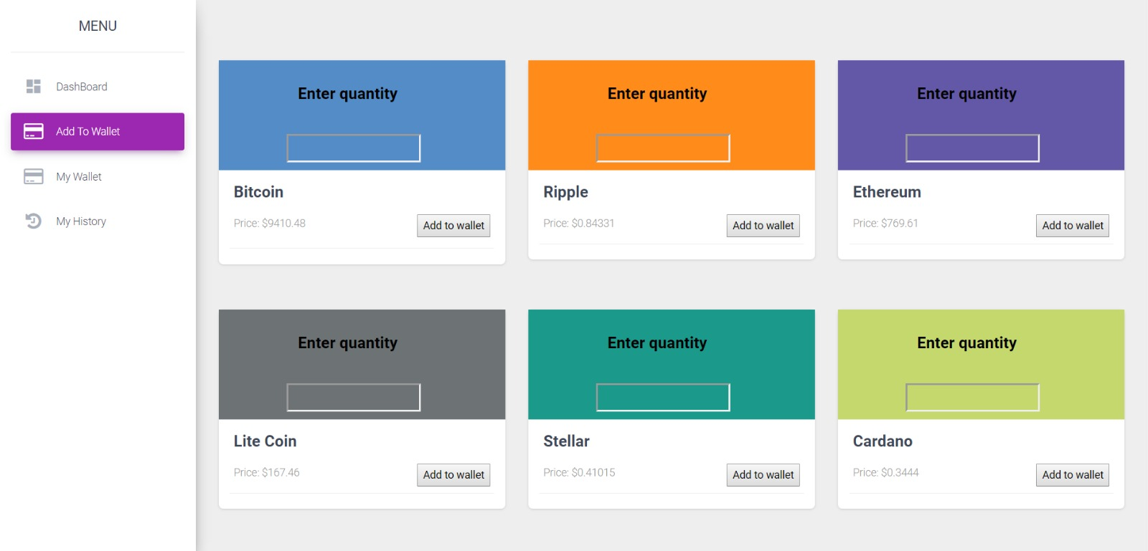
Page Layout Design Pattern – Grid of Equals
What
Each cryptocurrency is equally given an option to be added to wallet
When
User can add any of the cryptocurrency
Why
As each cryptocurrency is similar, user is given equal opportunity to buy any of them.
Displays all the currencies in an orderly manner

Slide 12
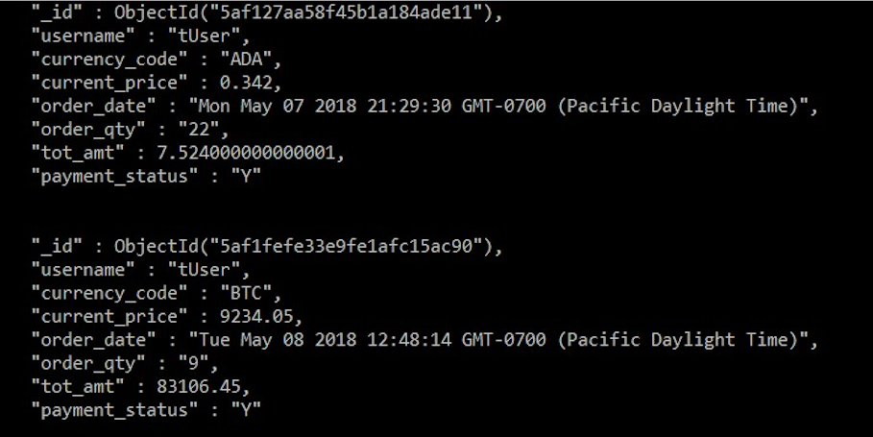
Data Model
This is the Transaction collection in the database which stores the different transactions a user makes while purchasing the currencies
Has got the following columns:
Username
Currency_code
Current_price
Tot_amt
Order_date
Order_qty
Payment_status

Slide 13
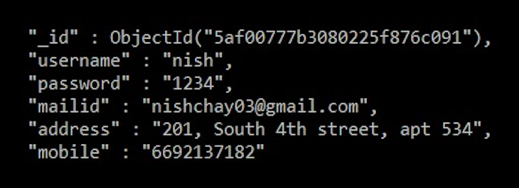
Data Model cont’d ..
This is the users collection which stores the details about different users who register and login
The different attributes are
Username
Password
Mailid
Address
mobile

Slide 14
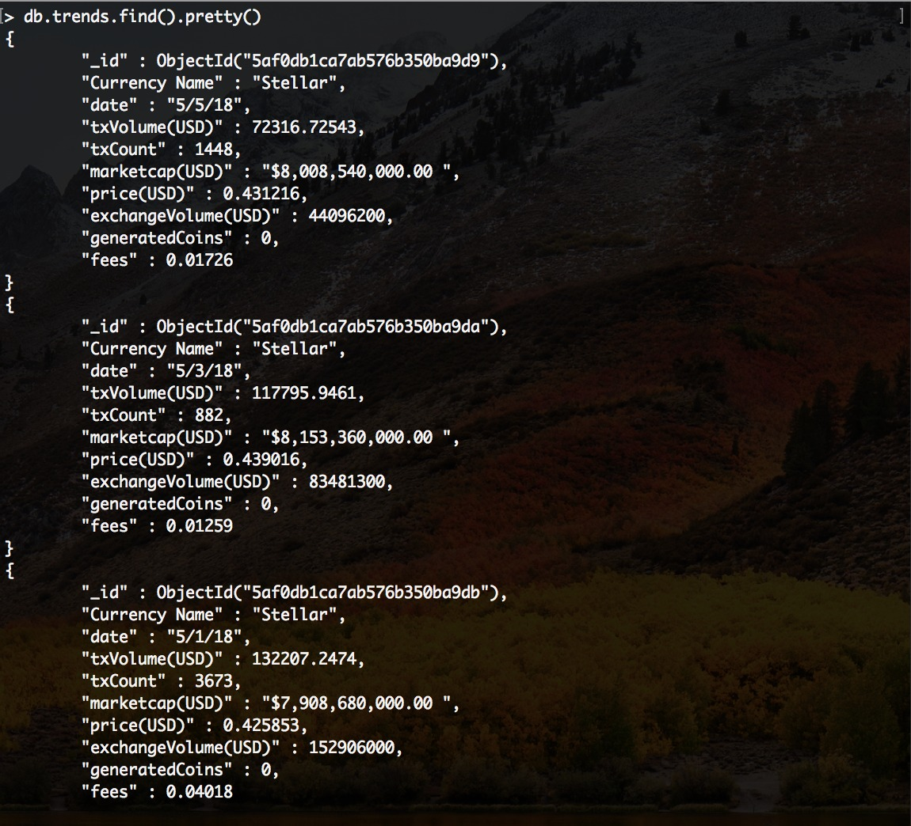
Data Model cont’d ..
This is the trends collection. This stores the information about various currencies, the price on various dates. This is accessed when the data is read by tableau.
The different attributes are
Currency_Name
Date
txVolume
txCount
Marketcap
Price
exchangeVolume
Fees
generatedCoins

Slide 15
Thank - you

