Slide 1
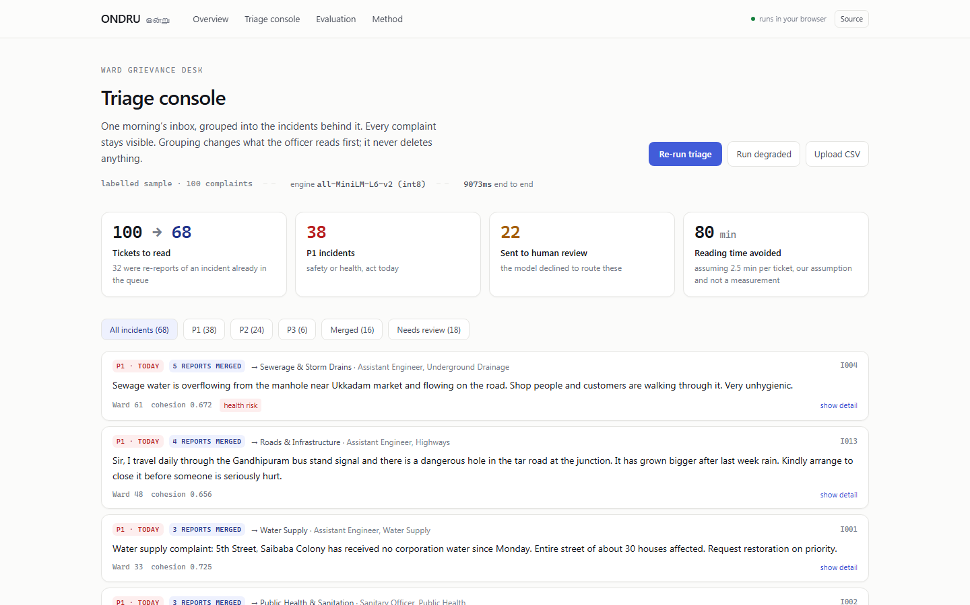
AI MINI PROJECT
RUNS IN THE BROWSER
ONDRU
ஒன்று · many voices, one issue
On-device AI triage for a municipal grievance desk. It groups re-reports of one incident into a single card, routes it to a desk, ranks what is dangerous, and refuses to guess when it is not sure.
SUBMITTED BY
Shyam Prasath S
Sri Krishna College of Technology, Coimbatore
TRACK
SDG 16 · Peace, Justice and Strong Institutions
The console. 100 complaints in a ward inbox, grouped into 68 real incidents.
Code for Communities · Tech for Good 2026
LIVE APPLICATION
SOURCE CODE
DEMO VIDEO
quantum-pi-blush.vercel.app
github.com/ishyamprasath/quantum
drive.google.com/file/d/1wskAFJJ6Vx5H08E7pGRBakwX2vZdtDsc/view

Slide 2
Problem Statement
ONDRU
many voices, one issue
Why a ward grievance desk is slow, and where the complaints go missing.
THE COST
01
02
DUPLICATES ARE READ AS NEW WORK
ROUTING IS MANUAL AND SLOW
49%
Eleven reports of one pothole become eleven tickets. The crew goes once, one ticket closes, and ten stay open with nobody looking at them.
A clerk reads each complaint to guess a department. A wrong desk does not bounce back. It sits in the wrong queue while the resident is told “under process”.
of the sample queue were re-reports of an incident already open
measured on 100 labelled complaints
03
04
200+
URGENCY IS FIRST COME, NOT SEVERITY
AI TRIAGE TOOLS GUESS WHEN UNSURE
An open manhole waits behind a request to repaint a speed breaker, because the queue is ordered by arrival time and nothing else.
A model that always answers will confidently file “please do the needful” to a desk. A confidently wrong label is worse than no label at all.
complaints a day into one shared ward inbox, sorted by hand
CODERA, team 295, Code for Communities
THE GAP ONDRU FILLS
“Show me the incidents, not the messages, and tell me plainly when you do not know which desk it belongs to.”

Slide 3
Proposed Solution
ONDRU
many voices, one issue
One queue, done properly, rather than a dashboard of four half-features.
INGEST
›
EMBED
›
CLUSTER
›
ROUTE
›
RANK
›
HAND BACK
MOAT 01
MOAT 02
MOAT 03
IT NEVER LEAVES THE TAB
IT IS ALLOWED TO SAY NO
EVERY NUMBER IS RECOMPUTED LIVE
▪ all-MiniLM-L6-v2 runs in the browser on ONNX Runtime Web. No API key, no server, no complaint text in transit.
▪ Routing needs a score floor AND a margin over second place. Fail either and nothing is assigned.
▪ The evaluation page scores 100 hand-labelled complaints in your browser when you press the button.
▪ That is the only reason a ward office can point it at a live inbox without a data sharing note.
▪ The complaint lands in a visible review lane with the numeric reason. Never dropped, never auto filed.
▪ Nothing is hard-coded. If the model gets worse, the page gets worse.
WHAT THE DESK GETS
▪ 100 complaints collapse to 68 incident cards, P1 first.
▪ 22 items handed back with the reason they failed the gate.
▪ Every original report stays attached to its card.
▪ A live metrics page the officer can audit, plus CSV upload for their own inbox.

Slide 4
Features
ONDRU
many voices, one issue
Six capabilities. The fourth is the one most triage demos skip.
FEATURE 01
FEATURE 02
FEATURE 03
INCIDENT GROUPING
DESK ROUTING
SEVERITY RANKING
▪ Complete-linkage clustering on cosine similarity, not single-linkage.
▪ Eight prototype vectors, one per municipal desk, built from the phrasing residents actually use.
▪ Similarity to three severity prototypes plus a nine-rule hazard lexicon that is printed in full.
▪ A report joins an incident only if it clears the threshold against every member, so unrelated complaints are never chained together and closed as one.
▪ 96.2% accurate on what it answered, across the labelled set.
▪ No language model writes the priority, so a supervisor can point at the rule that fired.
FEATURE 04
FEATURE 05
FEATURE 06
THE REFUSAL LANE
GRACEFUL DEGRADATION
AUDITABLE BY DESIGN
▪ Below the floor or inside the margin, nothing is assigned.
▪ If the model cannot be fetched, a deterministic n-gram engine takes over with its own tuned thresholds.
▪ Every threshold, prototype and lexicon rule is on the method page.
▪ It abstained on 7 of the 7 complaints a human reader could not route either.
▪ The sweep that chose them ships in the repository as tune.mts.
▪ The desk still gets grouping on a bad connection instead of a spinner.

Slide 5
Idea and Approach
ONDRU
many voices, one issue
Every layer is a component that already shipped. Nothing here is speculative.
MODEL
RUNTIME
GROUPING
SENTENCE ENCODER
BROWSER INFERENCE
CLUSTERING
▪ Xenova/all-MiniLM-L6-v2
▪ transformers.js v3
▪ Complete-linkage agglomerative
▪ 6-layer MiniLM, int8 quantised
▪ ONNX Runtime Web, WASM backend
▪ Pairs sorted by similarity, merged greedily
▪ About 23 MB, cached after first load
▪ Batched 16 at a time, yields to paint
▪ 384-dim, mean-pooled, L2 normalised
▪ No API route, no key, no database
▪ Merge refused unless every pair clears
▪ Dot product is the cosine
▪ 100 complaints in about 7 seconds
▪ Threshold 0.54, swept not guessed
▪ Cohesion shown per incident
ROUTING
SEVERITY
DELIVERY
PROTOTYPE CLASSIFIER
HYBRID SCORING
SERVING AND UI
▪ 8 desks by 5 exemplar phrases
▪ 3 severity prototypes, P1 / P2 / P3
▪ Next.js 16 App Router, React 19
▪ Prototype is the normalised mean
▪ 9-rule signed hazard lexicon, weight x2
▪ TypeScript throughout, strict
▪ Two-part gate: floor 0.35, margin 0.04
▪ Grid-searched on the labelled set
▪ Tailwind v4, single light theme
▪ Zero-shot, no labelled training run
▪ 84.6% P1 recall
▪ Static pages on Vercel
▪ Adding a desk is adding five sentences
▪ Zero true P1 demoted to routine
▪ No server-side inference to pay for

Slide 6
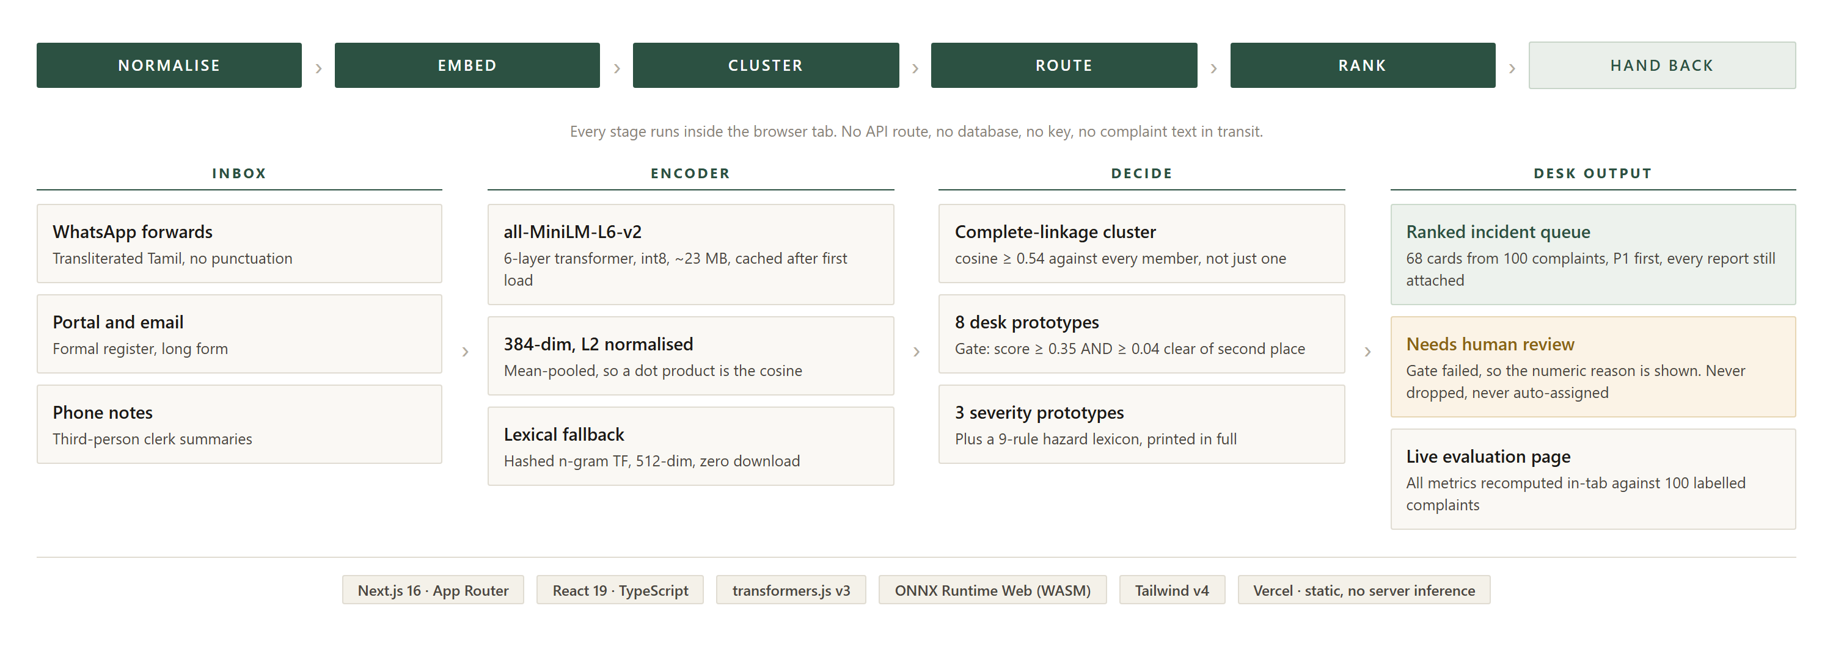
System Architecture and Workflow
ONDRU
many voices, one issue
One inbox, from raw messages to a ranked incident queue, entirely in the tab.
WHY COMPLETE LINKAGE
▪ Single linkage chains A to C through any middling B.
▪ Here the Ukkadam and Sungam drain reports would merge.
▪ One then hides behind the other and closes with it.
ASYMMETRIC ERRORS
▪ Splitting one incident into two cards wastes thirty seconds.
▪ Merging two incidents into one loses a complaint.
▪ So the threshold sits tight of the F1 peak.

Slide 7
Innovation and Existing Solutions
ONDRU
many voices, one issue
What a ward desk can use today, and where ONDRU sits.
CAPABILITY COMPARISON
CAPABILITY
MANUAL SORTING
KEYWORD RULES
CLOUD LLM API
GRIEVANCE PORTALS
ONDRU
Groups duplicate reports
✗
partial
✓
✗
✓
Routes to a department
✗
partial
✓
✓
✓
Ranks by severity, not arrival
✗
✗
✓
✗
✓
Refuses to guess when unsure
n/a
✗
✗
✗
✓
No text leaves the machine
✓
✓
✗
✗
✓
Works with no API key
✓
✓
✗
✗
✓
Published accuracy numbers
✗
✗
✗
✗
✓
Marginal cost per 1,000
8 hrs
free
~₹120
free
₹0
POSITIONING
WHAT IS NEW
Cloud LLM triage is the obvious build and it is the one a government desk cannot adopt, because it means posting citizen complaints to a third party, per call, forever. ONDRU takes the same job offline.
▪ A grievance triage tool with a measured, visible abstention rate.
▪ Zero marginal cost per complaint, and nothing to procure.

Slide 8
Impact and Future Scope
ONDRU
many voices, one issue
What it does today, measured, and the honest next step.
DEDUPE
ROUTING
REFUSAL
SAFETY
76.3%
96.2%
7 / 7
0
Duplicate grouping F1
Routing accuracy
Correctly abstained
True P1 sent to routine
pairwise over 4,950 complaint pairs
on the 84% of complaints it answered
on the deliberately unroutable ones
P1 recall 84.6%, never demoted to P3
ROADMAP
P1 · NOW · PROTOTYPE
P2 · NEXT · REAL LABELS
P3 · +1 MO · TAMIL SCRIPT
100 labelled complaints, live metrics page, deployed and public.
200 complaints from one Coimbatore ward, labelled by that ward officer.
Swap in a multilingual encoder so native Tamil, not just transliteration, is handled.
P4 · +2 MO · OFFICER FEEDBACK
P5 · +3 MO · PORTAL IMPORT
P6 · +6 MO · PILOT
A re-route button that logs corrections, so thresholds tune on real disagreement.
Read a CM Helpline or ASKTN CSV export directly, write back grouped incident ids.
One ward, one month, measured against the desk own resolution times.
STATED LIMITS
The 100 complaints were written by us to match the register real ones arrive in, and the desk anchors were written by the same hand, so treat routing accuracy as an upper bound. Urgency errors are lopsided: it over-calls P1 far more often than it under-calls it. Real labels from a real ward are the next step, not more features.

Slide 9
Thank You
ONDRU · many voices, one issue
DEMO VIDEO
LIVE APPLICATION
SOURCE CODE
SUBMITTED BY
drive.google.com/file/d/1wskAFJJ6Vx5H08E7pGRBakwX2vZdtDsc/view
quantum-pi-blush.vercel.app
github.com/ishyamprasath/quantum
Shyam Prasath S
3 minute walkthrough
runs in your browser
sweep script included
Sri Krishna College of Technology
QUESTIONS
“It ranks and groups. It never closes a complaint.”
Ask about the clustering choice, the abstention gate, or anything on the evaluation page.

