Slide 1
Window Control
ADD HERE
Functional firmware presentation
Prototype photo
or main web UI screenshot
Startup · routines · modes · patches · real prototype status
Editable deck · replace the boxes with your screenshots/diagrams
Notes:
Apertura: presentar el proyecto como una aplicación embebida completa montada sobre el ejemplo WiFi de ST. Esta diapositiva puede llevar una foto del prototipo o una captura limpia de la web.

Slide 2
1. What the system does
Window Control · 02
Overview before getting into code: problem, parts, and external use.
KEY IDEA
Brings up Soft-AP WiFi and a local HTTP interface.
Calculates positions using date, time, location and orientation.
Controls panel position with stepper motors.
Enables automatic, manual, ephemeris input, and homing.
Saves configuration and state across resets.
BOX TO REPLACE
Web Server
Configuration
GPS
Persitant data
MCU
User
Local web UI
FSM
Movement
Key routines
→ main_app() → SolarApp_Start()
→ fsmTask() selects the routine
→ movementTask() executes the physical action
Movement
main_app.c · httpserver.c · state_machine.c · movement_task.cpp · autoMode.cpp · storage.c
Notes:
El sistema parte de una placa STM32 con el módulo WiFi ST67W6X. Sobre el ejemplo HTTP de ST se construye una aplicación real: el usuario se conecta al punto de acceso, abre la interfaz y desde ahí consulta estado, cambia configuración, sincroniza hora, mueve el mecanismo, lanza homing o activa automático. Recalcar que la web no es el proyecto: la web dispara eventos sobre una FSM, la FSM decide y una tarea dedicada mueve motores.

Slide 3
2. Real firmware startup
Window Control · 03
Path from reset to an operational system with WiFi, tasks, and HTTP server.
KEY IDEA
main() initializes HAL, power, clock, and CubeMX peripherals.
GPIO, DMA, cache, SPI1, UARTs, LPTIM, RTC, and ST67W6X are configured.
The ST67W6X module task is created before FreeRTOS starts.
MX_FREERTOS_Init() creates defaultTask and gpsTask.
With the scheduler running, ST67W6XTask executes main_app().
BOX TO REPLACE
Startup sequence diagram
• Reset → HAL/clock → peripherals
• FreeRTOS tasks → main_app()
• SolarApp_Start → Soft‑AP → GPS sync → HTTP
Reset
HAL/clock
CubeMX
FreeRTOS
main_app
Key routines
→ MX_ST67W6X_Init() creates ST67W6XTask
→ main_app() initializes WiFi/network
→ SolarApp_Start() starts the custom app layer
Core/Src/main.c · app_st67w6x.c · app_freertos.c · Appli/App/main_app.c
Notes:
El arranque no entra directamente en la aplicación. Primero ejecuta el esqueleto CubeIDE. La parte WiFi entra de forma especial: MX_ST67W6X_Init crea ST67W6XTask, y esa tarea llama a main_app. Dentro de main_app se inicializan logging, callbacks, driver ST67, red y después SolarApp_Start. Solo entonces se configura Soft-AP y servidor HTTP. Mencionar parche SPI_RDY dentro de USER CODE.

Slide 4
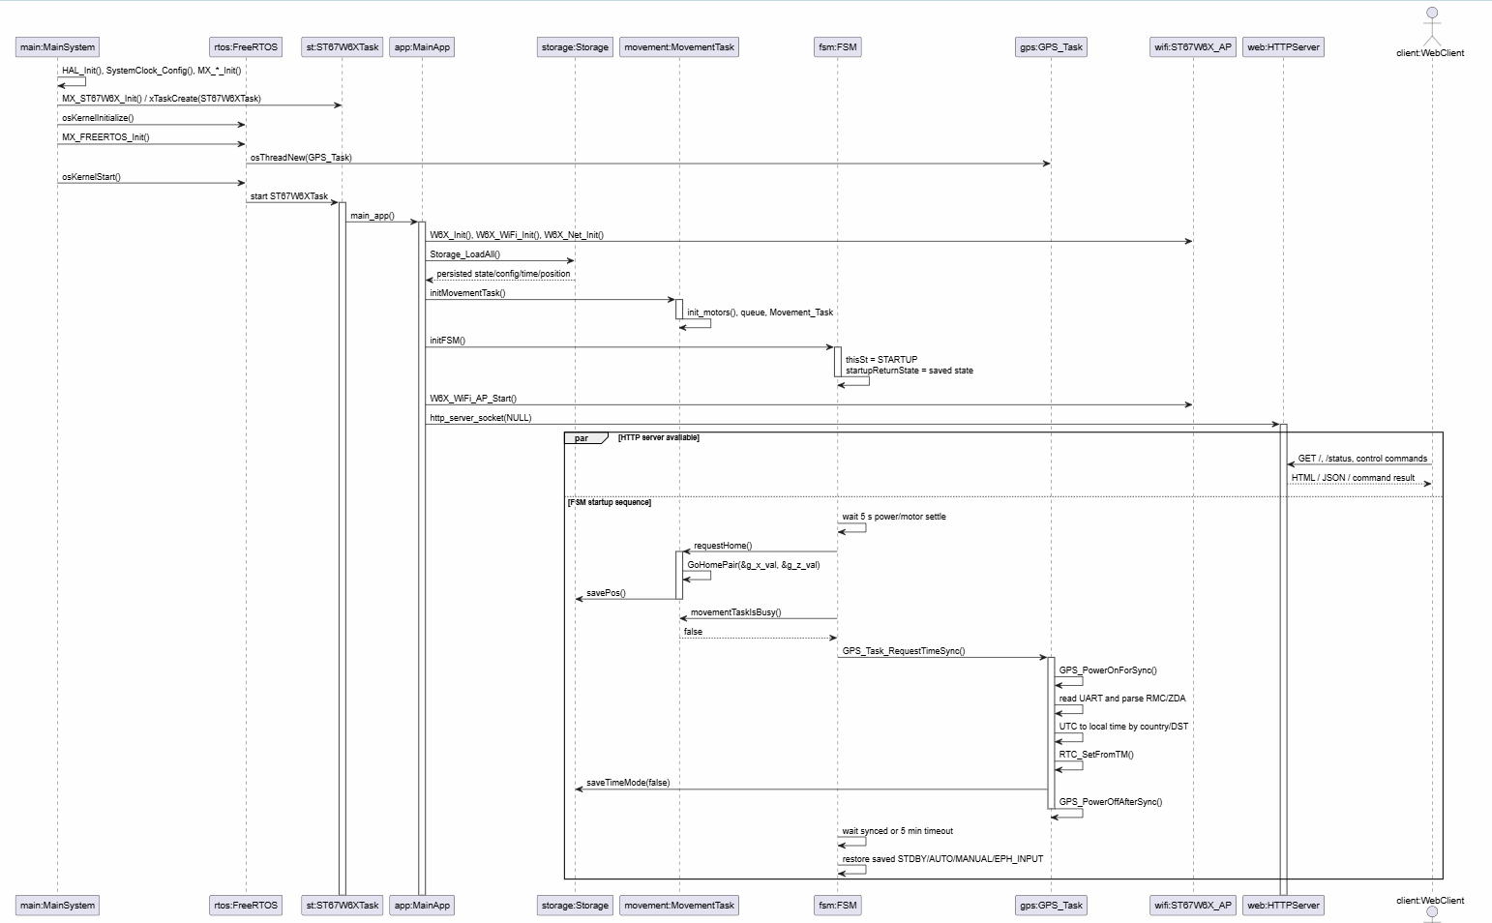

Slide 5
3. Task and service creation order
Window Control · 04
Responsibilities of concurrent tasks and layer separation.
KEY IDEA
ST67W6XTask: WiFi initialization and main application.
gpsTask: NMEA reading and RTC synchronization.
movementTask: serializes homing and motor moves.
fsmTask: modes, events, and automatic routines.
BOX TO REPLACE
Layer diagram
• WiFi/HTTP: sockets and ST67W6X
• Control: FSM
• Actuation: movementTask
• Time: GPS + RTC
• Data: flash storage
ST67W6XTask
SolarApp_Start
movementTask
requestHome
fsmTask
Key routines
→ initMovementTask() + moveQueue
→ initial requestHome()
→ initFSM() + fsmQueue
app_st67w6x.c · app_freertos.c · solar_app.c · movement_task.cpp · state_machine.c
Notes:
Explicar que el orden importa: WiFi viene del ejemplo ST, luego FreeRTOS crea defaultTask/gpsTask, y SolarApp_Start carga flash, crea movimiento, pide homing y crea la FSM. Insistir en que el socket HTTP no mueve motores directamente; valida y publica eventos. La separación evita que una petición HTTP bloquee el control físico.

Slide 6
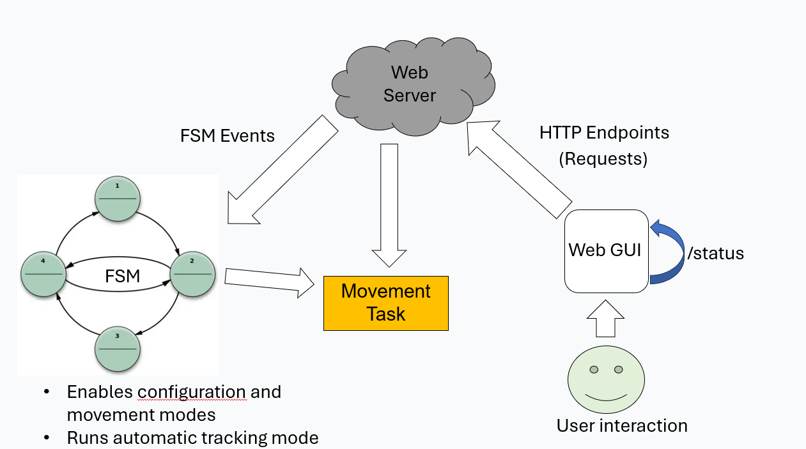
4. Overall operating flow
Window Control · 05
Practical use: from user connection to physical movement.
KEY IDEA
The user connects to the STM32 Soft-AP.
The web UI refreshes status through /status.
Buttons and forms call HTTP endpoints.
Endpoints validate the mode and publish events.
The FSM updates targets and movementTask executes them.
Web button
Endpoint
fsmPostEvent
fsmTask
requestMove
Key routines
→ /status centralizes live status
→ /manual_goto → submit_manual_goto
→ /eph_submit → submit_eph_input
httpserver.c · state_machine.c · manual_mode.cpp · eph_input_mode.cpp
Notes:
Uso local: STM32 crea su red, usuario abre la web. Ejemplo manual: primero MANUAL, luego objetivo X/Z, HTTP valida estado, guarda targets y dispara submit_manual_goto. La FSM recoge el evento y pide movimiento a movementTask. /status enseña estado FSM, auto_on, RTC, país, coordenadas, posición, targets, ángulos y diagnóstico GPS.

Slide 7
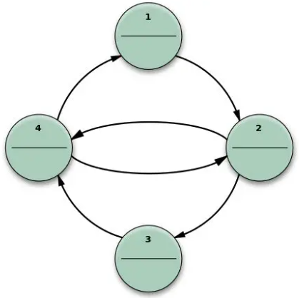
Web Server
FSM Events
HTTP Endpoints
(Requests)
Web GUI
/status
FSM
Movement
Task
Enables configuration and movement modes
Runs automatic tracking mode
User interaction
Notes:
El usuario interacciona con la interfaz y envía formularios al servidor web de manera asíncrona. El servidor web gestiona estos formularios y envía los cambios de estado a la FSM, que ejecuta las rutinas correspondientes en las que se segmenta el programa y habilita los distintos modos

Slide 8
5. Main states and modes
Window Control · 06
FSM as the layer that prevents incompatible actions from being mixed.
KEY IDEA
STDBY: idle state and safe configuration.
AUTO_MODE: tracking based on date/time.
MANUAL: X/Z targets and manual homing.
EPH_INPUT: external azimuth/elevation.
Event-driven transitions; state persisted in flash.
BOX TO REPLACE
State diagram
• STDBY ↔ AUTO_MODE
• STDBY ↔ MANUAL
• STDBY ↔ EPH_INPUT
• Add events: begin/end/toggle/submit
STDBY
AUTO_MODE
MANUAL
EPH_INPUT
Key routines
→ fsmPostEvent() from HTTP
→ fsmProcess() changes state
→ saveState() persists the transition
state_machine.h · state_machine.c · httpserver.c · storage.c
Notes:
La FSM es el centro de control. No se permite que cualquier botón actúe en cualquier modo. Manual y efemérides se bloquean si automático está activo. fsmTask espera eventos, fsmProcess cambia estado y si hay acción física llama a requestMove/requestHome. En AUTO_MODE ejecuta autoMode periódicamente.

Slide 9
6. Automatic routines
Window Control · 07
Which parts run by themselves, at what period, and under which conditions.
KEY IDEA
In AUTO_MODE, autoMode() runs every 5 s.
The RTC is saved periodically to preserve time.
At startup, GPS sync is requested after bringing up the Soft-AP.
GPS is powered only while a synchronization is pending.
It moves only if the target changes by at least 0.5 mm.
BOX TO REPLACE
Automatic-flow diagram
• RTC → SPA → AOI → interpolation
• X/Z target → movement queue
• /status screenshot before/after GPS sync
RTC
SPA
AOI
Interpolation
X/Z target
Key routines
→ autoMode() updates solar inputs and targets
→ GPS_Task_RequestTimeSync()
→ DisableSuppressTicksAndSleep() during calculation/movement
state_machine.c · autoMode.cpp · spa_func.cpp · gps.cpp · main_app.c
Notes:
autoMode no vive dentro de la web. Lo ejecuta fsmTask si el estado es AUTO_MODE. Lee RTC, rellena entradas solares, calcula posición solar, AOI e interpolación a X/Z. Si la diferencia supera 0,5 mm, encola movimiento. GPS se sincroniza al final del arranque Soft-AP: enciende receptor, lee NMEA, ajusta RTC y apaga GPS. Mencionar que GPS_REQUIRE_FIX_FOR_RTC_SYNC = 0 es decisión de banco.

Slide 10
7. Manual routines and configuration
Window Control · 08
What the user can do and which variables each action touches.
KEY IDEA
Configuration: lat/lon, pan, tilt, correction, and country.
Manual time: updates RTC and sets manual_time.
Manual: enters MANUAL, writes X/Z target, and moves.
Home: references the mechanics and sets position to zero.
Ephemeris input: receives azimuth/elevation and calculates X/Z.
Sync time: updates RTC and sets local time after a valid NMEA sentence.
BOX TO REPLACE
Action → effect table
• Web action
• FSM event
• Variables touched
• Effect visible in /status
Config
Time
Manual
Home
Ephemeris
Key routines
→ http_apply_config_submit() → saveData()
→ setManualTime() → RTC/manual_time
→ manualModeGoto() and ephInputMode()
httpserver.c · manual_mode.cpp · eph_input_mode.cpp · state_machine.c · storage.c
Notes:
La configuración define contexto solar y se guarda en flash. La hora manual existe para pruebas sin GPS. En manual, el usuario no manda pasos a motores; manda X/Z en mm. El firmware lo interpreta como objetivo absoluto y lo convierte internamente. Efemérides se parece al automático, pero azimuth/elevation entran desde usuario.

Slide 11
8. Hardware and peripheral control
Window Control · 09
Map the code to the real hardware connected to the board.
KEY IDEA
ST67W6X: SPI1, SPI_RDY through EXTI, and BOOT/CHIP_EN pins.
GPS: LPUART1 + power switch through GPS_enable_Pin.
Motors: GPIO STEP/DIR/ENABLE.
Endstops: EXTI and software-cached state.
RS485 remains prepared on USART2.
BOX TO REPLACE
Pin → function table
• CubeMX screenshot
• GPS/drivers wiring photo
• Oscilloscope or logic analyzer with STEP
WiFi
GPS
Motors
Endstops
RTC
Key routines
→ GPS is off by default and turns on for sync
→ DWT generates STEP pulses
→ EXTI updates endstop state
main.c · main.h · gps.cpp · movement.cpp · main_app.c · controled_shutdown.c
Notes:
CubeMX configura periféricos y pines; el código propio añade lógica de uso. GPS_enable tiene estado inicial bajo para dejar el GPS apagado. Al sincronizar, se pone alto, espera asentamiento y empieza a leer NMEA. Motores usan STEP/DIR/ENABLE con temporización directa por DWT. Finales de carrera llegan por EXTI.

Slide 12
9. Real movement and homing
Window Control · 10
How a logical command becomes physical movement and position referencing.
KEY IDEA
Commands enter a FreeRTOS queue.
requestHome() runs at startup to reference the mechanics.
move(x,z) treats targets as absolute positions in mm.
Homing: first touch, backoff, and second touch.
After move/home, g_x_val and g_z_val are saved.
BOX TO REPLACE
Homing sequence
• Approach → endstop
• Backoff
• Second touch
• Zero position
• Video/photos of initial homing
requestMove
moveQueue
movementTask
move/GoHomePair
savePos
Key routines
→ requestMove() rejects stale commands
→ movementTask() serializes commands
→ GoHomePair() sets software zero
movement_task.cpp · movement.cpp · movement.h · storage.c · global_structs.h
Notes:
La tarea de movimiento es deliberadamente serial: evita dos movimientos físicos simultáneos o una cola larga de objetivos antiguos. CMD_MOVE llama a move(x,z); CMD_HOME llama a GoHomePair. Posición física en g_x_val/g_z_val y objetivos en g_x_target/g_z_target. Tras cada movimiento se guarda con savePos; al reinicio aun así se pide homing para referenciar de nuevo.

Slide 13
10. Configuration and data persistence
Window Control · 11
Which data survives a reset and the limitations of the solution.
KEY IDEA
A single persistent record in the last flash page.
Header with magic, version, size, and CRC.
Stores config, FSM, position, time mode, manual time, and country.
If validation fails, defaults are loaded.
Each save API updates the full record.
BOX TO REPLACE
Flash record structure
• Header: magic/version/size
• Config + state + position
• Time/manual_time + country
• CRC at the end
Load
Validate
Apply data
Commit
CRC
Key routines
→ Storage_LoadAll() at startup
→ saveData()/saveState()/savePos()
→ storage_save_in_progress prevents re-entry
storage.c · storage.h · solar_app.c · state_machine.c · movement_task.cpp · httpserver.c
Notes:
No hay EEPROM externa ni FS. Se guarda una estructura en la última página de flash interna, con magic WCV1, version, size y CRC. Storage_LoadAll valida y carga, o usa defaults. Ventaja: formato único y controlado. Limitación: cada guardado borra/programa la página completa; para producto haría falta wear leveling o reducir escrituras.

Slide 14
11. Practical issues
Window Control · 12
Present real issues as technical decisions made to move the prototype forward.
KEY IDEA
Inherited ST example structure: middleware + generated code.
Build sensitive to Target folders and HTML prebuild.
Individual second touch motor movement to prevent end-stop damages.
- \ST67W6X_HTTP_Server\Appli\App → server and main app
- \ST67W6X_HTTP_Server\Html → HTML build
- \ST67W6X_HTTP_Server\Core\Src
- \ST67W6X_HTTP_Server\Core\Inc
Problem
Cause
Patch
Future improvement
Key fixes
→ WiFi ready interrupt restored after custom pinout changes
→ Boot sequence reordered: Soft-AP → GPS sync → homing → FSM
→ GPS receiver powered only when time synchronization is needed
main_app.c · gps.cpp · html_pages.h ·
Notes:
No esconder parches: explicarlos con lenguaje técnico. El proyecto migra/adapta un ejemplo ST, con ventajas y complejidad. SPI_RDY necesitó asegurarse después de regenerar pinout. GPS se pide tras Soft‑AP para no bloquear ni interferir con arranque. Mencionar RTC_WEEKDAY_MONDAY como detalle a pulir y endpoints GET como válido para laboratorio pero mejorable.

Slide 15
12. Current status and next steps
Window Control · 13
Close with an honest status snapshot and a clear list of improvements.
KEY IDEA
The base works: AP/HTTP, FSM, movement, homing, GPS/RTC, and flash.
The web UI controls configuration, modes, time sync, home, and movement.
Robustness, calibration, build, and dependency improvements remain.
The next step is turning a stable prototype into maintainable firmware.
Final message: task-separated architecture and localized patches.
BOX TO REPLACE
Visual roadmap
• Done: functional base
• Partial: calibration and testing
• Pending: robustness/build/cleanup
• Add demo photo or video
Done
Partial
Pending
Next iteration
Key routines
→ main_app → SolarApp_Start → requestHome → initFSM
→ fsmTask → autoMode → requestMove → movementTask
→ GPS sync → RTC → storage
main_app.c · httpserver.c · state_machine.c · movement_task.cpp · movement.cpp · gps.cpp · storage.c
Notes:
Cierre defendible: se ha priorizado funcionamiento sobre hardware real con arquitectura separada por tareas y parches localizados. No vender como producto cerrado: prototipo avanzado con puntos de mejora identificados. Eso demuestra criterio técnico y conocimiento real del firmware.

Slide 16
Appendix. Screenshot and diagram checklist
Window Control · 14
Quick list of placeholders to replace before delivery.
REPLACE
Prototype photo / full test bench.
Web UI and /status screenshot.
Startup sequence diagram.
Layer diagram: HTTP, FSM, movement, GPS/RTC, flash.
FSM state diagram.
Automatic flow: RTC → SPA → AOI → interpolation → X/Z.
Pin → function → file/routine table.
Homing sequence and final roadmap.
BOX TO REPLACE
Free space for thumbnails
• Paste 4–6 thumbnails here if you want to use this appendix as a reminder.
• You can also delete it if it is not needed.
This is a working slide: you can delete it before the defense.
Notes:
Diapositiva de apoyo para recordar qué capturas o diagramas faltan. No es necesario presentarla.

