Slide 1

ISICAS
2020

Slide 2




International Symposium on
Integrated Circuits and Systems

Slide 3

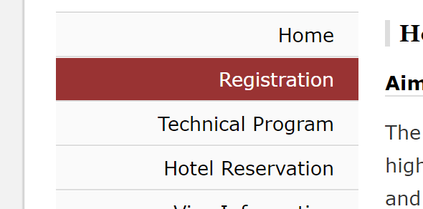
International Symposium on
Integrated Circuits and Systems

