Slide 1

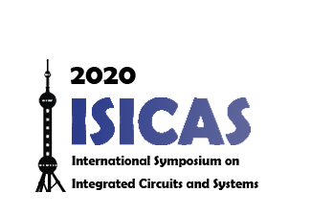




2020
ISICAS
International Symposium on Integrated Circuits and Systems

