Slide 1
ImmoWeb
Data Exploration
Tableau Team:
Isidora, Loic and Julien

Slide 2

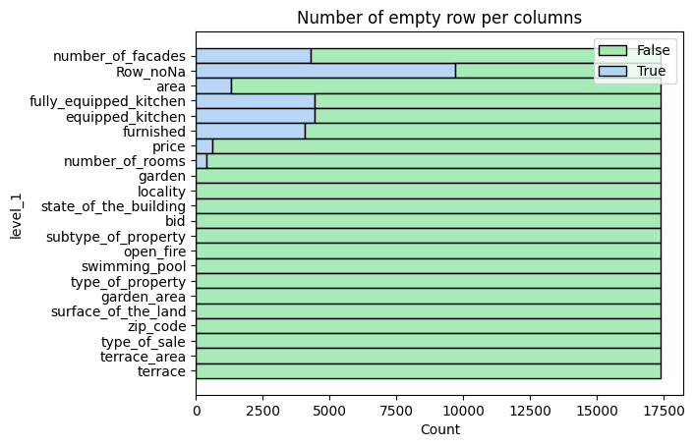
Data cleaning
Data frame with NaN (17373, 21)
  Assumption that for some variables if NaN = none
    garden_area
    terrace_area
    swimming_pool
    surface_of_the_land
    open_fire
Data frame without NaN (7688, 21)
Removing of outliers (tails) (7493,21)
  The percentile 0.5% en 99.5% have been removed for:
    Price
    Area
    garden_area
    number_of_rooms
    terrace_area
    surface_of_the_land

Slide 3
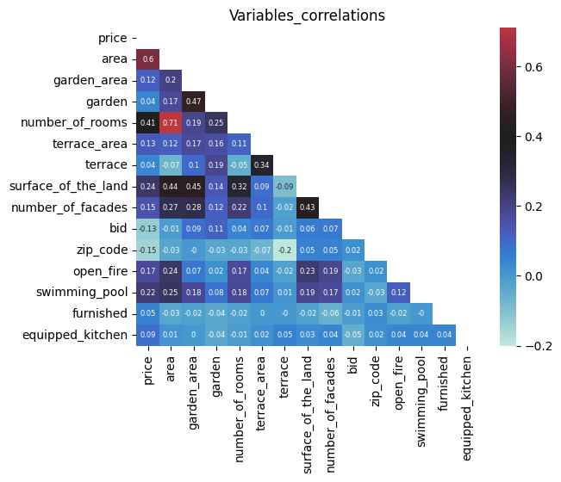
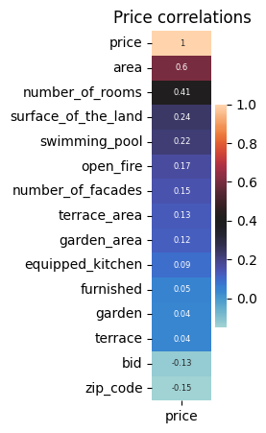
Variables correlation

Slide 4
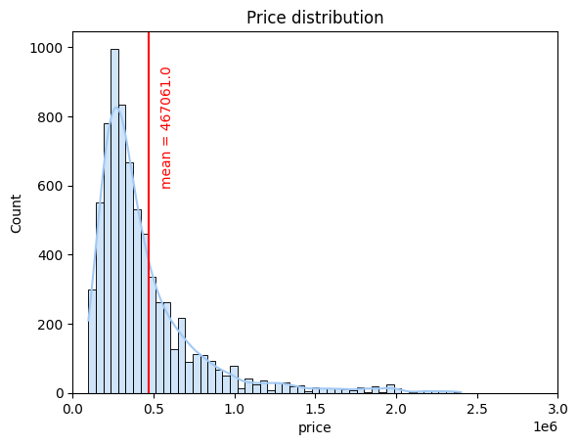
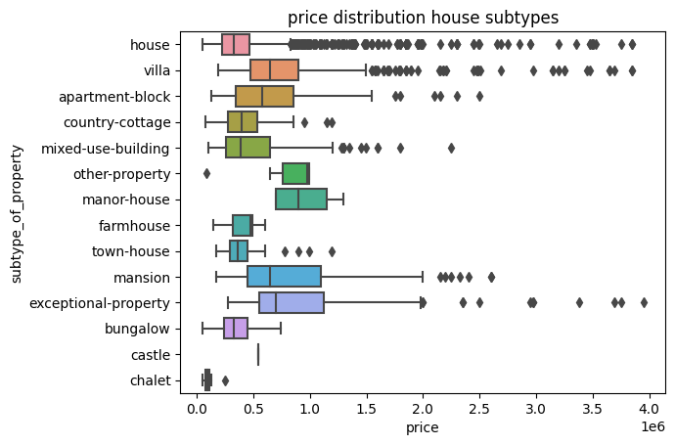
Price distribution

Slide 5
Most expensive municipalities in BE per meter square.
  Knokke 10469 €
  Belsele 10359 €
  Heist 6172 €
  Sterrebeek 5097 €
  Leuven 4876 €
  Ixelles 4792 €
Cheapest municipalities in BE per meter square.
  Doische 466 €
  Vance 643 €
  Paliseul 650 €
  Erquelinnes 704 €
  Stoumont 750 €
  Lierde 756 €
Price ranking among Belgium regions per meter square.
  Brussels 3743 €
  Flanders 3142 €
  Wallonia 1965 €

Slide 6
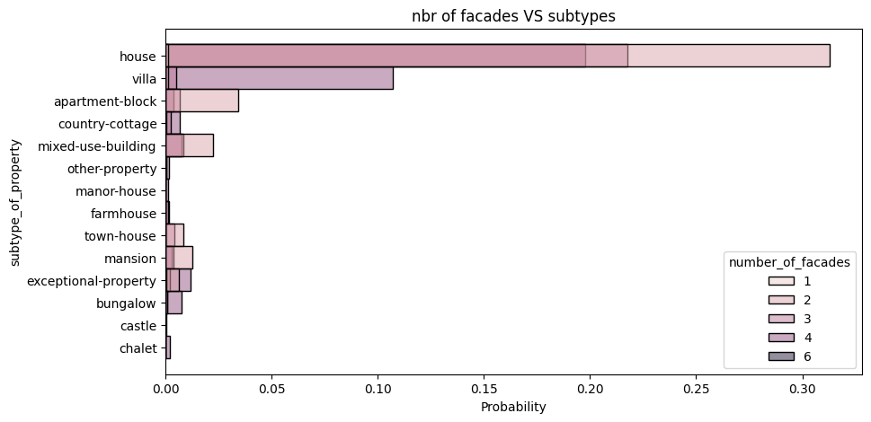
Next step to reduce the prices variables.
  Remove :
    Furnished, equiped_kitchen.
  Reduce the classes for some variables:
    Subtypes
  Improve some variables
    Number of facade (to see with subtype en m2)

