Slide 1
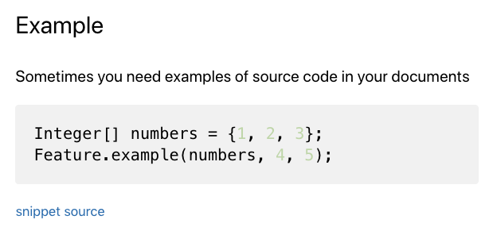

your_source.file
// snippet: my_example
Integer[] numbers = {1, 2, 3};
Feature.example(numbers, 4, 5);
// snippet: end
your_doc.md
MdSnippets
your_doc.source.md
## Example
Sometimes you need examples of source code in your documents
snippet: my_example
Easily add code examples
into your markdown documents
MdSnippets.com
Llewellyn Falco

