Slide 1
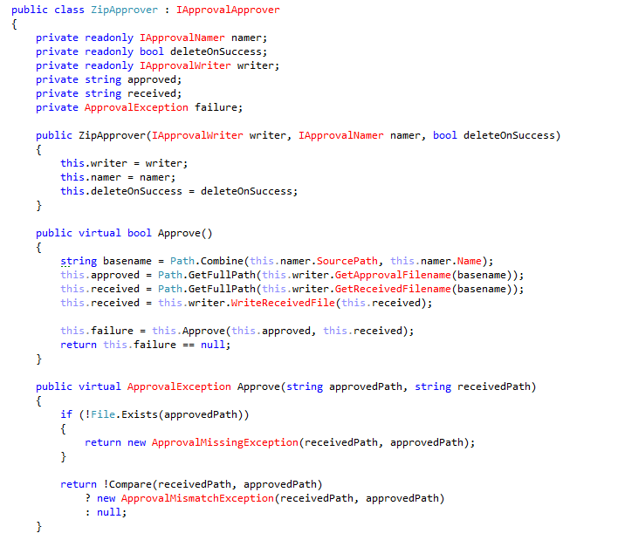

Slide 2
Distinct
Notes:
C:\code\FluencyPowerPoint\PowerPointGeneration\PowerPointGeneration.Tests\CodeSmells-Duplication\Distinct 01.png

Slide 3
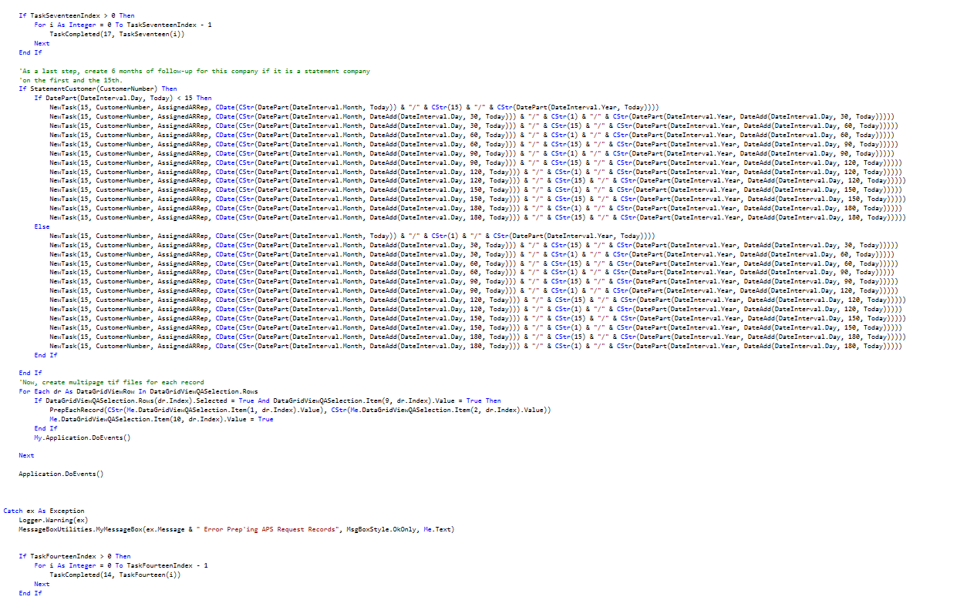

Slide 4
Duplication
Notes:
C:\code\FluencyPowerPoint\PowerPointGeneration\PowerPointGeneration.Tests\CodeSmells-Duplication\Duplication 01.png

Slide 5
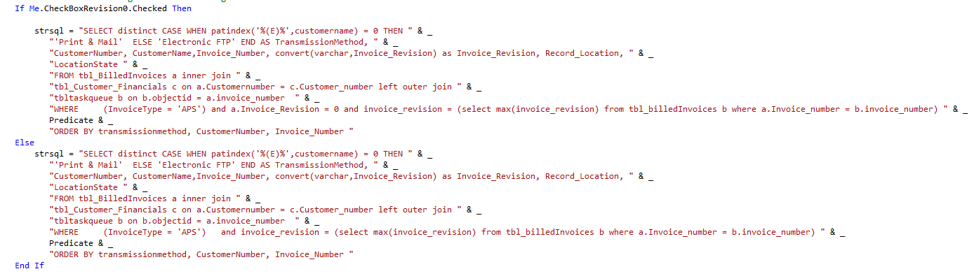

Slide 6
Duplication
Notes:
C:\code\FluencyPowerPoint\PowerPointGeneration\PowerPointGeneration.Tests\CodeSmells-Duplication\Duplication 02.png

Slide 7
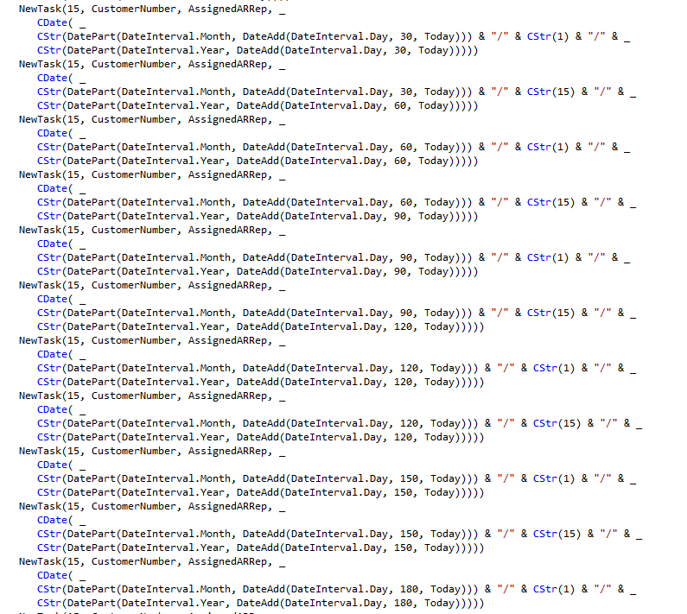

Slide 8
Duplication
Notes:
C:\code\FluencyPowerPoint\PowerPointGeneration\PowerPointGeneration.Tests\CodeSmells-Duplication\Duplication 03.png

Slide 9
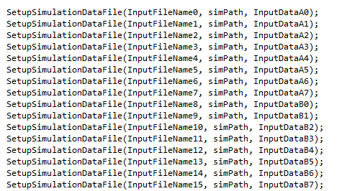

Slide 10
Duplication
Notes:
C:\code\FluencyPowerPoint\PowerPointGeneration\PowerPointGeneration.Tests\CodeSmells-Duplication\Duplication 04.png

Slide 11
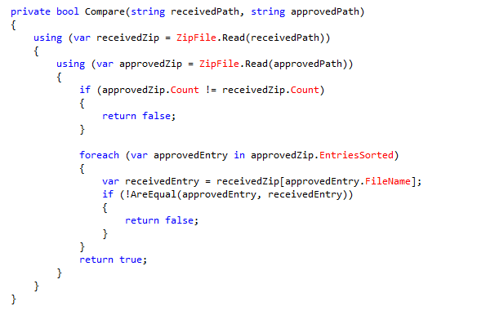

Slide 12
Distinct
Notes:
C:\code\FluencyPowerPoint\PowerPointGeneration\PowerPointGeneration.Tests\CodeSmells-Duplication\Distinct 02.png

Slide 13
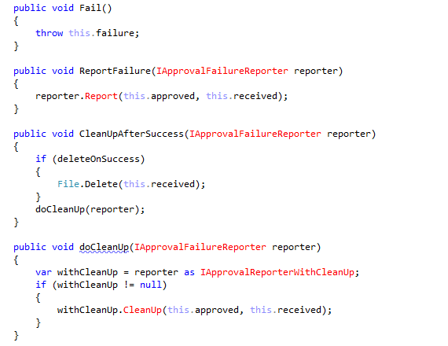

Slide 14
Distinct
Notes:
C:\code\FluencyPowerPoint\PowerPointGeneration\PowerPointGeneration.Tests\CodeSmells-Duplication\Distinct 03.png

Slide 15
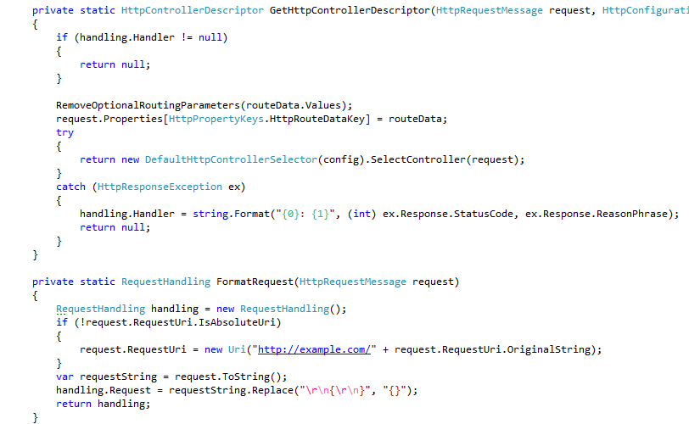

Slide 16
Distinct
Notes:
C:\code\FluencyPowerPoint\PowerPointGeneration\PowerPointGeneration.Tests\CodeSmells-Duplication\Distinct 04.png

Slide 17
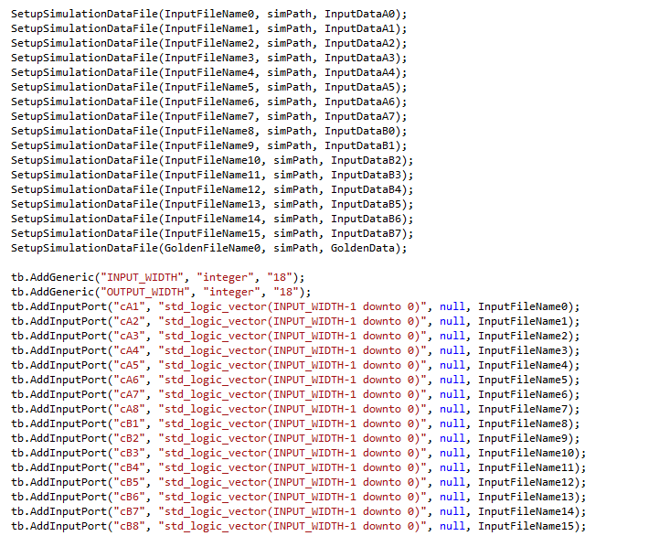

Slide 18
Duplication
Notes:
C:\code\FluencyPowerPoint\PowerPointGeneration\PowerPointGeneration.Tests\CodeSmells-Duplication\Duplication 05.png

Slide 19
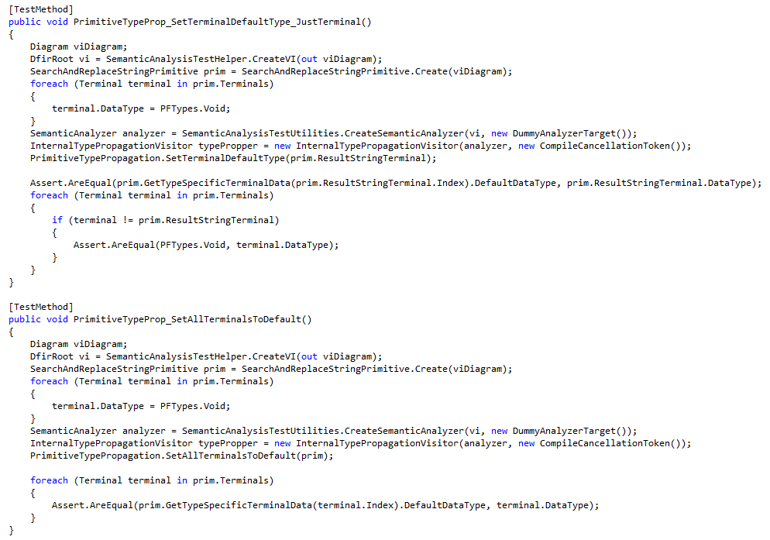

Slide 20
Duplication
Notes:
C:\code\FluencyPowerPoint\PowerPointGeneration\PowerPointGeneration.Tests\CodeSmells-Duplication\Duplication 06.png

Slide 21
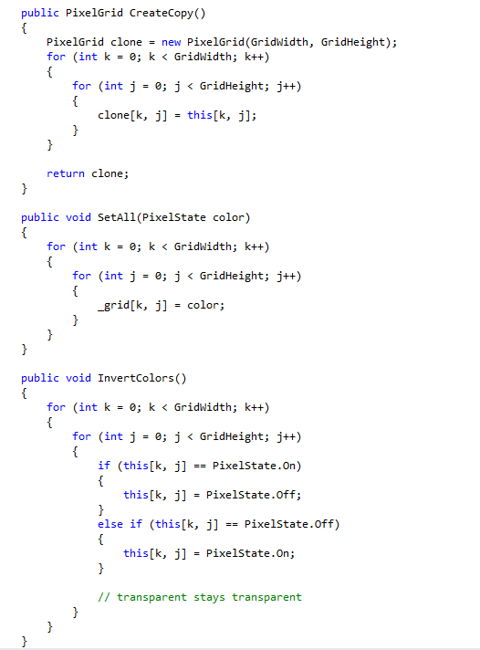

Slide 22
Duplication
Notes:
C:\code\FluencyPowerPoint\PowerPointGeneration\PowerPointGeneration.Tests\CodeSmells-Duplication\Duplication 07.png

Slide 23
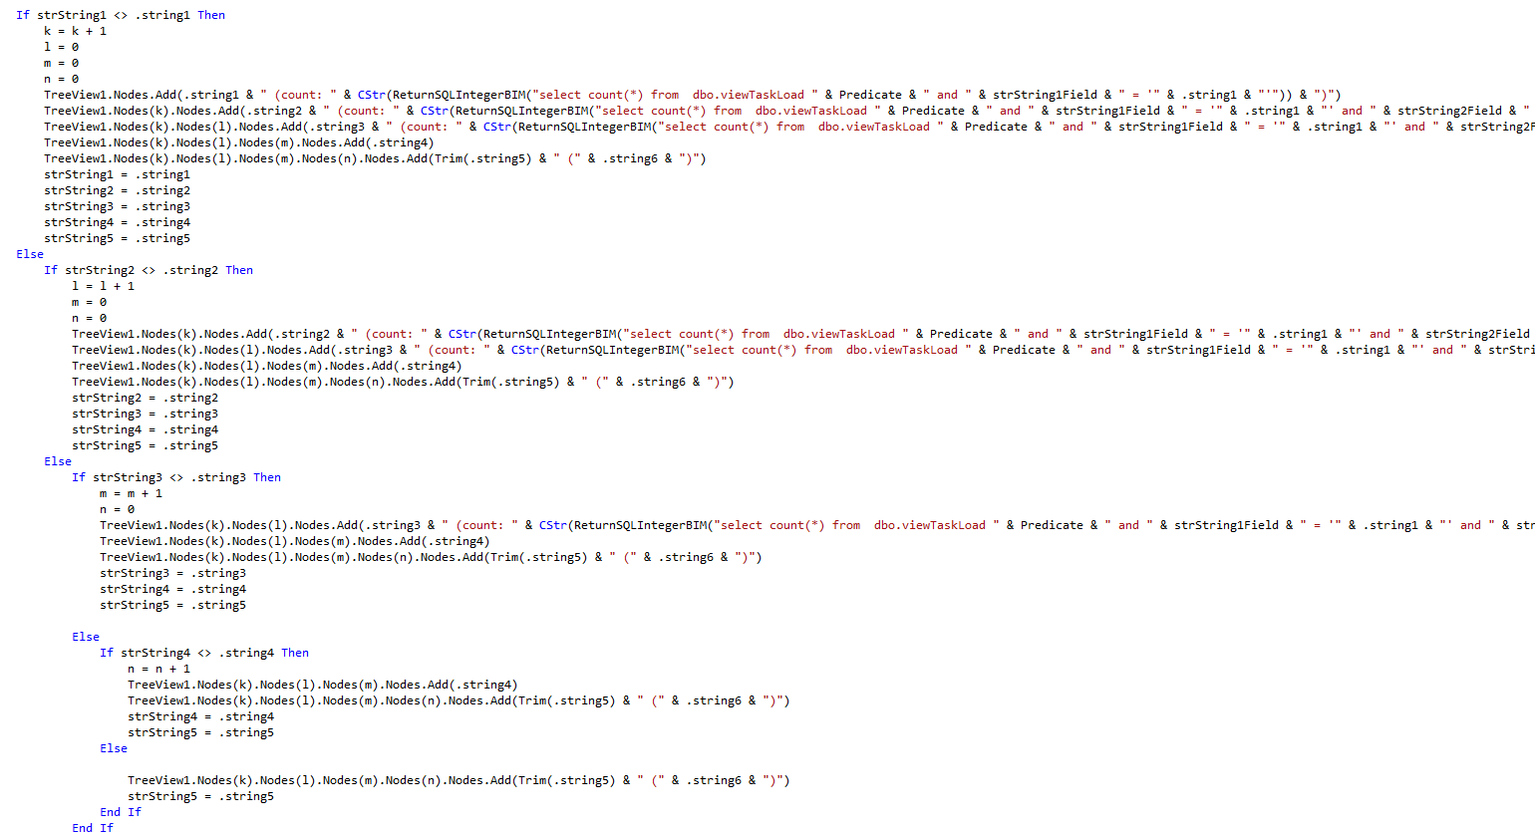

Slide 24
Duplication
Notes:
C:\code\FluencyPowerPoint\PowerPointGeneration\PowerPointGeneration.Tests\CodeSmells-Duplication\Duplication 08.png

Slide 25
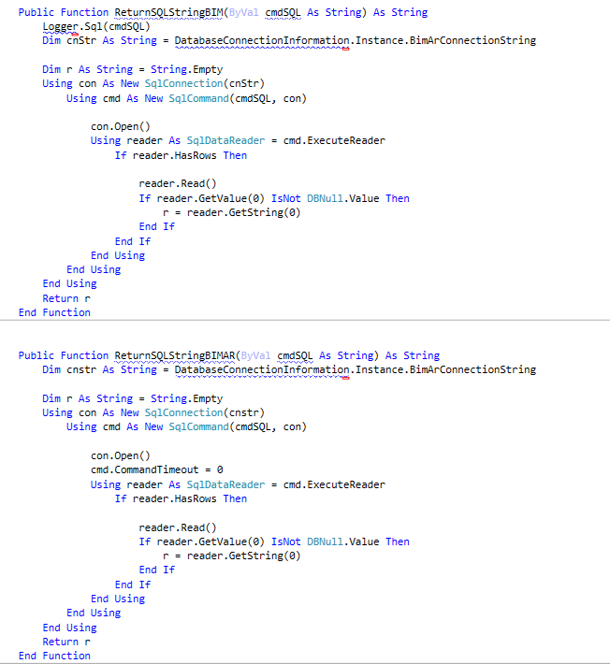

Slide 26
Duplication
Notes:
C:\code\FluencyPowerPoint\PowerPointGeneration\PowerPointGeneration.Tests\CodeSmells-Duplication\Duplication 09.png

Slide 27
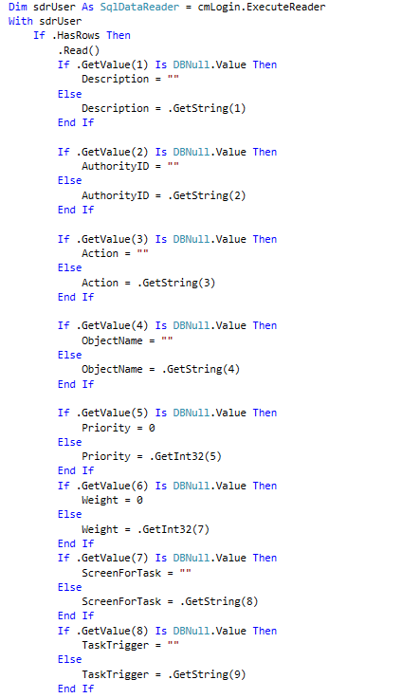

Slide 28
Duplication
Notes:
C:\code\FluencyPowerPoint\PowerPointGeneration\PowerPointGeneration.Tests\CodeSmells-Duplication\Duplication 10.png

Slide 29
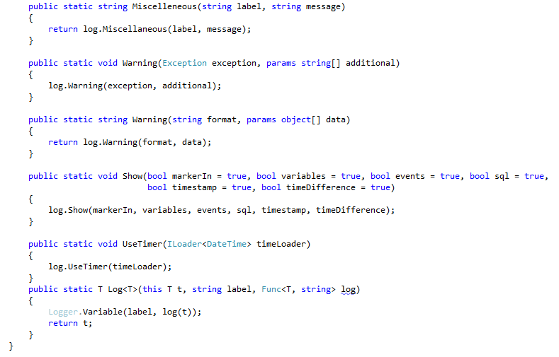

Slide 30
Distinct
Notes:
C:\code\FluencyPowerPoint\PowerPointGeneration\PowerPointGeneration.Tests\CodeSmells-Duplication\Distinct 05.png

Slide 31
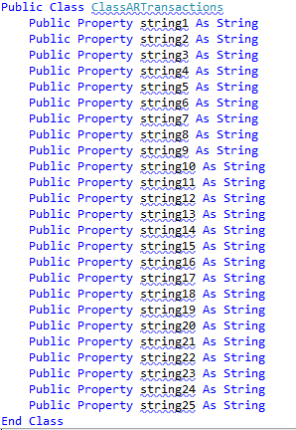

Slide 32
Duplication
Notes:
C:\code\FluencyPowerPoint\PowerPointGeneration\PowerPointGeneration.Tests\CodeSmells-Duplication\Duplication 11.png

Slide 33
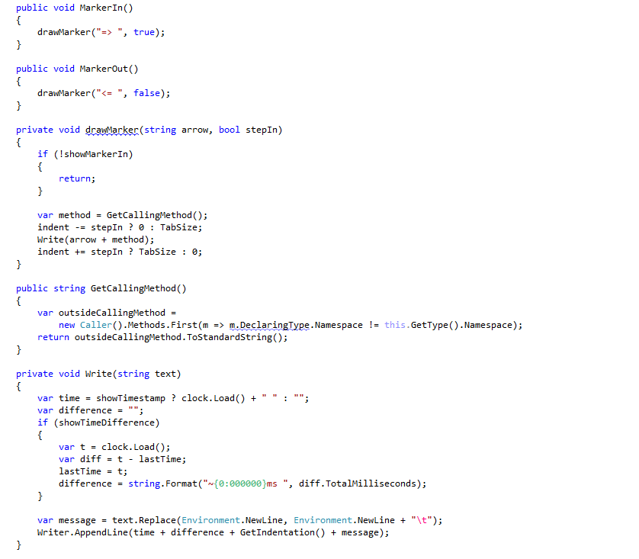

Slide 34
Distinct
Notes:
C:\code\FluencyPowerPoint\PowerPointGeneration\PowerPointGeneration.Tests\CodeSmells-Duplication\Distinct 06.png

Slide 35
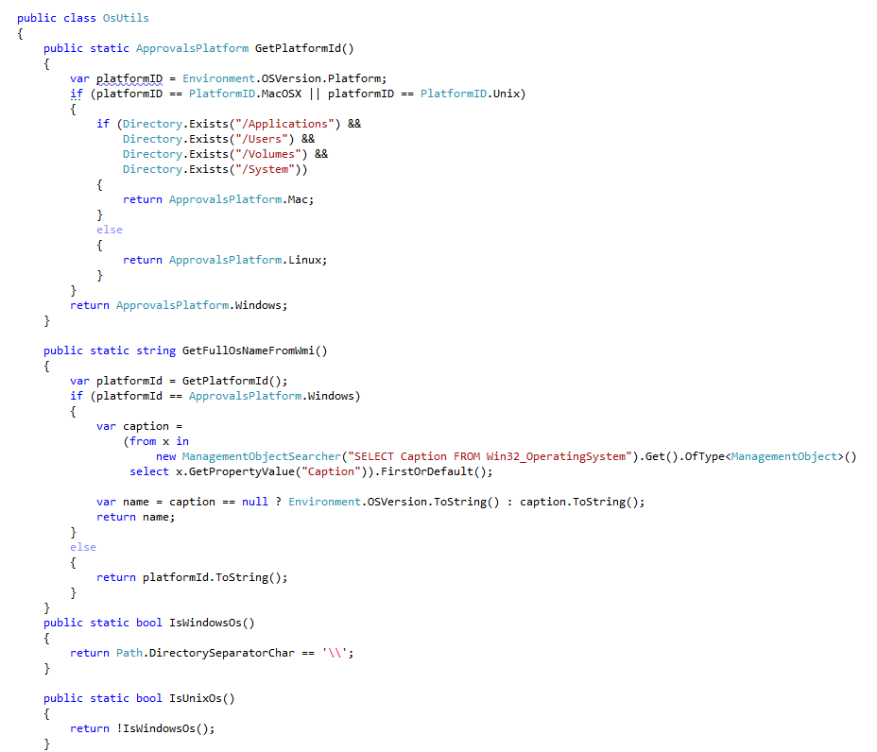

Slide 36
Distinct
Notes:
C:\code\FluencyPowerPoint\PowerPointGeneration\PowerPointGeneration.Tests\CodeSmells-Duplication\Distinct 07.png

Slide 37
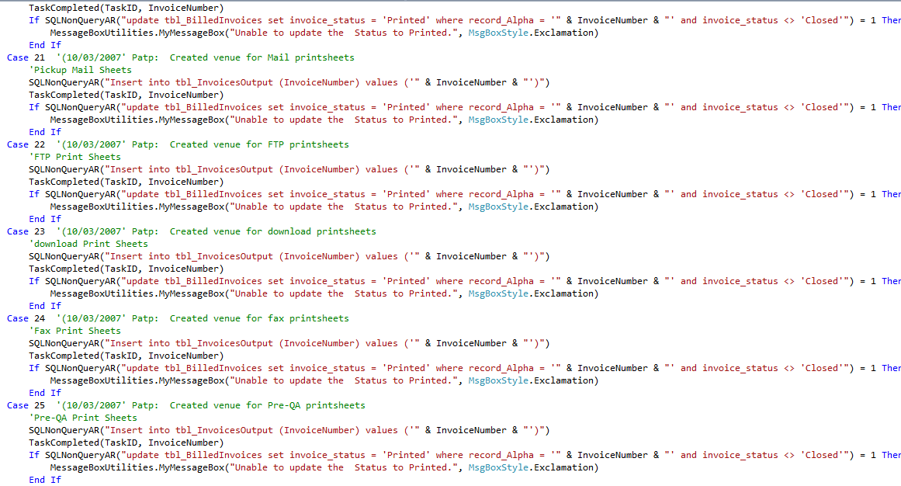

Slide 38
Duplication
Notes:
C:\code\FluencyPowerPoint\PowerPointGeneration\PowerPointGeneration.Tests\CodeSmells-Duplication\Duplication 12.png

Slide 39
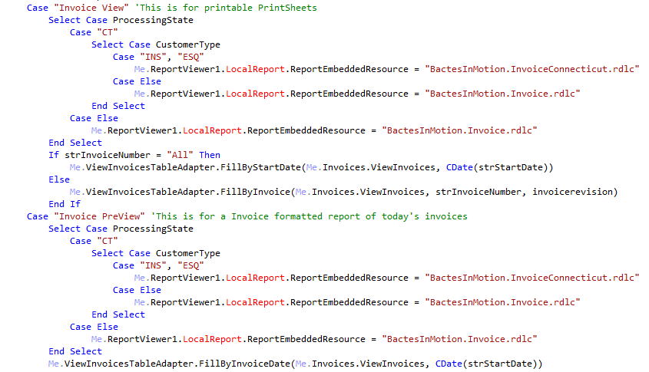

Slide 40
Duplication
Notes:
C:\code\FluencyPowerPoint\PowerPointGeneration\PowerPointGeneration.Tests\CodeSmells-Duplication\Duplication 13.png

Slide 41
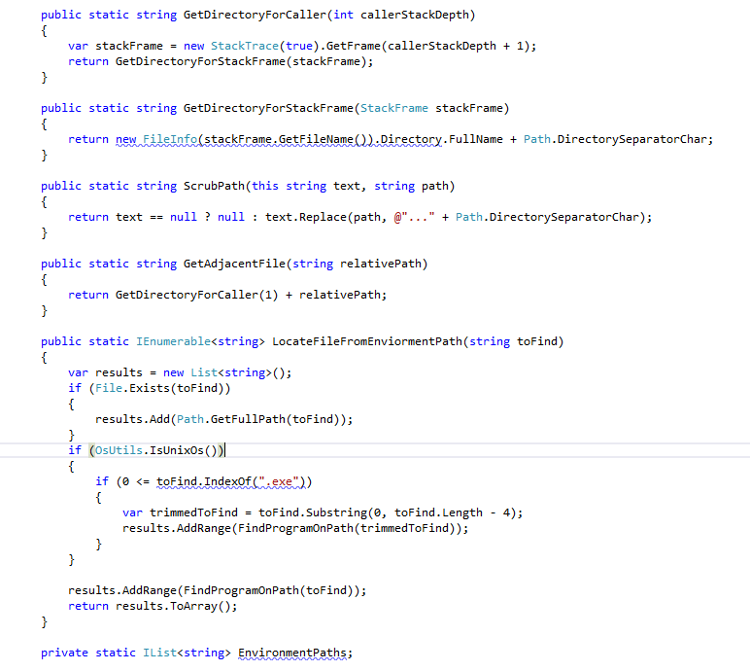

Slide 42
Distinct
Notes:
C:\code\FluencyPowerPoint\PowerPointGeneration\PowerPointGeneration.Tests\CodeSmells-Duplication\Distinct 08.png

Slide 43
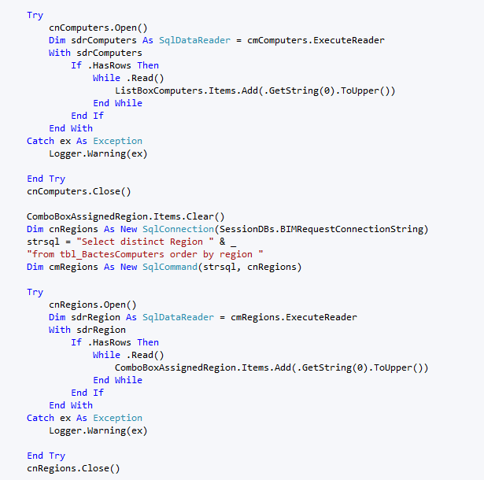

Slide 44
Duplication
Notes:
C:\code\FluencyPowerPoint\PowerPointGeneration\PowerPointGeneration.Tests\CodeSmells-Duplication\Duplication 14.png

Slide 45
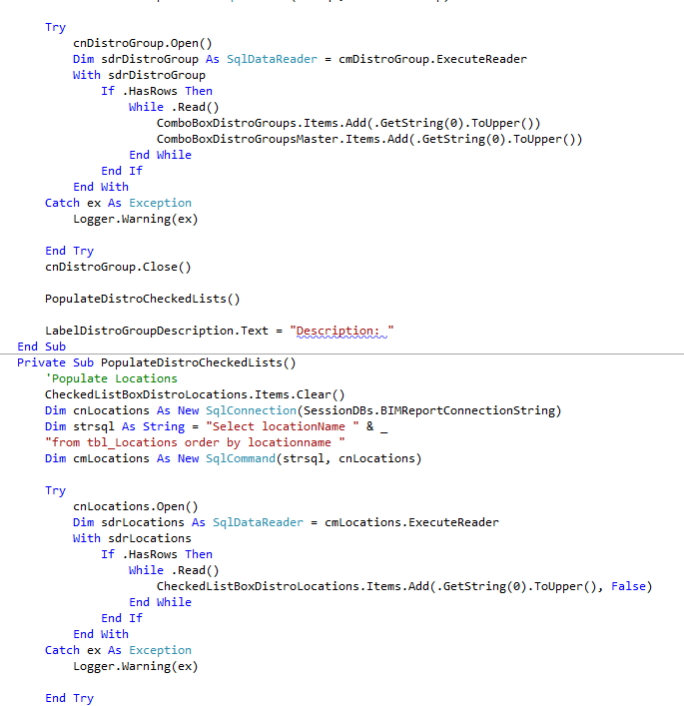

Slide 46
Duplication
Notes:
C:\code\FluencyPowerPoint\PowerPointGeneration\PowerPointGeneration.Tests\CodeSmells-Duplication\Duplication 15.png

Slide 47
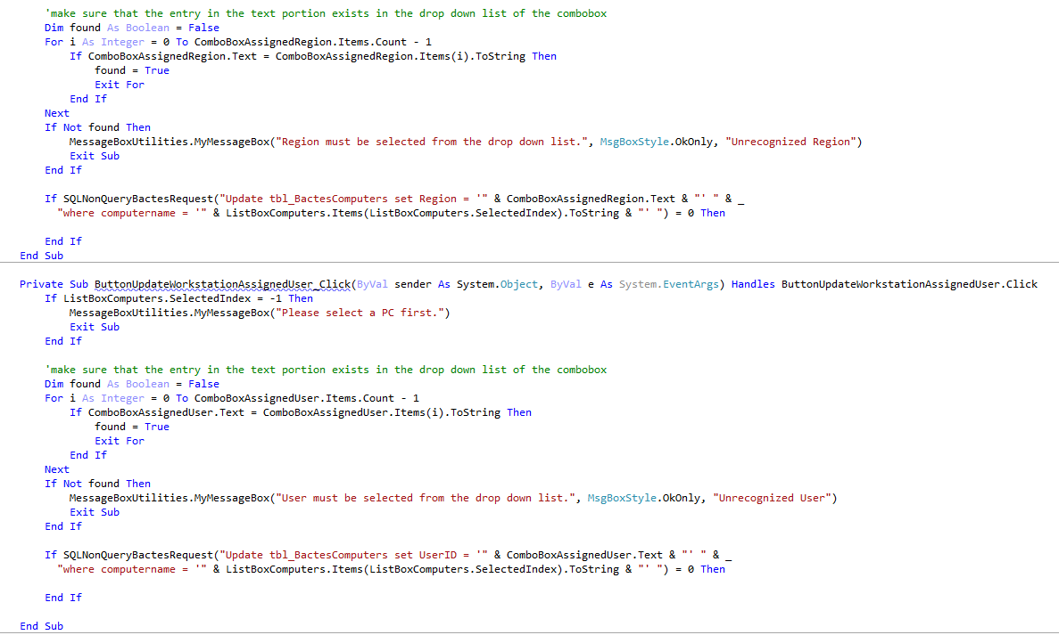

Slide 48
Duplication
Notes:
C:\code\FluencyPowerPoint\PowerPointGeneration\PowerPointGeneration.Tests\CodeSmells-Duplication\Duplication 16.png

Slide 49
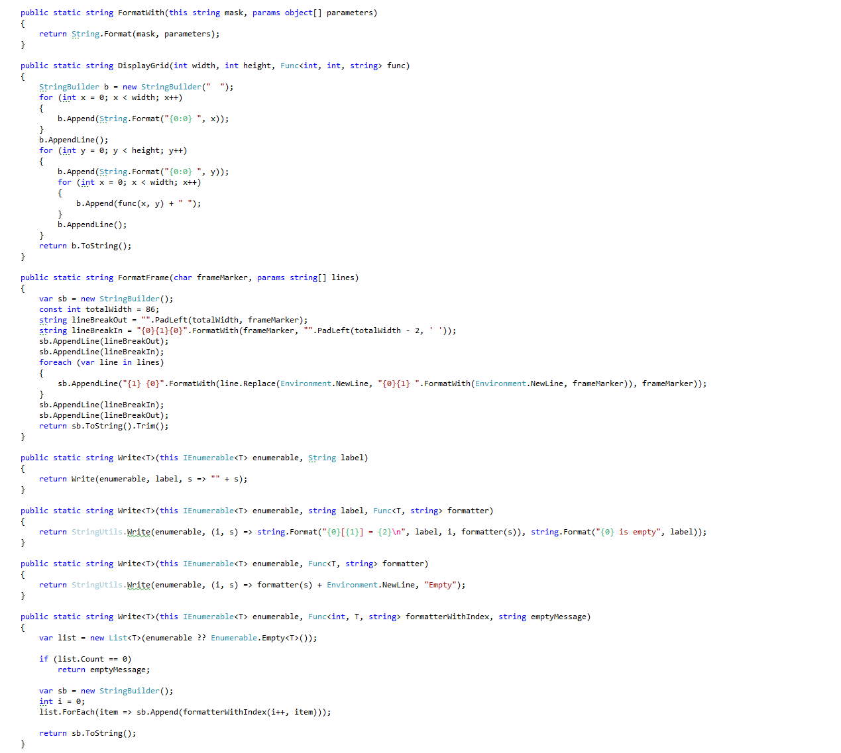

Slide 50
Distinct
Notes:
C:\code\FluencyPowerPoint\PowerPointGeneration\PowerPointGeneration.Tests\CodeSmells-Duplication\Distinct 09.png

Slide 51
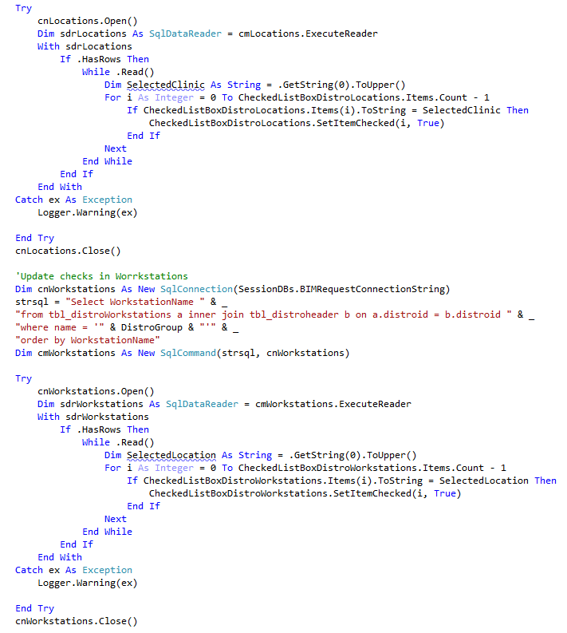

Slide 52
Duplication
Notes:
C:\code\FluencyPowerPoint\PowerPointGeneration\PowerPointGeneration.Tests\CodeSmells-Duplication\Duplication 17.png

Slide 53
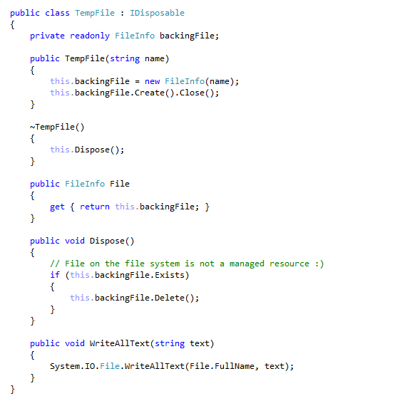

Slide 54
Distinct
Notes:
C:\code\FluencyPowerPoint\PowerPointGeneration\PowerPointGeneration.Tests\CodeSmells-Duplication\Distinct 10.png

Slide 55
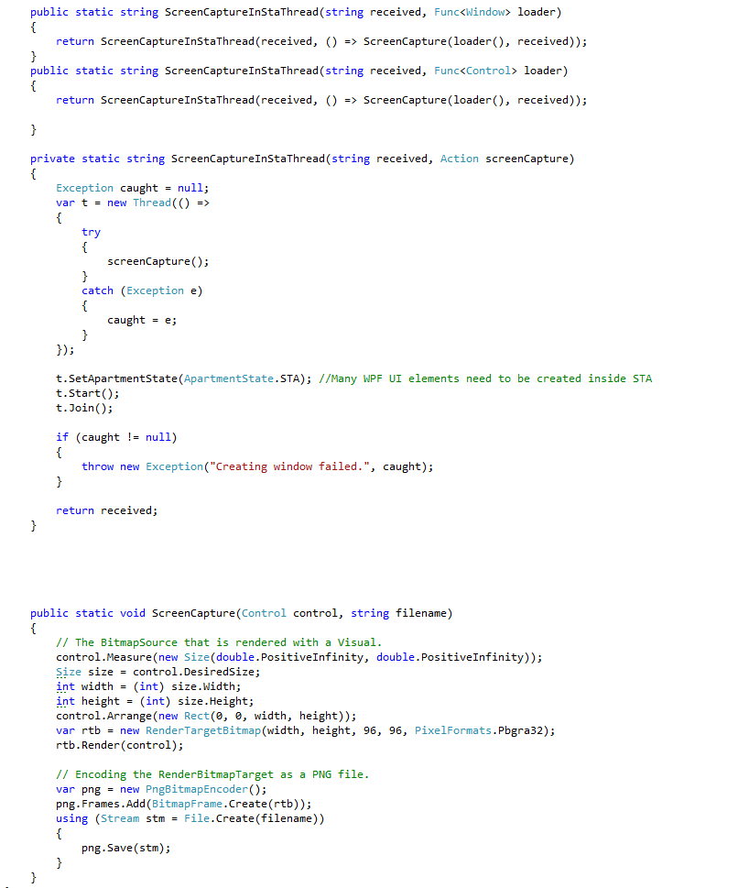

Slide 56
Distinct
Notes:
C:\code\FluencyPowerPoint\PowerPointGeneration\PowerPointGeneration.Tests\CodeSmells-Duplication\Distinct 11.png

Slide 57
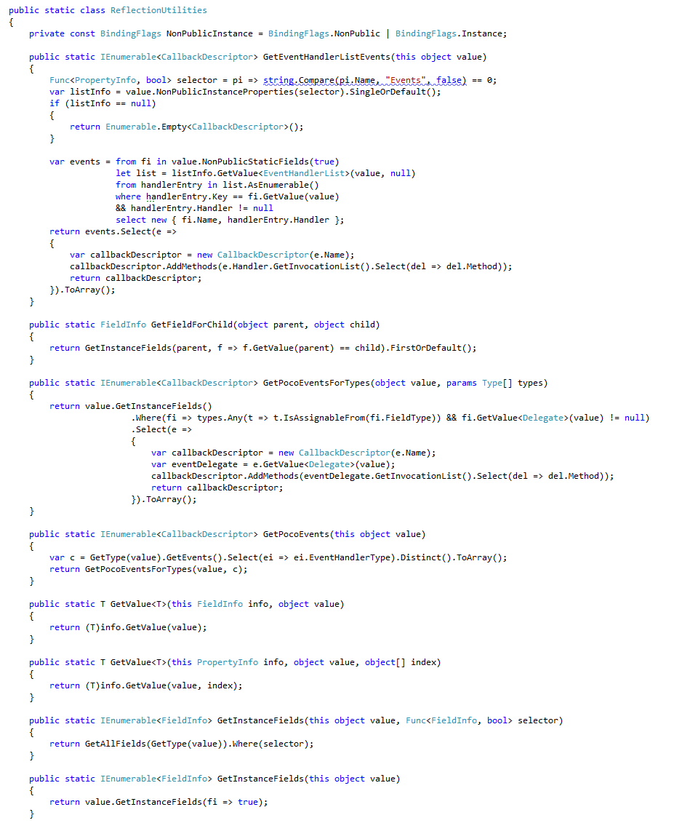

Slide 58
Distinct
Notes:
C:\code\FluencyPowerPoint\PowerPointGeneration\PowerPointGeneration.Tests\CodeSmells-Duplication\Distinct 12.png

Slide 59
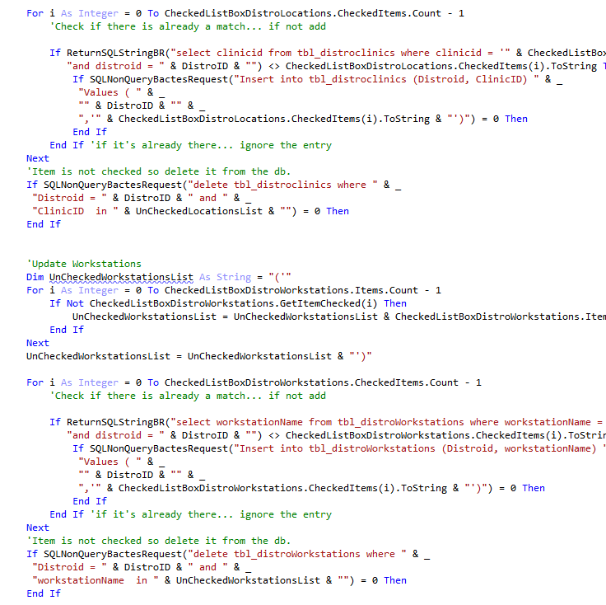

Slide 60
Duplication
Notes:
C:\code\FluencyPowerPoint\PowerPointGeneration\PowerPointGeneration.Tests\CodeSmells-Duplication\Duplication 18.png

Slide 61
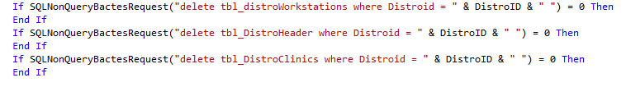

Slide 62
Duplication
Notes:
C:\code\FluencyPowerPoint\PowerPointGeneration\PowerPointGeneration.Tests\CodeSmells-Duplication\Duplication 19.png

Slide 63
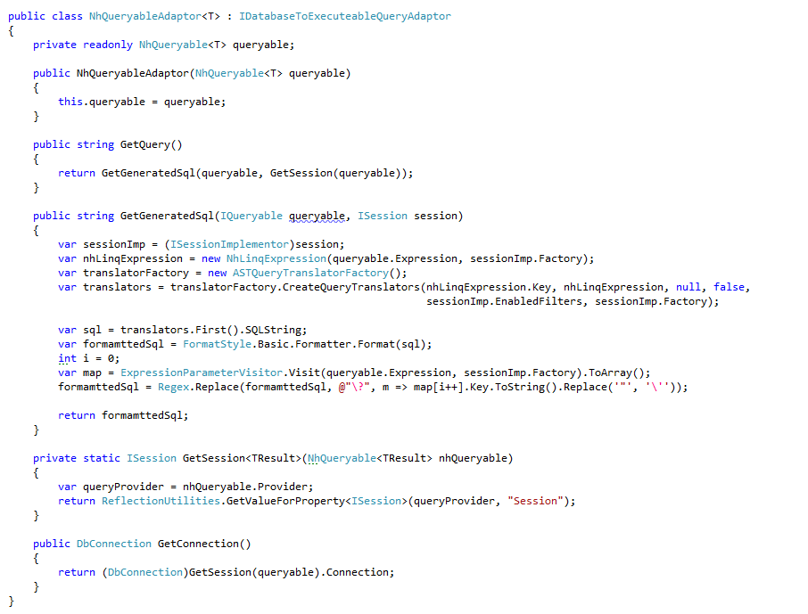

Slide 64
Distinct
Notes:
C:\code\FluencyPowerPoint\PowerPointGeneration\PowerPointGeneration.Tests\CodeSmells-Duplication\Distinct 13.png

Slide 65
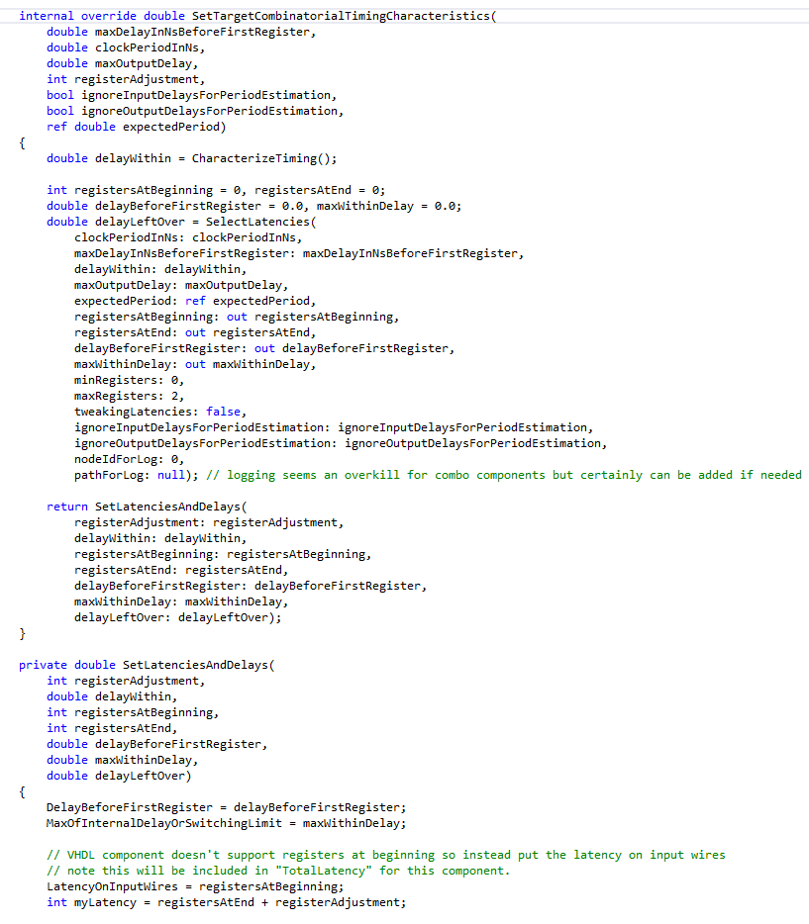

Slide 66
Distinct
Notes:
C:\code\FluencyPowerPoint\PowerPointGeneration\PowerPointGeneration.Tests\CodeSmells-Duplication\Distinct 14.png

Slide 67
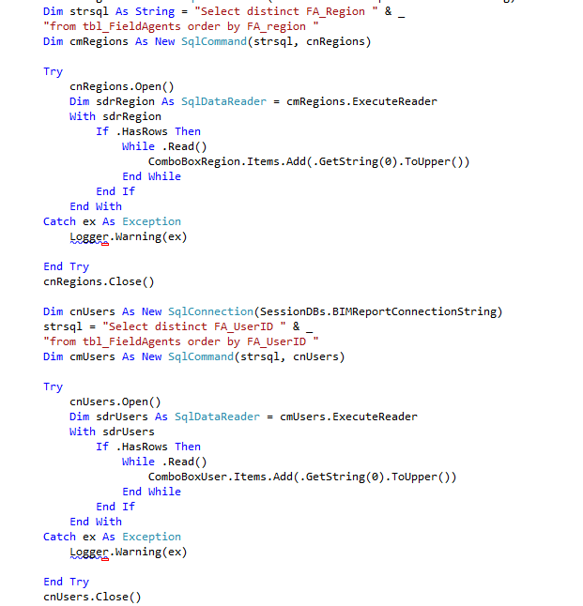

Slide 68
Duplication
Notes:
C:\code\FluencyPowerPoint\PowerPointGeneration\PowerPointGeneration.Tests\CodeSmells-Duplication\Duplication 20.png

Slide 69
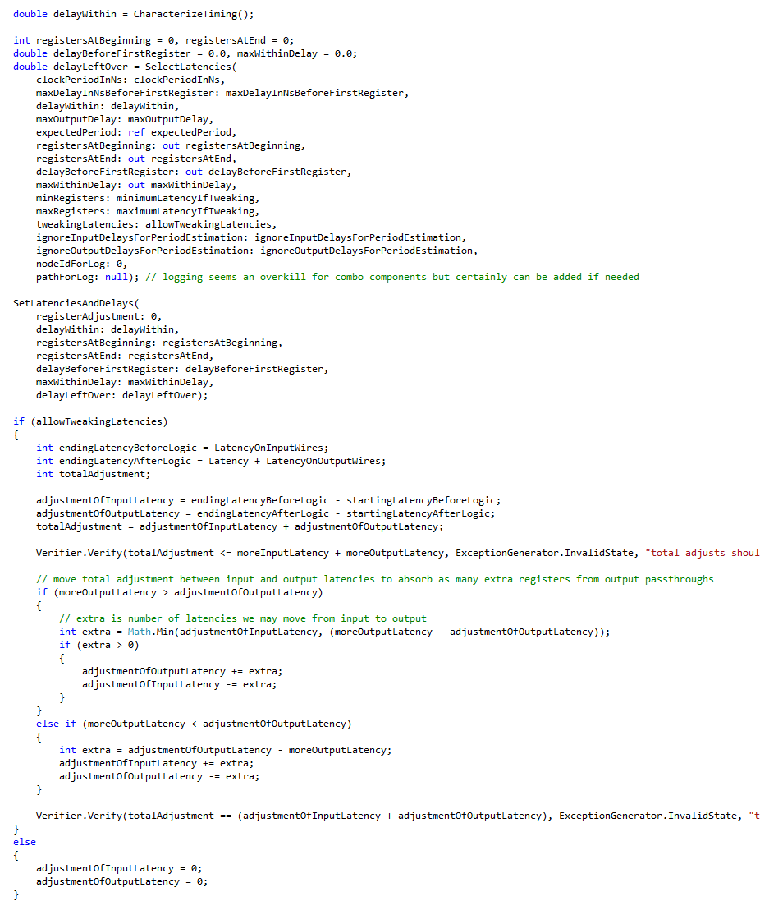

Slide 70
Distinct
Notes:
C:\code\FluencyPowerPoint\PowerPointGeneration\PowerPointGeneration.Tests\CodeSmells-Duplication\Distinct 15.png

Slide 71
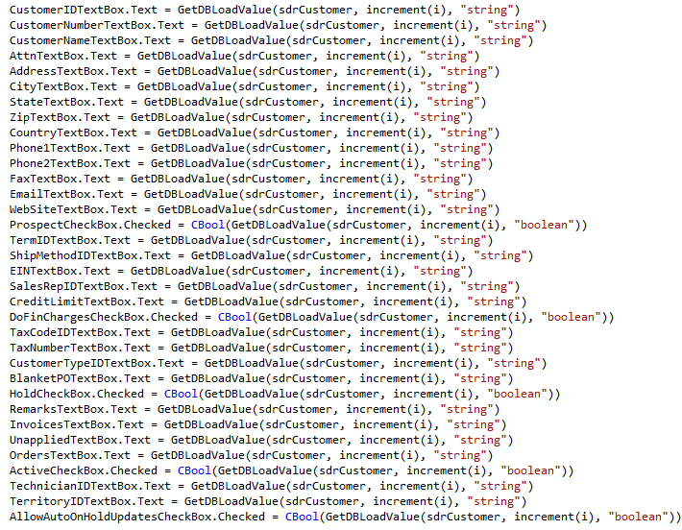

Slide 72
Duplication
Notes:
C:\code\FluencyPowerPoint\PowerPointGeneration\PowerPointGeneration.Tests\CodeSmells-Duplication\Duplication 21.png

Slide 73
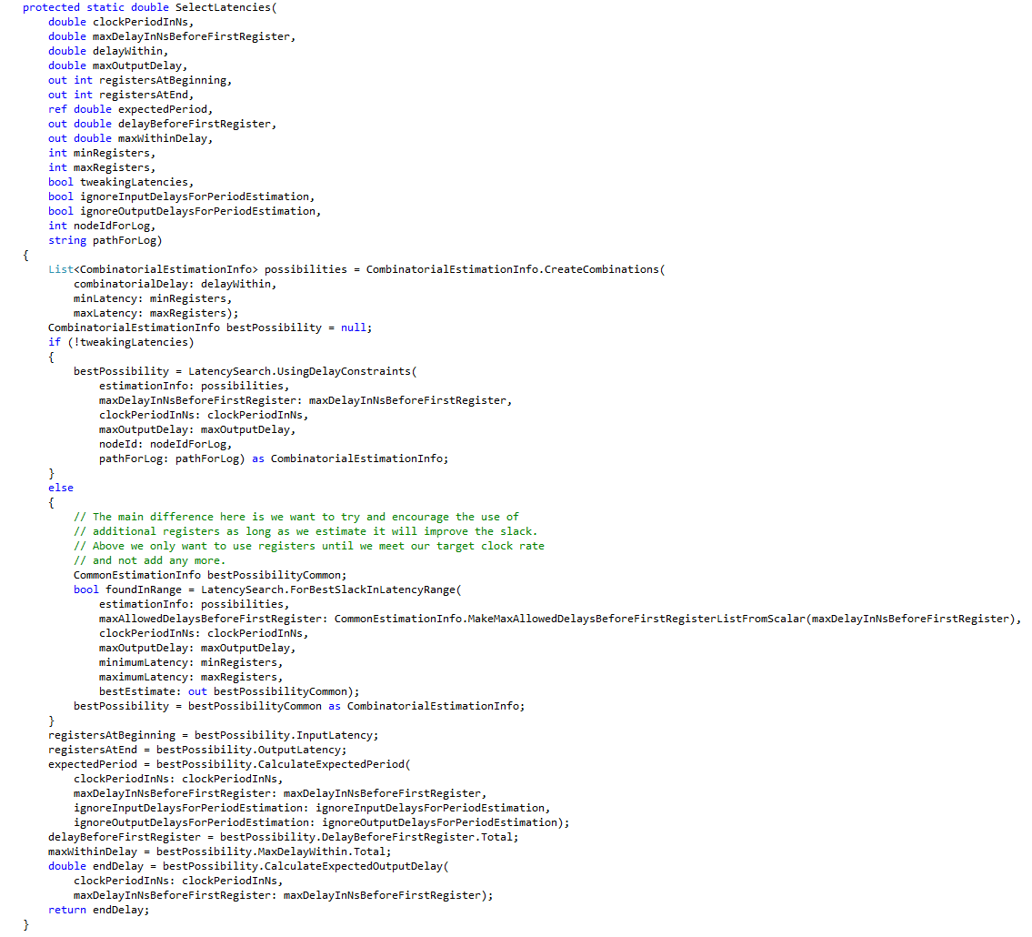

Slide 74
Distinct
Notes:
C:\code\FluencyPowerPoint\PowerPointGeneration\PowerPointGeneration.Tests\CodeSmells-Duplication\Distinct 16.png

Slide 75
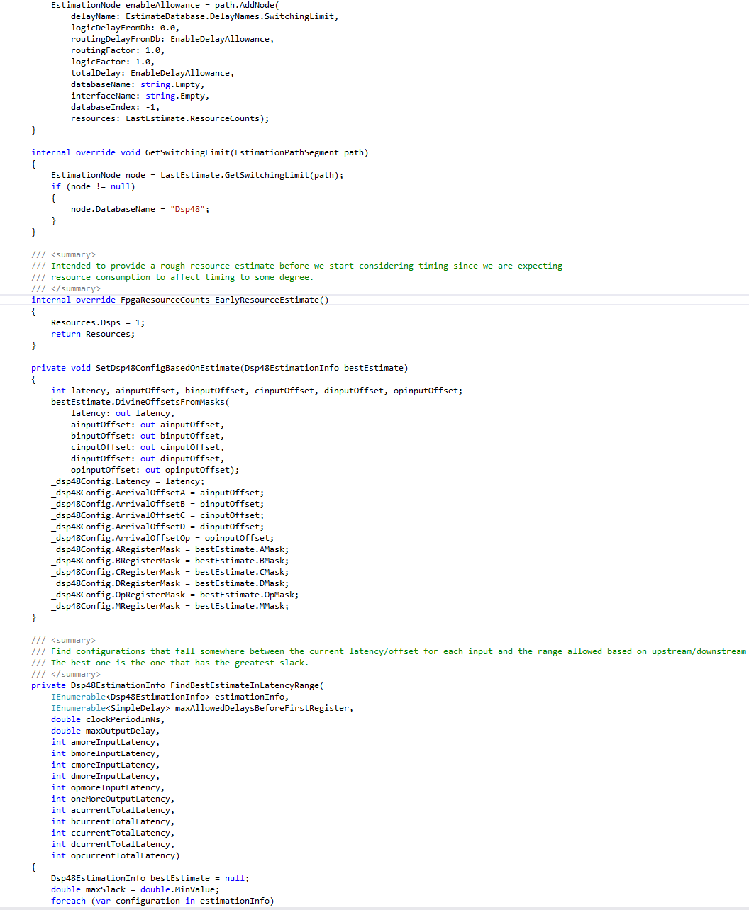

Slide 76
Distinct
Notes:
C:\code\FluencyPowerPoint\PowerPointGeneration\PowerPointGeneration.Tests\CodeSmells-Duplication\Distinct 17.png

Slide 77
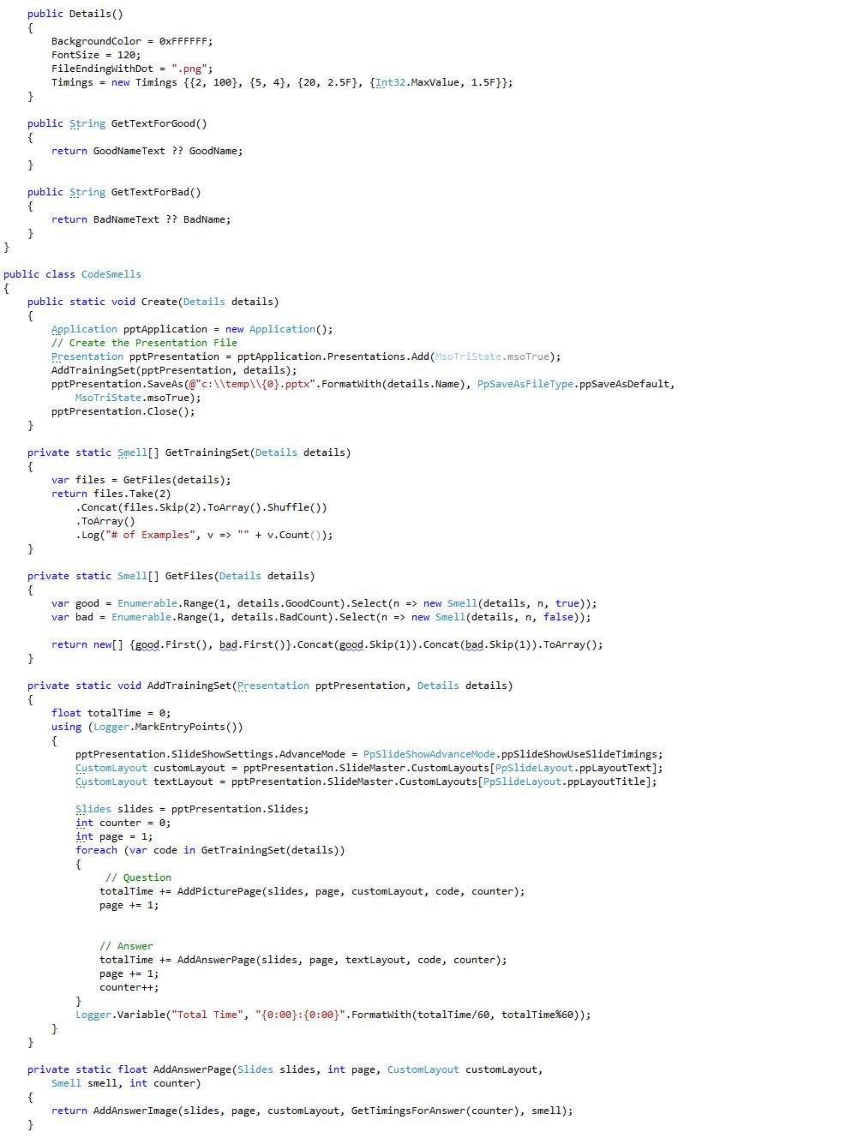

Slide 78
Distinct
Notes:
C:\code\FluencyPowerPoint\PowerPointGeneration\PowerPointGeneration.Tests\CodeSmells-Duplication\Distinct 18.png

Slide 79
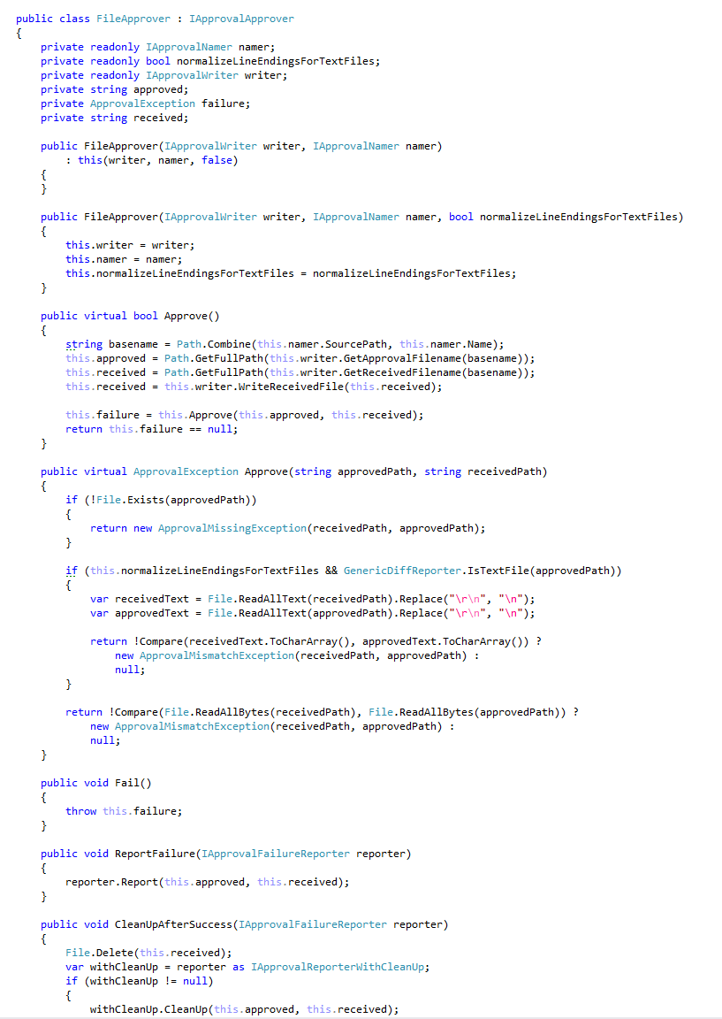

Slide 80
Distinct
Notes:
C:\code\FluencyPowerPoint\PowerPointGeneration\PowerPointGeneration.Tests\CodeSmells-Duplication\Distinct 19.png

Slide 81
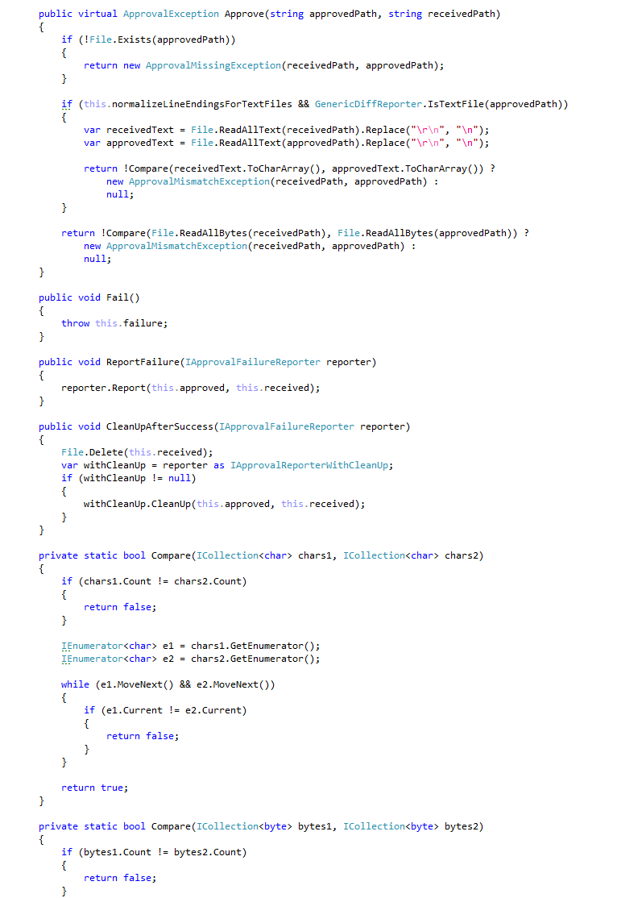

Slide 82
Distinct
Notes:
C:\code\FluencyPowerPoint\PowerPointGeneration\PowerPointGeneration.Tests\CodeSmells-Duplication\Distinct 20.png

Slide 83
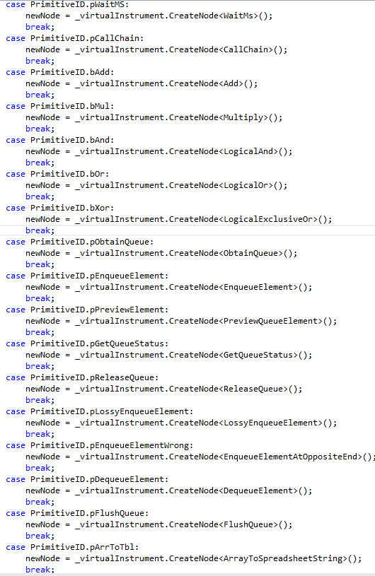

Slide 84
Duplication
Notes:
C:\code\FluencyPowerPoint\PowerPointGeneration\PowerPointGeneration.Tests\CodeSmells-Duplication\Duplication 22.png

Slide 85
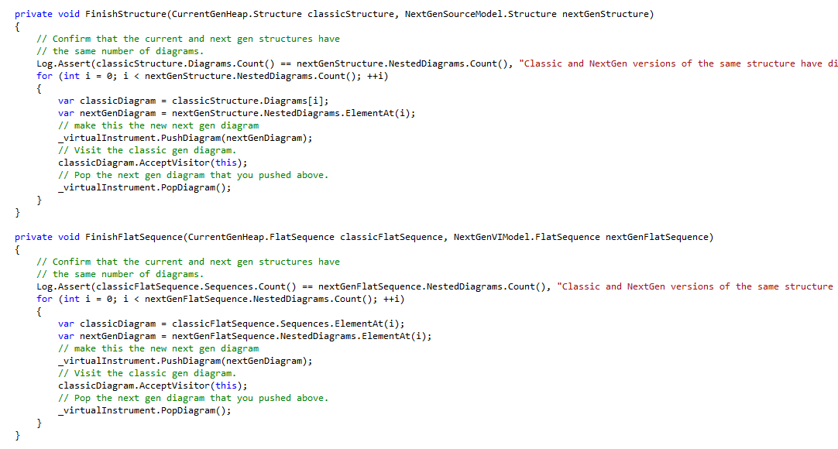

Slide 86
Duplication
Notes:
C:\code\FluencyPowerPoint\PowerPointGeneration\PowerPointGeneration.Tests\CodeSmells-Duplication\Duplication 23.png

Slide 87
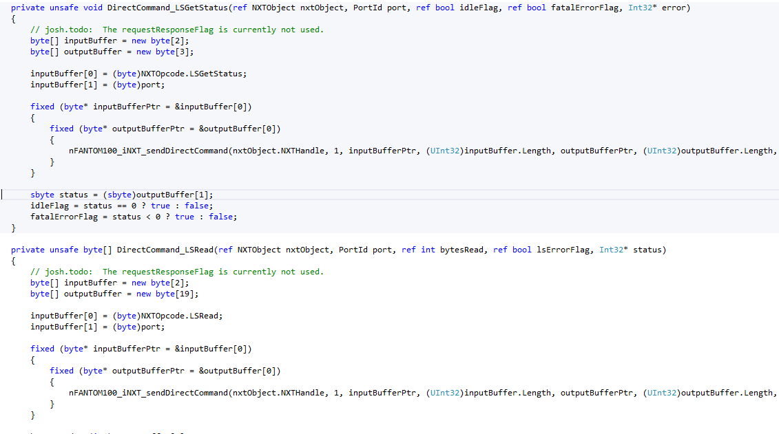

Slide 88
Duplication
Notes:
C:\code\FluencyPowerPoint\PowerPointGeneration\PowerPointGeneration.Tests\CodeSmells-Duplication\Duplication 24.png

Slide 89
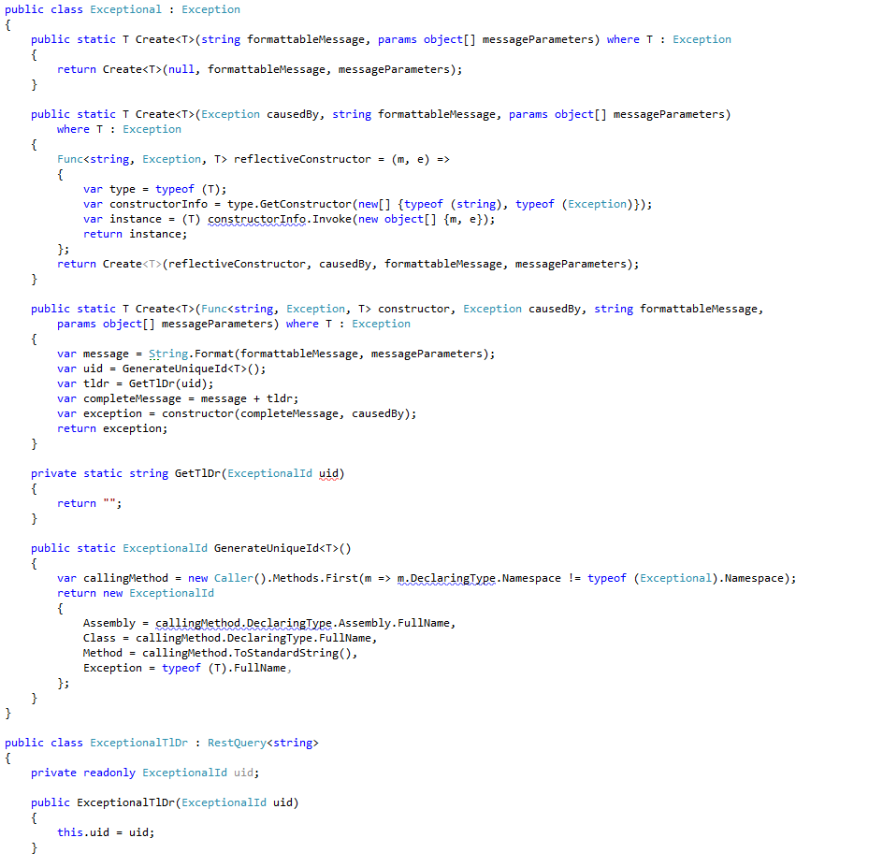

Slide 90
Distinct
Notes:
C:\code\FluencyPowerPoint\PowerPointGeneration\PowerPointGeneration.Tests\CodeSmells-Duplication\Distinct 21.png

Slide 91
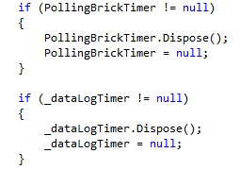

Slide 92
Duplication
Notes:
C:\code\FluencyPowerPoint\PowerPointGeneration\PowerPointGeneration.Tests\CodeSmells-Duplication\Duplication 25.png

Slide 93
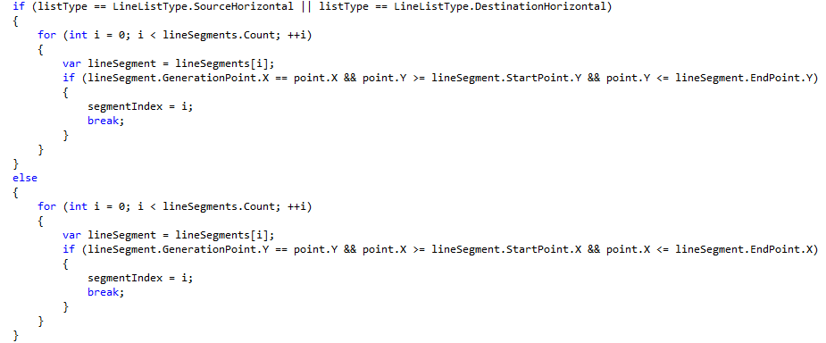

Slide 94
Duplication
Notes:
C:\code\FluencyPowerPoint\PowerPointGeneration\PowerPointGeneration.Tests\CodeSmells-Duplication\Duplication 26.png

Slide 95
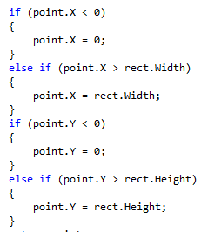

Slide 96
Duplication
Notes:
C:\code\FluencyPowerPoint\PowerPointGeneration\PowerPointGeneration.Tests\CodeSmells-Duplication\Duplication 27.png

Slide 97
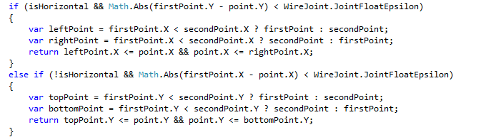

Slide 98
Duplication
Notes:
C:\code\FluencyPowerPoint\PowerPointGeneration\PowerPointGeneration.Tests\CodeSmells-Duplication\Duplication 28.png

Slide 99
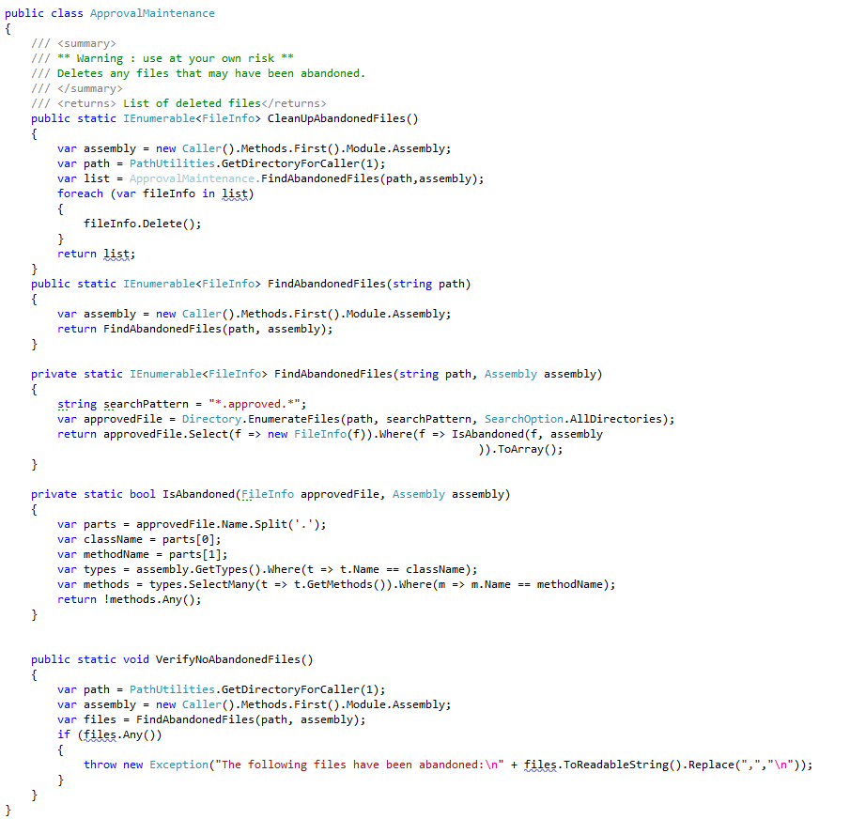

Slide 100
Distinct
Notes:
C:\code\FluencyPowerPoint\PowerPointGeneration\PowerPointGeneration.Tests\CodeSmells-Duplication\Distinct 22.png

Slide 101


Slide 102
Duplication
Notes:
C:\code\FluencyPowerPoint\PowerPointGeneration\PowerPointGeneration.Tests\CodeSmells-Duplication\Duplication 29.png

Slide 103


Slide 104
Duplication
Notes:
C:\code\FluencyPowerPoint\PowerPointGeneration\PowerPointGeneration.Tests\CodeSmells-Duplication\Duplication 30.png

Slide 105


Slide 106
Distinct
Notes:
C:\code\FluencyPowerPoint\PowerPointGeneration\PowerPointGeneration.Tests\CodeSmells-Duplication\Distinct 23.png

Slide 107


Slide 108
Distinct
Notes:
C:\code\FluencyPowerPoint\PowerPointGeneration\PowerPointGeneration.Tests\CodeSmells-Duplication\Distinct 24.png

Slide 109


Slide 110
Duplication
Notes:
C:\code\FluencyPowerPoint\PowerPointGeneration\PowerPointGeneration.Tests\CodeSmells-Duplication\Duplication 31.png

Slide 111


Slide 112
Distinct
Notes:
C:\code\FluencyPowerPoint\PowerPointGeneration\PowerPointGeneration.Tests\CodeSmells-Duplication\Distinct 25.png

Slide 113


Slide 114
Duplication
Notes:
C:\code\FluencyPowerPoint\PowerPointGeneration\PowerPointGeneration.Tests\CodeSmells-Duplication\Duplication 32.png

Slide 115


Slide 116
Duplication
Notes:
C:\code\FluencyPowerPoint\PowerPointGeneration\PowerPointGeneration.Tests\CodeSmells-Duplication\Duplication 33.png

Slide 117


Slide 118
Duplication
Notes:
C:\code\FluencyPowerPoint\PowerPointGeneration\PowerPointGeneration.Tests\CodeSmells-Duplication\Duplication 34.png

Slide 119


Slide 120
Distinct
Notes:
C:\code\FluencyPowerPoint\PowerPointGeneration\PowerPointGeneration.Tests\CodeSmells-Duplication\Distinct 26.png

Slide 121


Slide 122
Duplication
Notes:
C:\code\FluencyPowerPoint\PowerPointGeneration\PowerPointGeneration.Tests\CodeSmells-Duplication\Duplication 35.png

Slide 123


Slide 124
Duplication
Notes:
C:\code\FluencyPowerPoint\PowerPointGeneration\PowerPointGeneration.Tests\CodeSmells-Duplication\Duplication 36.png

Slide 125


Slide 126
Distinct
Notes:
C:\code\FluencyPowerPoint\PowerPointGeneration\PowerPointGeneration.Tests\CodeSmells-Duplication\Distinct 27.png

Slide 127


Slide 128
Distinct
Notes:
C:\code\FluencyPowerPoint\PowerPointGeneration\PowerPointGeneration.Tests\CodeSmells-Duplication\Distinct 28.png

Slide 129


Slide 130
Duplication
Notes:
C:\code\FluencyPowerPoint\PowerPointGeneration\PowerPointGeneration.Tests\CodeSmells-Duplication\Duplication 37.png

Slide 131


Slide 132
Duplication
Notes:
C:\code\FluencyPowerPoint\PowerPointGeneration\PowerPointGeneration.Tests\CodeSmells-Duplication\Duplication 38.png

Slide 133


Slide 134
Duplication
Notes:
C:\code\FluencyPowerPoint\PowerPointGeneration\PowerPointGeneration.Tests\CodeSmells-Duplication\Duplication 39.png

Slide 135


Slide 136
Duplication
Notes:
C:\code\FluencyPowerPoint\PowerPointGeneration\PowerPointGeneration.Tests\CodeSmells-Duplication\Duplication 40.png

Slide 137


Slide 138
Duplication
Notes:
C:\code\FluencyPowerPoint\PowerPointGeneration\PowerPointGeneration.Tests\CodeSmells-Duplication\Duplication 41.png

Slide 139


Slide 140
Duplication
Notes:
C:\code\FluencyPowerPoint\PowerPointGeneration\PowerPointGeneration.Tests\CodeSmells-Duplication\Duplication 42.png

Slide 141


Slide 142
Duplication
Notes:
C:\code\FluencyPowerPoint\PowerPointGeneration\PowerPointGeneration.Tests\CodeSmells-Duplication\Duplication 43.png

Slide 143


Slide 144
Duplication
Notes:
C:\code\FluencyPowerPoint\PowerPointGeneration\PowerPointGeneration.Tests\CodeSmells-Duplication\Duplication 44.png

Slide 145


Slide 146
Duplication
Notes:
C:\code\FluencyPowerPoint\PowerPointGeneration\PowerPointGeneration.Tests\CodeSmells-Duplication\Duplication 45.png

Slide 147


Slide 148
Duplication
Notes:
C:\code\FluencyPowerPoint\PowerPointGeneration\PowerPointGeneration.Tests\CodeSmells-Duplication\Duplication 46.png

Slide 149


Slide 150
Duplication
Notes:
C:\code\FluencyPowerPoint\PowerPointGeneration\PowerPointGeneration.Tests\CodeSmells-Duplication\Duplication 47.png

Slide 151


Slide 152
Duplication
Notes:
C:\code\FluencyPowerPoint\PowerPointGeneration\PowerPointGeneration.Tests\CodeSmells-Duplication\Duplication 48.png

Slide 153


Slide 154
Duplication
Notes:
C:\code\FluencyPowerPoint\PowerPointGeneration\PowerPointGeneration.Tests\CodeSmells-Duplication\Duplication 49.png

Slide 155


Slide 156
Duplication
Notes:
C:\code\FluencyPowerPoint\PowerPointGeneration\PowerPointGeneration.Tests\CodeSmells-Duplication\Duplication 50.png

Slide 157


Slide 158
Duplication
Notes:
C:\code\FluencyPowerPoint\PowerPointGeneration\PowerPointGeneration.Tests\CodeSmells-Duplication\Duplication 51.png

Slide 159


Slide 160
Duplication
Notes:
C:\code\FluencyPowerPoint\PowerPointGeneration\PowerPointGeneration.Tests\CodeSmells-Duplication\Duplication 52.png

Slide 161


Slide 162
Duplication
Notes:
C:\code\FluencyPowerPoint\PowerPointGeneration\PowerPointGeneration.Tests\CodeSmells-Duplication\Duplication 53.png

