Slide 1
Arlo Git Notation github.com/RefactoringCombos/ArlosCommitNotation

Slide 2
prefix | Risk | meaning
F | High | Feature
B | High | Bug
t | low | Test only
r | low | Provable Refactor
a | low | Automated formatting / generation
R!! | High | non-provable refactoring

Slide 3
* 7eb8bac - F Conjured items (20 hours ago) <Llewellyn Falco>
* 102edc6 - r public static (20 hours ago) <Llewellyn Falco>
* b70fffc - r Inline (20 hours ago) <Llewellyn Falco>
* 7a4d940 - r Extract Method (20 hours ago) <Llewellyn Falco>
* 8b70b9c - r Extract Variable (20 hours ago) <Llewellyn Falco>
* 70a73ac - r looped (20 hours ago) <Llewellyn Falco>
* 64e736c - r looping (20 hours ago) <Llewellyn Falco>
* 7659cc8 - r to many of 1 (20 hours ago) <Llewellyn Falco>
* e68d810 - r implementing item updater (20 hours ago) <Llewellyn Falco>
* 2f43d6c - r implementing item updater (20 hours ago) <Llewellyn Falco>
* b42cbcf - r added item (20 hours ago) <Llewellyn Falco>
* f9a9ffa - r interface (20 hours ago) <Llewellyn Falco>
* 89a406a - r public (20 hours ago) <Llewellyn Falco>
* 342e2c1 - r Rename (20 hours ago) <Llewellyn Falco>
* c271979 - r Rename (20 hours ago) <Llewellyn Falco>
* 58ef751 - r Rename (20 hours ago) <Llewellyn Falco>
* 09a5ce0 - r Rename (20 hours ago) <Llewellyn Falco>
* 721a412 - r seperate (20 hours ago) <Llewellyn Falco>
* 60418e8 - r seperate (20 hours ago) <Llewellyn Falco>
* 08917e4 - r dead code (20 hours ago) <Llewellyn Falco>
* 7eb3018 - r seperate (20 hours ago) <Llewellyn Falco>
* a1c5b36 - r seperate (20 hours ago) <Llewellyn Falco>
* 96ad3f1 - r Rename (20 hours ago) <Llewellyn Falco>
* 30244ee - r dead code (20 hours ago) <Llewellyn Falco>
* 5335fa6 - r seperate (20 hours ago) <Llewellyn Falco>
* 9f4ad5c - r seperate (20 hours ago) <Llewellyn Falco>
* 37c416c - r added dead code (20 hours ago) <Llewellyn Falco>
* 58f7f97 - r seperated class (20 hours ago) <Llewellyn Falco>
* 6d8f385 - r aged brie (21 hours ago) <Llewellyn Falco>
* ca0c832 - r Extract Variable (21 hours ago) <Llewellyn Falco>
* f466a84 - r extract superclass (21 hours ago) <Llewellyn Falco>
* 64c2738 - r extract superclass (21 hours ago) <Llewellyn Falco>
* 2501cd3 - r extract superclass (21 hours ago) <Llewellyn Falco>
* c76b23f - r extracted Brie (21 hours ago) <Llewellyn Falco>
* 7165da3 - r Delete Clutter (21 hours ago) <Llewellyn Falco>
* 09b4675 - r Extract Method (21 hours ago) <Llewellyn Falco>
* 11fcb91 - r Extract Method (21 hours ago) <Llewellyn Falco>
* c1def3d - r Extract Method (21 hours ago) <Llewellyn Falco>

Slide 4
* 7eb8bac - F Conjured items (20 hours ago) <Llewellyn Falco>
* 102edc6 - r public static (20 hours ago) <Llewellyn Falco>
* b70fffc - r Inline (20 hours ago) <Llewellyn Falco>
* 7a4d940 - r Extract Method (20 hours ago) <Llewellyn Falco>
* 8b70b9c - r Extract Variable (20 hours ago) <Llewellyn Falco>
* 70a73ac - r looped (20 hours ago) <Llewellyn Falco>
* 64e736c - r looping (20 hours ago) <Llewellyn Falco>
* 7659cc8 - r to many of 1 (20 hours ago) <Llewellyn Falco>
* e68d810 - r implementing item updater (20 hours ago) <Llewellyn Falco>
* 2f43d6c - r implementing item updater (20 hours ago) <Llewellyn Falco>
* b42cbcf - r added item (20 hours ago) <Llewellyn Falco>
* f9a9ffa - r interface (20 hours ago) <Llewellyn Falco>
* 89a406a - r public (20 hours ago) <Llewellyn Falco>
* 342e2c1 - r Rename (20 hours ago) <Llewellyn Falco>
* c271979 - r Rename (20 hours ago) <Llewellyn Falco>
* 58ef751 - r Rename (20 hours ago) <Llewellyn Falco>
* 09a5ce0 - r Rename (20 hours ago) <Llewellyn Falco>
* 721a412 - r seperate (20 hours ago) <Llewellyn Falco>
* 60418e8 - r seperate (20 hours ago) <Llewellyn Falco>
* 08917e4 - r dead code (20 hours ago) <Llewellyn Falco>
* 7eb3018 - r seperate (20 hours ago) <Llewellyn Falco>
* a1c5b36 - r seperate (20 hours ago) <Llewellyn Falco>
* 96ad3f1 - r Rename (20 hours ago) <Llewellyn Falco>
* 30244ee - r dead code (20 hours ago) <Llewellyn Falco>
* 5335fa6 - r seperate (20 hours ago) <Llewellyn Falco>
* 9f4ad5c - r seperate (20 hours ago) <Llewellyn Falco>
* 37c416c - r added dead code (20 hours ago) <Llewellyn Falco>
* 58f7f97 - r seperated class (20 hours ago) <Llewellyn Falco>
* 6d8f385 - r aged brie (21 hours ago) <Llewellyn Falco>
* ca0c832 - r Extract Variable (21 hours ago) <Llewellyn Falco>
* f466a84 - r extract superclass (21 hours ago) <Llewellyn Falco>
* 64c2738 - r extract superclass (21 hours ago) <Llewellyn Falco>
* 2501cd3 - r extract superclass (21 hours ago) <Llewellyn Falco>
* c76b23f - r extracted Brie (21 hours ago) <Llewellyn Falco>
* 7165da3 - r Delete Clutter (21 hours ago) <Llewellyn Falco>
* 09b4675 - r Extract Method (21 hours ago) <Llewellyn Falco>
* 11fcb91 - r Extract Method (21 hours ago) <Llewellyn Falco>
* c1def3d - r Extract Method (21 hours ago) <Llewellyn Falco>

Slide 5
* 7eb8bac - F Conjured items (20 hours ago) <Llewellyn Falco>
* 102edc6 - r public static (20 hours ago) <Llewellyn Falco>
* b70fffc - r Inline (20 hours ago) <Llewellyn Falco>
* 7a4d940 - r Extract Method (20 hours ago) <Llewellyn Falco>
* 8b70b9c - r Extract Variable (20 hours ago) <Llewellyn Falco>
* 70a73ac - r looped (20 hours ago) <Llewellyn Falco>
* 64e736c - r looping (20 hours ago) <Llewellyn Falco>
* 7659cc8 - r to many of 1 (20 hours ago) <Llewellyn Falco>
* e68d810 - r implementing item updater (20 hours ago) <Llewellyn Falco>
* 2f43d6c - r implementing item updater (20 hours ago) <Llewellyn Falco>
* b42cbcf - r added item (20 hours ago) <Llewellyn Falco>
* f9a9ffa - r interface (20 hours ago) <Llewellyn Falco>
* 89a406a - r public (20 hours ago) <Llewellyn Falco>
* 342e2c1 - r Rename (20 hours ago) <Llewellyn Falco>
* c271979 - r Rename (20 hours ago) <Llewellyn Falco>
* 58ef751 - r Rename (20 hours ago) <Llewellyn Falco>
* 09a5ce0 - r Rename (20 hours ago) <Llewellyn Falco>
* 721a412 - r seperate (20 hours ago) <Llewellyn Falco>
* 60418e8 - r seperate (20 hours ago) <Llewellyn Falco>
* 08917e4 - r dead code (20 hours ago) <Llewellyn Falco>
* 7eb3018 - r seperate (20 hours ago) <Llewellyn Falco>
* a1c5b36 - r seperate (20 hours ago) <Llewellyn Falco>
* 96ad3f1 - r Rename (20 hours ago) <Llewellyn Falco>
* 30244ee - r dead code (20 hours ago) <Llewellyn Falco>
* 5335fa6 - r seperate (20 hours ago) <Llewellyn Falco>
* 9f4ad5c - r seperate (20 hours ago) <Llewellyn Falco>
* 37c416c - r added dead code (20 hours ago) <Llewellyn Falco>
* 58f7f97 - r seperated class (20 hours ago) <Llewellyn Falco>
* 6d8f385 - r aged brie (21 hours ago) <Llewellyn Falco>
* ca0c832 - r Extract Variable (21 hours ago) <Llewellyn Falco>
* f466a84 - r extract superclass (21 hours ago) <Llewellyn Falco>
* 64c2738 - r extract superclass (21 hours ago) <Llewellyn Falco>
* 2501cd3 - r extract superclass (21 hours ago) <Llewellyn Falco>
* c76b23f - r extracted Brie (21 hours ago) <Llewellyn Falco>
* 7165da3 - r Delete Clutter (21 hours ago) <Llewellyn Falco>
* 09b4675 - r Extract Method (21 hours ago) <Llewellyn Falco>
* 11fcb91 - r Extract Method (21 hours ago) <Llewellyn Falco>
* c1def3d - r Extract Method (21 hours ago) <Llewellyn Falco>

Slide 6
* 7eb8bac - F Conjured items (20 hours ago) <Llewellyn Falco>
* 102edc6 - r public static (20 hours ago) <Llewellyn Falco>
* b70fffc - r Inline (20 hours ago) <Llewellyn Falco>
* 7a4d940 - r Extract Method (20 hours ago) <Llewellyn Falco>
* 8b70b9c - r Extract Variable (20 hours ago) <Llewellyn Falco>
* 70a73ac - r looped (20 hours ago) <Llewellyn Falco>
* 64e736c - r looping (20 hours ago) <Llewellyn Falco>
* 7659cc8 - r to many of 1 (20 hours ago) <Llewellyn Falco>
* e68d810 - r implementing item updater (20 hours ago) <Llewellyn Falco>
* 2f43d6c - r implementing item updater (20 hours ago) <Llewellyn Falco>
* b42cbcf - r added item (20 hours ago) <Llewellyn Falco>
* f9a9ffa - r interface (20 hours ago) <Llewellyn Falco>
* 89a406a - r public (20 hours ago) <Llewellyn Falco>
* 342e2c1 - r Rename (20 hours ago) <Llewellyn Falco>
* c271979 - r Rename (20 hours ago) <Llewellyn Falco>
* 58ef751 - r Rename (20 hours ago) <Llewellyn Falco>
* 09a5ce0 - r Rename (20 hours ago) <Llewellyn Falco>
* 721a412 - r seperate (20 hours ago) <Llewellyn Falco>
* 60418e8 - r seperate (20 hours ago) <Llewellyn Falco>
* 08917e4 - r dead code (20 hours ago) <Llewellyn Falco>
* 7eb3018 - r seperate (20 hours ago) <Llewellyn Falco>
* a1c5b36 - r seperate (20 hours ago) <Llewellyn Falco>
* 96ad3f1 - r Rename (20 hours ago) <Llewellyn Falco>
* 30244ee - r dead code (20 hours ago) <Llewellyn Falco>
* 5335fa6 - r seperate (20 hours ago) <Llewellyn Falco>
* 9f4ad5c - r seperate (20 hours ago) <Llewellyn Falco>
* 37c416c - r added dead code (20 hours ago) <Llewellyn Falco>
* 58f7f97 - r seperated class (20 hours ago) <Llewellyn Falco>
* 6d8f385 - r aged brie (21 hours ago) <Llewellyn Falco>
* ca0c832 - r Extract Variable (21 hours ago) <Llewellyn Falco>
* f466a84 - r extract superclass (21 hours ago) <Llewellyn Falco>
* 64c2738 - r extract superclass (21 hours ago) <Llewellyn Falco>
* 2501cd3 - r extract superclass (21 hours ago) <Llewellyn Falco>
* c76b23f - r extracted Brie (21 hours ago) <Llewellyn Falco>
* 7165da3 - r Delete Clutter (21 hours ago) <Llewellyn Falco>
* 09b4675 - r Extract Method (21 hours ago) <Llewellyn Falco>
* 11fcb91 - r Extract Method (21 hours ago) <Llewellyn Falco>
* c1def3d - r Extract Method (21 hours ago) <Llewellyn Falco>

Slide 7
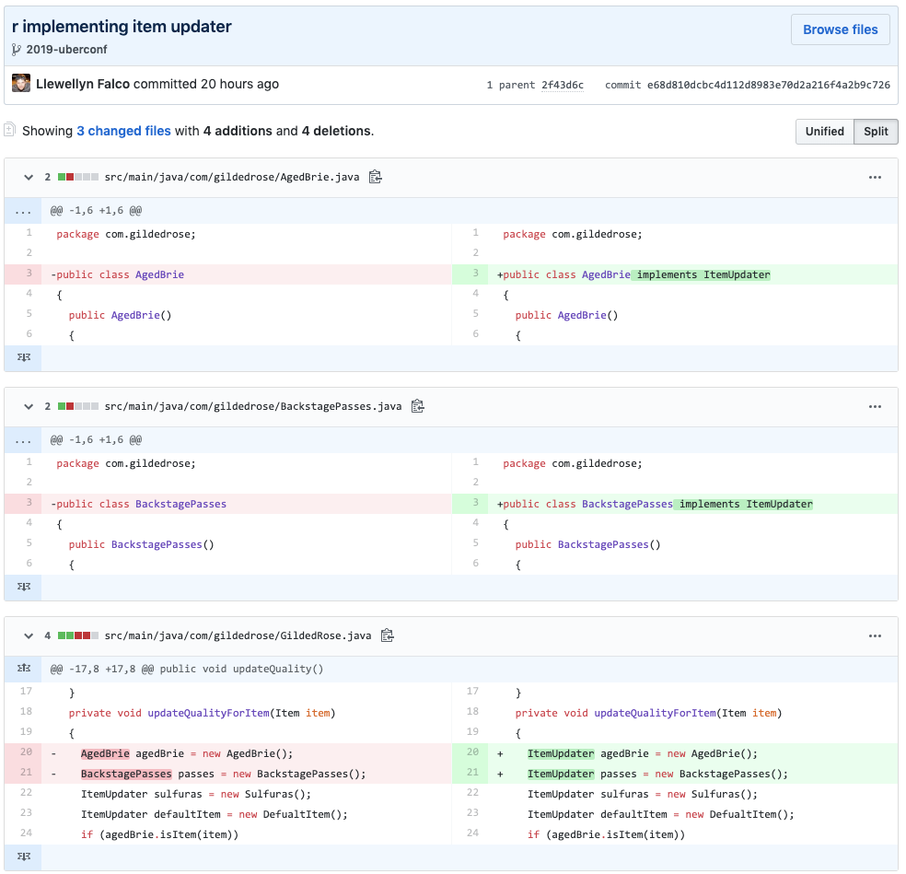

Slide 8
* b70fffc - r Inline
* 7a4d940 - r Extract Method
* 8b70b9c - r Extract Variable
* 70a73ac - r Deleted dead code
* 2f43d6c - !!! Simpler formula
* 89a406a - r Rename
* c271979 - r Rename
* 58ef751 - r Rename
* 09a5ce0 - r Rename
* 721a412 - !!! Extract Method
* 60418e8 - r Inline
* 08917e4 - r Joined Initiations
* 9f4ad5c - r Extract

Slide 9
* b70fffc - r Inline
* 7a4d940 - r Extract Method
* 8b70b9c - r Extract Variable
* 70a73ac - r Deleted dead code
* 2f43d6c - !!! Simpler formula
* 89a406a - r Rename
* c271979 - r Rename
* 58ef751 - r Rename
* 09a5ce0 - r Rename
* 721a412 - !!! Extract Method
* 60418e8 - r Inline
* 08917e4 - r Joined Initiations
* 9f4ad5c - r Extract

Slide 10
* b70fffc - r Inline
* 7a4d940 - r Extract Method
* 8b70b9c - r Extract Variable
* 70a73ac - r Deleted dead code
* 2f43d6c - !!! Simpler formula
* 89a406a - r Rename
* c271979 - r Rename
* 58ef751 - r Rename
* 09a5ce0 - r Rename
* 721a412 - !!! Extract Method
* 60418e8 - r Inline
* 08917e4 - r Joined Initiations
* 9f4ad5c - r Extract

Slide 11
* b70fffc - r Inline
* 7a4d940 - r Extract Method
* 8b70b9c - r Extract Variable
* 70a73ac - r Deleted dead code
* 2f43d6c - !!! Simpler formula
* 89a406a - r Rename
* c271979 - r Rename
* 58ef751 - r Rename
* 09a5ce0 - r Rename
* 721a412 - !!! Extract Method
* 60418e8 - r Inline
* 08917e4 - r Joined Initiations
* 9f4ad5c - r Extract

Slide 12
voltage = (incoming * normalizer) / normalizer;
voltage = incoming;

Slide 13
Resources
github.com/RefactoringCombos/ArlosCommitNotation

Slide 14

Thank YOU (please connect via LinkedIn and Twitter)
@LlewellynFalco
youtube.com/isidoreus
LlewellynFalco.Blogspot.com approvaltests.com

