Slide 1
Strong-Style Pairing
Maaret Pyhäjärvi & Llewellyn Falco

Slide 2
What is Strong Style?

Slide 3
“For an idea to go from your head to the computer it must go through someone else’s hands”

Slide 4
Highest level of abstraction Intent Location Details

Slide 5
In the beginning (stories of pairing with Llewellyn)

Slide 6
Lines
@LlewellynFalco

Slide 7
Being a good driver/navigator

Slide 8
Language (demo) normal strong strong
@LlewellynFalco

Slide 9
Language (Exercise)
@LlewellynFalco

Slide 10
How to start pairing.

Slide 11
Trust is built on Many small successes

Slide 12
Coding exercise
@LlewellynFalco

Slide 13
Mobbing exercise
@LlewellynFalco

Slide 14
Homework Assignment
@LlewellynFalco

Slide 15
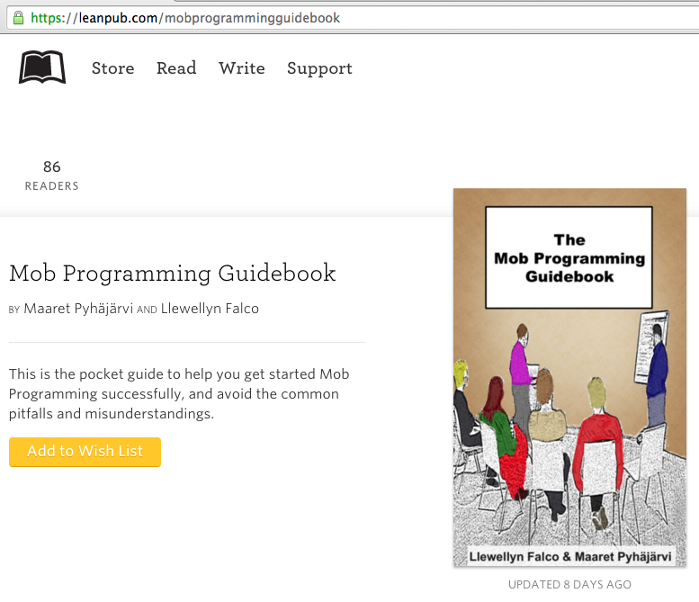
#MobProgrammingGuidebook

Slide 16
Thank you.
@maaretp
@LlewellynFalco
(please connect with us through Twitter or LinkedIn)

